Slide 1
Notes:
Walter to speak and announce DMC

Slide 2
Welcome and NINDS Comments

Slide 3
11/13/13
NCC call with RCCs.
Established Monthly Steering committee calls
2nd Wednesday at Noon (ET)
9/30/13
NOA.
12/3/13
NIH visit at
NCC
Cincinnati, OH.
12/17/13
NCC meeting
With NETT
Ann Arbor
TBD 2014
NIH StrokeNet Startup meeting
Bethesda, MD
.
TBD 2015
New Studies
Funded through
NIH StrokeNet.
Oct 2013
Nov 2013
Dec 2013
Feb 2014
Early 2014
Mid 2014
2015
11/1/13
NCC Call
with
NIH.
11/27/13
Operations Committee
Calls
weekly
12/16/13
NIH DMC Review.
2/10/14
Meeting at ISC
2/12/14
Network overview at ISC
2/12-13/14
On-going Clinical Trials
TBD 2014
Funded Trials
Started through
NIH
StrokeNet
.

Slide 4
National and Regional Coordinating Centers
UW Medicine/
Harborview Med. Ctr.
Chicago Stroke Trials Consortium
NIH Cleveland Stroke Trials Collaborative
U Minnesota RCC
U Wisconsin
New England RCC
Michigan StrokeNet
Stroke Trials Network of
Columbia and Cornell
NorCal Research RCC
U Utah RCC
U Iowa RCC
UPMC
Stroke
Institute
NY City Collaborative RCC
Ohio State
WexnerRCC
G. Philadelphia NIH StrokeNet
Stanford Stroke Center
Stroke National Capital Area
Network for Research
U Cincinnati RCC
Los Angeles-So. California
Regional NIH StrokeNet
UCSD Stroke Center
Vanderbilt U Medical Ctr
Georgia StrokeNet
So. Caroline Collaborative
Alliance for Stroke Trials
Gulf Regional Area
Stroke Programs
Miami RCC
Census Region:
West Midwest South Northeast
Notes:
In September 2013, the National Institutes of Health funded the stroke trials network, NIH StrokeNet. The StrokeNet infrastructure consists of 25 regional coordinating centers across the US, a national coordinating center at the University of Cincinnati, and a national data management center (TBN). The primary goal of this network is to maximize efficiencies to develop, promote and conduct high-quality, multi-site clinical trials focused on key interventions in stroke prevention, treatment and recovery.

Slide 5
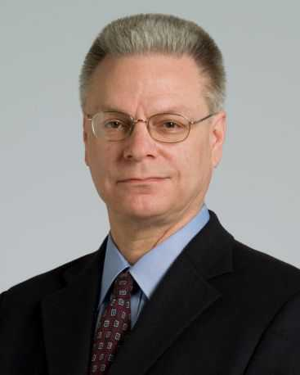
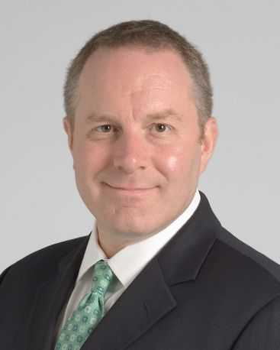
Regional Coordinating Center (R01) Awarded Institution Case Western University
Cleveland Regional Coordinating Center
Tony Furlan, MD (PI) Peter Rasmussen, MD (CO-PI)
Notes:
Send 1/14/14 for approval LRS

Slide 6
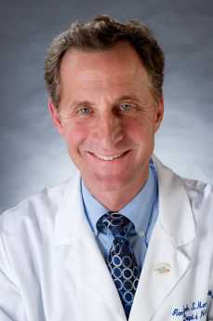
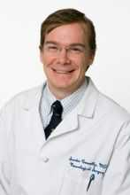
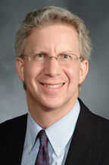
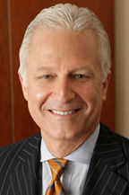
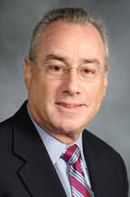
Regional Coordinating Center (R02) Awarded Institution: Columbia University Health Sciences
Stroke Trials Network of Columbia and Cornell
Randolph S Marshall, MD, MS (Co-PI) E Sander Connolly, MD, FACS (Co-PI) Dana Leifer, MD (Co-PI)
Philip E. Stieg, MD, PhD (Co-PI) Matthew E. Fink, MD (Co-PI) Alberto Canaan, RCC Study Coordinator

Slide 7
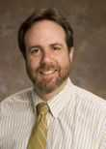
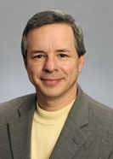
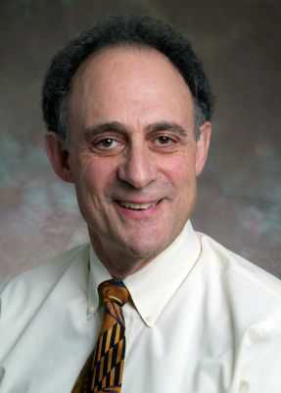
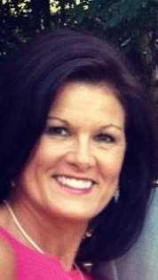
Regional Coordinating Center (R03) Awarded Institution: Emory University
Georgia StrokeNet
Michael Frankel, MD (PI) David Wright, MD (Senior Co-PI) Steve Wolf, PhD (Senior Co-PI)
Kiva Schindler, RN, CCRC Research Nurse Coordinator
Notes:
Proof sent 1/14/11-LRS

Slide 8
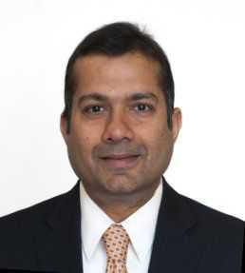
Regional Coordinating Center (R04) Awarded Institution: Massachusetts General
New England Regional Coordinating Center
(NERCC)
Lee Schwamm, MD (PI) Aneesh Singal, MD (Deputy-PI)
Notes:
Proof sent 1/14/14

Slide 9
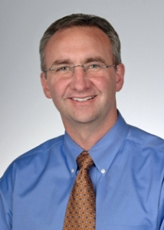
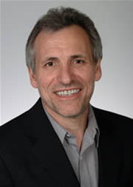
Regional Coordinating Center (R05) Awarded Institution: Medical University of South Carolina
South Carolina Collaborative Alliance for Stroke Trials (SC-CoAST)
Edward Jauch, MD (PI) Dr. Marc Chimowitz, MBChB (Co-PI) Fay Davis, LPN
Study Coordinator
Notes:
Send to USMC for approval 1/14/14-LRS

Slide 10
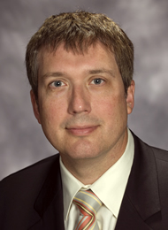
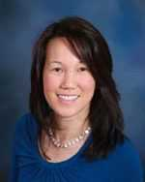
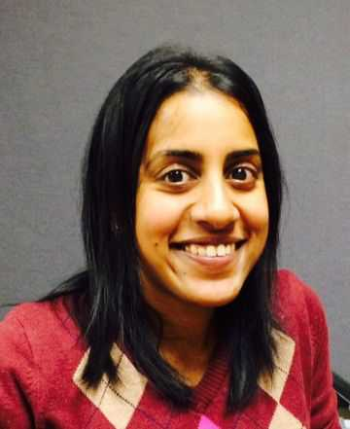
Regional Coordinating Center (R06) Awarded Institution: MedStar Research Institute
MedStar Research Institute RCC (SCANR)
Alexander Dromerick, MD (PI) Amie Hsia, MD, (CO-PI) Preethy Feit, MS Program Manager
Notes:
Sent proof 1/14/14

Slide 11
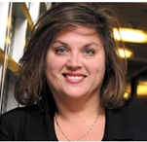
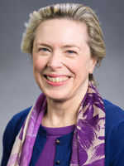
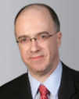
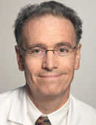
Regional Coordinating Center (R07) Awarded Institution: Mount Sinai School of Medicine, Albert Einstein School of Medicine, New York University
The New York City Collaborative Regional Coordinating Stroke Center
Bernadette Laura Balcer Mark Mehler Stanley Tuhrim Leigh Quarles,
Boden-Albala Coordinator

Slide 12
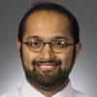
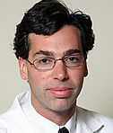
Regional Coordinating Center (R08) Awarded Institution: Northwestern University at Chicago
Chicago Stroke Trials Consortium
Shyam Prabhakaran, MD (PI) Richard Bernstein, MD, PhD (Site PI) Jillian Lux , CCRC Study Coordinator

Slide 13
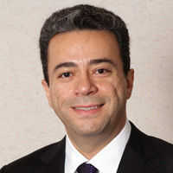
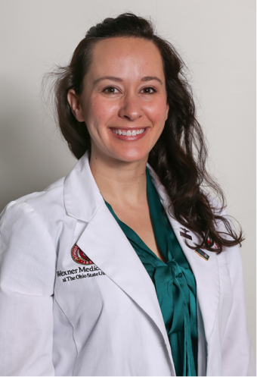
Regional Coordinating Center (R09) Awarded Institution: Ohio State University
Ohio State University Wexner Medical Center RCC
Michel Torbey, MD (PI-OSU) April Green, Study Coordinator

Slide 14
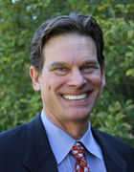
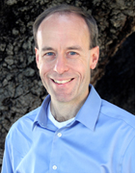
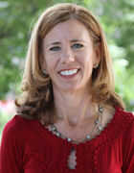
Regional Coordinating Center (R10) Awarded Institution: Stanford University
Stanford Stroke Center
Gregory Albers, MD (PI) Maarten Lansberg, MD (Co-PI) Stephanie Kemp Program Manager

Slide 15
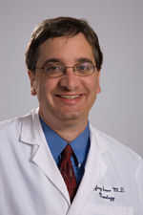
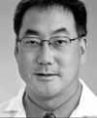
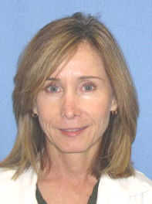
Regional Coordinating Center (R11) Awarded Institution: University of California Los Angeles
Los Angeles-Southern California Regional NIH StrokeNet (LASC-RSN)
Jeff Saver, MD PI UCLA Gene Sung, MD PI USC
Ileana Grunberg, RN SC UCLA Clare Binley, RN SC USC

Slide 16
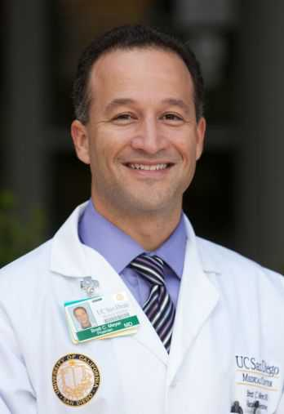
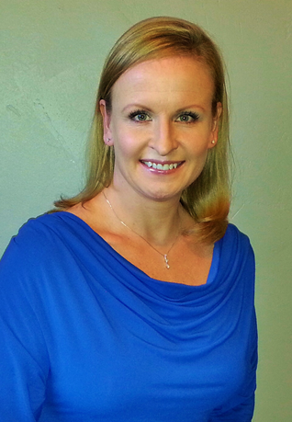
Regional Coordinating Center (R12) Awarded Institution: University of California San Diego
University of California San Diego
Brett C. Meyer, MD, PI Kristin Woods, Study Coordinator

Slide 17
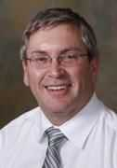
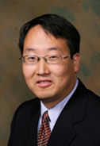
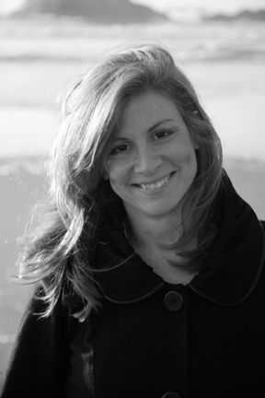
Regional Coordinating Center (R13) Awarded Institution: University of California San Francisco
NorCal Research Coordinating Center
Wade Smith, MD, PhD (PI) Anthony S. Kim, MD, MAS (Co-PI) Michele Meeker, RN, BSN Study Coordinator

Slide 18
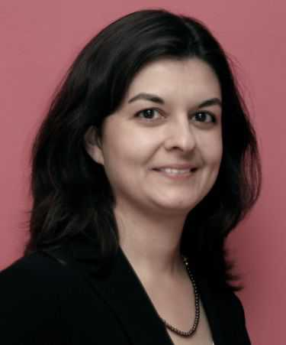
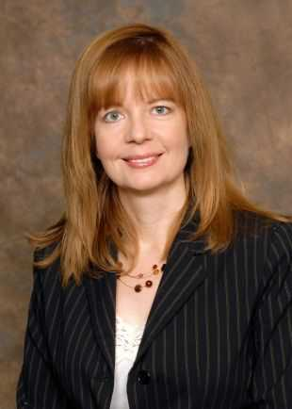
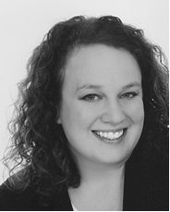
Regional Coordinating Center (R14) Awarded Institution: University of Cincinnati
University of Cincinnati RCC
Pooja Khatri, MD PI Dawn Kleindorfer, MD Co-PI Emily Goodall Study Coordinator

Slide 19
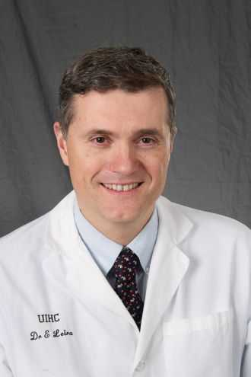
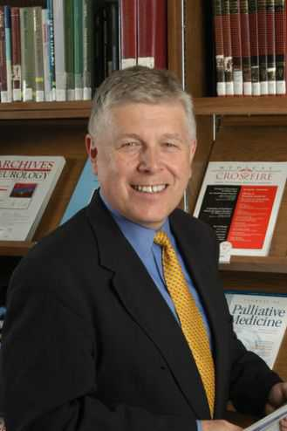
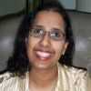
Regional Coordinating Center (R15) Awarded Institution: University of Iowa
University of Iowa Regional Coordinating Center
Enrique Leira, MD, MS, (PI) Harold Adams, MD, (Co-PI) Heena Olalde, RN, MSN Study Coordinator

Slide 20
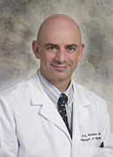
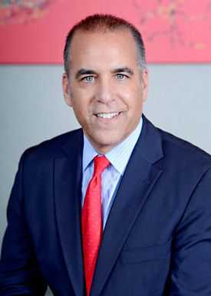
Regional Coordinating Center (R16) Awarded Institution: University of Miami School of Medicine
Miami Regional Coordinating Center
Jose G. Romano, MD Ralph L. Sacco, MD (Multiple Principal Investigators - MPI) (Multiple Principal Investigators - MPI)
Iszet Campo Bustillo, MD, MPH, CCRP

Slide 21
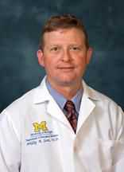
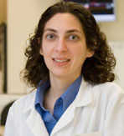
Regional Coordinating Center (R17) Awarded Institution: University of Michigan
Michigan StrokeNet
Phillip A. Scott, MD Devin L. Brown, MD

Slide 22
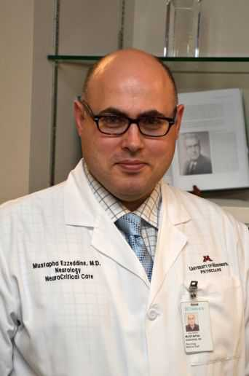
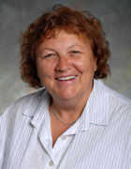
Regional Coordinating Center (R18) Awarded Institution: University of Minnesota
University of Minnesota Regional Coordinating Ctr
Mustapha Ezzeddine, MD PI Michelle Biros, MD CO-PI Kathleen Miller, BSN, CCRC Study Coordinator

Slide 23
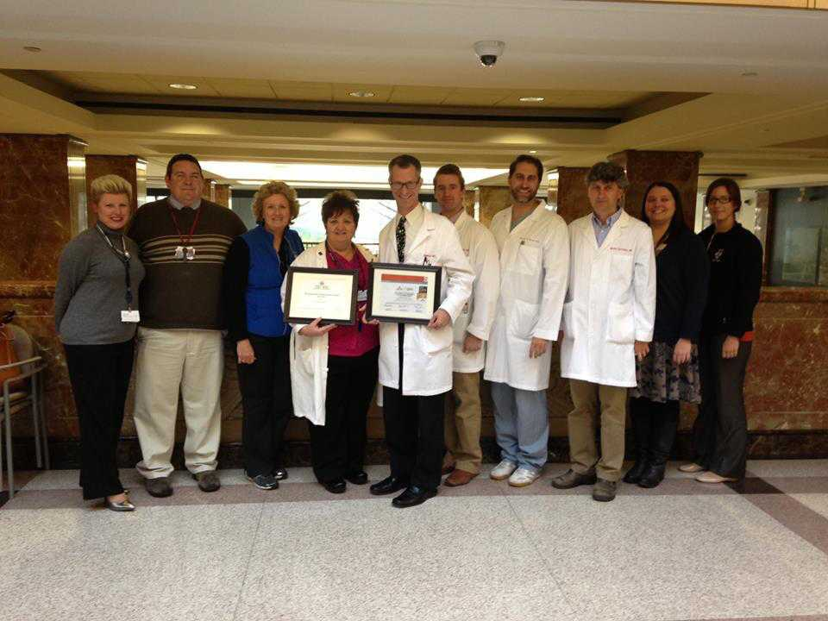
Regional Coordinating Center (R19) Awarded Institution: University of Pennsylvania
The Greater Philadelphia NIH StrokeNet (GPNSN)
Scott Kasner, MD (PI) Nichole Gallatti, CCRP Melissa Kruszewski, CCRP
Study Coordinator Co-Study Coordinator
© Copyright 2011 by the Trustees of the University of Pennsylvania. All rights reserved. No part of this publication may be reproduced without permission in writing from the Trustees of the University of Pennsylvania

Slide 24
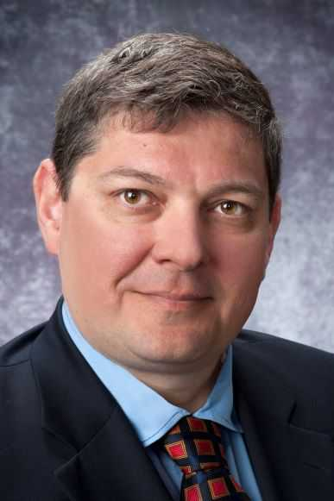
Regional Coordinating Center (R20) Awarded Institution: University of Pittsburgh at Pittsburgh
UPMC Stroke Institute RCC
Lawrence R. Wechsler, MD (PI) Tudor Jovin, MD (CO-PI)
Carlynn R. Jackson Graves, BS, CCRC Study Coordinator

Slide 25
Regional Coordinating Center (R21) Awarded Institution: University of Texas Health Science Center Houston
Gulf Regional Area Stroke Programs (GRASP)
Sean I. Savitz, (PI) Kirk Hamilton, Study Coordinator

Slide 26
Regional Coordinating Center (R22) Awarded Institution: University of Utah
University of Utah StrokeNet
Jennifer Majersik, MD, MS (PI)

Slide 27
Regional Coordinating Center (R23) Awarded Institution: University of Washington
UW Medicine/Harborview Medical Center RCC
David Tirschwell , MD ( PI) Kyra Becker, MD (Co-PI)
Glenn Schubert, MPH Study Coordinator Pat Tanzi, RN Study Coordinator

Slide 28
Regional Coordinating Center (R24) Awarded Institution: University of Wisconsin Madison
University of Wisconsin Regional Coordinating Center
Robert J. Dempsey, MD, (PI) Azam S. Ahmed, MD, (Co-PI) Stephanie Wilbrand, PhD Study Coordinator

Slide 29
Regional Coordinating Center (R25) Awarded Institution: Vanderbilt University Medical Center
Vanderbilt University Regional Coordinating Center
Michael Froehler, MD (Co-PI) J Mocco, MD (Co-PI)
Stephanie A. Smith Bree Burks Study Coordinator Study Coordinator

Slide 30
Ongoing Trials in StrokeNet

Slide 31
Ongoing Clinical Trials as Reported by RCCs (n=245*)
* Out of the 669 ongoing ‘Stroke Trials’ listed on clinicaltrials.gov

Slide 32
Single RCC Studies versus Multi-Center Studies (n=245)

Slide 33
Process of New Protocol Submission and Consideration

Slide 34
Scope of StrokeNet Program
StrokeNet will consider multi-center stroke trials (prevention, treatment, and recovery) for exploratory and confirmatory phases and bio-marker or clinical-validation studies supported by NINDS.
StrokeNet specific funding announcements (FOA) available this Spring (both investigators and industry)
Available to Network AND non-Network Investigators as well as industry partners.
The NINDS expects that ALL multi-center stroke trials submitted to NINDS will be considered for implementation through StrokeNet. (NINDS must approve exceptions).

Slide 35
Implementation of Protocols
Applicants required to use StrokeNet
Central coordination through NCC, data management through DMC, and patient recruitment through RCC’s and affiliated sites. Studies may include a non-StrokeNet DMC study specific statistician or make use of statistical expertise at DMC.
It is NOT required that ALL sites (RCC’s or satellites) participate in every trial.
But NINDS does expect that the RCC will participate in any trial that is being done at one or more of their satellites
NINDS also expects that each RCC will participate in all Phase 3 trials.
Support studies in patients (not healthy volunteers)
May include device trials (can be limited to subset of sites).

Slide 36
Implementation cont.
Regulatory (IND/IDE) approval or FDA exemption needed before submission for formal review.
Rationale of study must anchor to: (1) unmet clinical need (2) plausible biological mechanism (3) preclinical data and/or (4) early clinical data.
Pharmacometrics: Applications seeking to obtain data needed for pharmacometric modeling are permitted, with the ultimate aim of enabling the optimal design of a future efficacy trial of an intervention.
ALL studies will use NINDS Stroke common data elements and encouraged to use other NIH resources (CTSA’s, NeuroQOL, NIH Toolbox, PROMIS, etc.).

Slide 37
Implementation cont.
All trials will be funded under a cooperative agreement with the NINDS.
Leadership from the NCC, DMC, and NINDS will be involved in all trials.
The award and continuation of funding will be subject to performance milestones.
Timing of funding and initiation of a new trial will be based on study capacity and competition for similar participants in on-going trials. Thus, approved studies may be put in a pipe-line or queue.

Slide 39
StrokeNet Clinical Trial Feasibility Assessment
Many clinical trials have been stopped due to poor enrollment
Reasons for this are many, but likely include:
Too many exclusion criteria, making eligible cases very few and far between
Competing trials
Lack of enthusiasm and commitment of clinical investigators

Slide 40
Greater Cincinnati/Northern Kentucky Stroke Study
5-county region, bi-racial population of 1.3 million
1993/94, 1999, 2005, 2010
All local hospitals, clinics, coroner’s offices, sampling of nursing homes and physician offices
Region is representative of the U.S. for age, % black, median income and educational level
Broderick, et al, Stroke 1998, Kissela et al, Stroke 2004, Kleindorfer et al, Stroke 2006

Slide 41
IA Eligibility Assessment: Example
12,152
IV/IA Trial Eligible
(most inclusive design)
1003-2430
Eligible for Proposed Patient Selection Schemes
??
?150-365?
Pt Consent and Site Participation
NIHSS 8+
mRS 0-1
Arrival < 6 hours
Age 18-85
Proximal thrombus
and ASPECTS >4
60% consent rate?
25% at participating clinical site
Not treated outside of trial
Not enrolled in competing trial
Arrival during “on-hours “ at hospitals
and severe stroke OR
and length ≥8 mm OR
and penumbra OR
IN COMPARISON -- ~300 PTS NEEDED PER YEAR TO
COMPLETE THE TWO ONGOING, RANDOMIZED PHASE III TRIALS

Slide 42
Other Eligibility Evaluations
IV t-PA eligibility, including individual exclusion criteria
Warfarin-associated ICH
Impact of ECASS criteria on t-PA eligibility
Our data is best for hospitalized stroke, but if we are re-funded, we will be collecting more data regarding recurrent stroke/stroke prevention and stroke recovery trials

Slide 43
StrokeNet Assessment
Early on in the process of trial design, our study will perform a basic feasibility assessment utilizing inclusion/exclusion criteria
Basic estimates of number and type of patients eligible for the trial
These assessments will be given to proposal investigators, StrokeNet working groups, and the NIH
Requests for evaluations available through our website www.gcnkss.com
Assessment of ability to do proposed trial beyond patient availability will be done by a given Stroke Working Group and Executive Committee working with RCC representatives.

Slide 46
Interactions with Sites and Networks Outside of StrokeNet

Slide 47
Many Phase III Trials Cannot Be Done at Just RCC Sites
Part of feasibility assessment and also part of NINDS’s decision making regarding budget and importance of a given proposed trial.
Sites outside of RCC in the U.S.
International networks and sites.

Slide 48
International Networks Are Needed for Large Phase III Trials

Slide 49
NIH StrokeNet Mechanics

Slide 50
Performance Metrics (Network Infrastructure)
Master Trial Agreements (MTAs) between NCC and RCCs
RCCs NOA condition: Execution of MTAs for 50% of RCC affiliated sites and the NCC

Slide 51
Master Trial Agreements Between NCC and RCCs Fully Executed (as of 2/6/14)

Slide 52
Performance Metrics (Network Infrastructure)
Execution of Central IRB Reliance Agreements between NCC and RCC
RCCs NOA condition: Execution of RAs for 50%
of RCC affiliated sites at a given RCC and the NCC

Slide 53
Performance Metrics (Network Infrastructure)
Network Standard Operation Procedures (SOPs)
Submission of RCC SOPs describing interactions
with and management of affiliated sites

Slide 54
Performance Matrix (Network Infrastructure)
RCC participation in network activities:
Steering Committee Calls (monthly 2nd Wednesday noon (EST)
Participation in Working Groups (schedule to be determined)
Participation in Webinars and Educational Offerings
RCC NOA Establishment of monthly reporting to NCC of RCC Network Activities
Notes:
Steering Committee Calls 3 to date with 100% participation from RCCs
We plan to have a calendar of network events on the website detailing networks events that we will be measuring attendance for as part of the RCCs performance matrix.

Slide 55
Participation in Webinar by Role
Notes:
88 attended live webinar 43 have reviewed the recording as of 2/6/2014

Slide 56
Performance Metrics (Trial Specific)
With the Data Management Center Track:
Enrollment
Protocol and/or Regulation Violations
Timeliness of Data Entry
Data quality and Completeness

Slide 57
First Year Milestones
Execution of Master Trial Agreements with NCC by 50% of the performance sites identified by the RCC.
Execution of Central IRB Reliance Agreement with the NCC at 50% of the performance sites identified by the RCC.
Submission to NCC and NINDS Standard Operating Procedures describing the interactions and regional site management between the RCC and their affiliated clinical sites.
Establishment of monthly reporting to NCC for RCC Stroke Network activities.

Slide 58
Three Year Milestones
Evidence that the RCC is sustaining an average monthly enrollment of at least one participant per Stroke Network study conducted at this RCC over a consecutive three month period prior to the November 1, 2015 Administrative Continuation submission.
Evidence that the RCC has collaboratively participated in development of at least one Stroke Network clinical trial protocol that has been submitted as a new grant application to the NINDS.

Slide 59
Thinking Forward - Renewal
Most demonstrate performance (balance across Treatment/Prevention/Recovery trials).
Active participation in Network activities.
Contributing to the development of new studies.
Collaborative Team approach at RCC and participating centers.

Slide 60
How will RCC be successful?
““The way a team plays as a whole determines its success. You may have the greatest bunch of individual stars in the world, but if they don't play together, the club won't be worth a dime.”
Vascular Neurology
Interventional neuroradiology
Emergency Medicine
Neurointensive care
NEUROSURGery
Pediatric neurology
Babe Ruth
Stroke rehabilitation
NEUROimaging
TEAM SCIENCE

Slide 61
How will “WE” succeed?
“There are only two options regarding commitment. You're either IN or you're OUT. There is no such thing as life in-between.”
Pat Riley

Slide 62
NIH StrokeNet Website Demonstration
http://www.nihstrokenet.org/

Slide 63
NIH StrokeNet Central Institutional Review Board (CIRB) Update for International Stroke Conference
Maximizing efficiencies in cerebrovascular research

Slide 64
StrokeNet Central Institutional Review Board
StrokeNet CIRB Team
Michael Linke, PhD, CIP, Chair UC IRB
David Ficker, MD, Vice Chair UC IRB
Angela Braggs-Brown, RAC, CIP, Director, HRPP
Sarah K. Morabito, JD, MBA, StrokeNet CIRB Liaison

Slide 65
StrokeNet Central Institutional Review Board
“Efficiency will be encouraged through the use of master trial agreements and a central IRB.”
“It is advantageous if the NINDS Stroke Trials Network consider working with a central IRB which will be implemented by the CCC similar to the NeuroNEXT…”

Slide 66
StrokeNet Central Institutional Review Board
In collaboration with the NINDS, the NCC will implement all procedures required to establish and implement a Central IRB for all Stroke Network trials.
Coordinating a central IRB of Record
Managing IRB communication and documentation,
Tracking approvals
Maintaining regulatory documents
Communicating with RCC and satellite site IRBs
Handling adverse event reporting and notifications

Slide 67
StrokeNet Central Institutional Review Board
The RCC PI is responsible for:
complying with Central IRB requests
implementing the approved protocol at RCC
and satellite sites

Slide 68
Building the NIH StrokeNet Central IRB (CIRB) Process
Single IRB of record for NIH StrokeNet affiliated research as designated by NINDS
“Non-share model” CIRB developed by Partners for NeuroNEXT is intended to create efficiency of review for NIH StrokeNet affiliated research
Central IRB fulfills all IRB-review requirements including initial and continuing review, adverse events and amendments
Reliance agreement and SOPs
Notes:
NeuroNEXT
Network of academic institutions established by NINDS
Facilitate rapid development and implementation of protocols in neurological disorders affecting adult and/or pediatric populations.
MGH is the Clinical Coordinating Center for NeuroNEXT (the “NeuroNEXT CCC”).
“Partners Human Research Committee” is the Central IRB for NeuroNEXT

Slide 69
StrokeNet Central Institutional Review Board
University of Cincinnati Institutional Review Board
TYPE: Academic Institution
DATE: 06/15/2007
ACCREDITATION STATUS: Full Accreditation
INSTITUTIONAL OFFICIAL: Jane Strasser, PhD
IRB CHAIR: Michael Linke, PhD, CIP
IRB LIAISON: Sarah K. Morabito, JD, MBA
HRPP DIRECTOR: Angela Braggs-Brown, RAC, CIP
Notes:
The University of Cincinnati is part of the HRPP at University of Cincinnati which also houses an IND/IDE assistance program and a post-approval monitoring program
The UC IRB is fully accredited.
Maintains one IRB
- meets weekly
- registered with OHRP
in compliance with both HHS and FDA regulations
accredited since 2007
uses an electronic web-based system to automate the process of submission, review, approval and ongoing oversight of all research activities.
Recent metrics
Over 1200 open studies
Full Board Reviews 350
Expedited Reviews 695
Exempt 79
Reliance 111

Slide 70
How do we work together?
CIRB Responsibility |  | Local Site Responsibility
IRB review tasks Initial review Continuing review Amendments, deviations, etc. |  | Site specific context Local laws Institutional policies Local context
HIPAA determinations of: Authorization forms and any accompanying request for alterations when authorization is combined with informed consent Requests for waivers of informed consent |  | Ancillary reviews Nursing Radiation Safety
Local context review Collect local information required for IRB review Distribute a high-level protocol synopsis and highlights sheet |  | Other compliance areas HIPAA requirements outside those expressly covered by CIRB Oversight of research conduct Other required reporting and actions under federal, local, or institutional laws, regulations or policies, including those stipulated under the FWA and those regarding financial disclosure and conflict of interest laws, regulations and policy
Notes:
The responsibilities, including those dictated by law, regulation and institutional policy, that lie outside of those covered by the CIRB review must be handled locally as required. The CIRB is not responsible for those activities and requirements not within the review requirements stipulated in the RA.

Slide 71
How do we work together? Parent Protocol Process
Protocol and ICF to CIRB Liaison
Protocol to Sites
Protocol
and ICF
to CIRB
Readiness Review of Parent Protocol
Webinar
2 Week Institutional Review
CIRB Review of Parent Protocol
Notes:
All the tools will also be based on the “parent protocol / Child protocol” paradigm. As you can see this model is fluid and now based on further discussion of best practices the “webinar” step now appears in the process.
The initial review is to make sure that if there are any concerns with a standard of care stipulated under a protocol or any other study procedures are considered for incorporation in to the parent protocol. Any local requirements, such as ancillary reviews, take place during the development of your child protocol, that is, after the approval of the parent protocol.

Slide 72
How do we work together? Child Protocol Process
Approved
Parent protocol to sites
Sites create child protocol
Determine whether to participate
Perform ancillary reviews
Complete informed consent sections (e.g., CoI, injury compensation, contact information)
Child Protocol to CIRB

Slide 73
Reporting Requirements
Continuing Review
*Parent and Child have same expiration date
Amendments
Administrative and Exceptions are processed directly through the CIRB
Other Reporting Requirements

Slide 74
Next Steps
What is the CIRB doing now?
Finalizing RA for distribution
Drafting SOPs for approval and distribution
Creating baseline information sheet
What do I as an RCC need to do now?
Send updated contact information to Sarah Morabito the CIRB Liaison at sarah.morabito@uc.edu
Send any questions or concerns to the CIRB Liaison at Sarah or the IRB Chair at Michael.Linke@va.gov
Notes:
Finalizing the RA with the intent that there be a master document
SOPs will be distributed as finalized and approved
The information sheet is in the early stages of development and this is the format for sending your local information to the CIRB via the CIRB Liaison

Slide 75
Update on Educational Core

Slide 76
Educational Core
Network-wide educational activities
Webinars, similar to previous SPOTRIAS webinars
In-person meetings
Suggestions for professional development resources and/or coursework online
Mentoring
Partnering with other existing groups
NETT, Neuronext, CTSA

Slide 77
Webinars
Not just for fellows! Please attend in person to be able to ask questions/interact with speaker.
Timing will vary so that all will have opportunity to attend
Available online after the fact
Tracking of viewers
Evaluation and feedback after each segment

Slide 78
Webinar Content
Content planned to include didactics over
Stroke specific topics
Debates (Grizzly Jim…)
Coordinator-specific webinars (especially for newer coordinators)
Journal clubs
How to pick a mentor/be a good mentor
CV tips and tricks

Slide 79
Mentoring
Already have asked for listing of fellow research projects and interests
Our hope is to facilitate mentoring across centers
Research projects/manuscripts
Exchange programs, if funding available at sites

Slide 80
StrokeNet Education Website
Contact information for fellows
Job listings
Archived SPOTRIAS webinars
StrokeNET webinars
Suggested coursework and resources available online

Slide 81
Structure of Education Core
Chair/Co-Chair: Dawn Kleindorfer/Randy Marshall
2-3 more faculty (2 yr terms)
Candidates selected by NINDS, interested faculty send email to Scott Janis
3-5 fellows for 1-2 year terms
2-3 coordinators (2 yr terms)
Interested fellows/coordinators send email to Dawn Kleindorfer, candidates selected by core faculty
dawn.kleindorfer@uc.edu

Slide 82
Allocation of Fellowship Funding
During the first year, we recognize you likely don’t have a fellow
Reallocation of those funds is allowed
For EDUCATIONAL purposes only
With approval from NIH
Things like faculty education, coordinator education, are allowable

Slide 83
Description of Leadership Groups, Working Groups, Cores, and Advisory Groups

Slide 85
NIH StrokeNet Leadership and Governance

Slide 86
Executive Committee
Function: Strategic Network Leadership and overall network management.
NIH StrokeNet Executive Committee Members:
NINDS Scientific Program Director: Scott Janis, PhD
NCC PI: Joseph Broderick, MD
DMC PI: Yuko Palesch, PhD
NCC Staff: Pooja Khatri, MD, Thomas Brott, MD, Steve Cramer, MD, Laura Sauerbeck, Judith Spilker,
3 rotating RCC members
Non-Network adjunct members (from other Stroke consortia); working and core groups as needed

Slide 87
Steering Committee
Main scientific governing body of the network. All major network decisions will be made by a majority vote. All decisions must be concurred by NINDS leadership.
Membership: NINDS: Scott Janis, PhD
NCC PI: Joseph Broderick, MD
DMC PI: Yuko Palesch, PhD
PIs of all 25 RCCs

Slide 88
Operations Committee
Function: Oversees network operational issues (including MTAs, RAs and other agreements) and monitors trial performance.
Members: NINDS Joanna Vivalda
NCC PI Joseph Broderick, MD
Trial Specific PIs
NINDS Project Program Directors and/or trial specific designees
Key NCC and DMC staff

Slide 89
NIH StrokeNet Working Groups by Domain

Slide 90
Three Scientific Working Groups (Each Group has 13 members)
Prevention (Chair Tom Brott, Co-chair Ralph Sacco)
Acute Stroke Treatment (Chair Pooja Khatri, Co-chair Jeff Saver)
Recovery/Rehabilitation (Chair Steve Cramer, Co-chair Steve Wolf).
Notes:
Chair and co-chair, a DMC member, a RCC coordinator, and 9 RCC representatives

Slide 91
NIH StrokeNet NCC Cores

Slide 92
Internal Advisory Committees
Clinical & Translational Science Awards Program (CTSA) | Telemedicine
Neuro-Interventional | Minority Recruitment
Cerebrovascular Surgery | Pediatric Stroke
Emergency Medicine/EMS | Biomarkers
Physical Medicine and Rehabilitation/ Physical Therapy | Preclinical
Neurocritical Care

Slide 93
To Contact Us…
National Coordinating Center
Toll Free Number: 855-472-0072
Website: www.NIHStrokeNet.org

