Slide 1
Trial of Apixaban vErsus Aspirin in Cancer Patients with Cryptogenic IscHemic Stroke: the TEACH2 Randomized Clinical Trial
Babak Navi, MD, MS (Contact and Protocol PI)
Scott Kasner, MD, MSCE (Cryptogenic Stroke PI)
Mary Cushman, MD (Hematology/Cancer Thrombosis PI)
Mitchell Elkind, MD, MS (Trial Operations PI)
Sharon Yeatts, PhD (Study Statistician)
May 13, 2020

Slide 2
Cancer is Common in Stroke Patients
10% of stroke patients have a cancer history
Coprevalence of diseases increasing
Another 3-10% of AIS patients without cancer history are diagnosed with cancer soon after their stroke
Higher rate if cryptogenic

Slide 3
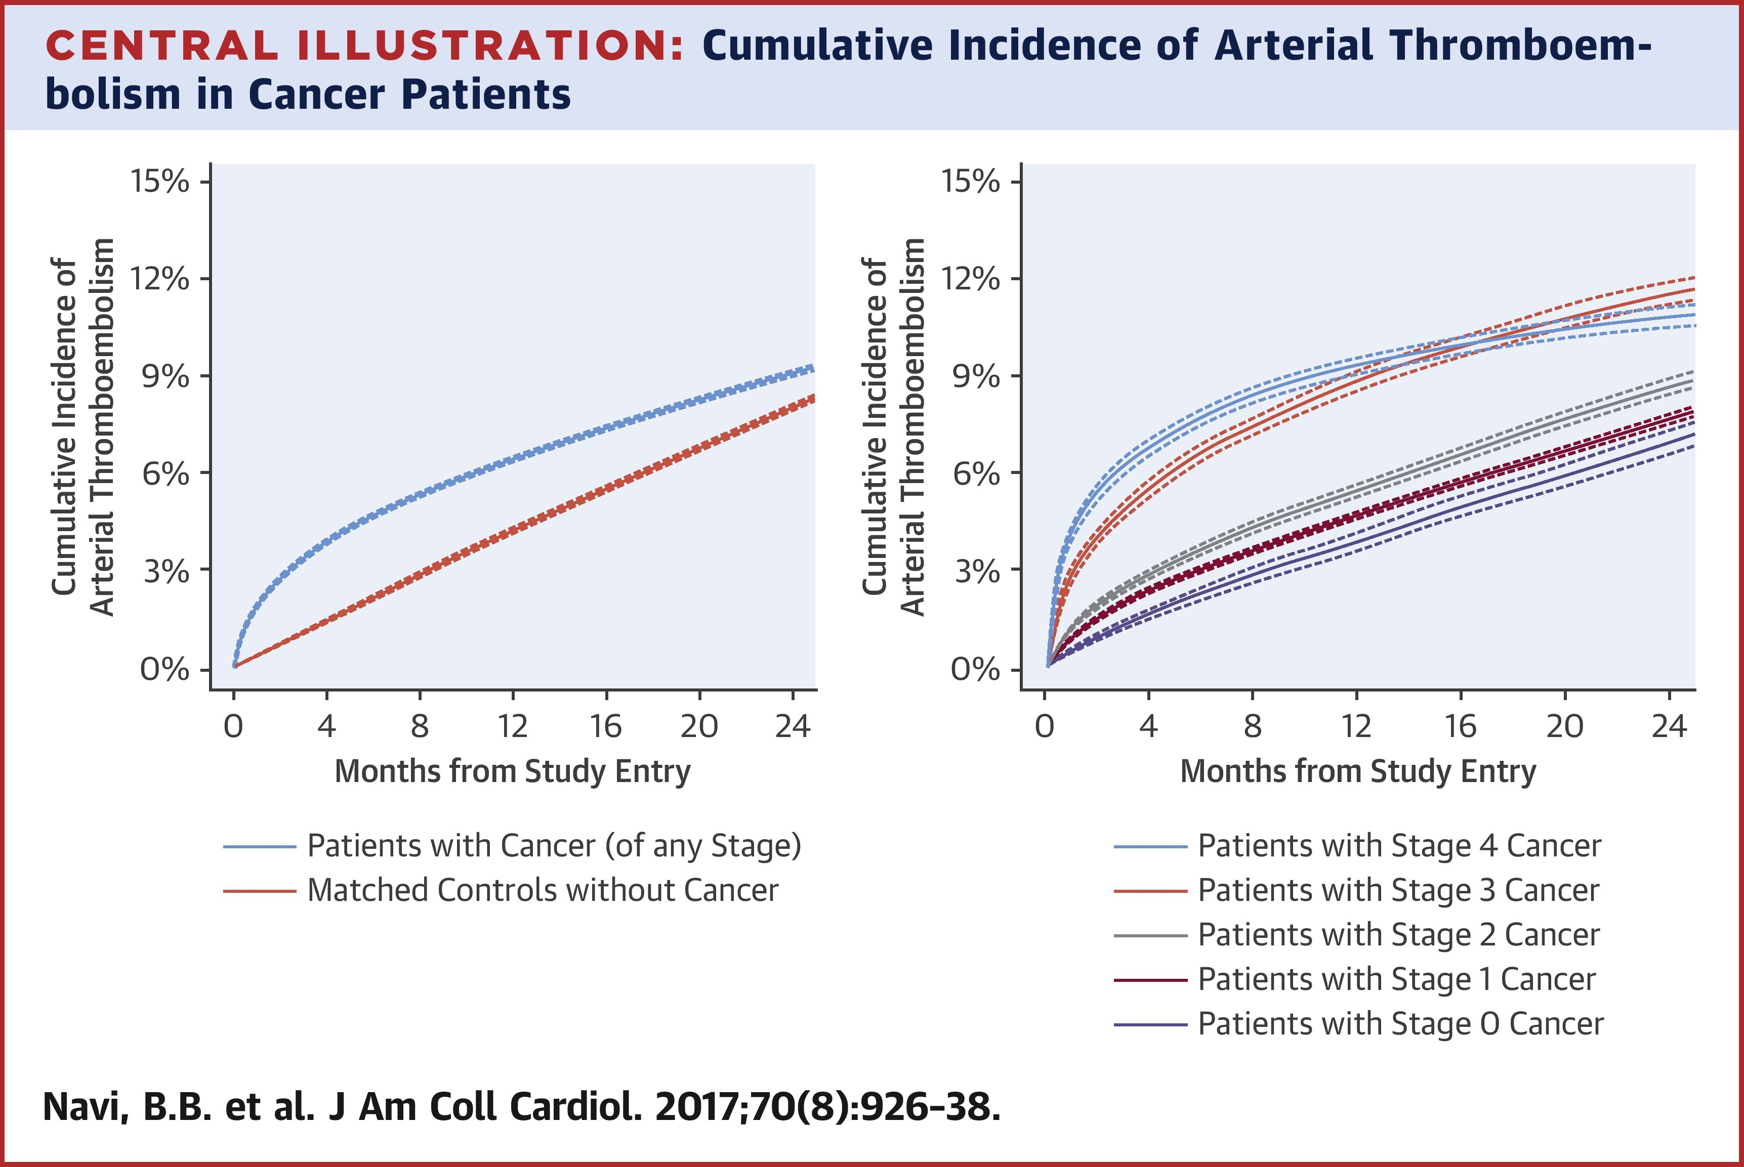

Slide 4
Cancer the Chronic Disease?
Earlier detection and improved cancer treatments have prolonged cancer survival
In USA, more than two-thirds survive >5 years
Targeted agents and immunotherapy are prolonging survival even further and therefore preventing cardiovascular events in these patients is paramount

Slide 5
Impetus for TEACH2
One-quarter of AIS are cryptogenic, of which 10% occur in cancer patients
Cancer-AIS patients face high recurrent thromboembolism rates
1-yr recurrent AIS rate ranges from 14-29%
Empiric anticoagulation sometimes employed because of the high recurrence rates and theoretical concerns for hypercoagulability
AC associated with reductions in serial D-dimer levels
DOACs increasingly used because of convenience and comparability to LMWH in recent cancer-associated VTE trials

Slide 6
Impetus for TEACH2
More data needed to determine optimal antithrombotic strategy
No trial data support this practice and it not endorsed by the AHA
Hypercoagulable stroke mechanisms (NBTE or DIC) rarely confirmed
Retrieved thrombi in cancer-AIS mostly platelet-rich (”white clots”)
Non-hypercoagulable pathologies (e.g., athero) are common in cancer
Major bleeding occurs in up to 20% of anticoagulated cancer patients
Many theoretical indications for AC were not supported by trials (WARSS, WASID, CADISS, WARCEF, ARCH); reductions in stroke risk offset by increased bleeding
Considerable practice variation exists
Among cancer-ESUS patients at MSKCC, 54% treated with AP and 43% treated with AC at discharge

Slide 8
Time to Deconstruct ESUS
Kamel H et al, JAMA Neurol 2019

Slide 9
Pilot TEACH Trial Data
Multicenter, randomized, clinical trial focused on feasibility
AC therapy with enoxaparin vs. AP therapy with ASA in patients with active cancer and AIS (75% ESUS); patients followed for 1 year
49 eligible, 20 enrolled, 41% enrollment rate (95% CI, 27-55%)
0.31 enrollments per site per month (3.75 enrollments/site/year)
Top enrollment failure reason was aversion to injections (n=11); enrollment could have been 63% (95% CI, 48-77%) with DOAC
24% major bleeding rate
No significant differences between groups for efficacy and safety outcomes

Slide 10
TEACH2 Aims & Hypotheses
Primary Aim: To determine the efficacy of AC therapy with apixaban vs. AP therapy with ASA in patients with active cancer and cryptogenic stroke
If recurrent ischemic stroke or other major thromboembolic events are significantly fewer with apixaban, then apixaban would be considered superior to aspirin for this population
Otherwise, we would conclude that apixaban is not superior to aspirin for the treatment of cancer-associated cryptogenic stroke
Secondary Aim: To compare the risks of major bleeding with apixaban versus aspirin for the treatment of cancer-associated cryptogenic stroke
If major bleeding rate is similar (<50% relative increase) between apixaban and aspirin, then apixaban would be considered safe for this population
Otherwise, we would conclude that apixaban is unsafe for patients with active cancer and cryptogenic stroke.

Slide 11
TEACH2 Tertiary Aims
To evaluate the differential effects of apixaban versus aspirin in prespecified high-risk subgroups:
Adenocarcinoma histology
Stage 4 metastatic cancer
Baseline D-dimer levels >550 ng/ml
Early randomization (0-15 days) after index stroke
To compare functional and health-related quality-of-life measures between groups and by individual outcomes

Slide 12
TEACH2 Study Design
Double-blind, randomized, active-control, phase 3 clinical trial
Apixaban 5 mg PO BID (2.5 mg BID if criteria met) vs. ASA 325 mg PO QD
Patients with active solid or hematological cancer and ESUS w/in 45 days
Followed for up to 12 months
Primary study and efficacy outcome is a composite of recurrent ischemic stroke or other major thromboembolic events (MI, SE, DVT, PE)
VTE included because 2nd most common cause of death in cancer, associated with poor functional status, and often hinders cancer treatment
Secondary study and safety outcome is major bleeding defined per ISTH criteria (includes any ICH)
Other efficacy outcomes include recurrent AIS, all stroke, any ATE, and any VTE
Other safety outcomes include mortality, any ICH, symptomatic ICH, and clinically relevant non-major bleeding (per ISTH criteria)
Navi BB et al, Neurology 2014; Timp JF et al, Blood 2013; Schulman S et al, J Thromb Haemost 2005.

Slide 13
TEACH2 Key Eligibility Criteria
ESUS must be confirmed by MRI
Echo required to exclude endocarditis; TEE optional
Elevated D-dimer is not exclusionary
Clear indications for AC including AF, mechanical heart valve, recent VTE, and confirmed NBTE are exclusionary
Clear indications for AP therapy including recent cardiac stent or PFO closure are exclusionary
Platelet count must be >70 and hemoglobin must be >8
Care can’t be limited to comfort or hospice services

Slide 14
TEACH2 Follow-Up
Lean pragmatic design with no study specific imaging
Visits at 30, 90, 180, 270, and 360 days
Visits can be remote
CBC and metabolic panel at 30 and 90 days
Focus on clinical outcome assessments
Data also collected on functional status and quality of life assessments (EQ-5D-5L and EORTC QLQ-C30)
Single optional blood draw at enrollment
For D-dimer analysis at Vermont and to store blood

Slide 15
TEACH2 Sample Size Estimation
36-month accrual period and up to 12-month follow-up period
48% annual KM rate of recurrent AIS or other major thromboembolic events in ASA-treated subjects
HR of 0.7 between treatment groups
5% annual loss-to-follow-up in each group
35% annual rate of non-informative death in each group
7.5% annual rate of crossover from ASA to apixaban (mostly for AF)
2.5% annual rate of crossover from apixaban to ASA
Total sample size estimate = 898 subjects
130 sites enrolling on average 2.3 subjects per year

Slide 16
Likely Benefits of TEACH2
Establish optimal antithrombotic strategy for a common, high-risk, and often neglected subgroup of ESUS
Support targeted approach to secondary stroke prevention
Strengthen ties between neurology and oncology
Determine the differential impact of individual clinical outcomes on patient-centered metrics

Slide 17
Questions?

