Slide 1
Operationalizing Acute Stroke Trial Enrollments
Andrew Barreto, MD, UT Houston
Opeolu Adeoye, MD, University of Cincinnati
Joe Broderick, MD, University of Cincinnati
Jim Grotta, MD, UT Houston

Slide 2
Goal of StrokeNet
“Because our ultimate goal is to test and compare therapies that will have a real impact on patient health, a coordinated and long range approach to solving challenges in stroke trial research is sorely needed.”
- Story Landis and Marc Fisher, Stroke 2013

Slide 3
StrokeNet
Prevention
Acute Treatment
Recovery

Slide 4
Goal of Today’s Discussion
Acute Stroke Clinical Trials
  Ensuring optimized enrollment processes across multiple trial settings within StrokeNet
  Discuss best practices for acute enrollments in setting of the need for rapid treatments with alteplase, thrombectomy, etc.

Slide 5
Current and Upcoming Acute StrokeNet Trials
MOST – study intervention within 60 minutes of IV alteplase
FASTEST – study intervention within 2 hours of symptom onset
RHAPSODY 2

Slide 6

Are these timelines feasible?

Slide 7
Multicenter Phase 2 Trials
ARTSS – Study drug started within 43 minutes (median) of IV alteplase
  89% started within 60 minutes
ARTSS 2 – Study drug started within 47 minutes (mean) of IV alteplase
  73% started within 60 minutes
CLEAR-ER – Study drug started within 40 minutes (median) of IV alteplase
CLEAR-FDR – Study drug started within 40 minutes (median) of IV aleplase

Slide 8
MSU Study
LSN to tPA bolus in combined Mobile Stroke Unit and Standard Management Patients—Ongoing BEST-MSU Study
MSU AND SM GROUPS COMBINED
The median door to tPA bolus time for the combined groups is 27 min (IQR 17 min) - “Door” = either MSU arrival on scene for MSU pts, or ED door arrival for SM pts

Slide 9
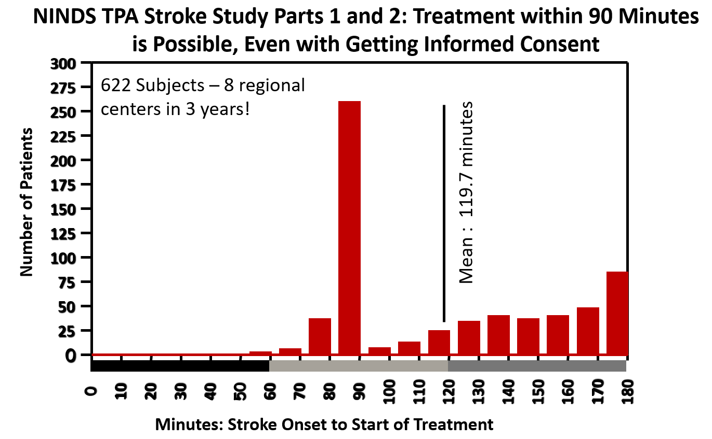
Historical Data - NINDS

Slide 10
Are these timelines feasible?

Slide 11
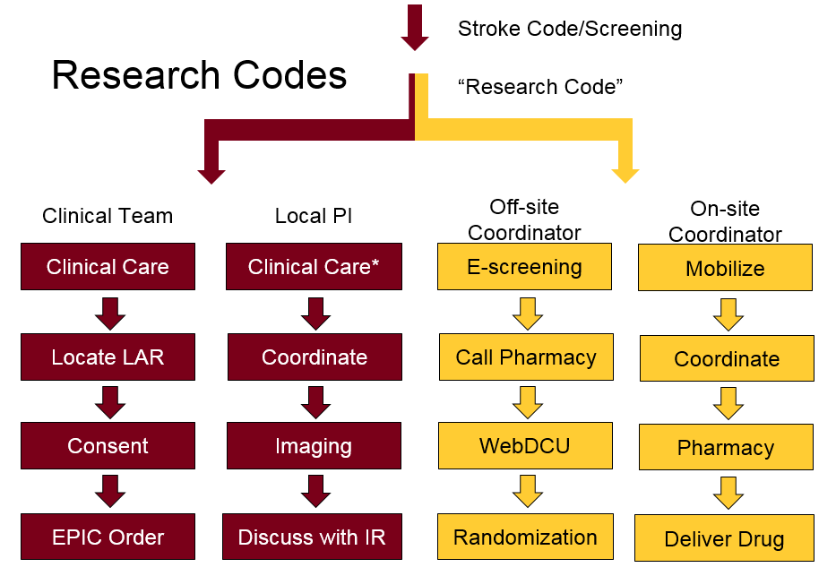
Proposed Best Practices for Successful Enrollments
University of Minnesota

Slide 12
Pharmacy and Study Drug Delivery Communication, communication, communication
Alert pharmacy of a potential subject as soon as possible
  Before consent
  Before eligibility is confirmed
  Allows pharmacy to start planning and should provide a 15-20min heads up before randomization
Confirm with pharmacy once verbal consent is obtained
  Moves pharmacy from “possible” to “very likely”
Call pharmacy again once randomized and concurrently head over to pick up the study drug if needed
  Now enrollment is confirmed and pharmacists and team are ready to prepare and disseminate study drug

Slide 13
Summary
Acute stroke trials require pre-planning and clarity of roles
  Practice, practice, practice
Timely treatment AND trial enrollments are both feasible
Many RCCs have successfully contributed to these trial timelines in the Phase 2 environment
Active RCC involvement with their participating sites is needed for successful enrollments

