Slide 1
Impact of Neuromuscular Electrical Stimulation and High Protein Supplementation on Recovery after SAH (INSPIRE)
Stroke Net Presentation
Neeraj Badjatia, MD MS
Alice Ryan, PhD
George Wittenberg MD PhD
May 13, 2020

Slide 2
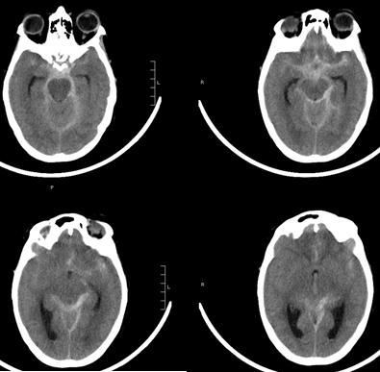
Background
Aneurysmal subarachnoid hemorrhage (SAH) affects 30,000 annually
  Incidence stable over the past four decades at 9 to 11 per 100 000 patient-years¹
  Median age of 55 years old with a higher proportion of women
  Case fatality has decreased during the previous three decades
  Lowest proportional mortality rates among cerebrovascular diseases²
  Relatively high proportion of years of potential life lost prior to age 65 years old.
Rinkel et al, Lancet Neurol 2011; 10: 349–56
Johnston et al. Neurology 1998;50:1413-1418
Notes:
Examples of basic surgical and medical advances:
Early Aneurysm Repair
Rebleeding: Aminocaproic Acid

Slide 3
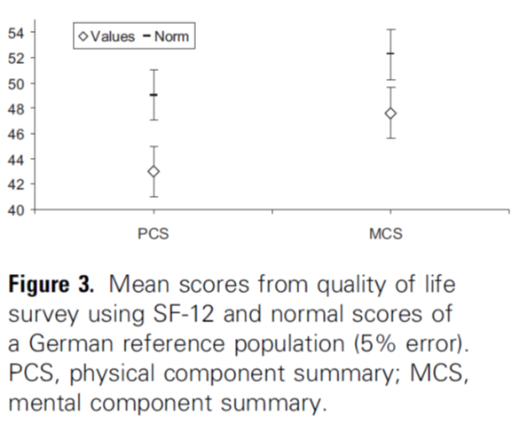
Clinical Features of
Aneurysmal Subarachnoid Hemorrhage
Prolonged critical care course
  Average ICU LOS approximately 2 weeks
Characterized by inflammation mediated sequelae
  Fever
  Hyperglycemia
  Delayed Cerebral Ischemia
  Malnutrition
Cognitive deficits prevalent
  Low occurrence of focal motor deficits, but lower extremity weakness common and disabling
10 years post SAH
J Neurosurg 119:198–206, 2013; International Journal of Rehabilitation Research 2016

Slide 4
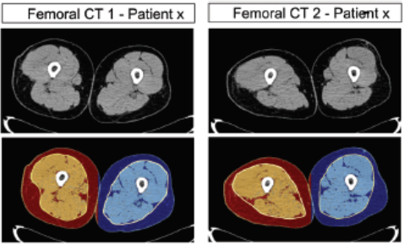
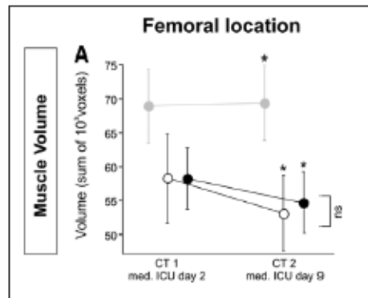
Immobilization -
Bed Rest = Muscle Atrophy
SAH patients often are limited in mobilization during critical illness
Healthy volunteers - one week of strict bed rest results in 3.2±0.9% decline in quadriceps CSA
Neurosurgical ICU patient population a 6.9% ± 1.7% loss in CSA of quadriceps after 7 days
Diabetes. 2016 Oct;65(10):2862-75. Critical Care Medicine 41 (10): 2998 – 2309.

Slide 5
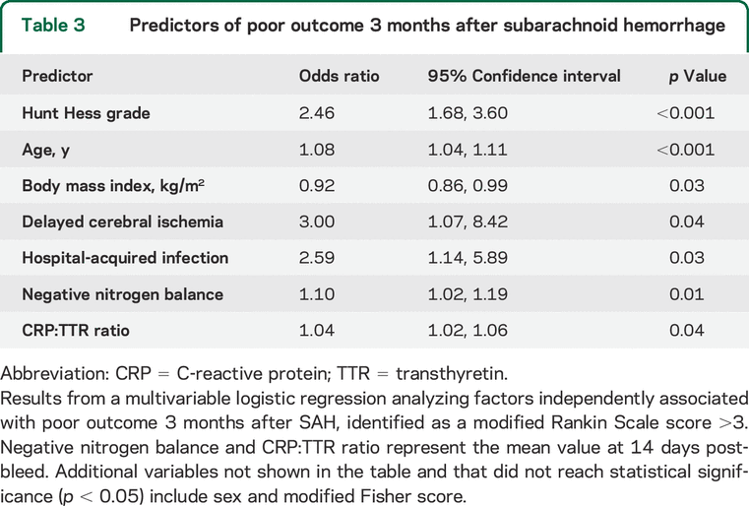
SAH: Inflammation – Mediated
Protein Catabolism and Outcome
Relationship between CRP and TTR (prealbumin) represents the interaction between inflammation and protein energy catabolism
  Independent predictor of poor outcome at 3 months
Amino Acid Depletion
  Low glutamine levels associated with lower TICS (P=0.03) and higher mRS (p=0.08) at 3 months
Badjatia, et al. Neurology 2015;84:680–687, Badjatia, et al. Neurology 2018 Jul 31;91(5):e421-e426.
Notes:
What about specific amino acids rather than total calories?
- Glutamine may be an important regulator of immune defense.

Slide 6
SAH: Paradigm of Inflammation-Mediated
Malnutrition and Muscle Loss after Injury
Hypothesis:
Strategy of modified nutrition and early, focused interventions targeting muscle health and function may mitigate the inflammation – mediated metabolic sequelae of SAH and improve long term physical recovery and global functional status.
JPEN 34(1):64-69, 2010.
Stroke. 2011;42:2436-2442
Neurology 2015;84:680–687
Neurology 2018 Jul 31;91(5):e421-e426

Slide 7
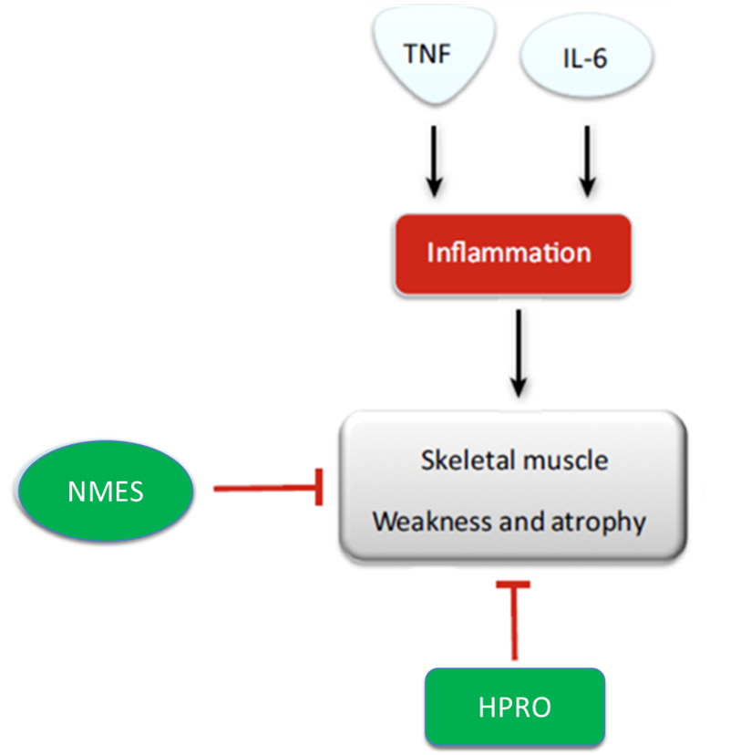
Modification of Inflammation-mediated
Protein Energy Catabolism and Muscle Wasting After SAH
Pilot Study:
Single center randomized trial to demonstrate the safety and feasibility of high protein supplementation (HPRO) coupled with neuromuscular electrical stimulation (NMES) as a combined therapeutic approach to reduce quadricep muscle atrophy acutely after SAH

Slide 8
Preliminary Data: Pilot Study Results
Figure 1. Study Flow diagram

Slide 9
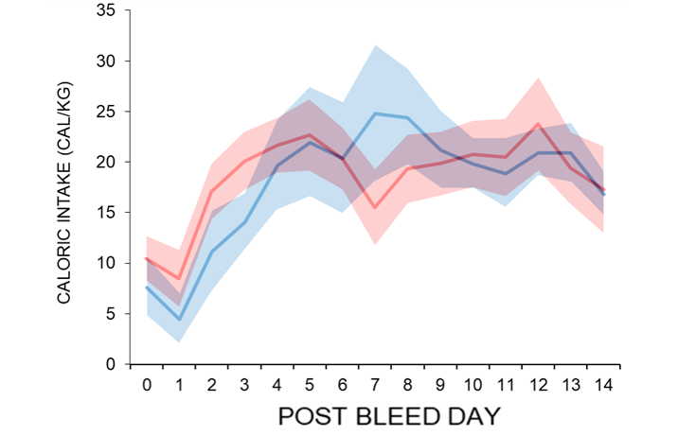
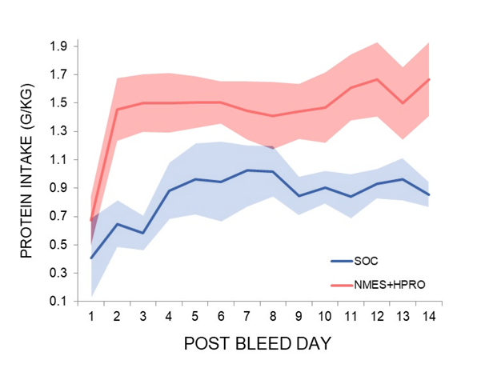
Preliminary Data: Feasibility & Safety
Achieved 86% of HPRO and 98% of NMES sessions completed
No SAEs with HPRO or NMES
NMES + HPRO group
  No difference in total caloric intake
  More protein intake (P = 0.001)
  Higher overall nitrogen balance (P = 0.002).

Slide 10
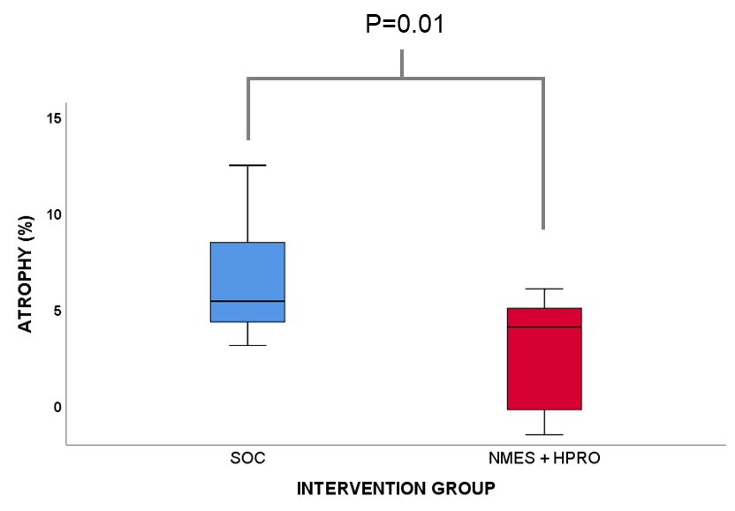
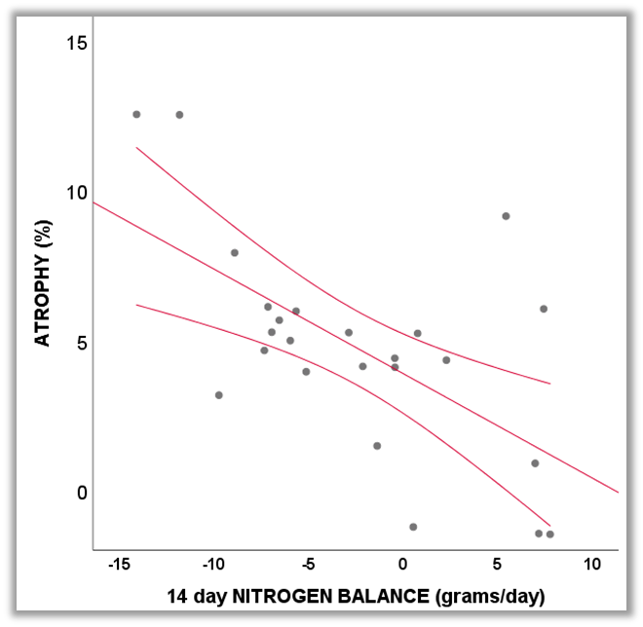
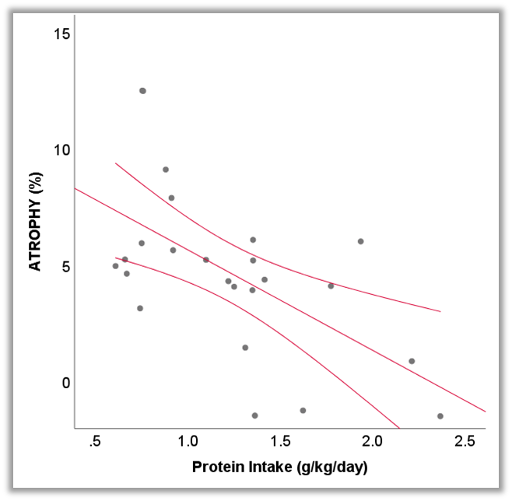
Primary End Point: Quadricep Muscle Atrophy
(Delta between CSA on PBD 0 and PBD 14)
Intervention Group
Protein Intake
Nitrogen Balance
SOC(6.7%) vs
NMES + HPRO(2.5%)
r= - 0.61, P = 0.001
r= - 0.59, P = 0.002

Slide 11
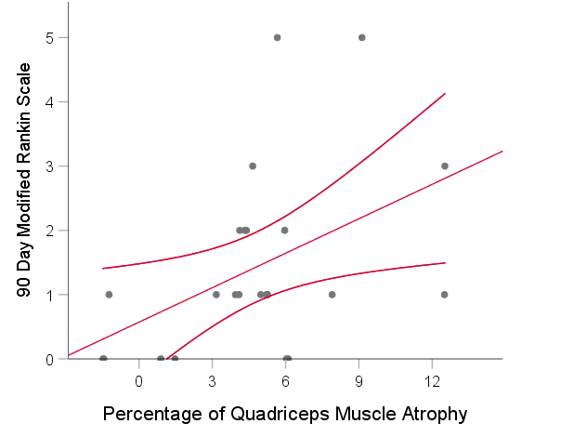
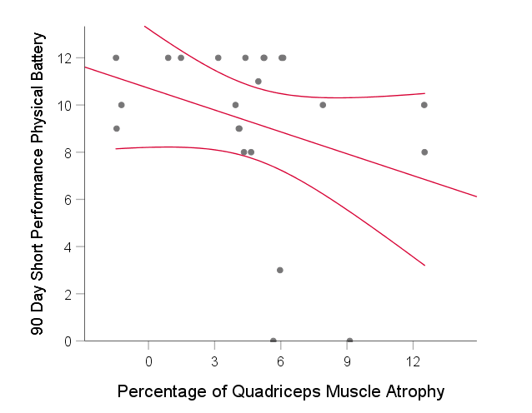
Quadriceps Muscle Atrophy and 90d Recovery
Correlation coefficients between percentage of atrophy at 2 weeks and 90 day measures of recovery (r = Spearman’s Correlation)
mRS
SPPB
r = 0.4 P = 0.04
r = -0.3 P = 0.1

Slide 12
Preliminary Data: Pilot Trial Summary
NMES + HPRO approach is feasible and safe to do in the acute setting after SAH
  Further validation of safety/feasibility needed in larger, multicenter setting
NMES + HPRO reduced quadricep muscle atrophy at two weeks
  Percentage of atrophy at day 14 associated with measures of recovery at 90d.
NMES + HPRO subjects appear to have improved mRS, MoCA at 90 days and QoL assessments of fatigue and LEM at 90d
  Not powered adequately for outcomes
  Unable to determine whether NMES and/or HPRO are responsible for observed benefits

Slide 13
Impact of Neuromuscular Stimulation and high ProteIn supplementation on REcovery after SAH (INSPIRE)
  A Phase 2 clinical trial to test the impact of NMES +/- HPRO on muscle health and function
  Determine feasibility and safety of these interventions across multiple sites
  Establish the relationship of NMES +/- HPRO induced changes muscle health and metabolism at 14 days with 90 day with measures of physical and global functional recovery
  Identify an intervention strategy (NMES +/- HPRO) for testing in a pivotal Phase 3 trial.

Slide 14
INSPIRE: STUDY ENDPOINTS
Primary Endpoint:
Comparison of percent change in lower extremity muscle atrophy by post bleed day 14 as measured by volumetric analysis of muscles on CT scan between three intervention groups: SOC, NMES only, NMES + HPRO
Safety and feasibility:
Ability to achieve 80% of HPRO and 90% NMES administration with no difference in a priori defined safety end points
Secondary Endpoints:
Relationship of atrophy to measures of physical activity, global functional recovery

Slide 15
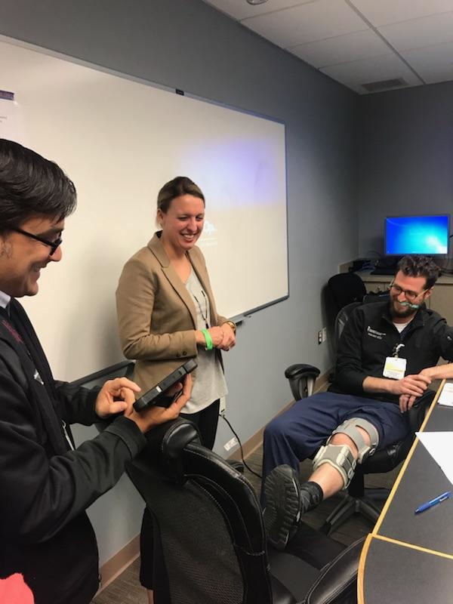
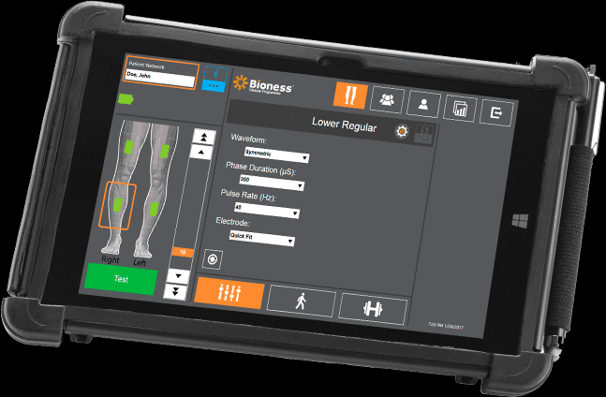
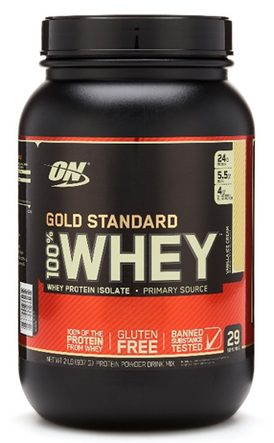
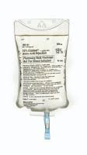
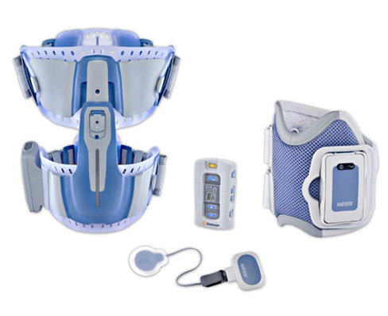
INSPIRE Study Interventions
NMES
30 minute sessions, twice daily delivered to quadricep and gastrocnemius muscles
modulating dosages to maximize stim and minimize discomfort
HPRO
  Whey protein supplement dissolved in water given over three times daily (< 1 L / day) or 15% A.A. solution (<500 cc / day) administered daily up to PBD 14.
  Timed with NMES sessions
  Target intake: 2.0 – 2.2 g/kg/day (total)

Slide 16
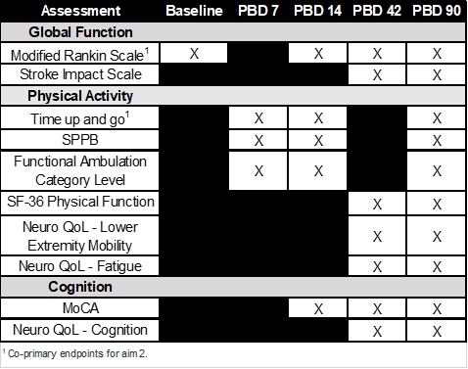
INSPIRE STUDY DESIGN
Figure 2. Study Schema for Intervention Groups (PBD 0 – 14)
Total Proposed Sample Size (N = 150)
1:1:1 Randomization into 3 Groups:
  Standard of Care (SOC) 50 subjects
  NMES only 50 subjects
  NMES + HPRO 50 subjects
Stratify by clinical grade (Hunt Hess Grade 2 and 3 vs 4 and 5)
Routine neurocritical care conforming to AHA/NCS guidelines
All subjects undergo 3 CT scans of lower extremities (baseline, PBD 14, PBD 90)
Follow up at 42 days by telephone, 90 days in person
Table 1. Schedule of Events for Outcome Assessments

Slide 17
INSPIRE PATIENT SELECTION
Inclusion criteria:
1). Aneurysmal SAH
2). Aneurysm repair < 48 hours of ictus.
3). Age between 25 and 80 years old. (>=25 years old and <=80 years old)
4). Expected stay in the NCCU > 72 hours.
5). Hunt Hess Grade >=2 assessed after recovery from the aneurysm securing procedure and after external ventricular drainage for hydrocephalus, if required
6). Modified Fisher score >1 on admission.
7) Presence of a cerebral CT scan, performed post aneurysm securing procedure, which rules out a significant (eg symptomatic or large) new or worsened cerebral infarct or rebleeding of the repaired aneurysm

Slide 18
Exclusion criteria:
1). Subjects diagnosed with SAH from trauma, rupture of an arteriovenous malformation, neoplasm, vasculitis, or other secondary causes
2). Subjects with at least one unruptured aneurysm for whom a subsequent intervention is planned within 3 months of the SAH.
3). Aneurysm rebleeding event prior to randomization.
4). Intracerebral hemorrhage on the hospital admission CT scan >30 cc.
5). Presence of cerebral vasospasm at hospital admission believed to be associated with SAH.
6). Unlikely to survive one week post hemorrhage either due to impending brain death or likely request for withdrawal of care;
7). Unlikely to remain in the ICU for more than 7 days
8). Any concomitant condition or disease( including psychiatric and neurological conditions, drug abuse, severe alcoholism) which, in the opinion of the investigator, would affect the assessment of the safety or efficacy of the study treatment.
9). Use of corticosteroids, except in instances of shock
10). Evidence of lower extremity paresis or spasticity within 48 hours of injury
11). Body mass index < 15 or >40 kg/m2;
12). Allergy to whey protein;
13). Pre-morbid modified Rankin Score >1.
14). Known pregnancy
15). Presence of active malignancy
16). Medical History of an autoimmune disorder or treatment of any disorder treated with an immunomodulatory agent
17). Medical History of a neuromuscular disorder
18). Presence of an implanted electrical device
19). Wound or skin breakdown noted on admission at the site of planned NMES administration
20). Diagnosis of chronic renal insufficiency or acute kidney injury (GFR < 30 mL/min/1.73m²) at time of admission
21). Hepatic insufficiency defined as AST/ALT levels >2.5 above normal upper limits at time of admission
22). Prisoner.

Slide 19
INSPIRE Team
Multi- PI Leadership
Neeraj Badjatia, MD MS
  Professor, Department of Neurology, University of Maryland School of Medicine
  Neurocritical Care, SAH, nutrition, inflammation
Alice Ryan, PhD
  Professor, Department of Medicine, University of Maryland School of Medicine
  Exercise physiology, post stroke physical recovery
George Wittenberg MD PhD
  Professor, Department of Neurology, University of Pittsburgh School of Medicine
  Neurorehabilitation, post-stroke motor recovery
Statistician
Jordan Elm, PhD
  Medical University of South Carolina
  StrokeNet-NDMC
Consultants
Daren Heyland, MD MSc
  Director, Clinical Evaluation Research Unit, Queens University
  Critical Care, nutrition, clinical trials
  Co-PI of NEXIS Trial (NHLBI: R01HL132887)
Marc Simard, MD PhD
  Professor, Department of Neurosurgery, University of Maryland School of Medicine
  SAH, neuroinflammation
Industry
Baxter, Inc
Clinisol solution
Bioness, Inc
NMES devices / disposables

