Slide 1
NIH StrokeNet Endovascular Platform Trial Plans and Discussion
Clinton Wright and Scott Janis
NINDS
StrokeNet Webinar
January 27, 2020
NINDS team:
Scott Janis
Joanna Vivalda
Claudia Moy
Carlos Faraco
Peter Gilbert
Clint Wright
Coming together is a beginning. Keeping together is progress. Working together is success.
~Henry Ford
http://nihstrokenet.org/

Slide 2
Housekeeping Issues
To join the meeting: https://nihstrokenet.adobeconnect.com/steering/
To take part in the audio you MUST dial in : Dial-In Number: (877) 621-0220 Pass code Number: 434578
All phone lines will be muted press *6 to mute and unmute.
If you have any issues viewing the presentation, please log out, then log back into the meeting room
After the brief presentation, we will address questions

Slide 3
Presentation Outline
Background for platform
Opportunities/process for platform
Next steps
Questions

Slide 4
Prevention
Prevention of Vascular Cognitive Impairment (VCI)
Imaging Biomarkers in Stroke Prevention: From Bench to Bedside
Expediting High Priority Comparative Effectiveness Research (CER) Trials in Stroke Prevention
Treatment
Preclinical and Clinical Studies to Improve Early Reperfusion Therapy and Establish Limitations of Late Reperfusion Therapy
Preclinical and Clinical Studies to Achieve Robust Brain Protection
Expand and Integrate Existing Stroke Trial Networks to Accelerate Translation
Recovery
Translational Research Using Neural Interface Devices for Stroke and Other Neurologic Disorders
Program for Translational Research Targeting Early Recovery after Stroke in Humans
Cross-cutting
Accelerate the Translation of Stroke Research in Preclinical Animal Models into
Clinical Studies of Highly Promising Treatments
Notes:
Theme across all 3 areas was need for infrastructure

Slide 5
Recent advances in endovascular therapy offer a new and timely opportunity to define the limits of EVT therapy and further evaluate neuroprotective agents as adjunctive therapies to recanalization.
Notes:
Talk about the ideas (without details) that came to us immediately after Dawn/Defuse results. Also address NINDS interest in defining the limits of EVT. Mention discussions with the FDA and their aligned interest in the same questions.

Slide 6
Current Approach to Clinical Trials
MR Clean
Does it work in the ultra early population?
DAWN/Defuse
Does it still work when treating a little later?
Future Trial
Another extension
Future Trial 2
And another…
Notes:
All the questions are important to us but with our current process we would be vastly restricted to addressing this space. In addition, we see this an inefficient way of getting information into practice given the lengthy process with this approach.

Slide 7
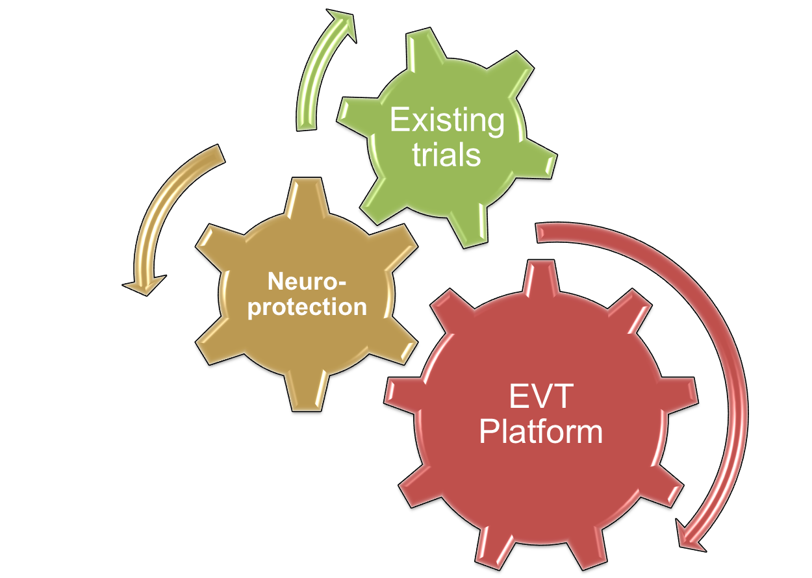
Take advantage of the network?
Notes:
29 regional centers (24 funded) with 486 satellite stroke hospitals, a coordinating center, and a data coordinating center
The opportunity is the Network provides the necessary infrastructure for a platform. And conversely is the platform.

Slide 8
NINDS StrokeNet-EVT Platform Concept
Inclusion of Registry, platform trials, and Currently Funded Trials
Notes:
How to start and create a platform.
We have leadership approval to proceed with a base-study. Ultimately, we need projects that answer hypothesis driven questions to justify funding.
We are reaching out to engage the community to develop this approach through the network.

Slide 9
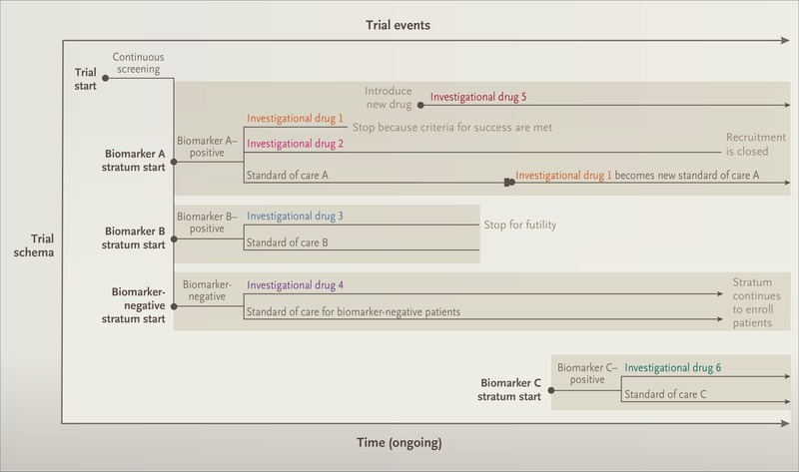
What is a Platform Trial?
An experimental infrastructure to evaluate multiple treatments, often for a group of diseases, and intended to function continually and be productive beyond the evaluation of any individual treatment

Slide 10
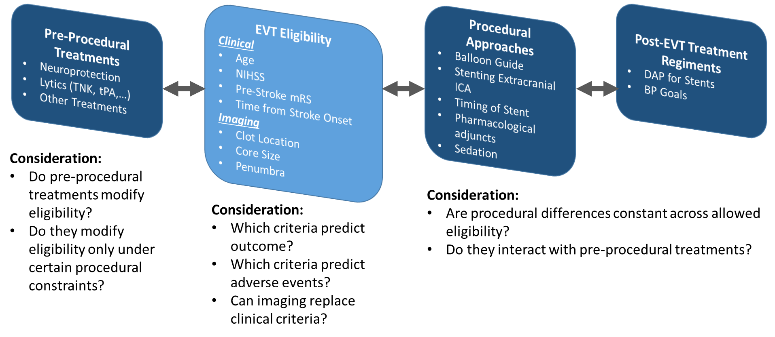
Basic Concept Long-Term Platform Plan

Slide 11
STEP Organization
NINDS DSMB Liaison
DSMB(s)
CIRB
Community Stakeholders Committee
Executive Committee
-----------
Operations Committee
Recruitment Core
Data Registry Core
National Coordinating Center (NCC)
National Data Management Center (NDMC)
Imaging Core
Endovascular Intervention Core
Statistical Core
Clinical Performance Sites

Slide 12
STEP Organization
NINDS DSMB Liaison
DSMB(s)
CIRB
Community Stakeholders Committee
Advisory / Writing Groups
Executive Committee
-----------
Operations Committee
Recruitment Core
Pubs/Analysis/Data Sharing Committee
Data Registry Core
National Coordinating Center (NCC)
National Data Management Center (NDMC)
Imaging Core
Endovascular Intervention Core
Statistical Core
Clinical Performance Sites

Slide 13
NIH StrokeNet FOA

Slide 14
What’s Next
What: StrokeNet Steering Committee call
When: Wednesday, 12-February, 2020 from 12-1p ET
Where: 1-877-621-0220; Passcode 434578
What: EVT platform Workshop
When: Tuesday, 18-February, 2020 from 3:00-5:30p PT
Where: [Room details TBD]
Email Rose Beckman (BECKMARE@UCMAIL.UC.EDU) if interested in attending
Notes:
Step-stone group reaching out to investigators who have already proposed ideas. If new potential platform ideas exist, we urge you contact us at NINDS to get involved.
The workshop is intended to help focus the discussion and make sure we are considering all options/variables/factors, etc. We will use the steering call on Feb 12th to hash out a focused agenda for the workshop.
The workshop is open but space may be limited. If interested in participating, please contact Rose Beckman at our NCC.

