Slide 1
Social Determinants of Health and Stroke Risk
Mellanie Springer, MD MS
Assistant Professor of Neurology
University of Michigan
August 25, 2022

Slide 2
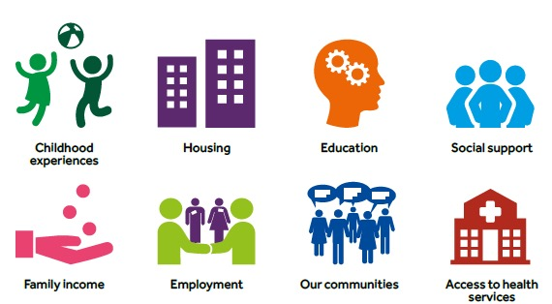
Social Determinants of Health
Conditions in which we are born, we grow and age, in which we live and work. The factors below impact our health and wellbeing
Notes:
The reason that place is matters is that it is tied to so many of the Social Determinant of health.
Social determinants of health are the conditions in which we are born---. I have recently read that SDH should be called Racism but I think they are broader than that and could also include other isms—seixm, ablism,
You can see that place impacts ones housing and childhood experiences—given the US school system it impacts education which in turn is associated with inclome and employment which is the US is often tied to insurance and access to care.

Slide 3
Macro socio-political environment
Political priorities & decisions
Societal values to equity & fairness
Racism
Unequal distribution of income, power & wealth
Poverty, marginalization & discrimination
Fundamental causes
Social determinants of health
Behavioral risk factors
Metabolic risk factors
Cardiovascular disease
Unhealthy diet
Tobacco use
Physical inactivity
Harmful use of alcohol
High blood pressure
Obesity
Diabetes
Stroke
Dementia
AMI
Heart failure
Housing
Income
Education
Transportation
Access to Medical Care
Notes:
Here is one conceptual framework showing the pathway of fundamental causes of disease to cardiovascular disease.
The fundamental causes of disease include (read)…lead to==culminating in
I will walk you through this starting with CVD..we know htn, obesity and DM are RF for CVD.
I want to challenge you today to think upstream of what we as physicians typically think about ==we are focused on the right—and I would like up to think about the left—this would require us to think outside the halls of medicine if you will and into the community to address SDH and even into fundamental causes

Slide 4
Neighborhood Environment
Availability of health-promoting resources
(access to healthy foods, recreational facilities)
Environment that promotes physical activity

Slide 5
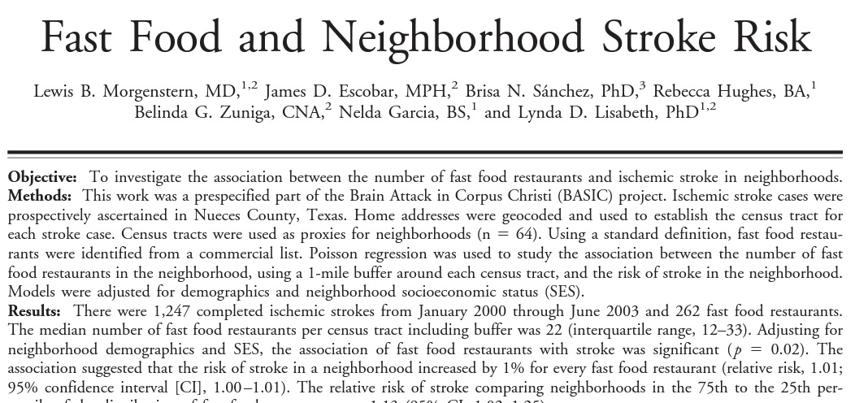

Slide 6
BASIC (Brain Attack Surveillance in Corpus Christi) project- ischemic stroke patients ≥ 45 years old, mostly a bi-ethnic community of Mexican American and non-Hispanic White individuals (2000 – 2003)
neighborhood- census tract for each stroke patient
number of fast food restaurants within the census tract generated from a commercial list
Outcome: stroke rates per 1000 population for the census tract (adjusted for the population size)

Slide 7
Median number of fast food restaurants in a census tract- 22
Median distance of fast food restaurant to stroke patient’s home- 0.32 miles
Risk of stroke in neighborhood increased by 1% for every fast food restaurant in the neighborhood, RR 1.01, (after adjustment for demographics and neighborhood SES)
The association was not present in adults > 75 years old

Slide 8
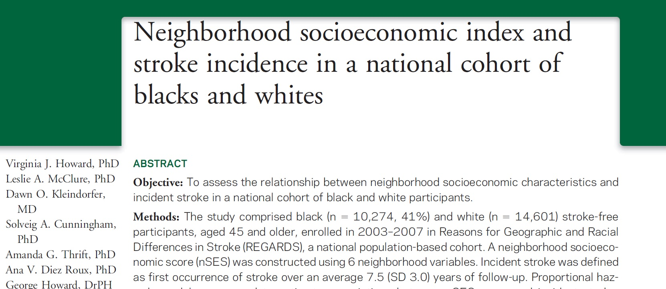

Slide 9
REGARDS- longitudinal population-based cohort across the US that enrolled (2003-2007) Black and White individuals 45 years of age and older and followed throughout time for outcomes
Demographic information, medical information
(computer assisted telephone interview)
In-person physical exam

Slide 10
Participant’s home address linked to the appropriate census block in the 2000 US census
Neighborhood SES:
Log of median household income
Log of median value of owner-occupied housing units
Proportion of households receiving interest, dividend, or rental income
Proportion of adults age ≥ 25 years with a high school diploma; college degree
Proportion of people employed in executive, managerial, or professional occupations

Slide 11
N = 24, 875
Those in more SES advantaged neighborhoods:
Older, male, non-Hispanic White, more likely to have higher individual SES, less likely to have stroke risk factors
During mean of 7.5 years of follow-up, 929 strokes occurred

Slide 12
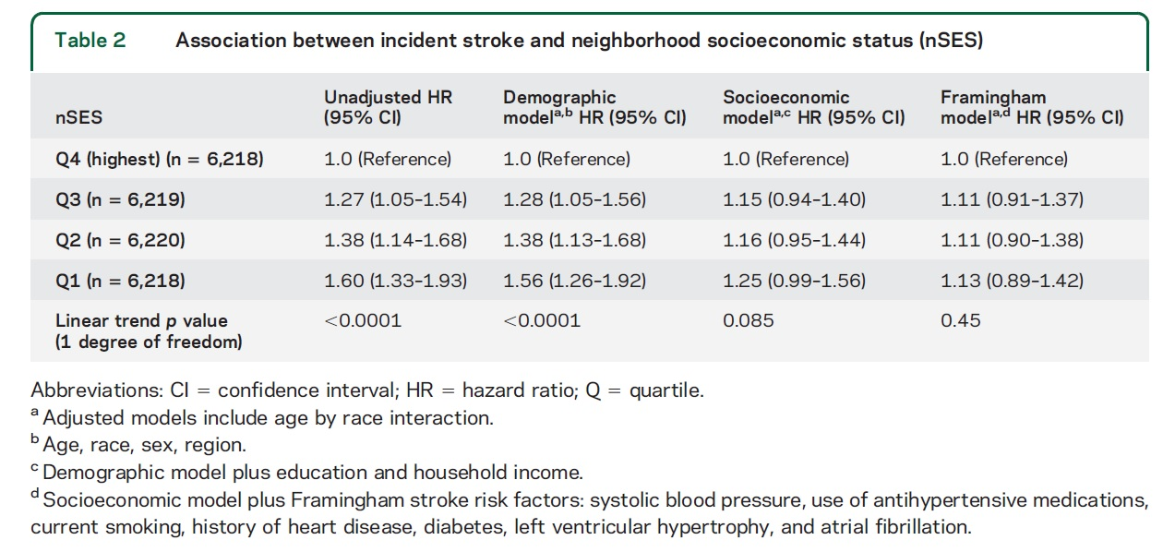

Slide 13
Income and Stroke Risk
Cost-related medication non-adherence
Healthy diet
Physical Activity

Slide 15
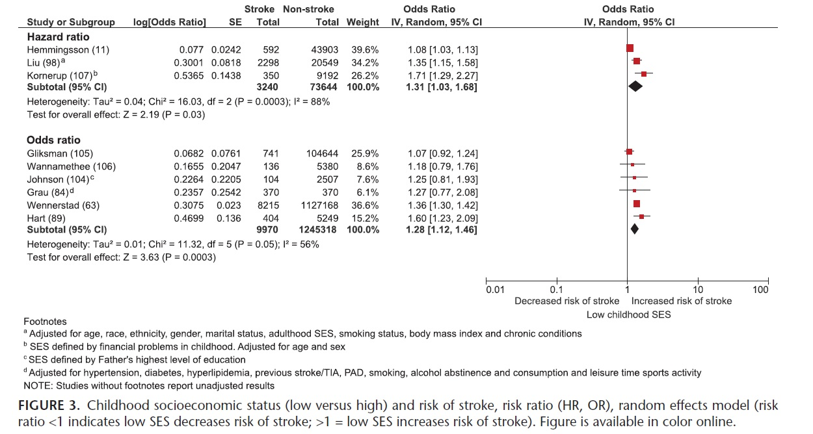
Childhood SES and stroke risk
N = 13,210 stroke patients
HR = 1.31 (1.03 – 1.68)
OR = 1.28 (1.12 – 1.46)

Slide 16
Education and Stroke Risk
79 studies, most from North America or Europe
Calculated an unadjusted odds ratio to evaluate the association between education and stroke risk
OR = 1.35 (1.24 – 1.48)
For every 2000 people who completed up to a high school education, 7 more will have stroke compared to people who completed more than a high school education

Slide 17
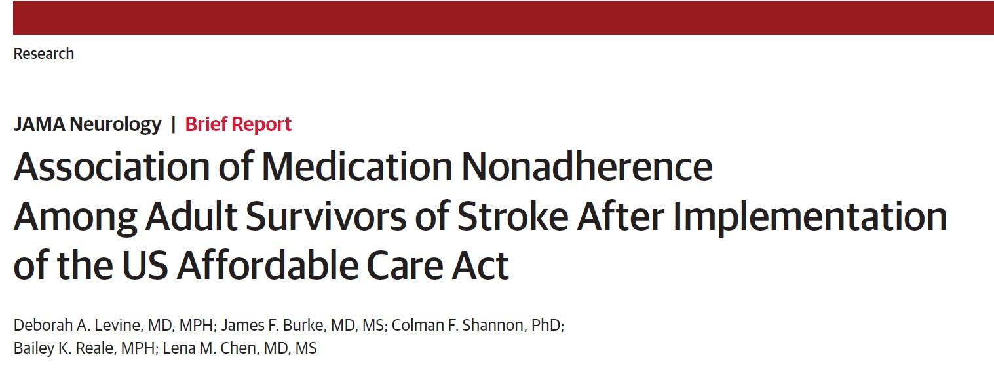
Access to Health Care
access to prescription medications

Slide 18
Affordable Access to Health Care and Stroke
Cost-related medication nonadherence (CRN) in stroke survivors before and after the Affordable Care Act
National health interview survey (2000 – 2016)
Self-reported physician diagnosis of stroke
Outcome: self-report of CRN- “During the past 12 months, was there any time when you needed prescription medicines, but didn’t get them because you couldn’t afford them”

Slide 19
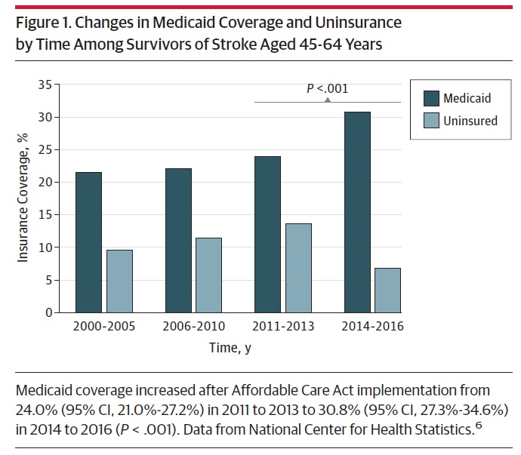

Slide 20
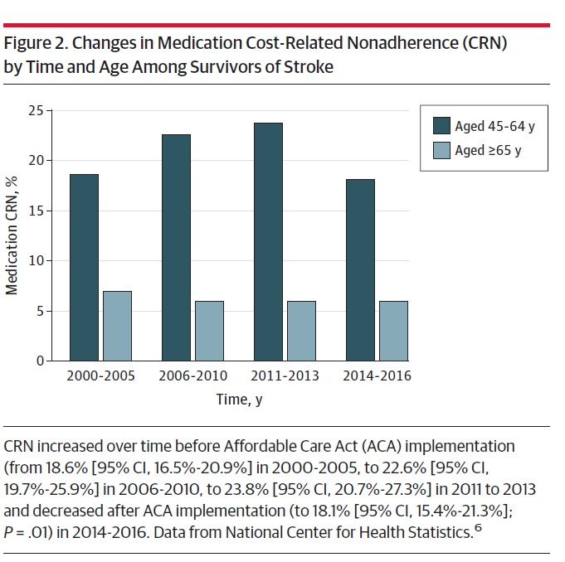

Slide 21
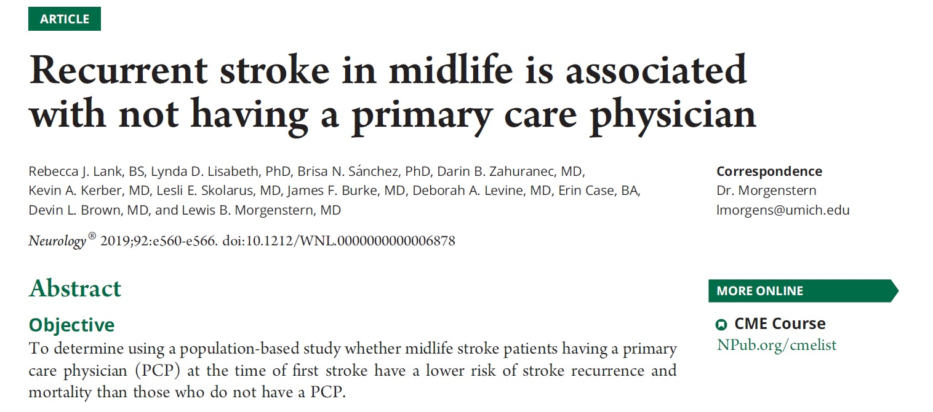

Slide 22
BASIC project- ischemic stroke patients ≥ 45 years old, mostly a bi-ethnic community of Mexican American and non-Hispanic White individuals (2000 – 2013)
Included stroke patients 45 – 64 years old
Not having a PCP before the stroke – defined as answering ‘no’ to the question “Do you have a routine place or physician that you saw for your routine medical needs before the stroke?”
Outcome- recurrent stroke over 5 years of follow-up

Slide 23
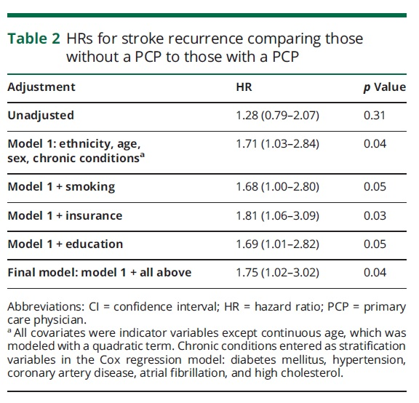
N=663

Slide 24
Social support and Stroke Risk
Social Network- relationships between individuals, families, groups, or corporations held together by a common interest, goal, or need
Social Support
Emotional- love, caring, sympathy, understanding
Instrumental- help with tangible needs (e.g. getting to the grocery, paying bills)
Appraisal- help in decision-making
Informational- provision of advice or information
Berkman et al. 2000, Social Science & Medicine

Slide 25
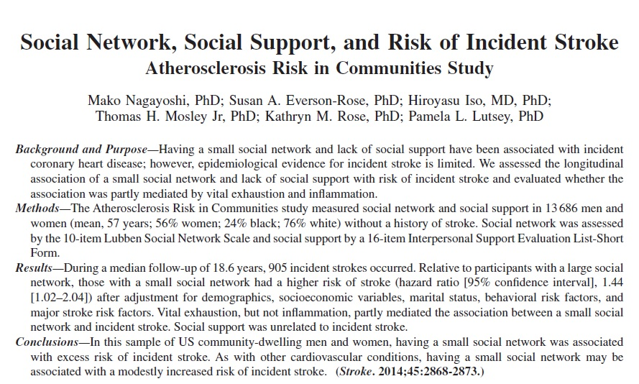

Slide 26
ARIC (Atherosclerosis Risk in Communities)- longitudinal cohort that enrolled (1987-1989) Black and White individuals age 45-64 years old from 4 US communities (Washington County, MD; Minneapolis, MN, Forsyth County, NC; Jackson, MS)
Social network size (Lubben social network scale)- family, friends, neighbors
Social support (modified Interpersonal Support Evaluation List- Short Form)
Appraisal, tangible, belonging, self-esteem
Outcome- incident stroke

Slide 27
N= 13,686
56% women, 24% Black adults
median follow-up of 18.6 years
905 incident strokes occurred

Slide 28
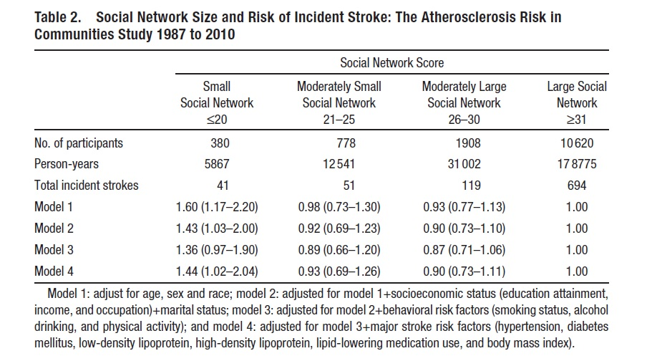

Slide 29
Vital exhaustion- increased fatigue, irritability, and feelings of demoralization (manifestations of psychological distress)
partially mediated the social network size incident stroke association
Similar direction of association between lack of perceived social support and incident stroke
(but small number of incident strokes, n=7, in that group precluded definitive conclusions)

Slide 30
Housing and Stroke Risk
Sims, et al., 2020. Importance of Housing and Cardiovascular Health and Well-Being

Slide 31
Housing Stability: Homelessness
not having the resources to obtain permanent housing
How does homelessness increase risk for cardiovascular disease?
Challenges with medication initiation and adherence
Access to healthy foods
Ability to attend physician office visits (fragmented care, stigmatization)

Slide 32
Housing Stability: Housing Insecurity
Cost of housing is high in relation to income (difficulty paying rent/mortgage)
How does housing insecurity increase risk for CVD?
Postponing medical care
Cost-related medication non-adherence

Slide 33
Housing Quality and Safety
How might poor housing quality and safety increase risk for CVD?
Second-hand smoke exposure
Negative effects on mental health

Slide 34
Housing Accessibility: Residential segregation
The separation of 2 or more socially defined groups in residential space
What are the factors that might be associated with residential segregation?
Limited economic resources
School quality
Access to quality health care
Access to healthy foods
Exposure to environmental toxins

Slide 35
What is the relationship between racial/ethnic residential segregation and incident CVD?
MESA (Multi-Ethnic Study of Atherosclerosis) – longitudinal cohort that enrolled (2000-2002) Black, White, Hispanic, Chinese adults 45-84 years old
NY, NY
Baltimore, MD
Forsyth County, NC
St. Paul, MN
Chicago, Il
Los Angeles, CA
Racial segregation- extent to which the racial composition in the census tract deviated from the mean composition of the larger surrounding set of counties
Incident CVD- angina, MI, coronary heart disease death, stroke, stroke death
Kershaw et al., 2015 Circulation.

Slide 36
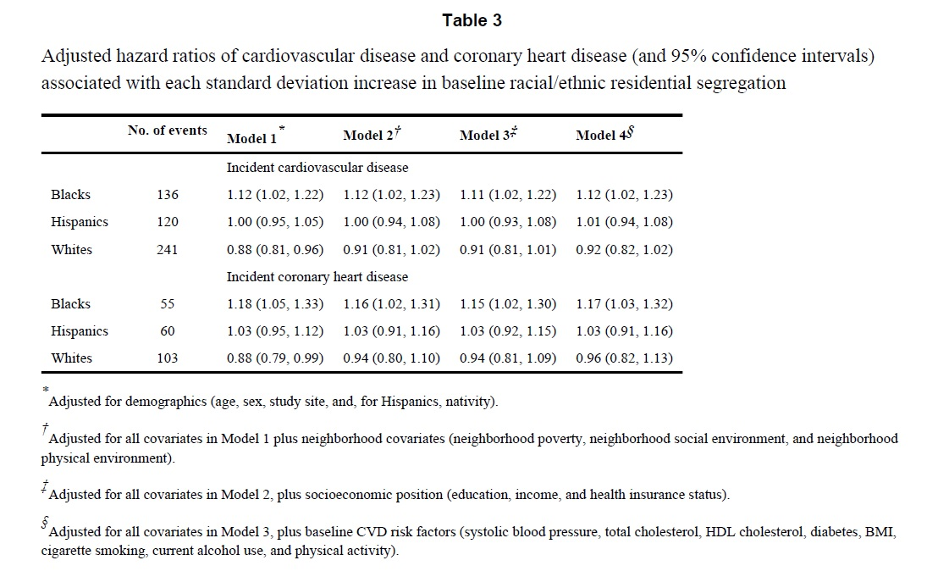
N=5,227

Slide 37
Racial Disparities in Stroke Risk
The risk of first stroke at a young age (~age 45) is higher in Black than White individuals
~40% of the excess stroke risk in Black individuals less than 45-65 years old is due to traditional vascular risk factors (diabetes, hypertension, smoking, heart disease)
Howard et al., 2016. Differences in the role of black race and stroke risk factors for first vs. recurrent stroke. Neurology
Howard et al., 2011. Traditional risk factors as the underlying cause of racial disparities in stroke: lessons from the half full (empty) glass. Stroke

Slide 38
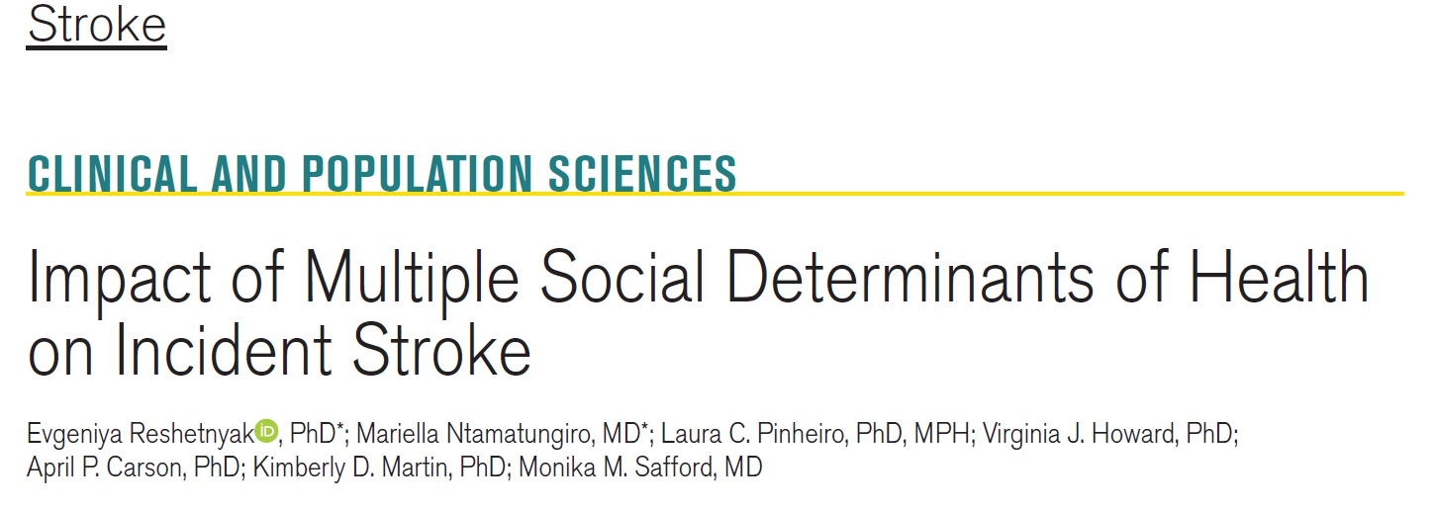
What accounts for the remainder of the Black-White disparity in stroke risk?

Slide 39
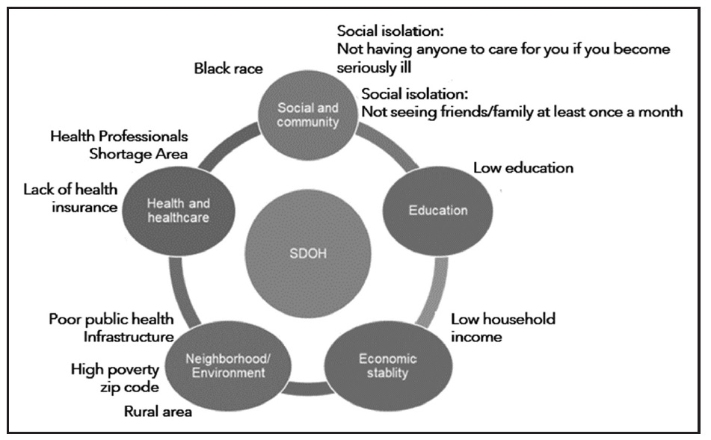
REGARDS- longitudinal cohort of Black and White individuals 45 years of age and older
Objective: to evaluate the association between increasing number of social determinants of health in the same person and incident stroke

Slide 40
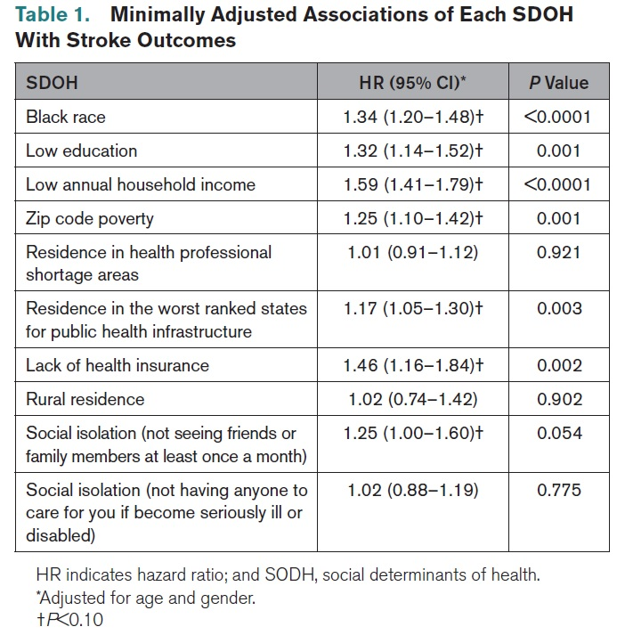

Slide 41
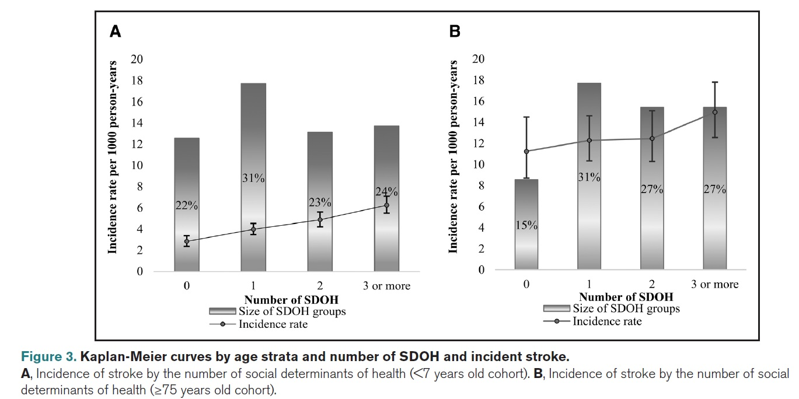
SDOH and incident stroke risk
<75 years old
≥75 years old
N=27,813

Slide 42
Who were the participants with increased number of SDOH?
Black women
history of hypertension or diabetes

Slide 43
Solutions?

Slide 44
Moving to Opportunity (1994-1998)
sponsored by the US Department of Housing and Urban Development
randomly selected subset of families living in high poverty housing projects were given housing vouchers to move to lower-poverty neighborhoods
4,498 households
Section 8 housing voucher (for rent assistance)- could only use in census tracts with 1990 poverty rates below 10% (low-poverty voucher group)
Section 8 housing voucher (for rent assistance)- no restriction on location (traditional voucher group)
No voucher

Slide 45
Moving to Opportunity- Physical Health outcomes
self-reported health
asthma attack in the past year
BMI (objectively measured)
hypertension (interviewers measured participant’s blood pressure)
whether person’s health limited them climbing stairs or carrying groceries
Ludwig 2012. Neighborhood Effects on the Long-term Well-Being of Low Income Adults.

Slide 46
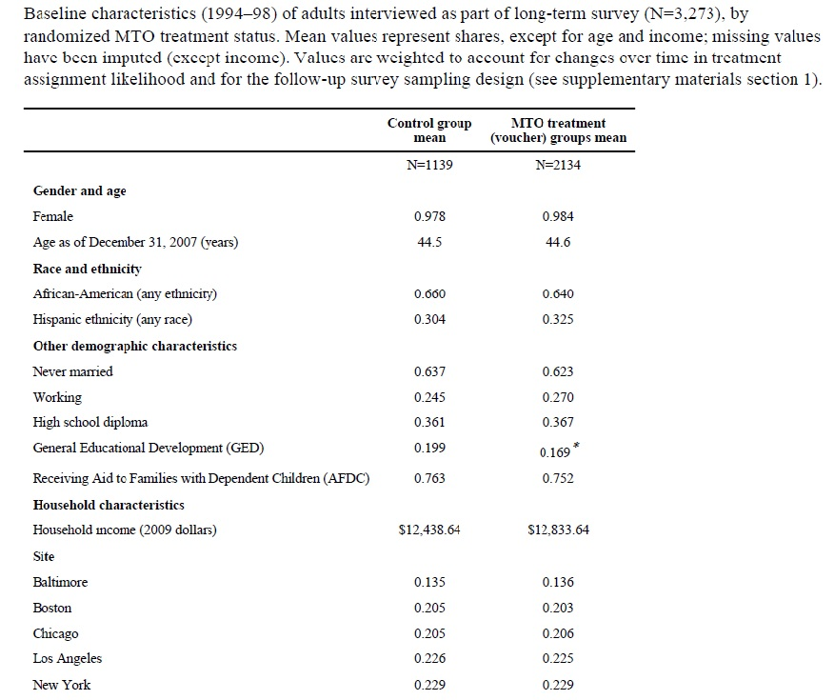
Moving To Opportunity- Table 1

Slide 47
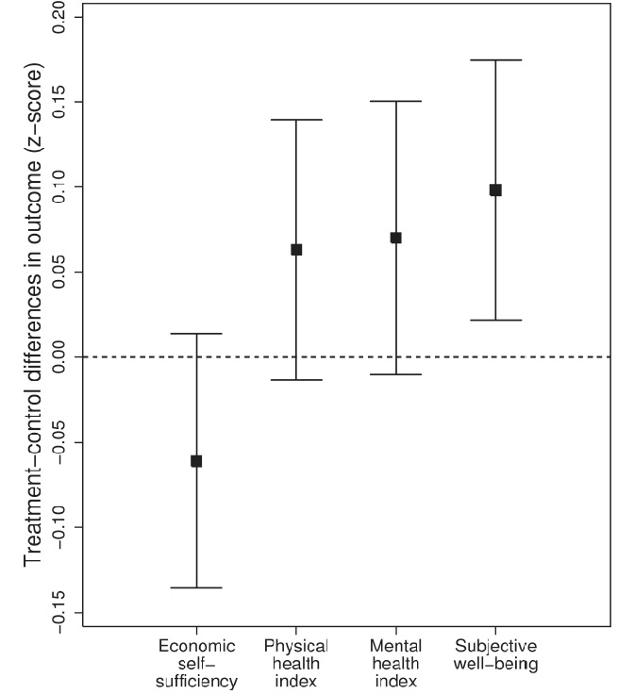
Moving To Opportunity- Results

Slide 48
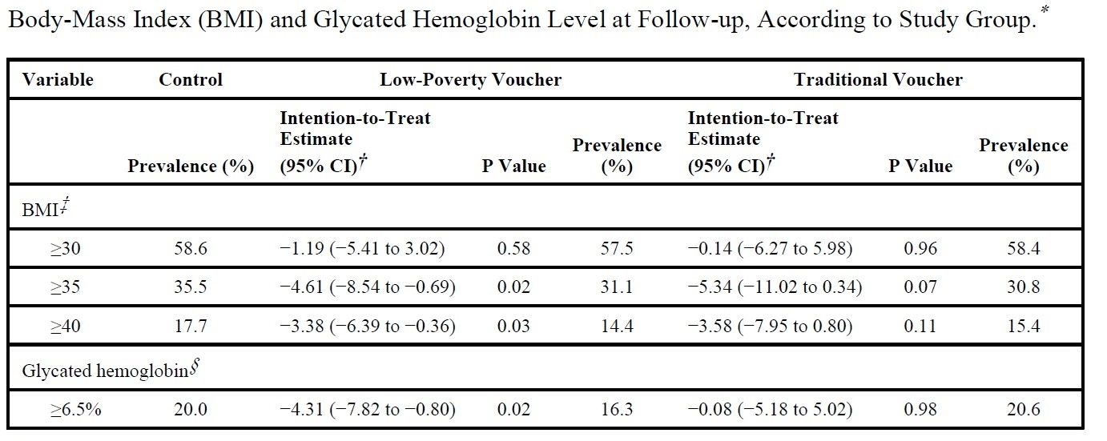
Ludwig, 2011. Neighborhoods, obesity, and diabetes- A randomized social experiment

Slide 49
Conclusions
Social determinants of health are associated with incident stroke
Clinicians should consider social determinants of health when treating patients
Policies are needed that address how to improve equity in social determinants of health

