Slide 1
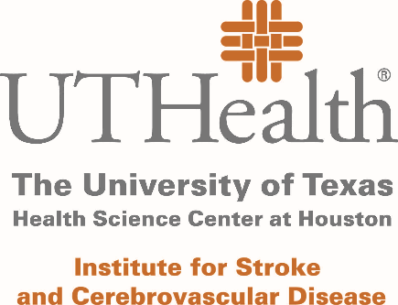
Recovery Enhancement using Marrow stromal cells in Acute stroKE (REMAKE)
Sean I. Savitz, MD UTHealth
Steve Cramer, MD UCLA Health
Larry Wechsler, MD Penn Medicine
Chuck Green, PhD UTHealth-Houston

Slide 2
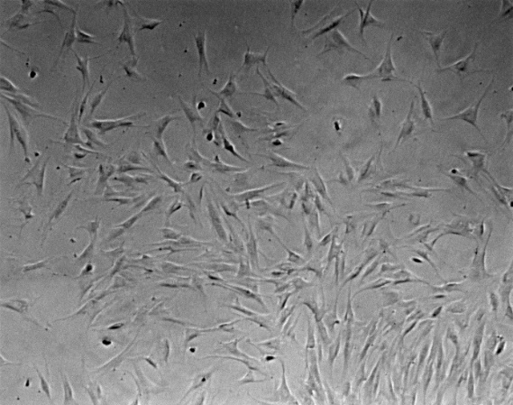
Marrow Stromal Cells (MSCs)
MSCs (0.01% of BM) isolated, grown and passaged in culture.
Stored and readily available (off the shelf)
Allogeneic
Mechanisms
Modulate Immune Responses
Facililate Brain Repair
Reduce White Matter Injury
Extensive Preclinical Data
Stroke, TBI, SCI
Over 20 years!
Clinical Trials have shown
extensive safety
1000s of patients
Approved Rx for GVHD

Slide 3
Satani et al. 2019 Frontiers in Neurology

Slide 4
A model for how cell therapies enhance recovery after stroke.
Mays and Savitz. Stroke. 2018;49:1058-1065
Copyright © American Heart Association, Inc. All rights reserved.
Notes:
A model hypothesis for how multipotent adult progenitor cells (MAPC) enhance recovery after stroke. In the untreated scenario, ischemic stroke leads to the activation of the peripheral immune system, including spleen reduction and the release from the spleen of proinflammatory cells and cytokines. These proinflammatory mediators contribute to worsening blood–brain barrier (BBB) disruption and central nervous system (CNS) inflammation mediated by M1 microglia. An intravenous administration of MAPC reverses splenic atrophy, promotes the release of anti-inflammatory mediators from the spleen, which ultimately leads to less BBB disruption and less CNS inflammation, and the promotion of a proregenerative environment. IL indicates interleukin; and Tregs, T regulatory cells.

Slide 5
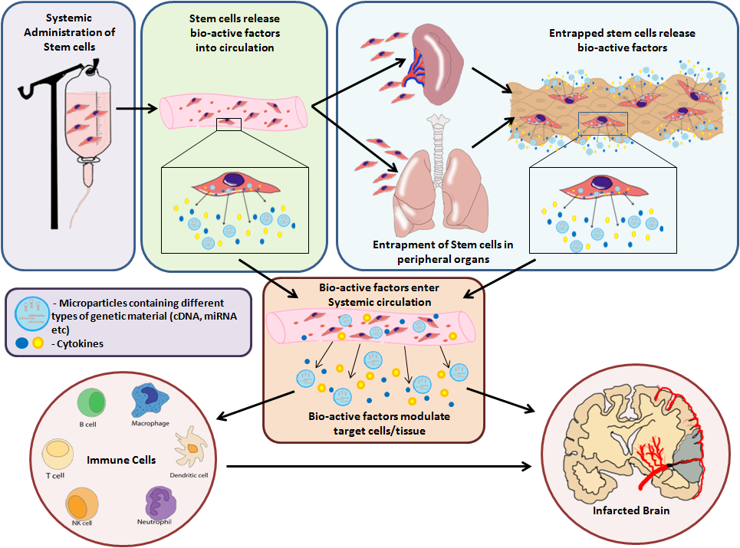
Savitz and Parsha. Cell therapies to enhance recovery of the
stroke patient. In: Grotta et al, eds. Stroke: Pathophysiology,
Diagnosis, and Management. Philadelphia: Saunders; 2015

Slide 6
Prior MSC Trials
Various small studies have tested MSCs in stroke patients with chronic stroke.
Most of these studies have used autologous preparations which are not feasible for the acute setting.
All of these trials have been underpowered with low sample sizes to draw conclusions on the treatment effects of MSCs, although several studies suggest MSCs lead to improvement on clinical outcomes (Bhasin et al, 2011; Levy et al, 2019; Honmou 2011; Lee et al).
However, no MSC trials in the acute setting.
But, the majority of preclinical studies administer MSCs at or around 24 hrs.
For maximal effect, MSCs are activated by the inflammatory response. The acute inflammatory response optimally activates MSCs, when damage and repair mechanisms coincide in the brain, and when patients are in the inpatient setting.

Slide 7
Phase I/II Seamless Adaptive Bayesian MSC Trial
We propose, for the first time, a randomized, placebo-controlled trial of allogeneic MSCs in patients 24-48hrs after ischemic stroke
Allogeneic MSC: manufacture cells from 1 volunteer to support the trial
Age: 18-80 yo
Target Population: acute ischemic stroke with arm weakness
Timing: 24-48 hrs after symptom onset
Challenge: minimize enrollment of patients who will worsen or substantially improve
Clinical Trial Design: Adaptive, Seamless Phase I-Phase II design consisting of an initial Bayesian continual reassessment, dose-finding method (BCRM) component (Phase 1), followed by a Bayesian Phase II efficacy component
Primary Safety Outcome of Phase I: MTD up to 10 million cells/kg
Primary Efficacy Outcome of Phase II: arm functional recovery (all patients must have arm weakness with finger extension)
FMA 6-54 at baseline

Slide 8
Specific Aims
SA 1: We will determine the maximum tolerated dose of MSCs in patients with acute ischemic stroke (1, 3, 10 million cells/kg)
60 participants in a 4:1 ratio to the dose escalation cohort or placebo, will result in optimizing the dose of the active therapy for purposes of safety (n = 48)
SA 2: We will obtain estimates of MSCs’ treatment effects by measuring improvement in arm impairment on the Fugyl Meyer Motor Scale of the Upper Extremity at 3 months after randomization.
Randomization will continue until a maximum of N = 160 participants have been randomized such that n = 80 participants exist in each of these two conditions
SA 3: We propose various exploratory outcomes to measure inflammatory and reparative biomarker effects of MSCs to validate, in stroke patients, preclinical mechanisms of action of MSCs.
Effect on various blood borne biomarkers including pro and anti-inflammatory cytokines, chemokines, growth factors, and extracellular vesicles
Effect on splenic volume change
Effect on structural preservation of white matter and grey matter structures
Effect on integrity of the corticospinal tract

Slide 9
Outcomes Measurements
UG3 milestone: Cell lots ready for deployment, all sites will be activated, IRB documents will be approved, all CRFs, SOPs and MOPs will be completed
Aim 1: Determine Maximum Tolerated Dose
Toxicity is defined as Grade 3 or higher allergic reaction based on current CTCAE criteria within 24 hours of infusion or clinically apparent arterial occlusion (PE, MI, stroke) within 7 days post infusion or grade 3 or higher study related adverse events.
Aim II: Clinical Efficacy
Primary efficacy endpoint at 90 day: FM-UE
Secondary
SIS, EQ5D, WAB, Gait velocity, mRS, cognition
Long term: 6 month will be final time point
Aim 3: Biomarker Studies
MRI at baseline with DTI, 3 mo, 6 mo
Serum markers at baseline, 1, 3, and 7 days after randomization
Spleen sizes daily up to 5 days post infusion

Slide 10
Analyses
Phase I Bayesian Continual Reassessment Method
3:1 Randomization (N_{max}= 60)
Dose Escalation (n_{max}= 48) and Placebo Control Arms (n_{max}= 12).
Phase II Efficacy Effect Size
1:1 Randomization N = 160
Highest acceptable dose versus placebo, incorporating Phase I participants receiving that dose or placebo.
Decision Rules
Minimum Clinically Meaningful Effect Size: 10% Improvement FM-UE (6.6 points in raw FM-UE units)
Placebo group estimate from Chollet, et al. (Placebo: 16.2 (S.D. = 16.6)).
Should be modeled in the log-normal form.
Decision Threshold: Posterior Probability (Improvement > 10%) > 0.80
K = 1000 Monte Carlo simulations suggest that N = 160 will detect this effect 99.3% of the time.
Pre-planned Heterogeneity of Treatment Effect (HTE) for: ethnicity/race, age sex/gender

Slide 11
Summary
After 20 years of animal studies showing efficacy, we are proposing the first Phase I/II clinical trial of allogeneic MSCs in patients with acute stroke
MSCs are not proprietary and can be manufactured in the public domain
Modality specific endpoints specifically chosen to measure recovery of the impaired arm
Biomarker studies embedded to validate mechanisms of action discovered in animal studies

