Slide 1
The NIH StrokeNet
Steering Committee Meeting
April 10, 2019
12:00-3:00pm ET

Slide 2
Steering Committee Welcome
Welcome and overview - Dr. Broderick
NINDS update and report - Dr. Janis

Slide 3
Recruitment in Prevention Trials – Best Practices
United
University of Iowa
UPMC
Intercoastal

Slide 4


Study Recruitment Tips
Heena Olalde, RN, MSN
Enrique Leira, MD, MS
University of Iowa RCC

Slide 5

Our Experience
Screen inpatient/outpatient stroke service daily
Team approach to recruitment (multiple eyes)
Simple algorithm for eligibility (one source)
Alert clinical team of potential candidate
Involve additional players (ED, transfer center, etc)
Capitalize on EMR resources

Slide 6
Specific Trial Experience
DEFUSE 3 – Utilize Air Care I and II to help with recruitment
CREST 2/H – Delegate to the most promising PI
  PI = Vascular Surgery
  Investigators from Vascular Surgery, Neurology, Neurosurgery, Radiology, and Cardiology
  Coordinators in multiple departments
ARCADIA- Incorporate Prevention Discussion Rounds for any ESUS
  TOAST classification in EMR
  Team approach to recruitment
  Kudos e-mails

Slide 7
Excel in Recruitment
Screen daily for trials
Anticipate and prevent recruitment challenges
Redundant pathways to help with identification and recruitment
Incorporate to patient rounds if possible
Educate your teams about the trials
Explore telehealth, aerial crew, or remote consenting.

Slide 8
Telemedicine Enrollment
Telemedicine allows study personnel to present the informed consent form from a remote location
Requires live two-way video feed via telemedicine and wet ink signature from subject/LAR
Study personnel will arrive on site and be able to immediately begin study interventions

Slide 9
eConsent Enrollment
eConsent allows electronic distribution and electronic signature of informed consent form via text or email
Door-to-randomization time reduced
Electronic timestamp may reduce consent documentation errors
Centralized management and monitoring of ICD
Potential to improve participant engagement depending on the study population

Slide 10
eConsent
Considerations
  Is eConsent appropriate for the trial?
  Must be compliant with all relevant regulations, such as the requirements of Part 11 and HIPAA
  Cost of implementation

Slide 11
eConsent
RCC 18 University of Minnesota – experience in prior acute trials
Potential for use in MOST but not currently

Slide 12
Telestroke & eConsent
Christopher Streib, MD, MS
Stroke and Telestroke Director, University of Minnesota
Abbey Staugaitis, MSN, RN, CCRC
U of MN StrokeNet RCC 18 Program Manager
U of MN SIREN HUB Program Manager
April 10, 2019

Slide 13
Outline
Telestroke Informed Consent at U of MN
  Proposed practice and limitations
  Future directions
Overview of eConsent
Real-world eConsent experience (HOBIT)
  Features of a good eConsent platform
  Lessons learned
Conclusions

Slide 14
Abbreviations
eConsent - electronic consent
SIREN - Strategies to Innovate EmeRgENcy Care clinical trials network
LAR - legally authorized representative
ICF - informed consent form
eICF - electronic informed consent form
HOBIT – Hyperbaric Oxygen Brain Injury Treatment trial

Slide 15
Spoke
“Stroke Code”
Telestroke and Clinical Trials
Telestroke: Emergent Clinical Care
Clinical Trial Screening
Spoke
Hub
Research Team Arrives at Hub
Consent
Consent
Consent
Randomize/Treat
Transfer
Randomize/Treat
Transfer
Randomize/Treat
Notes:
All Telestroke Physicians are trial investigators and trained in our acute stroke trial protocols, research informed consent process, including assessing capacity to consent.

Slide 16
Telestroke and Clinical Trials: Future Directions
Virtual Site
Telestroke
U of MN runs “virtual” stroke programs at partner hospitals
  Longitudinal inpatient care with 24-7 telestroke coverage
  Transfer rate: 25%
750+ projected patients in 2019
Consent, randomization, follow-up would occur remotely
Clinical Care
Screening
Consent
Randomize/Treat
Transfer
Notes:
With these telestroke and eConsent clinical reserach

Slide 17
Telestroke Research Consent U of MN
RN prints ICF from shared drive
  RN gives form to patient/LAR
Face-to-face informed consent via Telestroke
Subject/LAR review ICF, receive own copy
Obtain required signatures on the ICF
  Times/dates
  Ensure ICF reaches hub: screenshot signature page, fax copy, original ICF with patient
Notes:
In our upcoming acute stroke trials, we are replacing fax-phone consent with Telestroke consent. Previously, in acute trial such as DEFUSE-3, consent forms were faxed to the LAR at the outside hospital and an informed consent discussion occurred by phone. We have replaced faxing with a shared drive containing informed consent forms and the consent discussion will now take place via Telestroke directly with the physician and patient/LAR. Steps 3 and 4 are unchanged from the previous fax-phone consent process.
This proposed process has received a favorable review from our IRB and should be in place for TIMELESS and CHARM, 2 acute, non-StrokeNet trials beginning next month.
Consent discussions via telemedicine has been proposed in 2 current protocol submissions with the U of MN IRB. Preliminary discussions with IRB representatives about this process have returned a favorable response to the process. Both submissions are currently under review.
Required Elements:
Presentation of the research study
Clearly stating that the study is research and participation is voluntary
Subject/LAR able to review ICF
Answering all trial-related questions
Obtaining required signatures on the ICF

Slide 18
Limitations of the Consent Process
Printing, copying, faxing are resource intensive and inefficient
LAR must be physically present at the spoke hospital with the patient
Risk of incorrect version, incomplete, or lost ICFs
By addressing these limitations, eConsent platforms, in combination with robust Telestroke networks, have the potential to modernize and grow stroke clinical research
Notes:
Printing, copying,

Slide 19
Electronic Informed Consent
Use of electronic systems and processes…to convey information related to the study and to obtain and document informed consent.¹
eConsent streamlines delivery/return and documentation of signed ICF, but does not change the elements of informed consent
1. US Department of Health and Human Services OHRP. Use of Electronic Informed Consent Questions and Answers Guidance for Institutional Review Boards, Investigators, and Sponsors. Dec 2016.
Notes:
In a guidance from the FDA, electronic informed consent refers to the use of electronic
systems and processes that may employ multiple electronic media, including text, graphics,
audio, video, podcasts, passive and interactive Web sites, biological recognition devices, and
card readers, to convey information related to the study and to obtain and document informed
consent.
Overall, the use of these electronic tools serve to facilitate and document the consent conversation.
The process includes (but is not limited to) the following steps:
presenting information about the study, including the risks and potential benefits, at a level that allows for clear understanding;
allowing the potential subject or representative the adequate opportunity to read the ICF document;
• answering any initial questions;
• clearly stating that initial and ongoing participation in the study is voluntary, and that a subject may discontinue participation at any time;
• obtaining relevant signatures on the ICF; and
• continuing to provide information and answers to questions throughout study participation.

Slide 20
Effective eConsent Platforms Should Be:
Web-based
Easy to read and navigate
Required elements embedded seamlessly:
    Documentation of LAR relationship to participant
    LAR must confirm consent conversation occurred and all their questions are answered
    Capable of adding capacity questions
Real-time return of signed ICF via email to clinicians, research team, LAR/participant
Notes:
As Dr. Streib said, Ideally, a good eConsent remedies many of the limitations we currently face in the proposed (and previously used) telemedicine/remote research consent processes.
A “user-friendly” platform would include:
Web-Based platform
compatible with any device (that has a screen and wi-fi, of course)
very easy to access in person (created a shortcut on any device) or send as a link
one “click” opens the document
Easy to View
Text scales to the screen
Key information is condensed and right up front
More in-depth sections are in a “scroll” format that does NOT force the reader to scroll through every section to move to the next part of the document. This really helps reduce the burden on the LAR.
3. Embedded features
able to embed videos or graphics on the consent for better visual learning
Documentation of the consent conversation are embedded in the document and prompt a response from the end user before they can move to the next page. *this could also include questions to assess capacity and understanding; when applicable
Documentation of the LAR and his/her relationship to the subject are embedded in the eConsent.
Touch (or mouse) signature boxes that resemble touchpad signature pads often used in eCommerce (ie. they are familiar to many people and easy to use).
4. Real-time return of the full, signed document in an (secure) email to: the study team, the national coordinating center (monitors), and the LAR (if an email address is provided). The email contains a PDF that can easily be printed to give to the family onsite and place in the medical chart the day of the enrollment.

Slide 21
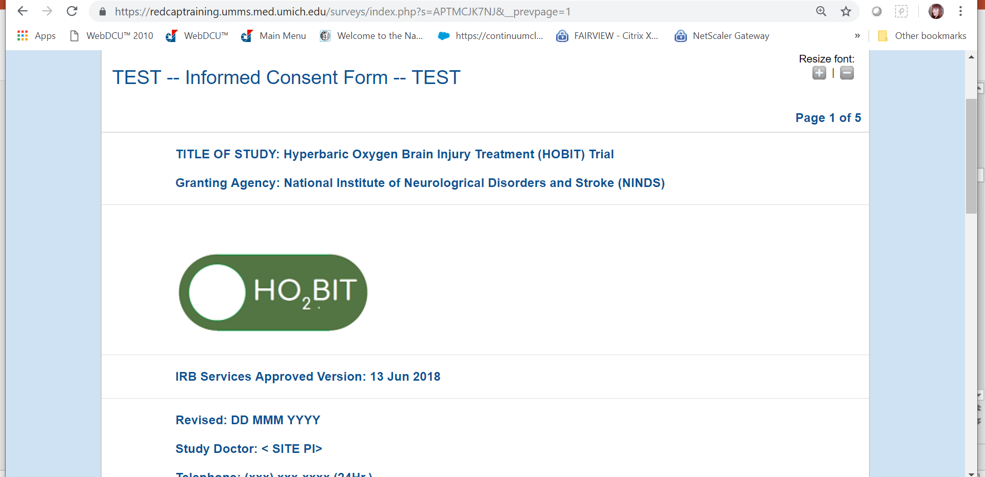
eICF: HOBIT
Notes:
I’ve listed those very specific things because we have worked with an eICF that has those features for the HOBIT trial. Hyperbaric Oxygen Brain Injury Treatment trial is a Multi-center NIH Funded prospective RCC study for severe TBI (GCS 3-8). The study is part of the SIREN network. Econsent will be used in all network studies.
This eICF has cIRB approval, required use by ALL participating sites (in person or remote)
This is an example of a way to facilitate remote consent and enrollment by streamlining “traditional” consent model ie. only in person, with paper documents.
This eICF has intrinsic version control and Can be sent to LAR who is not physically present via a simple web page link.
One link (or a bookmark on an iPad or phone) opens the this web page. The link can be sent via text or email and viewed on an device with a screen and connection to the internet (cellular or wi-fi)

Slide 22
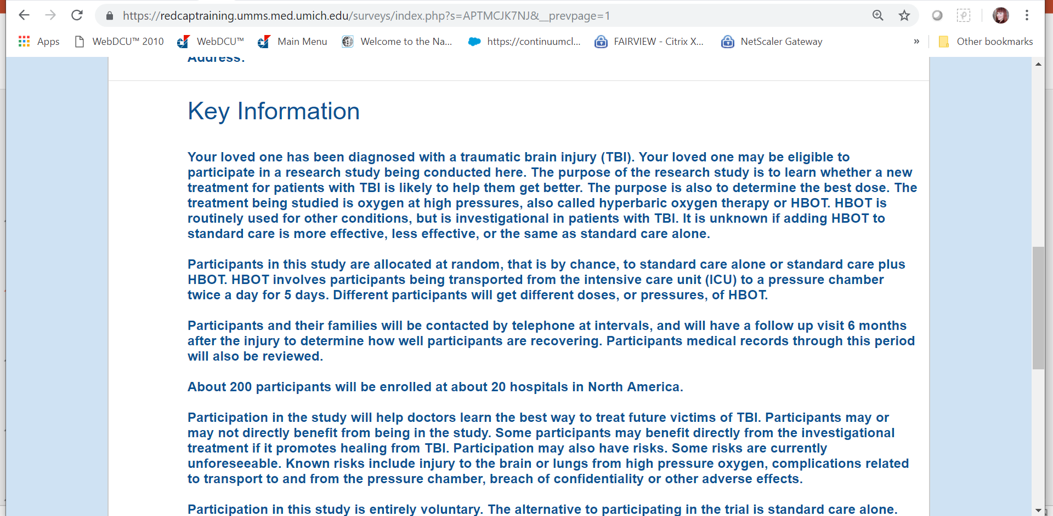
eICF: Key Information Highlighted
Notes:
Key information, including required elements of informed consent resides on initial page
This will become a standard for NIH funded studies and mirrors the actual consent discussion (where the required elements of informed consent are distilled into key discussion points). The end user (in this study it’s always the LAR) can scroll through the entire consent document, if they choose to, but they can also advance through the eICF without HAVING to scroll through 16 pages of text.

Slide 23
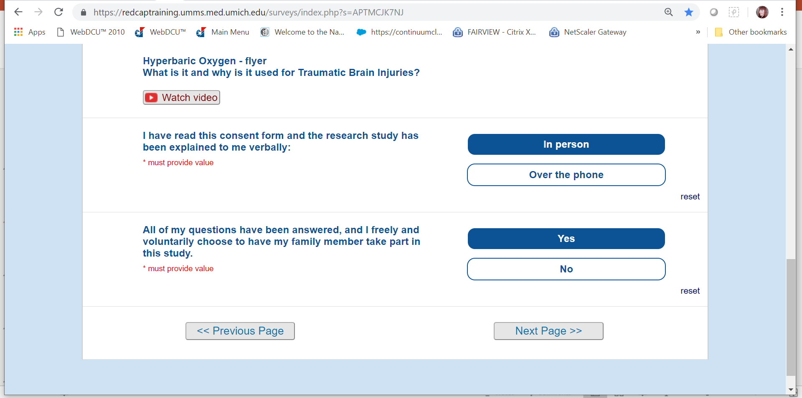
eICF: Embedded Documentation of Informed Consent
Notes:
I’d like to point out 2 things here and talk about (additional) possibilities. First, this is the example of the embedded consent discussion documentation elements that I spoke of in a previous slide. This feature could also be used to embed capacity assessment questions OR (simple) questions to assess understanding.
The second thing I’d like to note on this slide is the “watch video” button. I’ll discuss this on the next slide, but this demonstrates the ability to add additional elements (graphs, images, additional information) that can help add visuals to the consent discussion when appropriate.

Slide 24
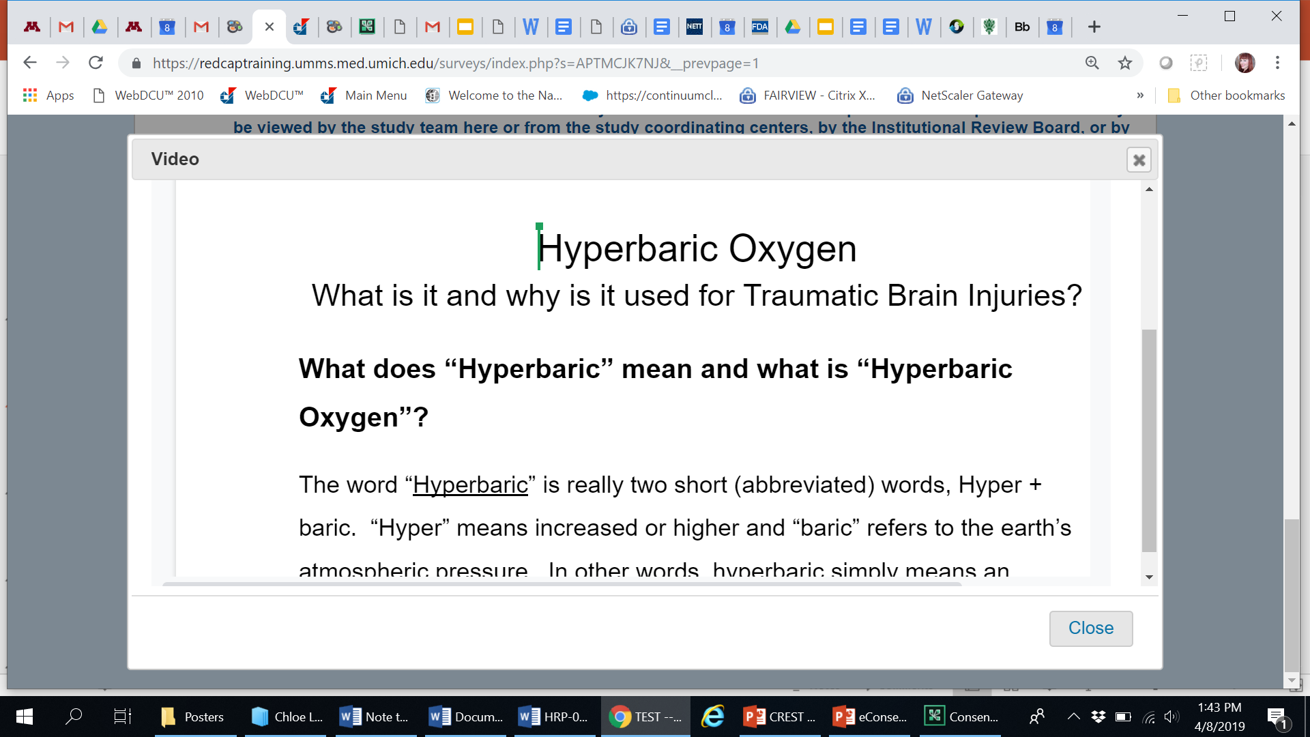
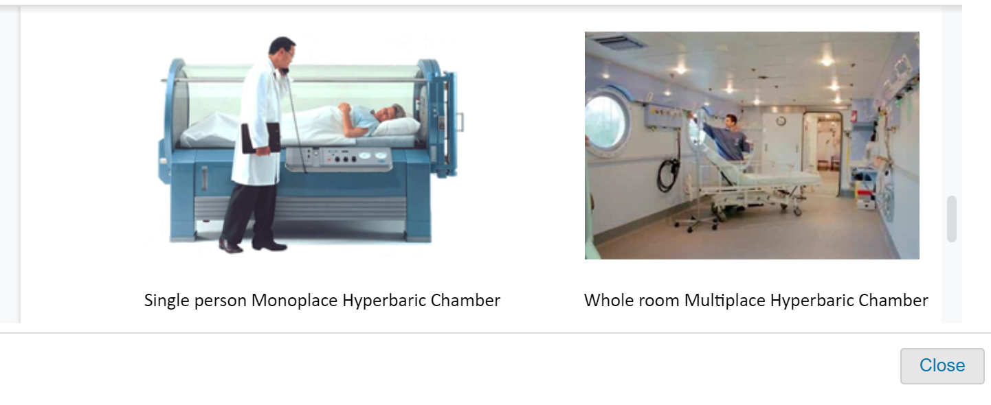
eConsent: eICF can Incorporate Media

Slide 25
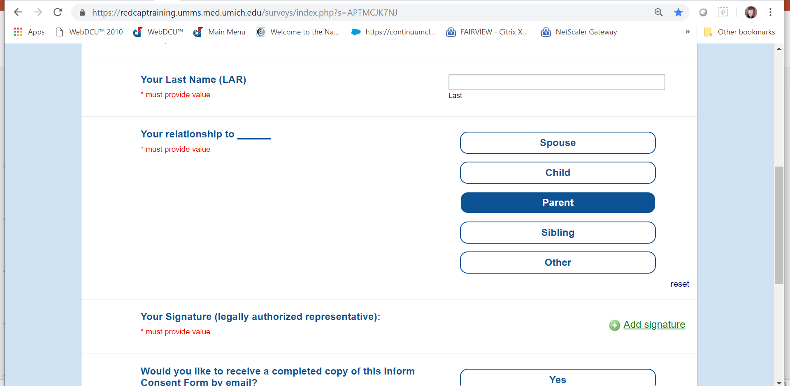
eConsent: Enhanced Signature Page

Slide 26
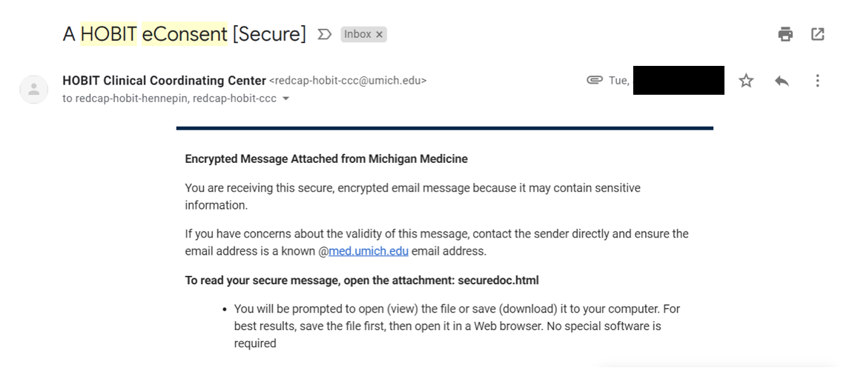
eConsent: Real-time Return of Signed eICF

Slide 27
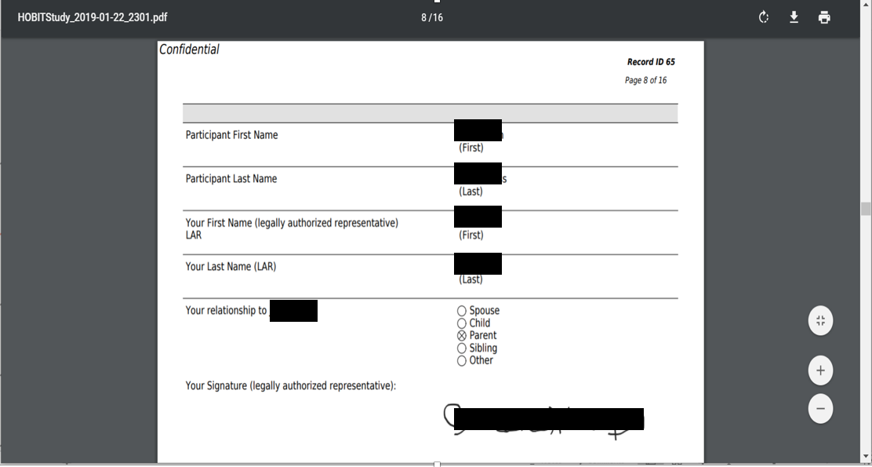
eConsent: Real-time Return of Signed eICF

Slide 28
Lessons from HOBIT eConsent: In Person
Test device Wi-Fi connectivity extensively (EDs/MRI/CT)
Larger screen preferred
Entire clinical team able to navigate eConsent application smoothly: device location, passwords, bookmarks, links
Hard copies of forms may still be necessary
Notes:
Before you start: 1. have a basic communication plan (clinical team should be first point of contact- introduce the research team, make sure to get multiple phone numbers/names, if possible, to re-contact if you are disconnected). We have had at least 2 calls or in-person attempts before we can complete a consent conversation. If you it is a remote conversation: Have the consent conversation BEFORE you send the link. Think about what an email that contains the link should say (before it’s 02am). Plan a follow-up call (if remote)
2. Test the tech. Check the wi-fi in multiple locations. Practice sending the eConsent link from a variety of devices and to a variety of devices. Double check for a complete link.
3. A supplemental hand-out for the LAR may be helpful. Up-to-date back-up paper copies should be kept available in the event of a poor connection, a dead battery or just as something to give the family for additional information to have in hand.

Slide 29
Lessons from HOBIT eConsent: LAR off-site
Clinical team should introduce study
Obtain call-back number where LAR can be reliably reached, even while traveling
May need multiple phone numbers or email addresses
Explain eConsent process prior to sending link to eICF
Anticipate follow-up calls
Notes:
Before you start: 1. have a basic communication plan (clinical team should be first point of contact- introduce the research team, make sure to get multiple phone numbers/names, if possible, to re-contact if you are disconnected). We have had at least 2 calls or in-person attempts before we can complete a consent conversation. If you it is a remote conversation: Have the consent conversation BEFORE you send the link. Think about what an email that contains the link should say (before it’s 02am). Plan a follow-up call (if remote)
2. Test the tech. Check the wi-fi in multiple locations. Practice sending the eConsent link from a variety of devices and to a variety of devices. Double check for a complete link.
3. A supplemental hand-out for the LAR may be helpful. Up-to-date back-up paper copies should be kept available in the event of a poor connection, a dead battery or just as something to give the family for additional information to have in hand.
answer additional questions
give LAR/families time to consider
update on clinical scenario/randomization

Slide 30
Lessons from HOBIT eConsent: Telestroke with LAR at Spoke
Ensure device connectivity and consistent device storage location
  Staff and telestroke team all know location of eConsent device
Investigator team must be able to walk LAR through eConsent process via Telestroke
Current version ICF hard copies available as a back-up
Notes:
We store our back-up ICFs and clinical trial information in the telestroke cart.

Slide 31
Conclusions
Remote/Telestroke research consent is important to optimize stroke trial enrollment
Limitations of the current Telestroke consent process can be improved via eConsent
Streamlining informed consent decreases research burden on patient/LAR, research team, and clinicians
eConsent may enhance traditional informed consent
A standardized eConsent platform for StrokeNet trials should be considered

Slide 32
Thank you
Chris Streib: streib@umn.edu
Abbey Staugaitis: staug002@umn.edu

Slide 33
Additional Slides

Slide 34
eConsent Streamlines On & Off-site Consent
Delivery of current version of eICF directly to patient/LAR
eICF can be sent to LAR who is not physically present
Real time return of signed eICF to entire research team/LAR with date and timestamp
Notes:
So, w

Slide 35
eConsent Enhances Informed Consent
More time for informed consent discussion in acute stroke trials
Embedded questions in eConsent document LAR relationship to patient and consent
Can embed educational materials (i.e. videos)
Real-time access to eICFs for study monitors and leadership team
Benefits of eConsent are also applicable when obtaining consent in person
Notes:
A problem with the eICF can be identified and fixed, possibly before randomization.

Slide 36
eConsent Platform Flaws to Avoid
Complex end user requirements
  Requires subject/LAR to establish an account
  Requires the subject or LAR to create a password
  Extensive navigation to access consent document
Complex research team requirements
  Research team creates individual LAR accounts
  Complex log-in to access the eConsent link
Data Storage not Part 11 compliant
Notes:
Why we have declined various eConsent platforms because of complicated end user issues: Requiring a subject or LAR to establish an account

Slide 37
Exception from Informed Consent (EFIC)
FASTEST Trial
General concept
Will require an entire steering committee future session (s).

Slide 38
NIH StrokeNet
Recovery & Rehabilitation Group
Steven C. Cramer, MD
Steven L. Wolf, PT, PhD

Slide 39
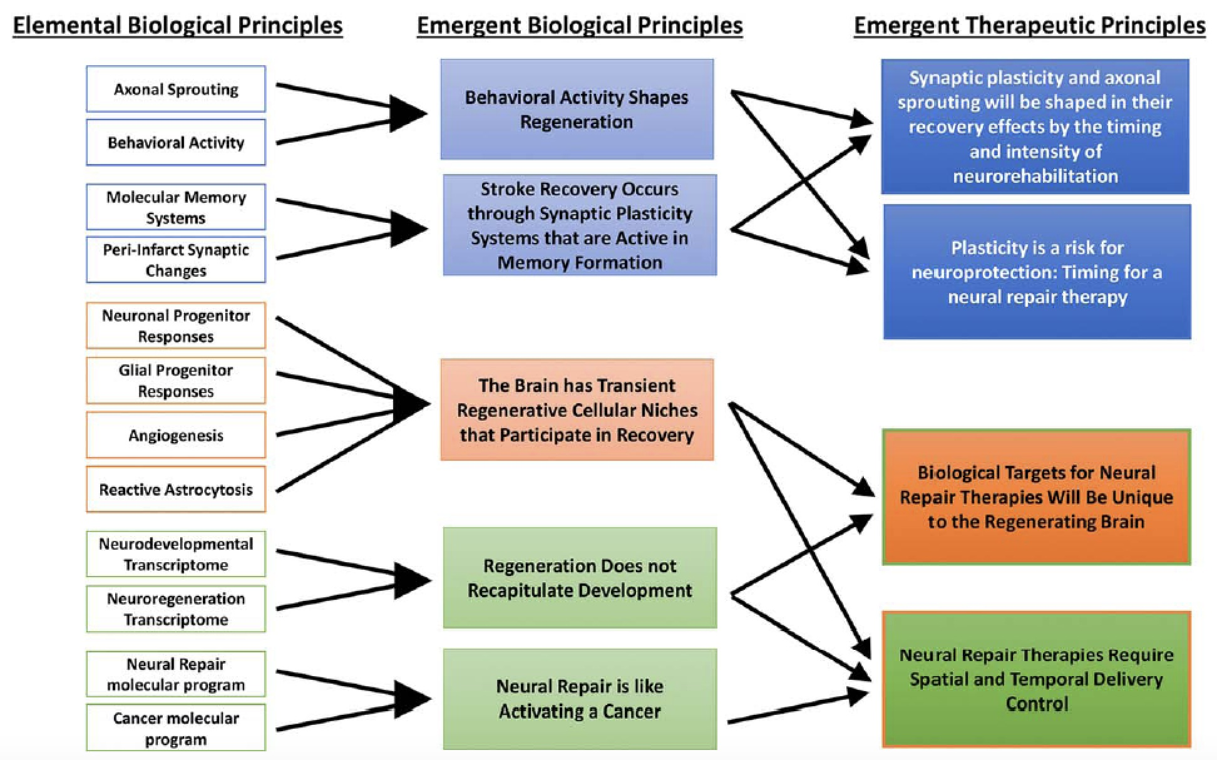
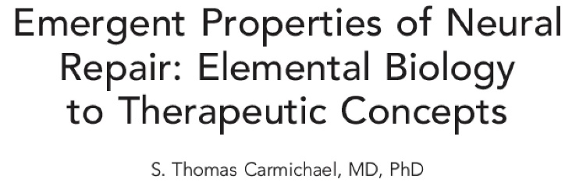


Slide 40
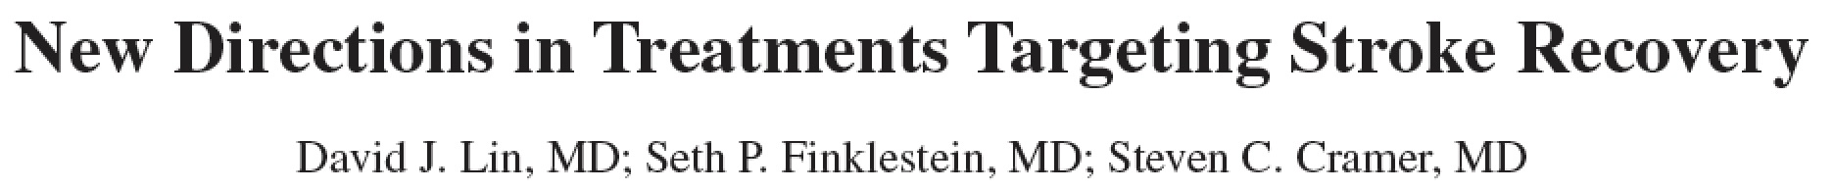
Stroke. 2018;49:3107-3114

Slide 41
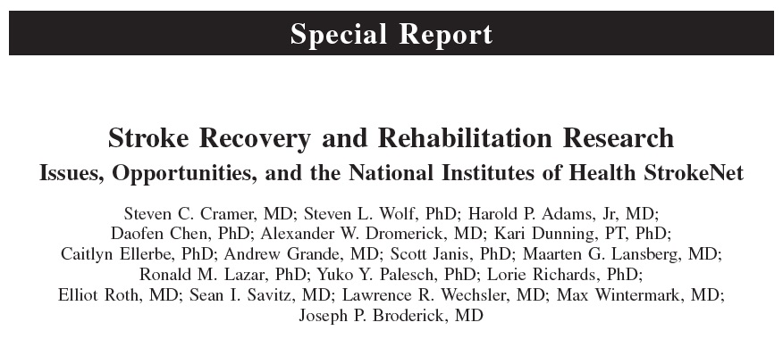
Stroke. 2017;48:813-819.

Slide 42
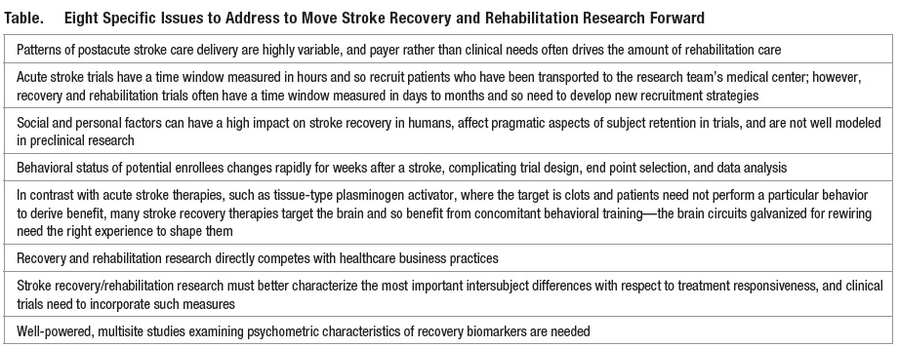
Stroke. 2017;48:813-819.

Slide 43
Stroke. 2017;48:813-819.

Slide 44
Stroke. 2017;48:813-819.

Slide 45
StrokeNet Recovery & Rehabilitation Group trials
As of 4/1/2019
1 completed
Telerehabilitation
2 active
I-ACQUIRE (Intensive Infant Rehabilitation)
TRANSPORT 2 (Transcranial Direct Current Stimulation)
2 under advanced consideration
Brain stimulation for aphasia (June 2019 submission)
Biomarkers of motor recovery (with the ESC)
5+ in development
Genetics of recovery
Stem cell therapy
Intense language therapy
Apnea treatment (spinoff)
Telerehabilitation in low resource setting
and numerous other Synopses at various stages of pre-development

Slide 46
Telerehabilitation In The Home Versus Therapy In-Clinic For Patients With Stroke
Steven C. Cramer*, Lucy Dodakian, Vu Le, Jill See, Renee Augsburger, Alison McKenzie, Robert Zhou, Nina Chiu, Jutta Heckhausen, Jessica M. Cassidy, Walt Scacchi, Megan Therese Smith, A. M. Barrett, Jayme Knutson, Dylan Edwards, David Putrino, Kunal Agrawal, Kenneth Ngo, Elliot J. Roth, David Tirschwell, Michelle L. Woodbury, Ross Zafonte, Wenle Zhao, Judith Spilker, Steven L. Wolf, Joseph P. Broderick, and Scott Janis, for the NIH StrokeNet Telerehab Investigators
*Professor, Depts. Neurology, Anatomy & Neurobiology, and PM&R
University of California, Irvine; USA

Slide 47
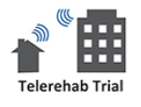
Telerehabilitation in the Home Versus
Therapy In-Clinic for Patients With Stroke
124 subjects with stroke 4-36 weeks prior and arm motor deficits
Randomized at 11 US sites to intensive arm motor therapy
(a) traditional In-Clinic, versus
(b) in-home Telerehabilitation
Treatment
36 sessions (18 superv’d, 18 unsuperv’d), 70 min, over 6-8 wk
Intensity, duration, and frequency of therapy matched
Assessor-blind, randomized, non-inferiority design
clinicaltrials.gov NCT02360488

Slide 48
Results
 | In-Clinic | Telerehab
Baseline Fugl-Meyer | 42.7 ± 8.7 | 42.8 ± 7.8
Fugl-Meyer change to d30 | 8.36 ± 7.0 | 7.86 ± 6.7

Slide 49
Results
 | In-Clinic | Telerehab
Baseline Fugl-Meyer | 42.7 ± 8.7 | 42.8 ± 7.8
Fugl-Meyer change to d30 | 8.36 ± 7.0 | 7.86 ± 6.7
The adjusted difference* between groups in ΔFM is 0.06 points.
The non-inferiority margin (2.47 points) fell outside the 95% CI
2.47
*Adjusted for age, baseline FM, time post-stroke, enrollment site, and stroke subtype

Slide 50
Perinatal Arterial Stroke:
A RCT of Intensive Infant Rehabilitation (I-ACQUIRE)
240 infants with hemiparetic stroke randomized to 1 of 3 therapies
Primary Aim: Determine efficacy of I-ACQUIRE at 2 dosage levels compared to usual and customary treatment to increase upper extremity skills on the hemiparetic side.
Secondary Aim: Determine the efficacy…to improve use of the hemiparetic upper extremity in bimanual activities.
Sharon Landesman Ramey, Ph.D. (Lead PI)
Virginia Tech Carilion Research Institute, Virginia Tech (Roanoke)
Warren Lo, M.D. (Co-PI)
Nationwide Children’s Hospital & The Ohio State University (OSU)

Slide 51

Transcranial Direct Current Stimulation for
Post-stroke Motor Recovery – a Phase2 Study (TRANSPORT2)
Wayne Feng MD/MS and Gottfried Schlaug MD/PhD
Examine the effects of bihemispheric tDCS (sham vs 2mA vs 4mA) combined with intense arm motor therapy on arm motor FM score in 129 patients with stroke 1-6 months prior
Serially assess behavior plus several key biomarkers, including neurophysiology, connectivity, and white matter integrity
Clinicaltrials.gov NCT03826030

Slide 52
NIH StrokeNet
Recovery & Rehabilitation Group
We welcome discussions at all stages of Synopsis development
We are available to join your RCC meetings, explain, answer Qs
Steven C. Cramer, MD
Steven L. Wolf, PT, PhD
Or just email me
scramer@uci.edu

Slide 53
The NIH StrokeNet Central IRB
Michael Linke, PhD, CIP Chair, CIRB
David Ficker, MD, Vice Chair CIRB
Susan K. Roll, RN, BSN, CIRB Liaison
Jo Ann Behrle, CIRB Coordinator
Keeley Hendrix, CIRB Coordinator

Slide 54

Reliance Agreement
  Responsibilities of the CIRB
  Duties, Rights, and Responsibilities of the Relying Institution (RI)

Slide 55
Reliance Agreement - Basic Responsibilities
  CIRB
    is the single IRB of record.
    regulatory responsibility for assuring the protection of the rights and welfare of research participants.
  Relying Institution (RI)
    sets standards to determine whether a research investigator can conduct research under its auspices.
    agrees to cede IRB review of the NIH StrokeNet research to the CIRB.
    agrees to accept the decisions of the CIRB regarding review, approval and oversight of research covered by this Agreement.

Slide 56
CIRB and MOST/SLEEP SMART Trials
Factors slowing down trial start-up
  Lack of knowledge about the NIH StrokeNet processes at new trial sites
  Many sites will not sign CTAs until their site has local and/or CIRB approval
  Strategies to facilitate the execution of CTAs
    Send a cover letter explaining the process to help expedite the approvals
    Also send the approved consent template as a resource

Slide 57
Competing trials/overlap and enrollment strategies
Every StrokeNet site has to have a locally defined process for competing trials and communicate the plan with the National Coordinating Center. We don’t legislate the approach.
  Rolling prioritization enrollment grid
  Equal opportunity enrollment grid
  Prioritize lagging trials
  Maximize patient autonomy
  Minimize Trial Participation

Slide 58
Ongoing Trial Updates
ARCADIA – 186/1100 randomized Dr. Elkind/ Dr. Kamel
788/4400 consented
CREST-2 –1356/2480 Dr. Meschia
CREST-H –54/500 Dr. Marshall
MOST – startup update Dr. Adeoye
Sleep SMART – startup update Dr. Brown/Dr. Chervin

Slide 59
Ongoing Trial Updates
TRANSPORT2 – startup update Dr. Schlaug/Dr. Feng
I-ACQUIRE – startup update Dr. Ramey/Dr. Lo
ASPIRE – pre-award update Dr. Sheth
SATURN – pre-award update Dr. Selim
FASTEST – pre-award update Dr. Broderick
ARCADIA-CSI – pre-award update Dr. Lansberg

