Slide 1
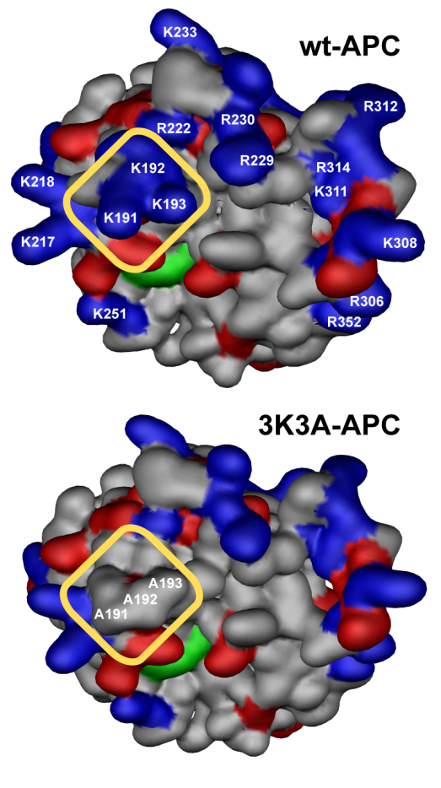
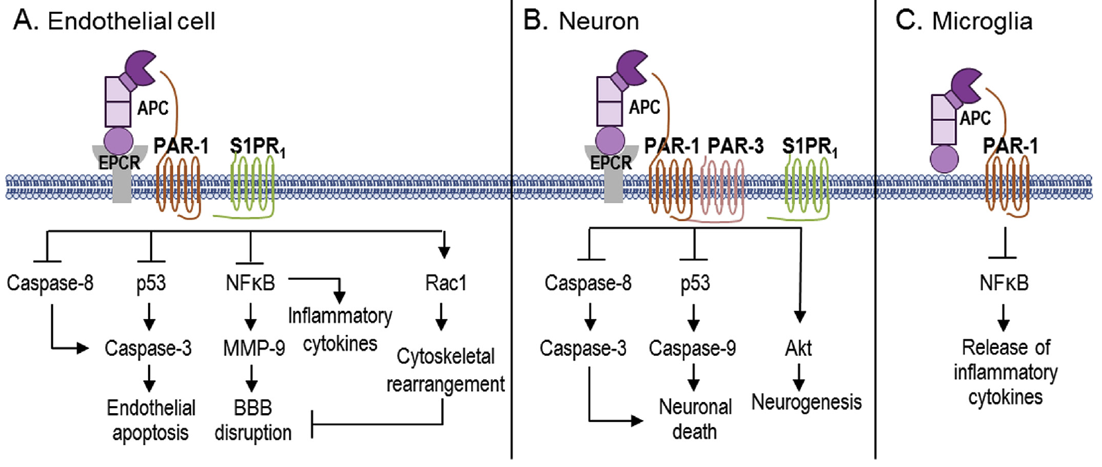

3K3A-APC: Multiple-action multiple-target approach
Endothelium: Vasculoprotective, Stabilizes BBB integrity
Neurons: Direct Neuronal Protective + promotes neurogenesis
Microglia: Anti-inflammatory
Anticoagulant activity: lowered by >90%
Griffin. Zlokovic, Mosnier, Blood 2018
Amar, …Griffin, Zlokovic, Neuropharmacology, 2018

Slide 2
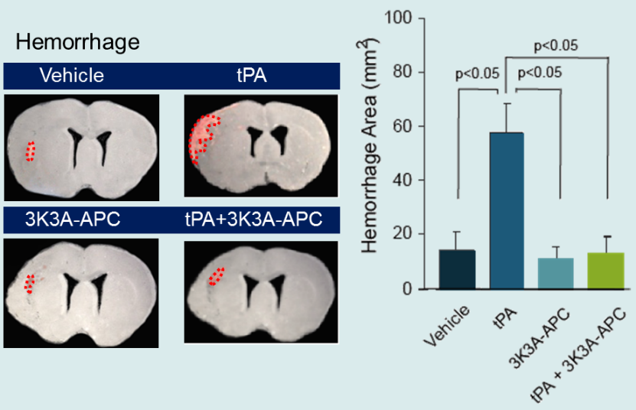
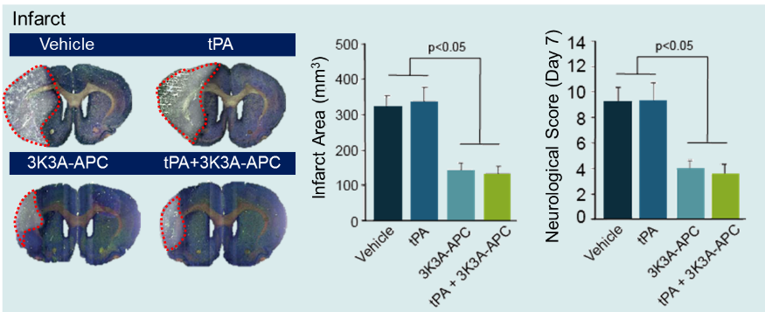
Preclinical data: 3K3A-APC Reduces tPA bleeding
THERAPEUTIC WINDOW AFTER STROKE IN RODENTS
3K3A-APC 12 h
rtPA 3-4 h
Functional Outcome after Embolic Stroke in Rats
Wang et al., Stroke 2013

Slide 3
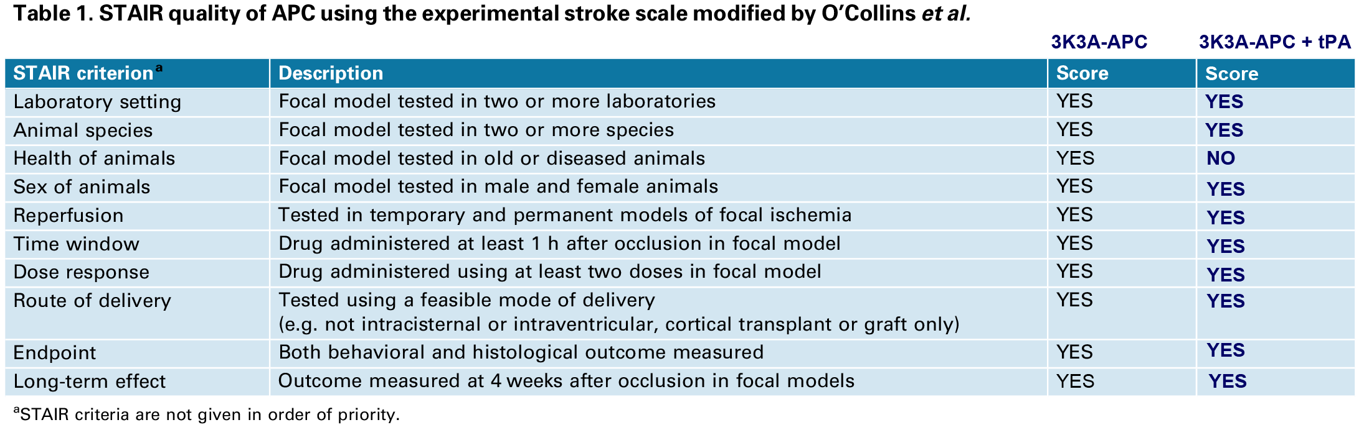
3K3A-APC is among the best-validated stroke cytoprotective agents—fully satisfying STAIR criteria for preclinical fitness
Stroke Therapy Academic Industry Roundtable (STAIR) score for preclinical fitness
Treatment | STAIR Score
3K3A-APC | 10/10
3K3A-APC + tPA | 9/10
tPA | 9/10
3K3A-APC has been extensively studied and has demonstrated statistically significant, clinically meaningful improvements in multiple validated stroke models
3

Slide 4
3K3A-APC Phase 1 Study
4

Slide 5
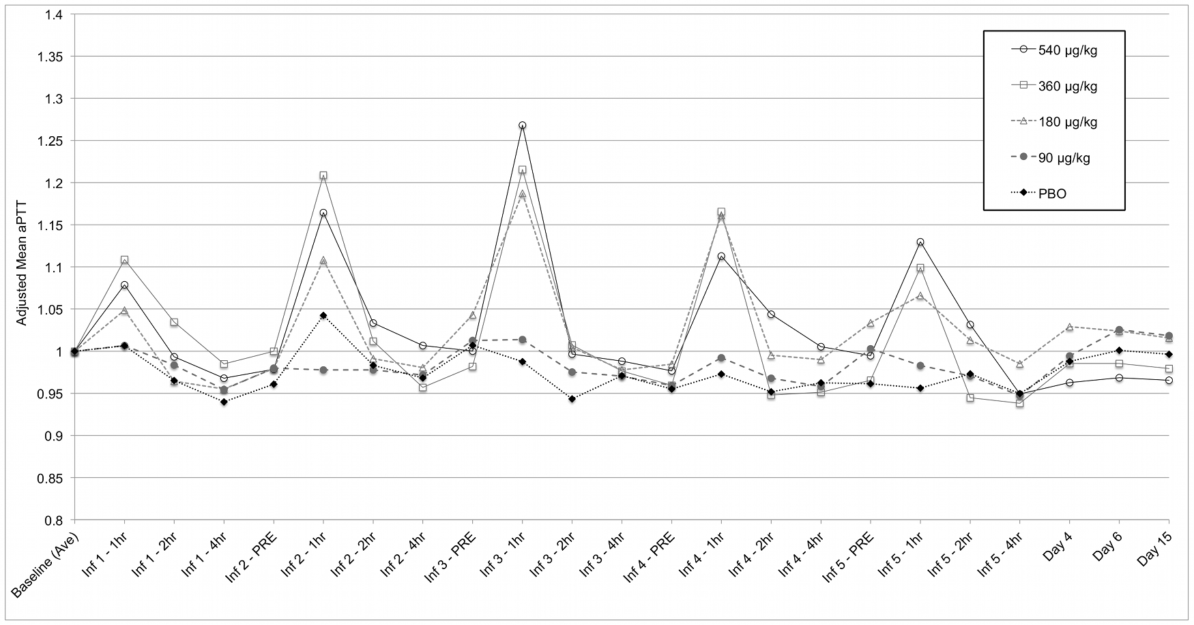
Phase 1: No individual aPTT exceed 1.51 x ULN at 1 hour following infusion (60.4 sec) aPTT
1.3
Multiple Dose: Baseline Adjusted Mean Change in aPTT
Source: Lyden et al, Zlokovic. Curr Pharm Des 2013
5

Slide 6
3K3A-APC Phase 2A Study
6

Slide 7



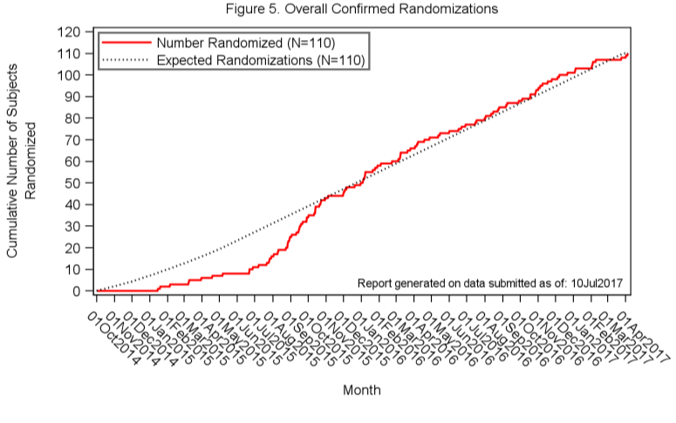
Site | Clinical Study Site PI
Cedars-Sinai | Shlee Song, MD
Columbia | Jan Claassen, MD
Harvard Partners (Mass General) | Natalia Rost, MD, MPH
Northwestern | Shyam Prabhakaran, MD, MS
Ohio State | Michel Torbey, MD, MPH
SUNY Buffalo | Robert Sawyer, MD
U of Cincinnati | Opeolu Adeoye, MD, MS
U of Kansas | Michael Rippee, MD
U of Pittsburgh | Andrew Durcruet, MD
U of Rochester | Curtis Benesch, MD
U of Texas Southwestern | Mark Johnson, MD
U of Utah | Peter Hannon, MD
U of Virginia | E. Clarke Haley, MD
Vanderbilt University | Michael Froehler, MD
Washington University | Jin-Moo Lee, MD, PhD
RHAPSODY final Investigators’ Meeting
7

Slide 8
Primary Outcome: All four doses tested were deemed to be safe and well-tolerated
Patient Group Outcomes
110 patients
3K3A-APC
Placebo
3 dose limiting toxicities (DLTs)
4 DLTs
120 μg/kg
240 μg/kg
360 μg/kg
540 μg/kg
Placebo
N=15
N=24
N=12
N=15
N=44
Phase 2A Safety Results
Overall 3K3A-APC is safe and tolerable in the acute stroke population receiving tPA, mechanical thrombectomy, or both
540 μg/kg, the highest dose studied, was the maximum tolerated dose with low final estimated DLT rate of 7%
More DLTs observed on placebo than drug
8

Slide 9
Vascular Protection: Strong trend toward less hemorrhage incidence and total hemorrhage volume in 3K3A-APC treated patients vs. placebo
Hemorrhage Type at Day 30 (Hemorrhage Incidence) | Total | Dose (µg/kg) |  |  |  |  |  | P-Value (Collapsed 3K3A-APC v Pbo)
 |  | 120 (N = 12) | 240 µg/kg (N = 16) | 360 µg/kg (N = 6) | 540 µg/kg (N = 9) | 3K3A-APC (N = 43) | Placebo (N = 37)
(> 0 mL) | 61 (76.3%) | 8 (66.7%) | 13 (81.3%) | 3 (50.0%) | 5 (55.6%) | 29 (67.4%) | 32 (86.5%) | 0.046
(> 0.06 mL) | 49 (61.3%) | 7 (58.3%) | 11 (68.8%) | 2 (33.3%) | 4 (44.4%) | 24 (55.8%) | 25 (67.6%) | 0.282
(> 0.5 mL) | 24 (30.0%) | 4 (33.3%) | 5 (31.3%) | 0 (0.0%) | 1 (11.1%) | 10 (23.3%) | 14 (37.8%) | 0.156
(> 1.8 mL) | 13 (16.3%) | 1 (8.3%) | 2 (12.5%) | 0 (0.0%) | 1 (11.1%) | 4 (9.3%) | 9 (24.3%) | 0.069
Microbleeds | 15 (18.8%) | 1 (8.3%) | 2 (12.5%) | 3 (50.0%) | 1 (11.1%) | 7 (16.3%) | 8 (21.61%) | 0.542
Total Hemorrhage Volume (mL) | N/A | N/A | N/A | N/A | N/A | 0.8 ± 2.1 | 2.1 ± 5.8 | 0.066
9

Slide 10
Fewer Asymptomatic Intracerebral Hemorrhage (ICH)
Treatment-Related AE and Hemorrhage | 120 (N=15) | 240 (N=24) | 360 (N=12) | 540 (N=15) | All 3K3A-APC (N=66) | Placebo (N=44) | P-value
Any Treatment-Related AE | 5 (33%) | 12 (50%) | 4 (33%) | 5 (33%) | 26 (39%) | 21 (48%) | 0.43
Asymptomatic ICH | 1 (7%) | 2 (8%) | 0 (0%) | 1 (7%) | 4 (6%) | 10 (23%) | 0.017
Symptomatic ICH | 0 (0%) | 3 (12%) | 0 (0%) | 1 (7%) | 4 (6%) | 1 (2%) | 0.65
Among AEs deemed related to treatment by the blinded attending physician,
asymptomatic hemorrhage was significantly reduced on drug vs. placebo
10

Slide 11
RHAPSODY-2
Primary Aim:
To evaluate the effect of 3K3A-APC on 3-month disability (utility-weighted modified Rankin score [mRS] analysis) and on bleed-free survival at Day 30.

Slide 12
RHAPSODY-2
Intervention (drug/biologic/device/behavioral):
Subjects will be randomized to 3K3A-APC (10, 15, or 30 mg) or placebo.
No later than 60 minutes following completion of tPA infusion or initiation of mechanical thrombectomy (arterial puncture), whichever is sooner, adult subjects will receive study treatment given as a 15-minute infusion.
Subjects will receive another 15-minute infusion of 3K3A-APC every 12 hours (± 1 hour) for up to 5 total doses.

Slide 13
RHAPSODY-2
Secondary Aims/Outcomes:
Day 30 bleeding (yes/no) or death.
Day 30 death (yes/no).
Day 30 mean volumes of bleeding using MRI
Proportion of subjects achieving a 7-point or better improvement (or a score of zero if baseline was < 7) in Day 7 NIHSS score
Ordinal shift analysis of Day 90 mRS score.
Adverse events (AEs)

Slide 14
Inclusion Criteria
Age 18 to 90 years
Acute ischemic stroke
Eligible to receive IV tPA per local standard of care
NIHSS score ≥ 5 at time of randomization
Signed informed consent
Agreement to use effective birth control throughout the study (i.e., Day 90):
7. Willing (subject and/or caretaker) to commit to follow-up assessments

Slide 15
Lead in Phase
10
15
30mg
Pivotal Phase
N=400
N=1000 + relevant lead in patients
Bayesian
Adaptive
Response
Bleed Free Survival
OR
Mean UW-mRS
Bleed Free Survival
AND
Not futile on UW-mRS

Slide 16
During lead-in, the sample size needs to have > 80% Bayesian power to select 1 treatment arm when it is better than control by an absolute 20% decrease in the rate of death or bleeding and no evidence of futility in the utility-weighted analysis of the 3-month mRS.
A maximum of 400 subjects will be enrolled using outcome adaptive randomization after randomizing the first 60 subjects to the control arm and 3 treatment arms (Arms A, B, and C) with equal probability.

Slide 17
No Difference in Rate of Bleeding/Death and mRS
Scenario 1a | Rate of bleeding or death |  |  |  |  | Probability of MRS by category
 |  |  |  |  |  | 0 | 1 |  |  | 2 | 3 |  |  |  | 4 | 5 |  |  | 6
Control | 0.88 |  |  |  |  | 0.1 | 0.169 |  |  | 0.191 | 0.169 |  |  |  | 0.156 | 0.062 |  |  | 0.153
Arm A | 0.88 |  |  |  |  | 0.1 | 0.169 |  |  | 0.191 | 0.169 |  |  |  | 0.156 | 0.062 |  |  | 0.153
Arm B | 0.88 |  |  |  |  | 0.1 | 0.169 |  |  | 0.191 | 0.169 |  |  |  | 0.156 | 0.062 |  |  | 0.153
Arm C | 0.88 |  |  |  |  | 0.1 | 0.169 |  |  | 0.191 | 0.169 |  |  |  | 0.156 | 0.062 |  |  | 0.153
 |  |  |  |  |  | Effect size; A = 0; B = 0; C = 0
Phase 2
Arm | P(Winner) |  | P(Early Selection) |  |  | P(Early Stop) |  |  | P(Futility) |  |  |  |  | Expected Sample Size |  |  |  | Total Time
Control | 0.054 |  | 0.024 |  |  | 0.056 |  |  | 0 |  |  |  |  | 101 (41; 201) |  |  |  | 8.8(6.0; 9.8)
A | 0.032 |  | 0.014 |  |  | 0.152 |  |  | 0 |  |  |  |  | 95 (35; 191) |  |  |  | #N/A
B | 0.044 |  | 0.03 |  |  | 0.143 |  |  | 0 |  |  |  |  | 97 (36; 195) |  |  |  | #N/A
C | 0.03 |  | 0.012 |  |  | 0.152 |  |  | 0 |  |  |  |  | 97 (35; 197) |  |  |  | #N/A
Phase 2 to Phase 3
Arm |  |  |  |  | P(futility) |  |  |  |  |  |  |  | Time
Control |  |  |  |  | 0.028302 |  |  |  |  |  |  |  | 9.79 (7.14; 11.39)
Arm A |  |  |  |  | 0 |  |  |  |  |  |  |  | #N/A
Arm B |  |  |  |  | 0.0454545 |  |  |  |  |  |  |  | #N/A
Arm C |  |  |  |  | 0 |  |  |  |  |  |  |  | #N/A
Phase 3
Arm |  | P(Winner) |  | P(Early Selection) |  |  |  | P(Futility) |  |  |  | Expected Sample Size |  |  |  |  | Time
Control |  | 0.076923 |  | 0 |  |  |  | 0 |  |  |  | 479.5288 |  |  |  |  | 21.8 (18.6; 28.2)
A |  | 0.34375 |  | 0.0625 |  |  |  | 0 |  |  |  | 481.8125 |  |  |  |  | #N/A
B |  | 0.285714 |  | 0.02381 |  |  |  | 0 |  |  |  | 498.2143 |  |  |  |  | #N/A
C |  | 0.333333 |  | 0.133333 |  |  |  | 0 |  |  |  | 451.2667 |  |  |  |  | #N/A
P(Type I error₁) = 0.025

Slide 18
Difference in Rate of Bleeding/Death but Not mRS
Scenario 2a | Rate of bleeding or death |  |  |  |  | Probability of MRS by category
 |  |  |  |  |  | 0 | 1 |  |  | 2 | 3 |  |  |  | 4 | 5 |  |  | 6
Control | 0.88 |  |  |  |  | 0.1 | 0.169 |  |  | 0.191 | 0.169 |  |  |  | 0.156 | 0.062 |  |  | 0.153
Arm A | 0.68 |  |  |  |  | 0.1 | 0.169 |  |  | 0.191 | 0.169 |  |  |  | 0.156 | 0.062 |  |  | 0.153
Arm B | 0.68 |  |  |  |  | 0.1 | 0.169 |  |  | 0.191 | 0.169 |  |  |  | 0.156 | 0.062 |  |  | 0.153
Arm C | 0.68 |  |  |  |  | 0.1 | 0.169 |  |  | 0.191 | 0.169 |  |  |  | 0.156 | 0.062 |  |  | 0.153
 |  |  |  |  |  | Effect size: A = 0; B = 0; C = 0
Phase 2
Arm | P(Winner) |  | P(Early Selection) |  |  | P(Early Stop) |  |  | P(Futility) |  |  |  |  | Expected Sample Size |  |  |  | Total Time
Control | 0 |  | 0 |  |  | 0.532 |  |  | 0 |  |  |  |  | 41.6 (23; 64) |  |  |  | 7.5 (4.37; 9.62)
A | 0.196 |  | 0.171 |  |  | 0.418 |  |  | 0 |  |  |  |  | 97.6 (26; 199) |  |  |  | #N/A
B | 0.231 |  | 0.186 |  |  | 0.417 |  |  | 0 |  |  |  |  | 92.9 (25; 201) |  |  |  | #N/A
C | 0.224 |  | 0.175 |  |  | 0.434 |  |  | 0 |  |  |  |  | 93 (26; 219) |  |  |  | #N/A
Phase 2 to Phase 3
Arm |  |  |  |  | P(futility) |  |  |  |  |  |  |  | Time
Control |  |  |  |  | 0.053763 |  |  |  |  |  |  |  | 8.7 (6.35; 11.43)
A |  |  |  |  | 0.020408 |  |  |  |  |  |  |  | #N/A
B |  |  |  |  | 0 |  |  |  |  |  |  |  | #N/A
C |  |  |  |  | 0.03125 |  |  |  |  |  |  |  | #N/A
Phase 3
Arm |  | P(Winner) |  | P(Early Selection) |  |  |  | P(Futility) |  |  |  | Expected Sample Size |  |  |  |  | Time
Control |  | 0.059375 |  | 0 |  |  |  | 0 |  |  |  | 472.8313 |  |  |  |  | 21.8 (18.4; 28.2)
A |  | 0.276042 |  | 0.088542 |  |  |  | 0 |  |  |  | 470.724 |  |  |  |  | #N/A
B |  | 0.298701 |  | 0.090909 |  |  |  | 0 |  |  |  | 474.8312 |  |  |  |  | #N/A
C |  | 0.428571 |  | 0.078341 |  |  |  | 0 |  |  |  | 472.9078 |  |  |  |  | #N/A
P(Type I error_{2a}) = 0.21

Slide 19
Differences in Rate of Bleeding/Death in 1 Arm Only and a Difference in mRS for That Arm
Scenario 3c | Rate of bleeding or death |  |  |  |  | Probability of MRS by category
 |  |  |  |  |  | 0 | 1 |  |  | 2 | 3 |  |  |  | 4 | 5 |  |  | 6
Control | 0.88 |  |  |  |  | 0.1 | 0.169 |  |  | 0.191 | 0.169 |  |  |  | 0.156 | 0.062 |  |  | 0.153
Arm A | 0.88 |  |  |  |  | 0.1 | 0.169 |  |  | 0.191 | 0.169 |  |  |  | 0.156 | 0.062 |  |  | 0.153
Arm B | 0.88 |  |  |  |  | 0.1 | 0.169 |  |  | 0.191 | 0.169 |  |  |  | 0.156 | 0.062 |  |  | 0.153
Arm C | 0.68 |  |  |  |  | 0.12 | 0.200 |  |  | 0.333 | 0.069 |  |  |  | 0.125 | 0.033 |  |  | 0.120
 |  |  |  |  |  | Effect size: A = 0; B = 0 ; C = 0.809
Phase 2
Arm | P(Winner) |  | P(Early Selection) |  |  | P(Early Stop) |  |  | P(Futility) |  |  |  |  | Expected Sample Size |  |  |  | Total Time
Control | 0 |  | 0 |  |  | 0.994 |  |  | 0 |  |  |  |  | 32 (21.975; 73.025) |  |  |  | 4.79 (4.22; 7.07)
A | 0 |  | 0 |  |  | 0.996 |  |  | 0 |  |  |  |  | 32 (22; 69) |  |  |  | #N/A
B | 0 |  | 0 |  |  | 0.996 |  |  | 0 |  |  |  |  | 34 (23; 69.025) |  |  |  | #N/A
C | 1 |  | 0.994 |  |  | 0 |  |  | 0 |  |  |  |  | 90 (79; 130.025) |  |  |  | #N/A
Phase 2 to Phase 3
Arm |  |  |  |  | P(futility) |  |  |  |  |  |  |  | Time
Control |  |  |  |  | 0.046 |  |  |  |  |  |  |  | 6.79 (6.22; 9.07)
A |  |  |  |  | #N/A |  |  |  |  |  |  |  | #N/A
B |  |  |  |  | #N/A |  |  |  |  |  |  |  | #N/A
C |  |  |  |  | 0 |  |  |  |  |  |  |  | #N/A
Phase 3
Arm |  | P(Winner) |  | P(Early Selection) |  |  |  | P(Futility) |  |  |  | Expected Sample Size |  |  |  |  | Time
Control |  | 0.029 |  | 0 |  |  |  | 0 |  |  |  | 375 (124; 502) |  |  |  |  | 30.55 (22.29; 32.49)
A |  | #N/A |  | #N/A |  |  |  | #N/A |  |  |  | NA (NA; NA) |  |  |  |  | #N/A
B |  | #N/A |  | #N/A |  |  |  | #N/A |  |  |  | NA (NA; NA) |  |  |  |  | #N/A
C |  | 0.881 |  | 0.823 |  |  |  | 0 |  |  |  | 375 (126; 502) |  |  |  |  | #N/A
Power = 0.88

Slide 20
Clinical Advisory Board
Jeff Saver
Enrique Leira
Cheryl Bushnell
Johanna Fifi
First teleconference 12/18/19

Slide 21
Back Up Slides

Slide 22
3K3A-APC: Multiple-action multiple-target approach
Endothelium: Vasculoprotective, Stabilizes BBB integrity
Neurons: Direct Neuronal Protective + promotes neurogenesis
Microglia: Anti-inflammatory
Anticoagulant activity: lowered by >90%
Griffin. Zlokovic, Mosnier, Blood 2018
Amar, …Griffin, Zlokovic, Neuropharmacology, 2018

Slide 23


3K3A-APC is an engineered protein (3-amino acid mutation of wt-APC) that solves key issues limiting the therapeutic application of wild-type APC
3K3A-APC
Wild-type APC
Replaced 3 lysine residues with alanine
189-DSKKKLA-195
189-DSAAALA-195
wt-APC previously marketed as Xigris by Eli Lilly for sepsis
Removed from the market in 2011, in large part due to concerns over bleeding risk
2-3 fold increased risk of serious bleeding during infusion, including intracranial hemorrhage vs. placebo
Potential to significantly exacerbate bleeding risks already present with tPA
3K3A-APC is a 405-residue protein produced via recombinant technology in CHO cells
Reverses bleeding risk of wt-APC
Designed to reduce anti-coagulant activity of wt-APC by >90%, altering factor Va binding exosites in APC
Maintains cytoprotective activity of APC
Mutation does not impact action on PAR-1 and EPCR
~3X more anti-apoptotic potency than wt-APC in vitro
Improvement in neurological function relative to comparable doses of wt-APC
Demonstrates reduction of tPA-induced bleeding
3K3A-APC maintains cytoprotective effects of wt-APC while eliminating its bleeding risk, making it an optimal drug for stroke patients receiving tPA or thrombectomy

Slide 24
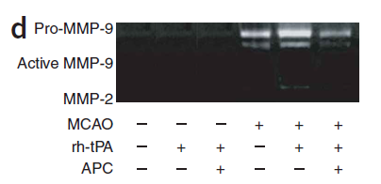
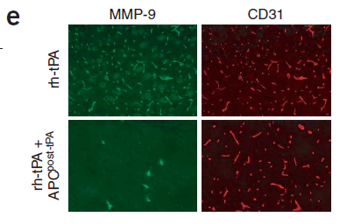
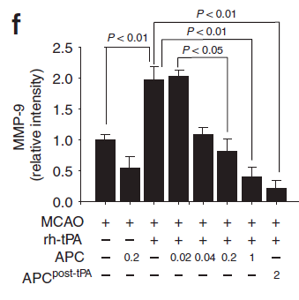
APC interferes with the tPA-MMP-9 pathway, which mediates BBB breakdown in mice subjected to focal transient ischemia
MMP-9 gelatin zymography in ischemic brain in the presence/absence of rh-tPA and APC (0.2 mg/kg)
Immunostaining for MMP-9 and brain vascular CD31 after MCAO and rh-tPA or rh-Tpa and 3 hour after TPA
APC substantially reduced the levels of pro-MMP-9 and activated MMP-9 in mice treated with rh-tPA and ischemia
MMP-9 colocalized with ischemic brain endothelium acutely after stroke
Dose-dependent reduction in MMP-9 immunostaining in ischemic brain microvessels in mice treated with rh-tPA and APC
Mice subjected to MCAO and rh-tPA therapy exhibited a significant (p<0.001) increase in MMP—9 microvascular staining vs. control mice subjected to ischemia and control
Dose-dependent effect of APC on MMP-9 vascular staining
Notes:
-

Slide 25
3K3A-APC is predicted to reduce bleeding during tPA-therapy for stroke based on mechanistic rationale and signaling actions
1
APC-induced signaling activates endothelial Rac-1, thereby stabilizing endothelial cell (EC) barriers to reduce vascular leakage
2
APC-induced signaling reduces matrix metalloproteinase (MMP) 9 levels, thereby blunting MMP9-induced breakdown of the blood-brain-barrier and bleeding
3
APC-induced signaling provides anti-apoptotic effects for ischemic brain microvascular endothelial cells by reducing p53 and favorably decreasing the ratio of pro-aptotic Bax to anti-apoptotic Bcl-2, thereby reducing bleeding linked to breakdown o the microvasculature
Source: Stroke 41.3 (2010): e123-e128.

Slide 26
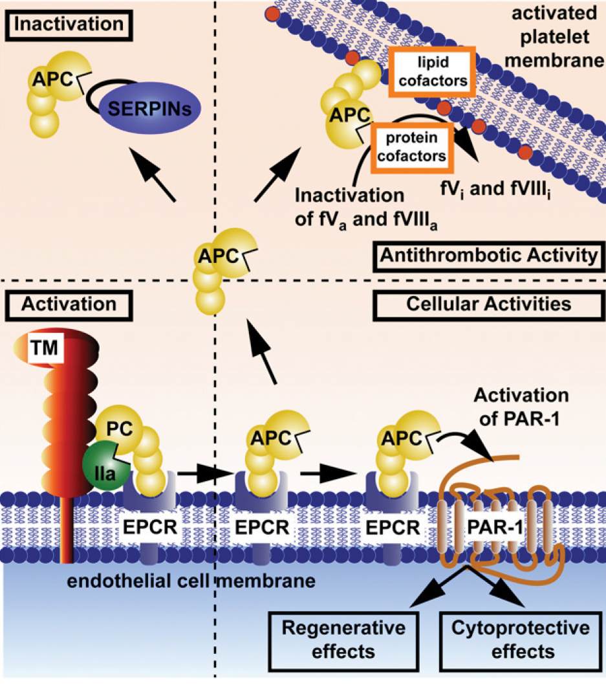
Protein C activation and expression of APC’s multiple activities
Neuroprotective Effects
APC is activated by thrombin, then goes on to exert antithrombotic activity and
several beneficial effects through cell-signaling pathways
Source: Griffin, Zlokovic, Mosnier, Blood, 2015
26

Slide 27
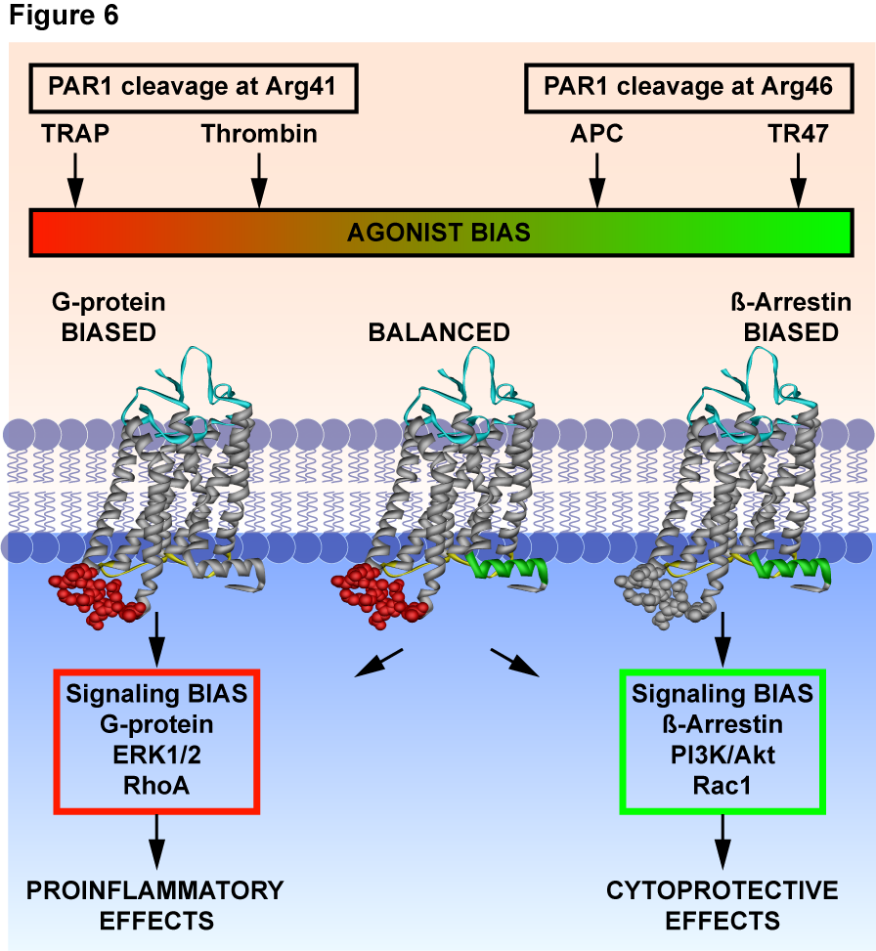
3K3A-APC signaling will activate Rac-1 in brain endothelium and reduce the risk of bleeding due to enhanced endothelial barrier stability
APC promotes biased signaling via PAR1 resulting in endothelial barrier stabilization
Activation of PAR1 by APC results in activation of Ras-related C3 botulinum toxin substrate 1 (Rac1) and endothelial barrier protection
The mechanistic basis for APC-induced biased PAR1 signaling was clarified by Mosnier ('12) who showed that APC cleaves PAR1 at the noncanonical Arg46 site whereas thrombin cleaves PAR1 at the long-known, canonical Arg41 site (Mosnier '12)
APC's cleavage at Arg46 generates a novel N-terminus at Asn47, and a 20-mer peptide with the PAR1 sequence of residues 47-66 reduces vascular leakage in murine models (Mosnier ‘12)
Thrombin cleaves PAR1 at Arg41 (left side) to initiate G protein-dependent signaling that leads to activation of RhoA, that causes endothelial cell retraction and increases vascular leakage reflected as edema and bleeding. In contrast, APC cleaves PAR1 at Arg46 (right side) and signals via β-arrestin 2 leading to activation of Rac-1, that promotes endothelial cortical actin polymerization and endothelial barrier stability, thereby reducing vascular leakage, edema, and bleeding. (figure from Mosnier '12).
Source: Stroke 41.3 (2010): e123-e128.

Slide 28
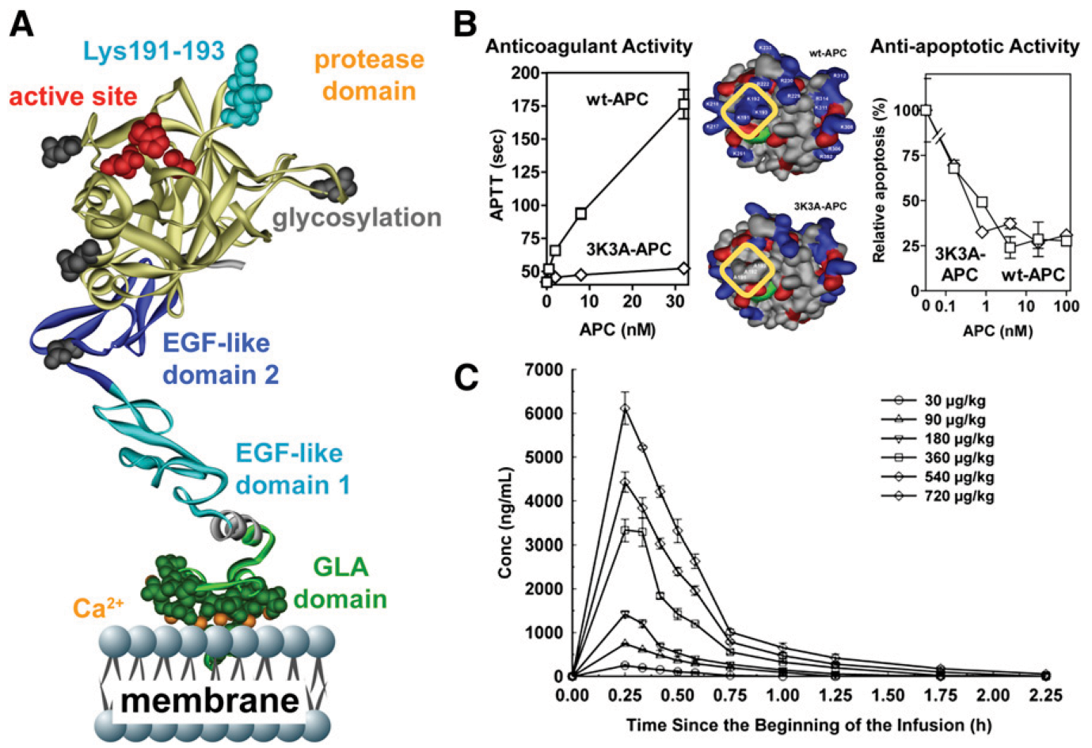
3K3A-APC has reduced anticoagulant activity with fully-retained cytoprotective activity
B
Unlike APC, modified APC (3K3A-APC) is safe in humans when given in high-dose bolus regimen
Source: Griffin, Zlokovic, Mosneir, Blood, 2015 – modified from Cheng…Zlokovic, Nature Medicine, 2006
28

Slide 29
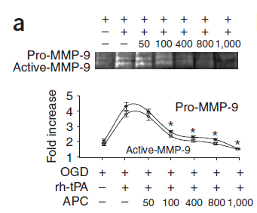
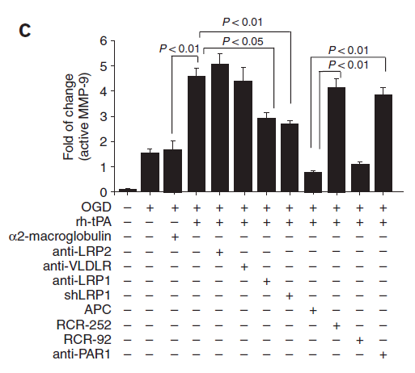
APC blocks a tPA-induced NF-kB-MMP-9 pathway
APC inhibits tPA-mediated MMP-9 upregulation in OGD-treated BEC
APC’s inhibition of MMP-9 required the protease-activated receptor 1 (PAR1) and endothelial protein C receptor (EPCR)
tPA-mediated increase in pro-MMP-9 and activated MMP-9 was dose-dependently inhibited by APC
Demonstrated by blockade of APC’s effect with a PAR1-specific blocking antibody and an APCR antibody that inhibits the APC binding site

Slide 30
APC promotes endothelial barrier stabilization, critical for stability of the blood-brain-barrier
APC rapidly increases endothelial cell cytoskeletal rearrangement in a spatially restricted manner
APC promotes cortical actin polymerization, resulting in endothelial barrier stability
APC acts directly on the endothelial cell receptors, endothelial protein C receptor (EPCR) and protease activated receptor 1 (PAR1), to initiate signaling that results in activation of the small Rho family GTPase, Rac-1, widely recognized for its key role in promoting endothelial barrier stabilization
Source: Stroke 41.3 (2010): e123-e128.

Slide 31
Efficacious in Healthy Animals
Note: Human 3K3A-APC was used in this study
Study Details
Hemorrhagic Area (Day 7)
tMCAO model with 10 young, healthy, male Wistar rats per dose group
tPA (10 mg/kg) and human 3K3A-APC (2 mg/kg) dosed 4 hours after embolic stroke
Human 3K3A-APC was additionally administered 1, 3, 5, and 7 days post-stroke
When dosed earlier, tPA shows significant benefit on its own in this model
* P<0.05 vs. saline
† P<0.05 vs. tPA
§ P<0.05 vs. 3K3A
*
†
†
Combo product has the potential to be utilized in the 0-3 and 3-4.5 hours post-stroke time window and demonstrated statistically significant improvement in efficacy compared with tPA alone and eliminated tPA’s bleeding risk
31

Slide 32
Efficacious in Healthy Animals
Lesion Volume (Day 7)
Adhesive Removal Test (Sensory Motor Function)
* P<0.05 vs. saline
† P<0.05 vs. tPA
§ P<0.05 vs. 3K3A
* P<0.05 vs. saline
† P<0.05 vs. tPA
§ P<0.05 vs. 3K3A
*†§
*†§
*†
Foot Fault Test
Neurological Severity Score
* P<0.05 vs. saline
† P<0.05 vs. tPA
§ P<0.05 vs. 3K3A
* P<0.05 vs. saline
† P<0.05 vs. tPA
§ P<0.05 vs. 3K3A
*†§
*†§
*
*†§
*†§
Source: Stroke. 2012 Sep;43(9):2444-9
32

Slide 33
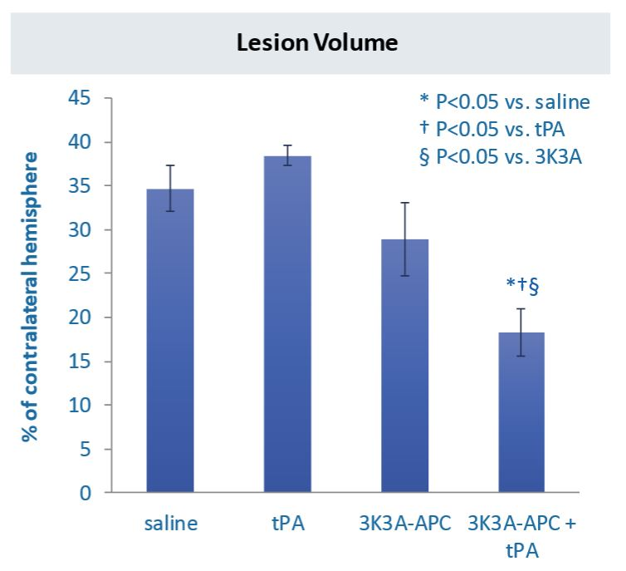
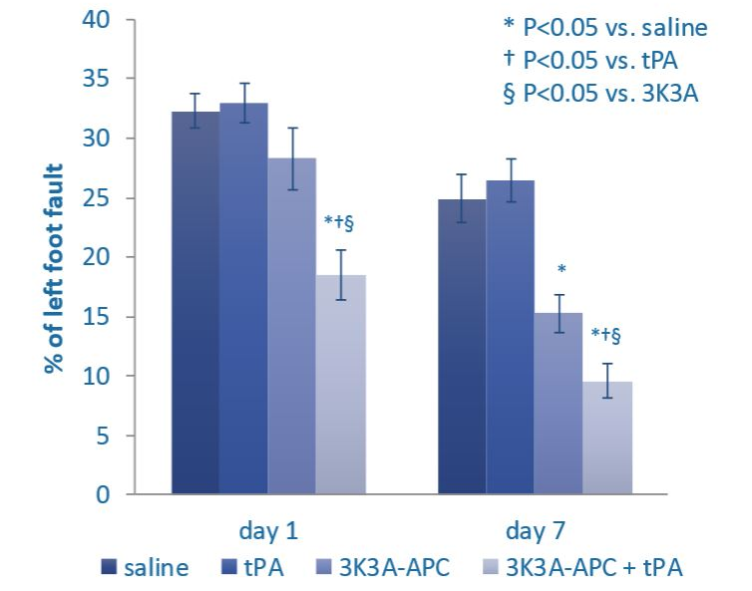
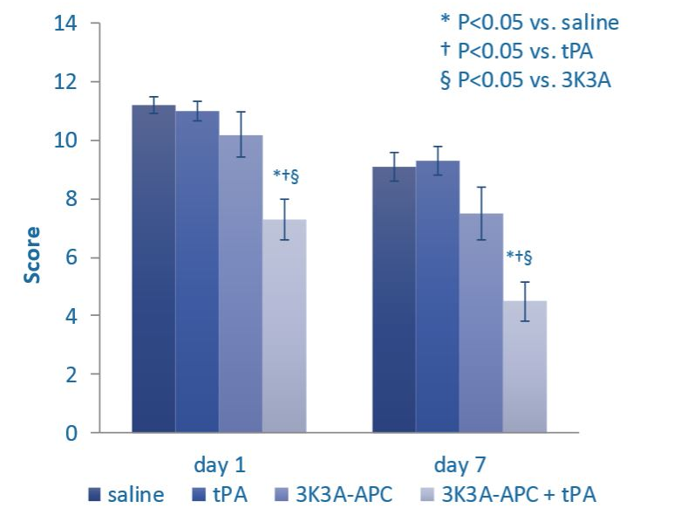
Human 3K3A-APC shows synergy with tPA when dosed outside of the tPA therapeutic window in embolic rat stroke model
Lesion Volume
Adhesive Removal Test
* P<0.05 vs. saline
† P<0.05 vs. tPA
§ P<0.05 vs. 3K3A
Synergistic effect of 3K3A-APC + tPA in reducing lesion volume over tPA and 3K3A-APC monotherapy
*†§
*†
Foot Fault Test
Neurological Severity Score
Foot-fault test is used for assessing locomotor function
Excellent 3K3A-APC monotherapy improvements in locomotor function further enhanced by addition of tPA.
3K3A-APC improved functional outcomes
3K3A-APC + tPA synergistically improved functional outcomes
Source: Stroke. 2012 Sep;43(9):2444-9
33

Slide 34
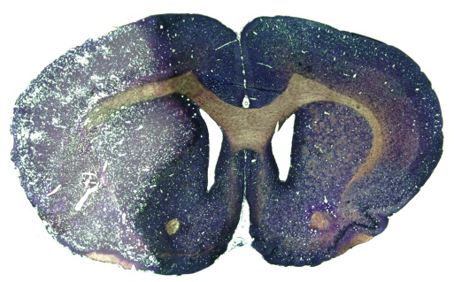
Efficacious in Hypertensive Animals
Study Details
Control
tPA
9 spontaneously hypertensive (HTN) rats per dose group
  Study recommended by STAIR
tPA (10 mg/kg) and murine 3K3A-APC (0.2 mg/kg) dosed 4 hours after embolic stroke in spontaneously hypertensive rat
Murine 3K3A-APC was additionally administered within 3 to 7 days post-stroke
3K3A-APC
3K3A-APC + tPA
3K3A-APC + tPA combination demonstrated statistically significant improvement in efficacy compared with tPA alone in HTN animals
Note: Efficacy data using murine 3K3A-APC in rodents are thought to provide a better clue for the efficacy of human 3K3A-APC in humans than data using human 3K3A-APC in rodents (much higher doses are needed in the latter case)
34

Slide 35
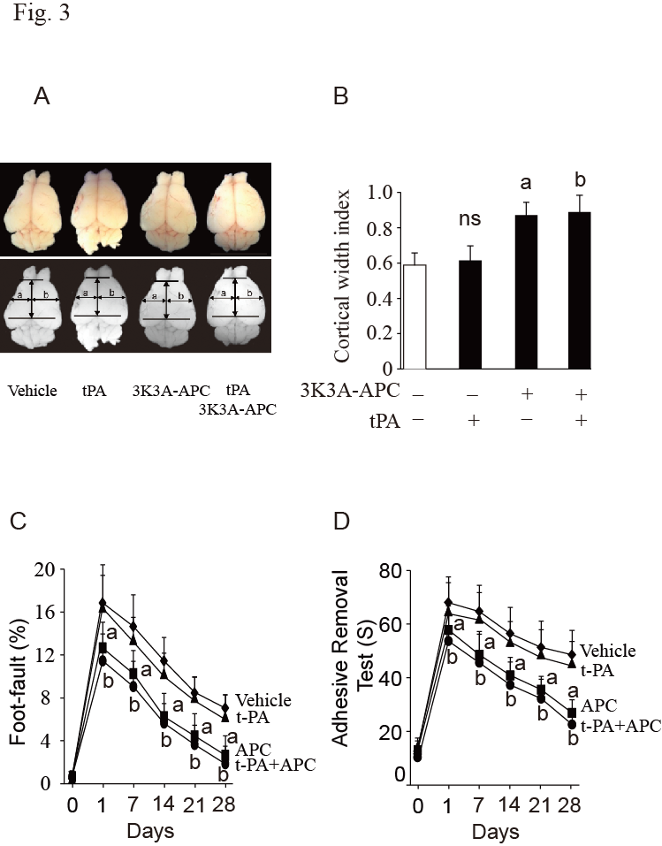
Efficacious in Aged Female Mice
Study Details
Hemoglobin concentration in aged female mouse brains, day 7
5 aged female mice per group
  Study recommended by STAIR
tPA (10 mg/kg) and murine 3K3A-APC (0.2 mg/kg) dosed 4 hours after distal permanent MCAo
Murine 3K3A-APC was additionally administered within 1, 3, 5, and 7 days post-stroke
Results presented at 28 days post-stroke
*
* P<0.01 vs. vehicle
† P<0.01 vs. tPA
†
†
3K3A-APC + tPA combination demonstrated statistically significant improvement in efficacy compared with tPA alone in aged female mice
35

Slide 36
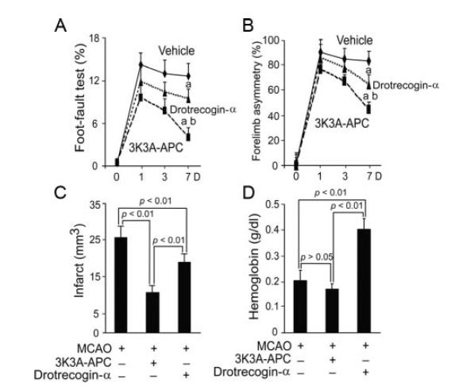
Delayed Dosing: Permanent Model
Study Details
5 male mice per group
Permanent distal MCAo
Multiple doses 12hr, 1, 3, 5, 7 days
Human wt-APC (Xigris) and human 3K3A-APC, 1 mg/kg
a: p<0.05 vs. vehicle
b: p<0.05 v. wt-APC
In the permanent occlusion model, 3K3A-APC is significantly more effective than
wt-APC when dosing starts 12 hours after stroke
Source: Wang et al., Stroke 2009
36

Slide 37
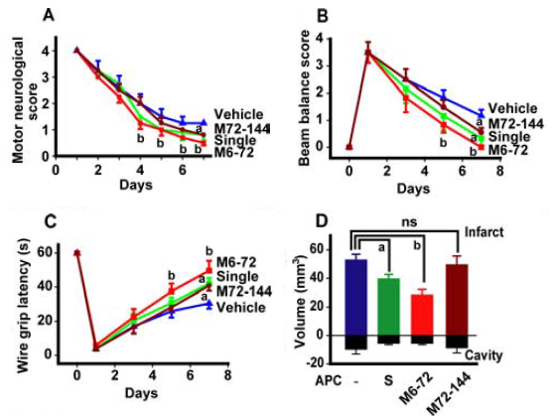
Delayed Dosing: Transient Model
a: p<0.05
b: p<0.01
Study Details
6 male mice per group
Transient proximal MCAo
Single dose 24 h
Multi dose 6-72 h or 72-144 h
Murine wt-APC, 800 µg/kg
In the tMCAO model, single-dose at 24 hours post-stroke or delayed multiple-dose APC administration at 6-72 hours and 72-144 hours is neuroprotective and mediates brain repair
37

Slide 38
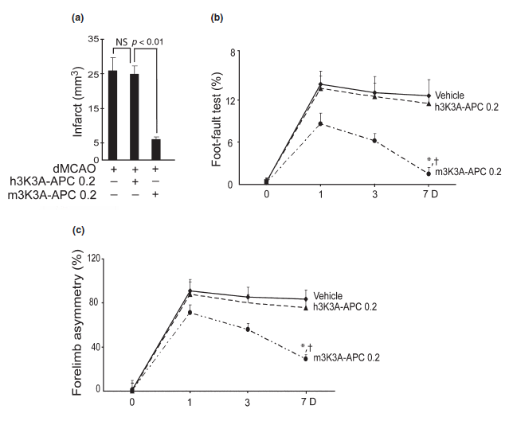
Murine vs. Human 3K3A-APC
Study Details
5-6 male mice per group
Permanent distal MCAo
Multiple doses 12hr, 1, 3, 5, 7 days
Murine vs. human 3K3A-APC, 200 µg/kg each
*: p<0.01 vs. vehicle
†: p<0.01 v. h3K3A-APC
Strong species specificity underscores efficacy of human 3K3A-APC in rodent models and suggests maximally efficacious human dose of ≤200 µg/kg
Source: Guo et al. J. Neurochem. 2009
38

Slide 39
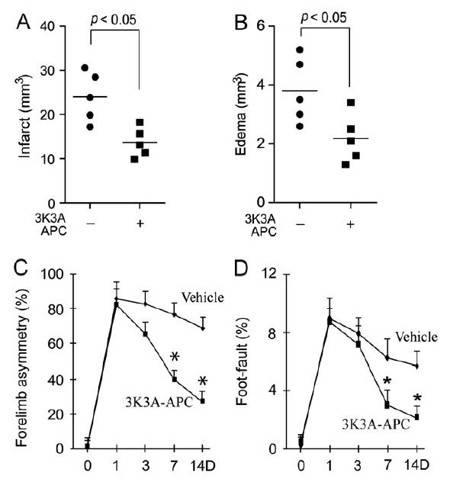
Potent Benefit of Species-Matched 3K3A-APC
Study Details
5-6 male mice per group
Permanent distal MCAo
Multiple doses 12hr, 1, 3, 5, 7 days
Infarct and Edema at 7 days, Functional tests at 14 days
Murine 3K3A-APC, 800 µg/kg
Recent work continues to support strong benefit of 3K3A-APC when dosed long after onset of ischemia
Note: Wang et al. Brain Res. 2013
39

Slide 40
Efficacious in Hypertensive Animals
Infarct Volume, day 7
Neurological Severity Score: mNSS
Hemorrhagic area in hypertensive rats, day 7
* P<0.01 vs. vehicle
† P<0.01 vs. tPA
* P<0.01 vs. vehicle
† P<0.01 vs. tPA
*
* P<0.01 vs. vehicle
† P<0.01 vs. tPA
*†
*†
*†
*†
*†
*†
†
†
Data reflects significantly reduction of hemorrhagic area from combo product as well as potential of 3K3A-APC as a monotherapy, and potential to extend the therapeutic time window of tPA
Wang et al., Stroke 2013
40

Slide 41
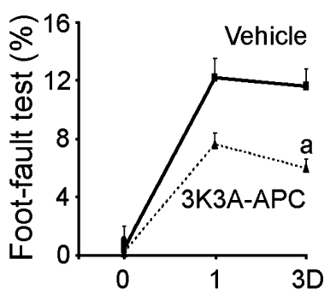
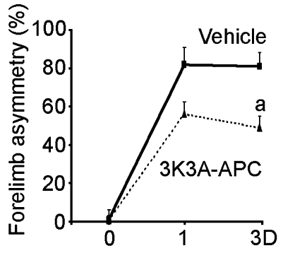
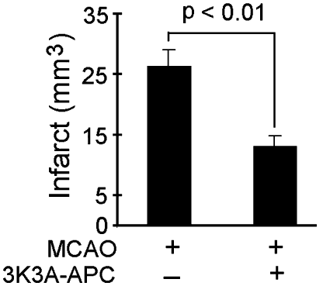
Significant Efficacy as Monotherapy in tMCAO Model
Foot-Fault Test Functional Recovery
Forelimb Asymmetry Functional Recovery
Infarct Size
Post-Dose
In the transient middle cerebral artery occlusion (tMCAO) model, murine 3K3A-APC demonstrated significant efficacy (ªP < 0.01, n=5 mice per group) as single dose monotherapy 4 hours post-stroke, while showing no evidence of intracerebral hemorrhage
Source: Eur J Neurosci. 2009 March; 29(6): 1119–1130
41
Notes:
Bleeding benefit (3 studies)
2 study shows (sthis as monotherapy )

Slide 42
3K3A-APC Primate Studies
42

Slide 43
3K3A-APC is Very Well Tolerated in Primate Studies
GLP Primate Toxicology
3K3A-APC Primate Pharmacokinetics
14-day GLP Toxicology Study at 3 dose levels (0.2, 1.0, or 5.0 mg/kg IV bolus qd)
No clinical signs of toxicity (hematology, chemistry) and no histopathological changes indicating target organ toxicity
No drug-related effects on neurological, respiratory, or cardiovascular functions
Changes in aPTT and PT were not associated with signs of bruising or bleeding, and returned to within normal limits (WNL) by 24 hrs post-dose
  Active 3K3A-APC in plasma was measured
    Immunocapture, amidolytic assay
    Same assay used in Phase 1 and NN104
  3 dose levels (0.2, 1 and 5 mg/kg/day) on Days 1 and 14
  Half-life (t_{1/2})
    0.2 mg/kg/day ~ 18 minutes
    1.0 mg/kg/day ~ 23 minutes
    5.0 mg/kg/day ~ 40 minutes
      Decreased clearance at 5.0 mg/kg/day, presumably related to limited naturally circulating proteases
Primate toxicology studies demonstrated no clinical signs of toxicity for 3K3A-APC at any dose level
43

Slide 44
3K3A-APC Mean Coagulation Parameters in Primates
Dose (mg/kg/day) | aPTT¹ T = 15 min (sec) | aPTT¹ T = 3 hrs (sec) | PT¹ T = 15 min (sec) | PT¹ T = 3 hrs (sec) | HED (μg/kg)
0 (control) | 23.3 | 24.5 | 11.4 | 11.3 | 0
0.2 | 26.0 (1.12x baseline) | 23.9 (1.03x baseline) | 11.2 (0.98x baseline) | 11.3 (0.99x baseline) | 60
1.0 | 35.2 (1.45x baseline) | 25.8 (1.06x baseline) | 11.3 (0.98x baseline) | 11.6 (1.01x baseline) | 320
5.0 | 112.0 (4.89x baseline) | 34.6 (1.51x baseline) | 15.2 (1.33x baseline) | 13.8 (1.21x baseline) | 1620
¹Mean Data from all animals in each dose group on Day 14; baseline = mean predose value within dose group
Source: 14-day Toxicology Study Report No. 20002858
44

Slide 45
Mean Toxicokinetic Data
Mean Toxicokinetic Data: Active Drug/Monkey
Note: A validated assay was developed to measure active 3K3A-APC in monkey plasma to parallel the analysis of active drug in humans. This assay was based on the published method of Gruber & Griffin (1992) that was developed to measure circulating, active wt-APC in human and nonhuman primate plasma.
45

Slide 46
Drotrecogin Alfa, Activated Coagulation Study in Primates
  aPTT and PT were measured following IV bolus injections of 0.02 to 1 mg/kg of DrotAA to 6 monkeys
  aPTT values were elevated in monkeys following DrotAA doses of 0.1, 0.2 and 1.0 mg/kg
  aPTT was ~1.4-fold greater than baseline at 0.1 mg/kg dose (similar increase observed at 1.0 mg/kg of 3K3A-APC) indicating ~10-fold difference in anticoagulant activity
  Pre-dose values of aPTT prior to the 1 mg/kg dose (72 hours post-dose 0.2 mg/kg) were elevated above normal implying a persistent anticoagulant effect (not seen with 3K3A-APC)
46

Slide 47
Drotecogin Alfa Activated: Mean Coagulation Parameters in Primates
Confirm with Kent: this is pk from Xigris as a control to produce following graph
Dose (mL/kg) | aPTT1 T = 15 min (sec) | aPTT1 T = 3 hrs (sec) | PT1 T = 15 min (sec) | PT1 T = 3 hrs (sec)
0.02 (Day 1) | 28.90 (1.12x baseline) | 26.27 (1.02x baseline) | 12.00 (1.01x baseline) | 12.00 (1.01x baseline)
0.1 (Day 3) | 36.75 (1.43x baseline) | 27.30 (1.05x baseline) | 12.65 (1.07x baseline) | 12.32 (1.04x baseline)
0.2 (Day 5) | 46.18 (1.81x baseline) | 28.75 (1.51x baseline) | 13.00 (1.14x baseline) | 12.10 (1.06x baseline)
1.0 (Day 8) | >200 | 42.38 (1.51x baseline) | 21.97 (1.41x baseline) | 15.23 (0.98x baseline)
1.0 (Day 18) | >200 | 66.02 (1.40x baseline) | 25.02 (2.06x baseline) | 21.02 (1.73x baseline)
1Mean Data from all animals in each dose group; baseline = mean predose value on indicated study day
Source: Pharmacodynamic Study of Xigris Report No. 1909-001
47

Slide 48
3K3A-APC vs. Wild-Type APC in Primates
Change in coagulation parameter in Cynomolgus monkeys dosed with 3K3A-APC and Xigris (recombinant wt-APC, Lilly)
~90% reduction in 3K3A-APC anti-coagulation activity relative to Xigris (wild-type APC)
  0.2 mg/kg: 9.4x
  1.0 mg/kg: 11.9x
Dramatically reduced risk of bleeding at planned doses
Source: Williams et al, Davis, Cur Pharm Des, 2012.
48

Slide 49
3K3A-APC Phase 1 Study
49

Slide 50
3K3A-APC was very well tolerated in the Phase 1 safety study
Phase 1
Patient Population | Healthy volunteers
Study Design | Randomized, double-blind, placebo-controlled Phase 1 study of safety and pharmacokinetics of single and multiple ascending doses of APC
Study Size | 64 patients were enrolled for the study (32 single-dose, 32 multiple-dose)
Primary Endpoint | Safety, maximum tolerated dose
Secondary Endpoint | Maximum observed plasma concentration Area under the Plasma concentration time curve Total clearance of 3K3A-APC Volume of Distribution of 3K3A-APC
Adverse events and lab findings occurring in greater frequency in 3K3A-APC treated subjects
AE or Lab Finding | % of 3K3A-APC Subjects (N=50) | % of Placebo Subjects (N=14)
Headache | 54% | 7%
Increased aPTT | 30% | 21%
Nausea | 8% | 7%
Increased PT | 6% | 0%
Vomiting | 4% | 0%
Vertigo, Migraine, Diarrhea, Fatigue, Sweating, Bronchitis, Tonsillitis and Neck Pain | 2% | 0%
First in human clinical study demonstrated no serious adverse events (SAEs)
for 3K3A-APC at any dose level
Source: Lyden et al, Zlokovic. Curr Pharm Des 2013
50

Slide 51
3K3A-APC Phase 2A Study
51

Slide 52
NN-104 (RHAPSODY) Study Design
NN-104 (RHAPSODY) Study Design
Design | Multicenter, Prospective, Randomized, Placebo-Controlled, Double-Blind Phase II Study
Purpose | To evaluate the following after administration of tPA, mechanical thrombectomy, or both in subjects with moderate to acute ischemic stroke: Safety Pharmacokinetics Incidence of intracranial hemorrhage
Subject Enrollment | Enrolled 110 subjects 22 cohorts in groups of four (three treated / one placebo) “Extra” placebo subjects enrolled during safety review pauses Randomization “confirmed” once subject receives any amount of 3K3A-APC or placebo Placebo group included: For secondary comparison of hemorrhage To provide useful data for planning future studies
Treatment | Following completion of tPA infusion or initiation of mechanical thrombectomy: Subjects received 3K3A-APC or placebo 30-120 minutes later – given as a 15 minute infusion Subjects received another 15 minute infusion every 12 hours (+/- 1 hour) for up to 5 total doses (or discharge from hospital
Assessment | Dose-limiting toxicity events (DLTs) assessed from first dose to 48 hours following last dose of study treatment Safety evaluations conducted through day 7 MRI scans obtained at days 7, 30, and 90
52

Slide 53
NN-104 (RHAPSODY) was powered and designed for safety and evaluation of hemorrhage, not for clinical outcomes
Primary Objectives | To evaluate the safety of multiple ascending intravenous (IV) doses of 3K3A-APC following tPA administration or mechanical thrombectomy or both in subjects who have experienced moderate to severe acute ischemic stroke.
Secondary Objectives | To investigate the PK properties of 3K3A-APC following tPA or mechanical thrombectomy or both in adults with acute ischemic stroke. To evaluate the effect of 3K3A-APC on the presence of tPA/mechanical thrombectomy-related bleeding in the brain (hemorrhage and microbleeds) as determined by MRI at Day 30.
Exploratory Objectives | To evaluate the effect of 3K3A-APC on the volume of tPA/mechanical thrombectomy-related bleeding (hemorrhage and microbleeds) in the brain as determined by MRI at Day 30 To evaluate the effect of 3K3A-APC on incidence of subarachnoid hemorrhage in subjects who receive mechanical thrombectomy To collect the 7-day National Institutes of Health Stroke Scale (NIHSS) scores as a predictor for 90-day modified Rankin Scale (mRS) To collect the 90-day mRS To collect the 90-day Barthel Index (BI) To collect infarct volume at 90 days (MRI, or CT if unable to obtain MRI) To assess the immunogenic potential of 3K3A-APC
Efficacy endpoints collected to demonstrate feasibility of measuring them in a future trial
53
53

Slide 54
Baseline Stroke Characteristics
 | Placebo (n = 44) | 3K3A-APC (n = 66) | P-value
NIHSS Prior to Recanalization Therapy | 14 (6.8) | 14 (6.3) | 0.89
NIHSS Eligibility | 13 (6.3) | 14 (7.6) | 0.44
Modified Rankin - 0 - 1 - ≥ 2 | 41 (93%) 3 (7%) 0 (0%) | 58 (88%) 8 (12%) 0 (0%) | 0.52
Recanalization Therapy - IV tPA Only - IAT Only - IV tPA and IAT | 24 (55%) 2 (5%) 18 (41%) | 35 (53%) 3 (5%) 28 (42%) | 1.00
Time from Stroke Onset to First Therapy - Time to tPA Initiation - Time to First Skin Puncture - Time to tPA Initiation or First Skin Puncture | 2:07 (1:01) 1:59 (0:44) 5:39 (0:21) 1:53 (0:35) | 2:13 (0:58) 2:16 (0:49) 3:31 (1:37) 2:02 (1:00) | 0.57 0.19 0.18 0.57
54

Slide 55
3K3A-APC has an extremely favorable safety profile, as it is safe at all doses tested
Continual Reassessment Method (CRM)
CRM was used to establish a maximum tolerated dose (MTD) of the drug
  MTD defined as an estimated DLT of 10% or less
DLT frequencies were initially estimated in each dose tier: 120-5%, 240-7%, 360-9%, and 540-11%
Initial patient cohort was started at the lowest dose level (120 µg/kg)
From there, dose escalations were driven by CRM based on incidence DLTs
CRM determined number of patients included in the study at each dose level
  Enroll 4 subjects (3 treatment / 1 placebo) into a cohort
  Determine number of evaluable subjects in cohort
  Observe number of evaluable subjects (out of 3 treated) that have a DLT per study definition
  Refit dose-response curve using observed information from all evaluable subjects to date
  Dose level may be escalated by no more than one dose between consecutive cohorts
55
55
Notes:
Split up into 49 and 51 -

Slide 56
Continual re-assessment method was used to determine maximum tolerated dose (MTD)
Used a hyperbolic tangent dose-response model
Assumed prior probabilities of toxicity
120 | 240 | 360 | 540
5% | 7% | 9% | 11%
Cohort | Dose (μg/kg) | Evaluable Subjects | # of DLTs | Toxicity Estimates
 |  |  |  | 120 | 240 | 360 | 540
 |  |  |  | 5% | 7% | 9% | 11%
1 | 120 | 3 | 0 | 1% | 2% | 3% | 4%
No DLTs observed in Cohort 1, estimated curve substantially lower -- all doses < 10%.
But, since dose can only increase by one level, cohort 2 treated at 240 μg/kg
56

Slide 57
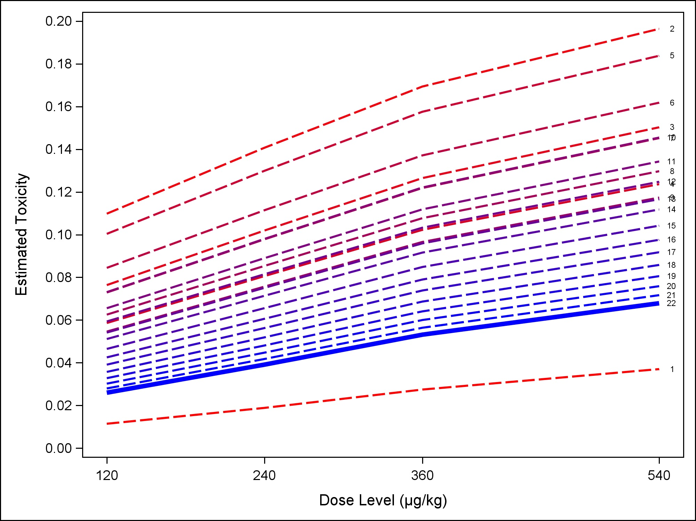
Continual re-assessment method was utilized to determine that 540 μg/kg is the maximum tolerated dose, with an estimated DLT rate around 7%
57
57
Notes:
Split up into 49 and 51 -

Slide 58
Secondary Outcome: Vascular Protection – Strong trend toward less hemorrhage incidence and total hemorrhage volume in 3K3A-APC treated patients vs. placebo
P-Value: 0.046
P-Value: 0.282
P-Value: 0.156
P-Value: 0.069
P-Value: 0.542
58

Slide 59
Overall Conclusions: Phase 2 Study
Study Conclusions
3K3A-APC is safe & tolerable in the acute stroke population receiving tPA, mechanical thrombectomy, or both.
540 μg/kg, the highest dose studied, was the maximum tolerated dose with low DLT rate of 7%.
There is a strong trend toward reduced hemorrhage incidence and reduced total hemorrhage volume in patients treated with 3K3A-APC vs. placebo.
A study of neuroprotectant 3K3A-APC in patients receiving tPA, mechanical thrombectomy, or both is feasible and can be recruited in a timely fashion.
Rhapsody was designed to satisfy the highest possible safety bar: safety when dosed on top of clot-centric treatment for ischemic stroke, including bleed-inducing tPA, so future studies are now enabled with tPA or mechanical thrombectomy.
Preclinical data also strongly support the use of 3K3A-APC as monotherapy.
Clinical Outcome Measures
This Phase 2a study was designed and powered to evaluate safety and identify an MTD, with a secondary objective to evaluate hemorrhage.
In order to demonstrate the feasibility of conducting an efficacy study in this challenging patient population, the protocol included the collection of clinical outcome measures.
As expected, no significant differences were found on any outcome measure:
  7 Day NIHSS
  90-Day Modified Rankin Scale (mRS)
  90-Day Barthel Index
  90-Day Infarct Volume by MRI

