Slide 1
Stephanie M. Wilbrand, PhD

Slide 2
STROKENET RESOURCES FOR STUDY COORDINATORS
AND PROGRAM MANAGERS
Results of targeted survey for study coordinators and program managers
StrokeNet intro
StrokeNet resources & Educational Core
In construction: resource platform for study coordinators and program managers

Slide 3
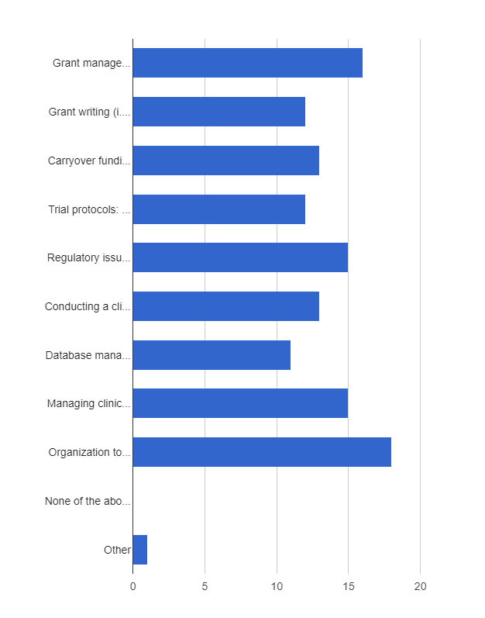
STROKENET RESOURCES FOR STUDY COORDINATORS
AND PROGRAM MANAGERS
Grant management and budgets (16, 72.7%)
Grant writing (i.e. for renewal/competitive renewal applications) (12, 54.5%),
Carryover funding/use of unobligated funds (13, 59.1%),
Trial protocols: Science/background/pre-clinical history (maybe) (12, 54.5%),
Regulatory issues (e-consenting, new regulations, etc.) (15, 68.2%),
Conducting a clinical trial/initiation of trials/management of a trial network (13, 59.1%),
Database management or programming (access, redcap) for screening, trial referrals (11, 50.0%),
Managing clinical trial staff (15, 68.2%),
Organization tools for Managers/Coordinators (18, 81.8%)
Other (1, 4.5%) General stroke education for new coordinators hired into the role.
*Could choose multiple responses

Slide 4
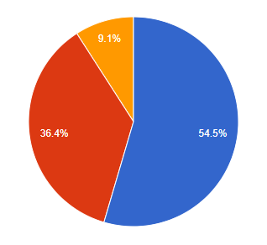
STROKENET RESOURCES FOR STUDY COORDINATORS
AND PROGRAM MANAGERS
How would you prefer educational opportunities to be presented?
During the 2nd half of the monthly RCC Manager call (12, 54.5%)
Separate Call (8, 36.4%)
Other suggestion (2, 9.1%)
Other Suggestions/Comments:
-Educational opportunities should be optional.
-Educational sessions presented during the monthly manage/coordinator call offering in deep revision of regulatory and administrative clinical research topics.
-Separate sessions of detailed and comprehensive educational activities must be offered to clinical research coordinators for community SS/CPS that are relatively new to clinical research.

Slide 5
STROKENET RESOURCES FOR STUDY COORDINATORS
AND PROGRAM MANAGERS
other General Comments Related to these topics:
Topic I Websites:
Streamline process for onboarding new study coordinators
All in one place
Topic II Meetings:
All StrokeNet studies – monthly webinars
Topic III Educational Offerings:
Coordinator Educational Opportunities
Educational Core to act as resource, as needed
Program Managers and Study Coordinators invited to Grand Rounds and Professional Development Series

Slide 6
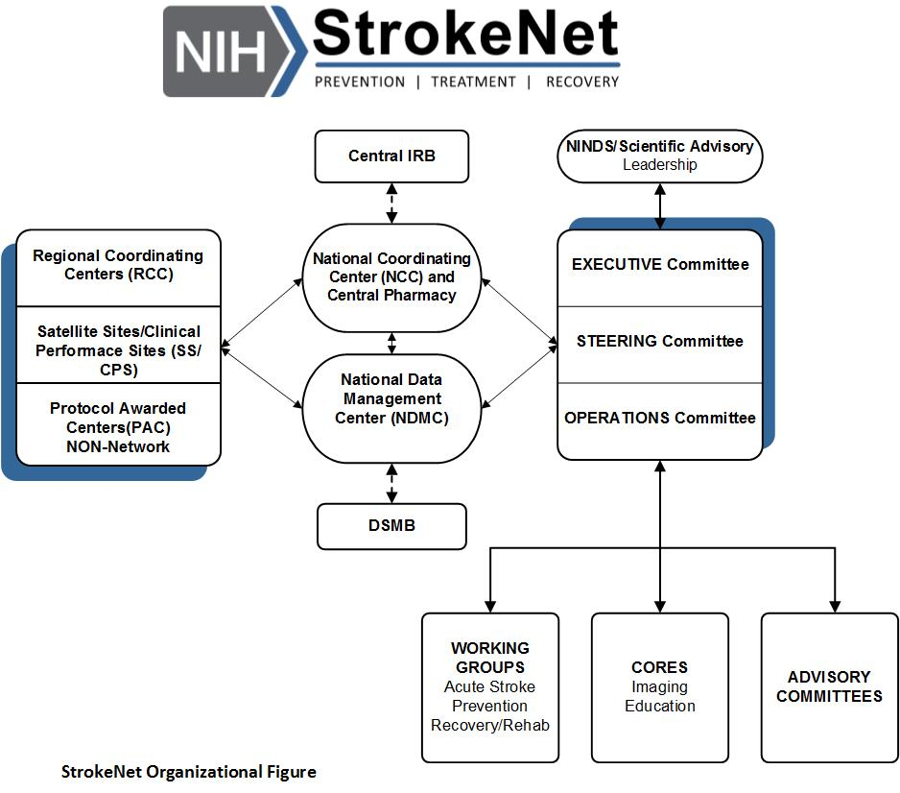
STROKENET RESOURCES FOR STUDY COORDINATORS
AND PROGRAM MANAGERS

Slide 7
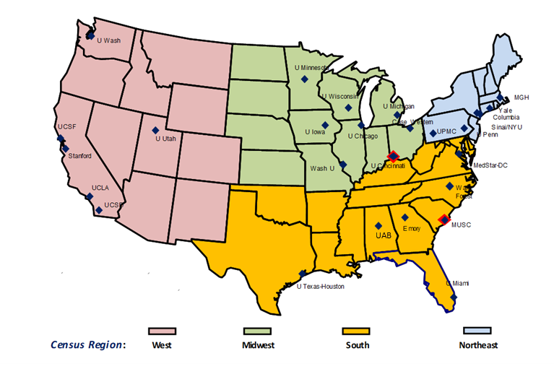
STROKENET RESOURCES FOR STUDY COORDINATORS
AND PROGRAM MANAGERS
The University of Cincinnati serves as the National Coordinating Center and provides national leadership for StrokeNet.
The National Data Management Center at the Medical University of South Carolina oversees all aspects of data management and provides full statistical support for StrokeNet research. WebDCU
The University of Cincinnati IRB serves as the Central IRB (CIRB) for StrokeNet
VA
Advarra

Slide 8
STROKENET RESOURCES FOR STUDY COORDINATORS
AND PROGRAM MANAGERS
Regional Coordinating Site / CLINICAL PERFORMANCE SITE
(CPS)
MTA
RA (Reliance Agreement)
SOPs
Protocol Trial Agreement
RA basic responsibilities:
CIRB
is the single IRB of record.
regulatory responsibility for assuring the protection of the rights and welfare of research participants
Relying Institution (RI)
sets standards to determine whether a research investigator can conduct research under its auspices.
agrees to cede IRB review of the NIH StrokeNet research to the CIRB.
agrees to accept the decisions of the CIRB regarding review, approval and oversight of research covered by this Agreement.

Slide 9
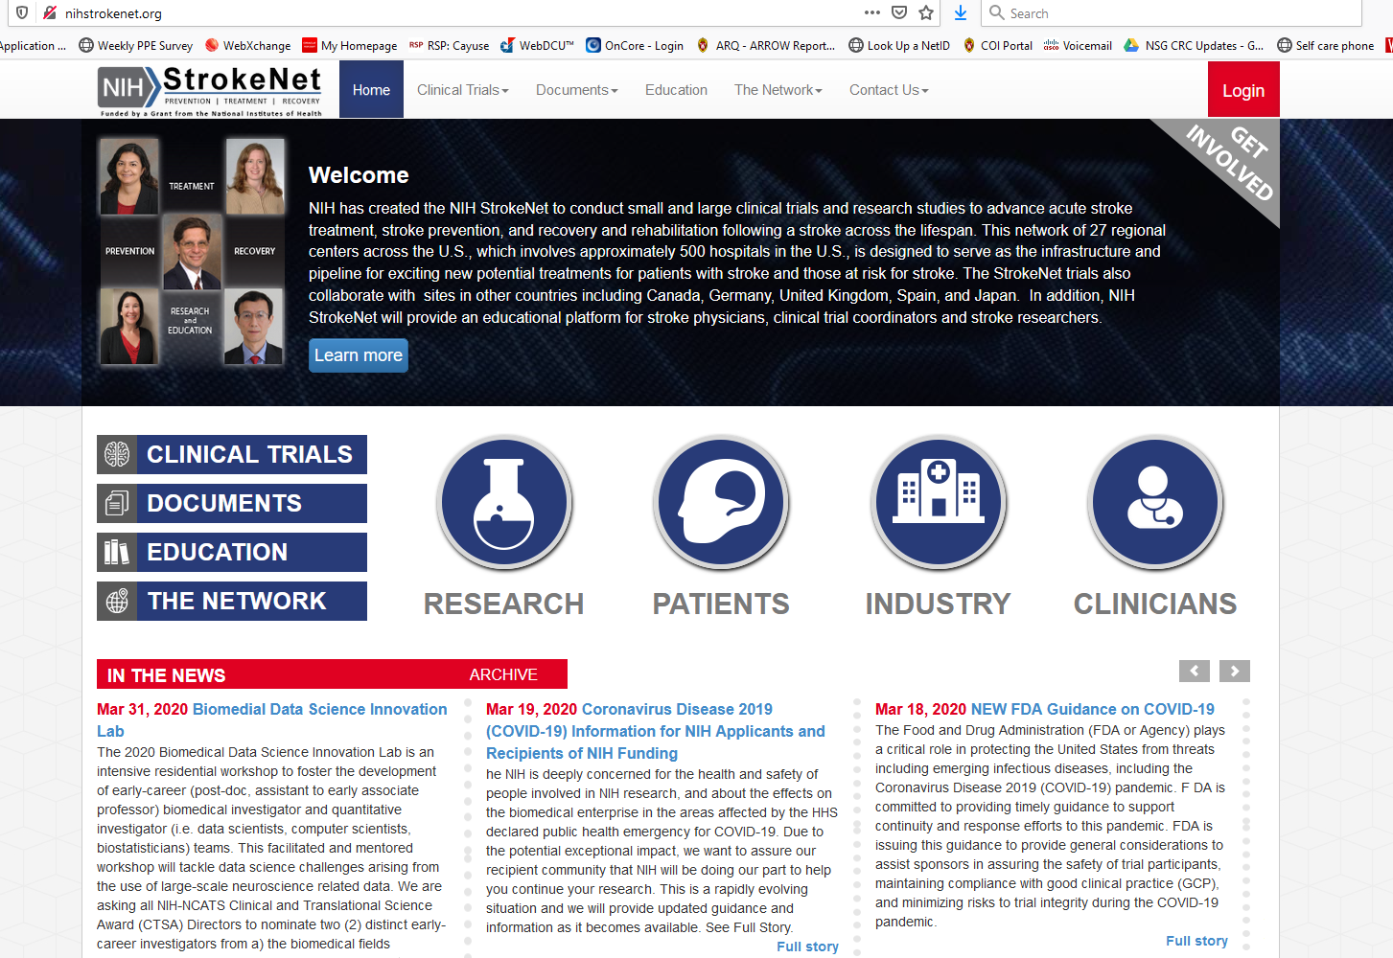
STROKENET RESOURCES FOR STUDY COORDINATORS
AND PROGRAM MANAGERS

Slide 10
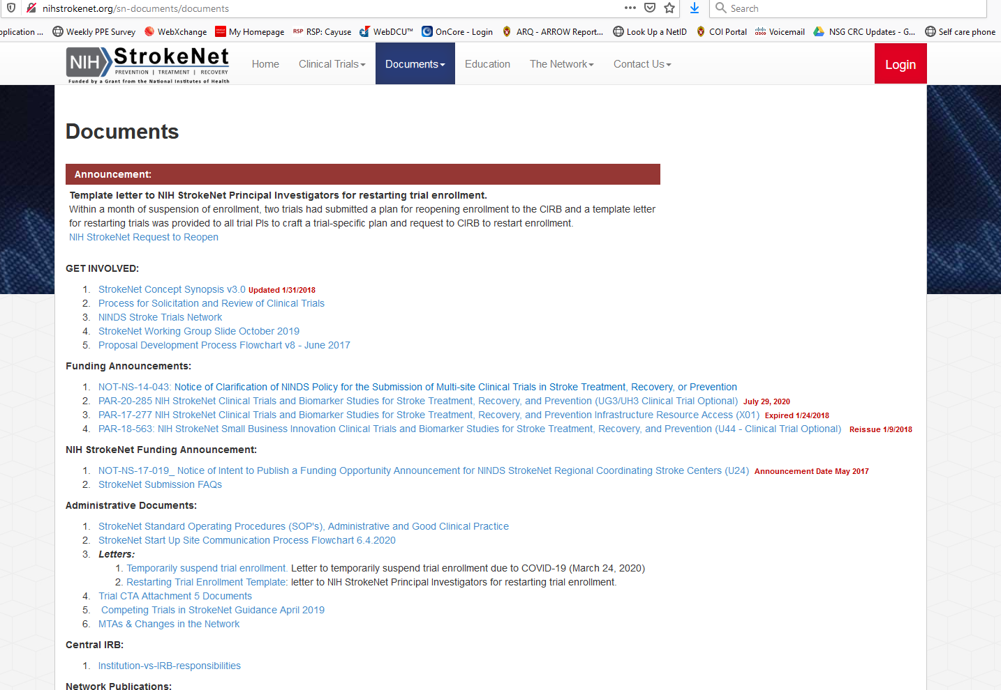
STROKENET RESOURCES FOR STUDY COORDINATORS
AND PROGRAM MANAGERS

Slide 11
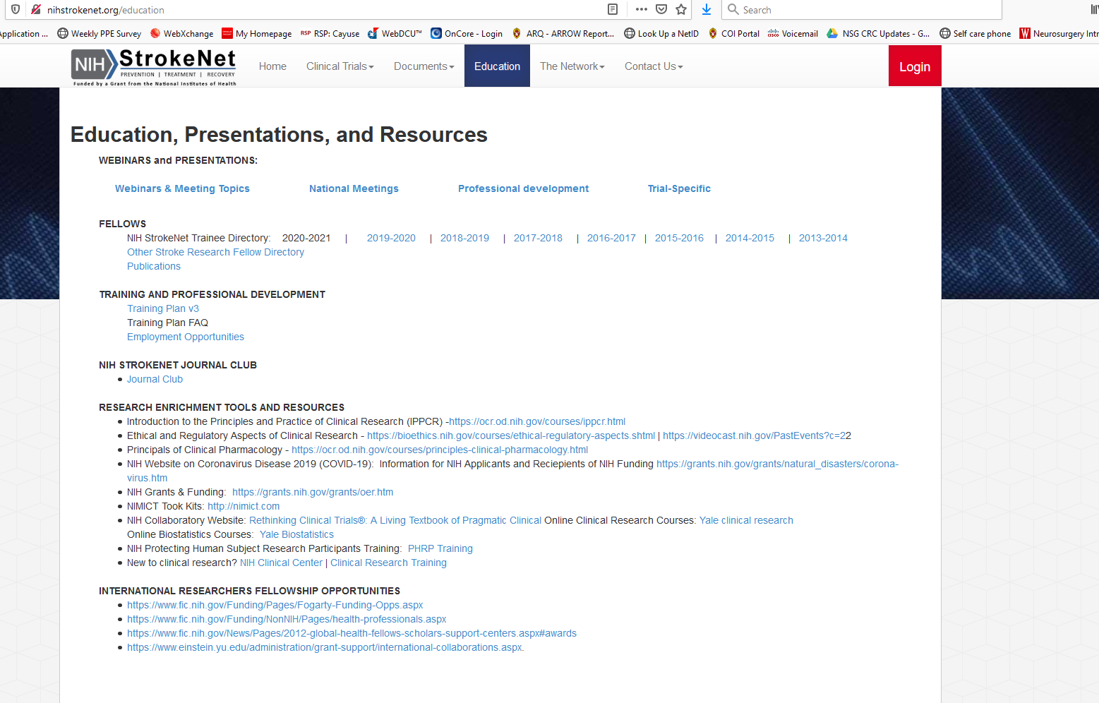
STROKENET RESOURCES FOR STUDY COORDINATORS
AND PROGRAM MANAGERS

Slide 12
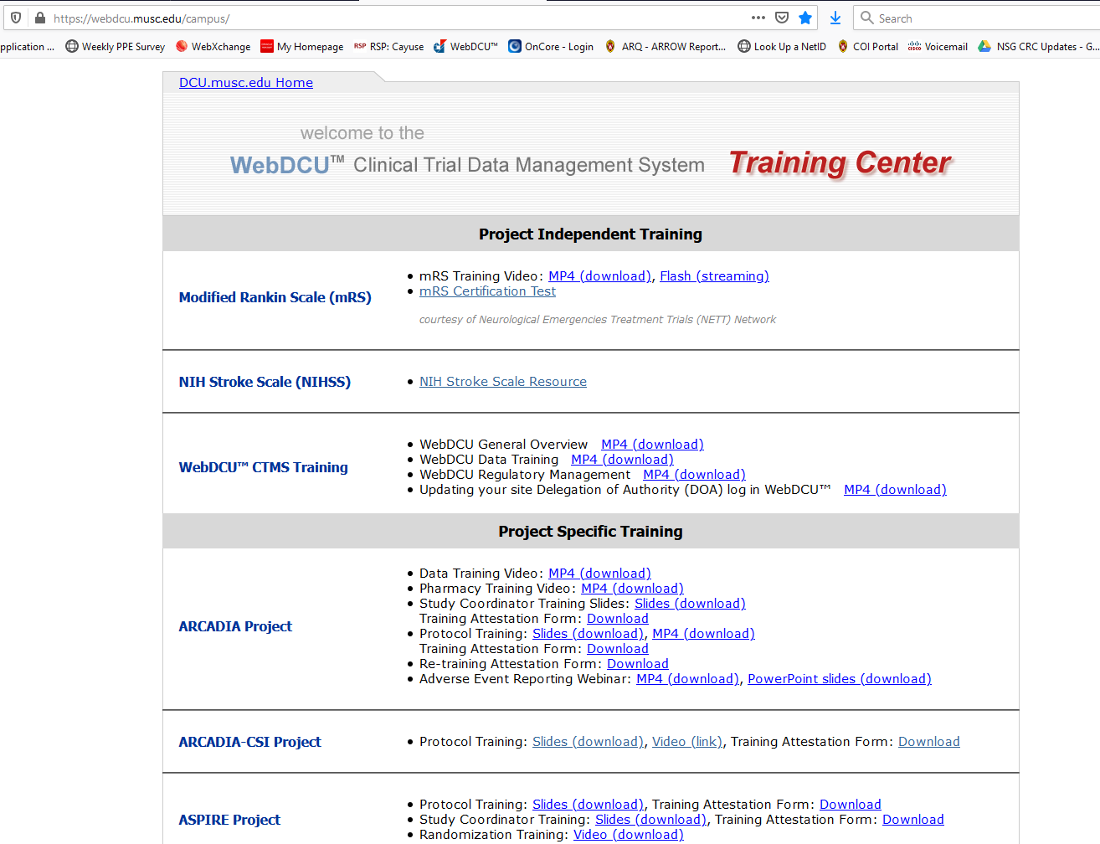
STROKENET RESOURCES FOR STUDY COORDINATORS
AND PROGRAM MANAGERS

Slide 13
STROKENET RESOURCES FOR STUDY COORDINATORS
AND PROGRAM MANAGERS
The NIH StrokeNet Training/Educational Core is designed to provide research training and career development for future stroke researchers. Dr. Randy Marshall is the Core chair and Dr. Devin Brown is the Core co-chair.
Scott Janis – NIH/NINDS Project Scientist
Tatjana Rundek– Faculty Representative
Harold Adams – Faculty Representative
Anthony Kim – Faculty Representative
Shyam Prabhakaran – Faculty Representative
Cemal Sozener – Past Trainee Representative
Farhaan Vahidy – Past Trainee Representative
Ashby Clay Turner – Trainee Representative
Yan Wang – Trainee Representative
Andrea Escobar– Coordinator Representative
Stephanie Wilbrand – Coordinator Representative
Jeanne Sester – Core Coordinator

Slide 14
STROKENET RESOURCES FOR STUDY COORDINATORS
AND PROGRAM MANAGERS
Track progress of trainees during the year with phone interviews, surveys, and progress reports
Trainee presentations
In person at national meeting
On the Professional Development webinar
Publications, grant submissions, and professional appointments during and post-StrokeNet training
What can the Educational Core do for us?
They can act as a resource, on a as needed basis, to facilitate speakers
Invited to their Grand Rounds and Professional Development Series

Slide 15
STROKENET RESOURCES FOR STUDY COORDINATORS
AND PROGRAM MANAGERS
What’s Next?
We are working on a platform that will house all necessary documentation and training for study coordinators and program managers
We are developing a series of presentations/videos about onboarding, training, documentation, etc. that will be presented most likely in the November coordinator webinar
Thoughts are welcome!

Slide 16
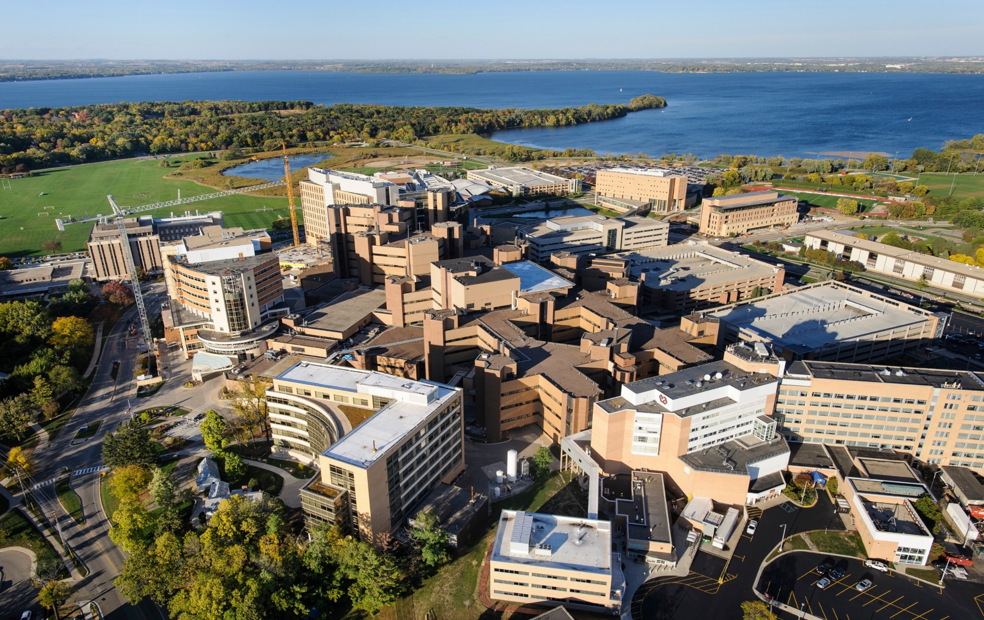
Thank you

