Slide 1
ARCADIA-CSI
An ancillary study to the ARCADIA trial

Slide 2

Integration with Parent Trial
ARCADIA Parent Trial
Apixaban vs. aspirin for secondary stroke prevention
1100 patients with cryptogenic stroke and atriopathy
2.5 years of enrollment; 1.5-4 (median 3) yrs of f/u
No data on cognitive and neuroimaging outcomes
ARCADIA-CSI Ancillary Study
Adds key cognitive and neuroimaging outcomes
Integrates seamlessly with ARCADIA study visits
Low patient / investigator burden
Potentially high impact

Slide 3
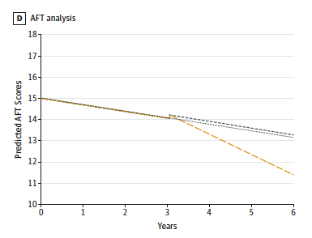
Post-stroke Cognitive Decline
Cognitive decline accelerates after stroke
Stroke doubles the risk of developing dementia
30% prevalence of dementia post-stroke
Levine. JAMA 2015

Slide 4
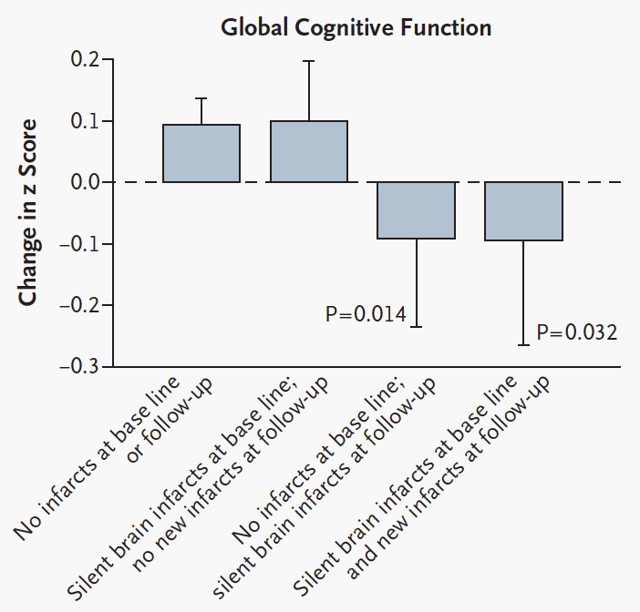
Silent Infarcts
Common
  Prevalence 30-50%
  Incidence up to 19% annually after TIA
Accelerate cognitive decline
Double risk of dementia
Secondary stroke prevention studies have not focused on preventing silent infarcts and cognitive decline
Vermeer. NEJM 2003
Vermeer. Lancet 2007

Slide 5
Aims
To determine the effect of anticoagulation (vs antiplatelet therapy) on the slope of cognitive function after stroke (primary clinical outcome)
To determine the effect of anticoagulation (vs antiplatelet therapy) on the incidence of silent infarcts after stroke (primary imaging outcome)
To determine (a) the imaging and clinical predictors of cognitive decline after stroke and (b) how much of the treatment effect on cognitive function is explained by a reduction in silent infarcts

Slide 6
ARCADIA
events
ARCADIA-CSI
events
Index stroke
Baseline MRI
Enrollment and
Randomization
> 3 months
f/u visit
Enrollment ARCADIA-CSI
Neurocog test +/- MRI
1 yr
f/u visit
Neurocog test – Year 1
1 yr
f/u visit
Neurocog test – Year 2
1 yr
f/u visit
Neurocog test – Year 3
+ MRI

Slide 7
Annual neurocognitive test
22 minute phone battery
Covers 4 key cognitive domains relevant to post-stroke cognition
Centrally administered by trained interviewers to reduce interrater variability
Tested in >30,000 subjects in REGARDS and CREST-2 studies
Demonstrated sensitivity to cognitive change, cerebrovascular risk factors, large vessel disease.

Slide 8
Cerebral Protection in Transcatheter Aortic Valve Replacement: The SENTINEL Study
Correlation of Day 2-7 DW-MRI Lesion Volume with
30-Day Change in Neurocognitive Battery
Correlation of Day 2-7 DW-MRI Lesion Number
with 30-Day Change in Neurocognitive Battery
p = 0.0012 r = -0.26650
p = 0.0002 r = -0.30212
Kapadia et al, JACC, 2017

Slide 9
MRI
Simple protocol with standard sequences
Preferably on 3T (1.5T acceptable)
15 minute scanning time
30 minutes total time
MUSC will collect and store the images
Stanford Radiology Core will analyze the images:
  New Silent infarcts
  White matter disease burden
  GRE lesions

Slide 10
Inclusion/Exclusion Criteria
Inclusion Criteria
Randomized in ARCADIA
>3 months post index stroke
Able to undergo MRI
Able to provide self-consent for ARCADIA-CSI in English
Score of 0-1 on NIHSS language at time of ARCADIA-CSI enrollment
Exclusion Criteria
Diagnosis of dementia
Active illicit drug use
Psychiatric admission or ECT for major depression within last two years
Education less than 8 years
History of traumatic brain injury with loss of consciousness of more than 30 minutes
ARCADIA study drug permanently discontinued

Slide 11

Analysis
Sample: 1100 patients in ARCADIA -> 85% (n=935) will meet ARCADIA-CSI eligibility -> 75% will be willing to consent (n=700) -> will easily meet our target enrollment of 500 patients
Cognitive outcome: Random effects regression model with 90% power to detect a difference of 0.26 SD on the average z-score at 3 years
Radiological outcome: Poisson regression model with 90% power to detect a 13% reduction (from 50 to 37%) in the incidence of silent infarcts over 3 years

Slide 12
Impact of ARCADIA-CSI
Large scale data of effect of anticoagulation on silent infarction and cognitive decline
Results that are important regardless of the results of the parent trial
Will provide deeper insight in the incidence of silent infarcts, the slope of post-stroke cognitive decline, and the relationship between them
Will set the stage for future trials to prevent silent infarction and post-stroke cognitive decline

Slide 13
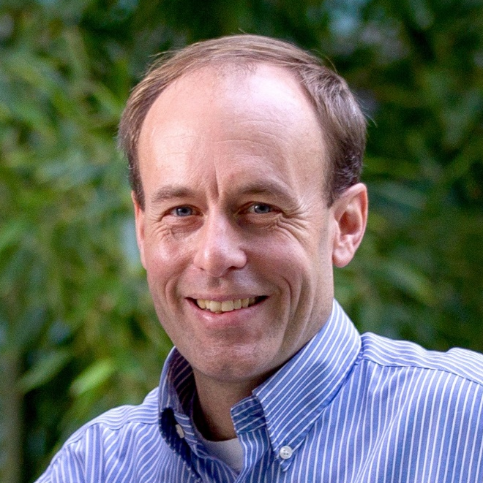
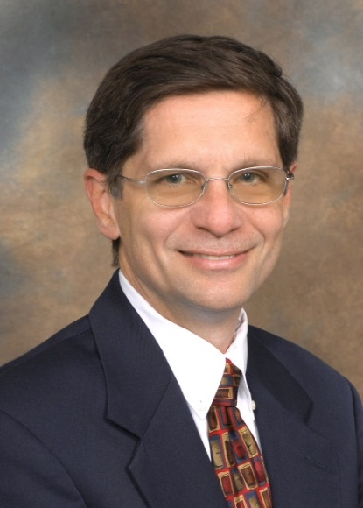
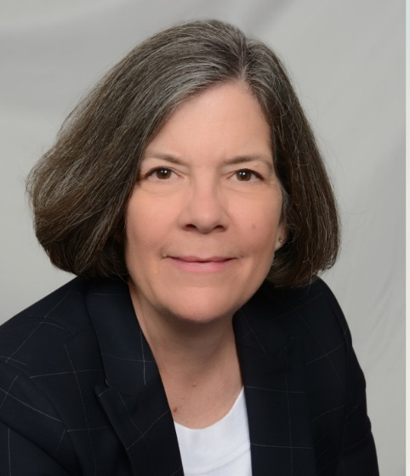
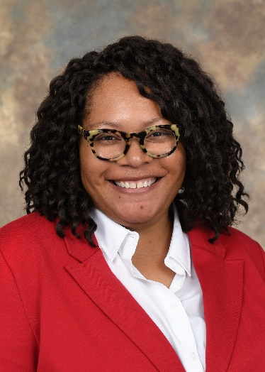
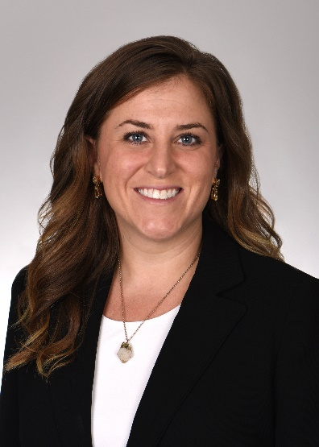
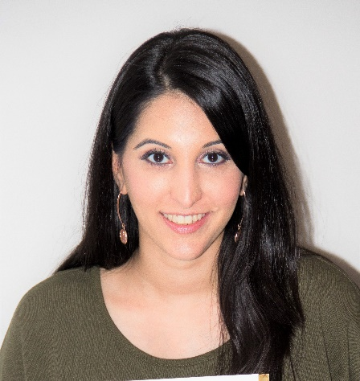
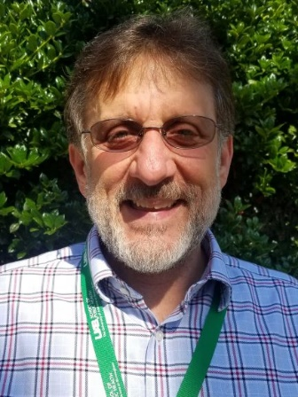
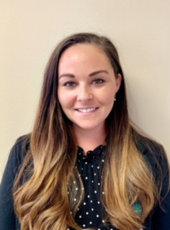
George Howard
UAB
Maarten Lansberg
Stanford University
Ron Lazar
UAB
Kevin Sheth
Yale University
David Tirschwell
University of Washington
Max Wintermark
Stanford University
Stephanie Kemp
Stanford University
Joe Broderick
Univ of Cincinnati
Jamey Frasure
Univ of Cincinnati
Tashia Harris
Univ of Cincinnati
Christy Cassarly
Statistical PI
MUSC
Faria Khattak
Data Manager
MUSC
Paul Wolff
UAB
Terina Meyers
UAB

