Slide 1
PI and Coordinator Webinar
July 24, 2018

Slide 2
Enrollment
186 patients consented
~45% eligible for randomization
52 randomized

Slide 3
Top enrolling sites
 | Consented | Randomized
United | 13 | 4
OHSU | 12 | 5
Cincinnati | 10 | 3
Iowa | 9 | 5
Intercoastal | 9 | 2
UPMC | 8 | 2
MUSC | 8 | 1
UF Shands | 6 | 3
Memorial Hermann | 6 | 2

Slide 4
Top enrolling sites
 | Consented | Randomized
United | 13 | 4
OHSU | 12 | 5
Cincinnati | 10 | 3
Iowa | 9 | 5
Intercoastal | 9 | 2
UPMC | 8 | 2
MUSC | 8 | 1
UF Shands | 6 | 3
Memorial Hermann | 6 | 2

Slide 5
Top enrolling sites
 | Consented | Randomized
United | 13 | 4
OHSU | 12 | 5
Cincinnati | 10 | 3
Iowa | 9 | 5
Intercoastal | 9 | 2
UPMC | 8 | 2
MUSC | 8 | 1
UF Shands | 6 | 3
Memorial Hermann | 6 | 2

Slide 6
Top enrolling sites
 | Consented | Randomized
Northwestern | 6 | 0
Penn | 5 | 3
MGH | 5 | 2
OSU | 5 | 1
Intermountain | 5 | 1
LA County USC | 5 | 1
Harborview | 5 | 0
Columbia | 4 | 2
Cornell | 4 | 2

Slide 7
Top enrolling sites
 | Consented | Randomized
Mercy St. Vincent | 4 | 1
Vanderbilt | 4 | 1
Brigham | 4 | 0
Maimonides | 3 | 2
Utah | 3 | 1
Nebraska | 3 | 1
UCSD Hillcrest | 3 | 1
Univ. Illinois | 3 | 1

Slide 8
Site startup
112 completed trial agreements
94 CIRB submissions
91 CIRB approvals
79 readiness calls
78 sites released to enroll
28 sites with at least one randomization

Slide 9
Coordinator heroes
Subject Transferred Sites:
  A subject enrolled at UPMC was moving and needed to transfer sites to Grady in order to stay in the study.
  Beyond the extra work at both sites to make this happen, the UPMC coordinator also arranged to ship study drug and do a telephone call since the subject wasn’t yet settled at the new site and would otherwise miss a study visit/study medication.
Heroes: Cathy Van Every and Jason Weimer at UPMC Presbyterian Hospital, Pittsburgh, PA. Also a big thank you to the Grady team!

Slide 10
Coordinator heroes
Subject transferred to rehab:
  A subject was transferred to rehab instead of being discharged home and the rehab center was not allowing study drug administration.
  The coordinator successfully stayed in touch with the patient and they’re now out of rehab, on study medication, and still in the study.
Hero: Maura Fernandez at Los Angeles County + USC Medical Center, Los Angeles, CA.

Slide 11
Identifying eligible patients
Experience at MGH

Slide 12
FAQs
Question: What if a patient had a recent echo before their stroke and the team doesn’t think that another one is clinically indicated?
Answer: If the site investigator feels that the echo is sufficient to establish ESUS, the patient can be consented. The echo could not be used to qualify for randomization—the patient would need to qualify by ECG or NT-proBNP.

Slide 13
FAQs
Question: How quickly will unblinding occur in an emergency?
Answer: Within minutes.
  Subject/MD/investigator/coordinator calls 24-hour ARCADIA hotline and briefly presents situation.
  ARCADIA PIs call WebDCU hotline to request unblinding.
  WebDCU team calls subject/MD/investigator/coordinator with treatment assignment.

Slide 14
FAQs
Question: Is PFO closure an exclusion?
Answer: No, but please clarify and think through the planned antithrombotic strategy around PFO closure—ARCADIA subjects cannot receive open-label antiplatelets or anticoagulation.

Slide 15
FAQs
Question: Can subjects be randomized before discharge to a rehabilitation hospital?
Answer: Yes, but please keep in mind that some rehabilitation facilities may not allow or may not have the capacity to administer study drug. You may need to work with the rehab team to figure out how the subject can get study drug during their stay, or wait until afterwards to randomize.

Slide 16
FAQs
Question: What is expected for the physical examination for the baseline and randomization visits?
Answer: Intention was to acknowledge/compensate investigators for time spent assessing patient's suitability for trial. We are not collecting info besides vitals, NIHSS, and mRS. It is up to investigator's discretion whether to perform any other physical exam items when deciding on eligibility.

Slide 17
FAQs
Question: Can I measure PTFV₁ myself to “pre-screen” patients?
Answer: Measuring PTFV₁, while possible, can be challenging. It is not yet a standard clinical measurement. The measures we are using, PTFV₁ and NT-proBNP, are also independent of each other, so the fact that a PTFV₁ is negative for atrial cardiopathy does not mean that another measurement would also be negative. We do not want people to exclude potential patients by mismeasuring PTFV₁.

Slide 18
ARCADIA ENROLLMENT CASE
7/13/18

Slide 19
HPI
57 year old right handed woman with no past medical history, no tobacco abuse presented to ED on 7/5/18 with sudden onset of speech difficulty while singing in church. Complete resolution in 10 minutes.
LKW: 7/5/18 9:00pm
Neuro evaluation 7/5/18 9:31pm
NIHSS 0
preMRS 0

Slide 20
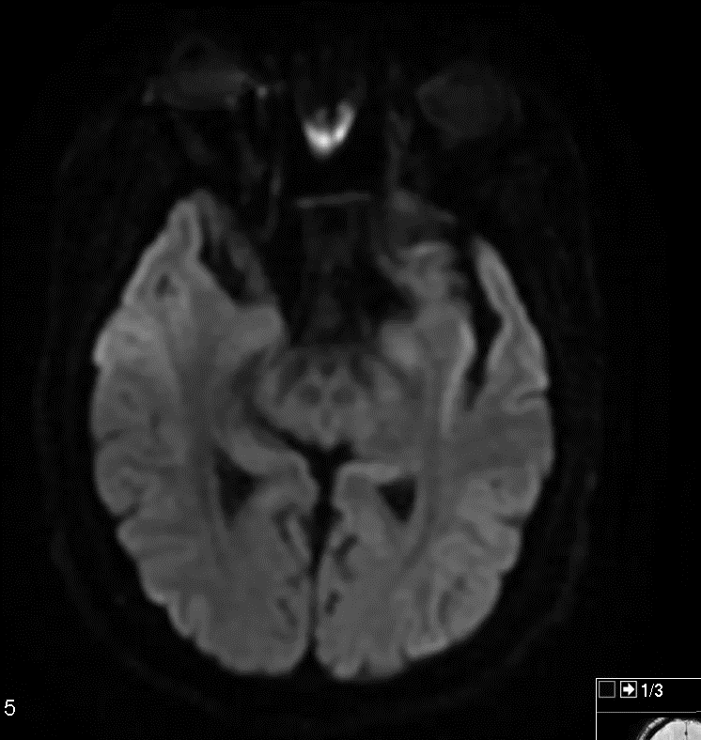
MRI brain without contrast (DWI)
Left insular, left parietal ischemic stroke

Slide 21
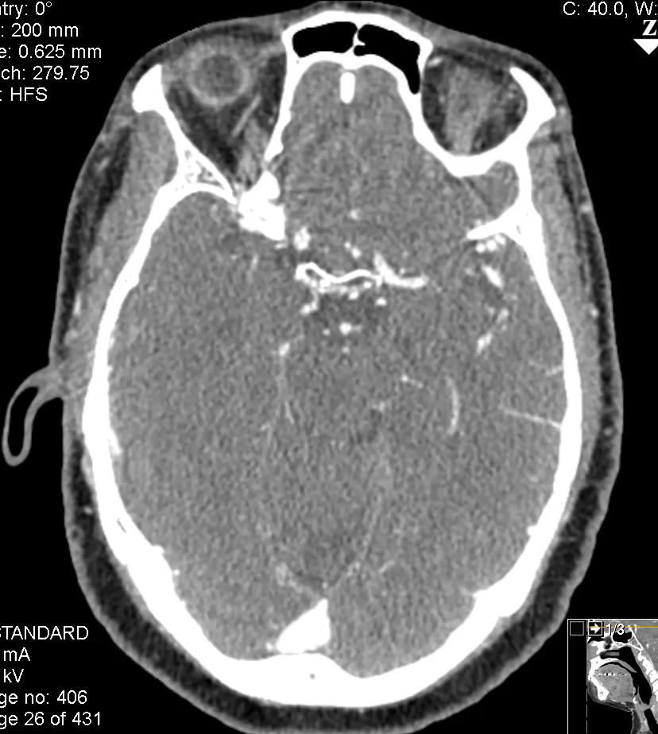
CTA intracranial with contrast
High grade stenosis / occlusion of left M2

Slide 22
FAQs
Question: Is a large-vessel occlusion aka cut-off an exclusion?
Answer: Not necessarily.
  If the investigator feels that it represents in-situ large-vessel atherosclerosis causing >50% stenosis of the lumen, the patient is excluded.
  If the investigator feels that it represents a distant embolus, then by itself that is not an exclusion.

Slide 24
Hotline
24-hour telephone hotline
  Please use it for any urgent questions
  Eligibility, randomization, unblinding, etc
1-877-427-2234 (1-877-4AR-CADI): useful to save in your cell phone
The hotline automatically calls the four PIs in succession
  Please let it ring
  And call back if no luck—one of us will pick up!
Please email arcadia@ucmail.uc.edu with non-urgent questions

Slide 25
Recruitment materials and study tools
Video
Patient brochure
Newsletters
Toolbox for minority recruitment

Slide 26
Next steps
Actively screen
Bring back randomization-eligible patients
Look for recruitment video
Send us feedback—we will make changes as needed to make this trial successful!

