Slide 1
Education and Training core
Farhaan Vahidy
Anthony Kim
Andrea Escobar (RCC Coordinator)
Stephanie Wilbrand (RCC Coordinator)
Amit Sethi - Pittsburgh(Trainee)
Lily Zhou - Stanford (Trainee)
Jeanne Sester (Coordinator)
Randolph Marshall (Chair)
Devin Brown (Co-Chair)
Scott Janis (NINDS)
Harold Adams
Tatjana Rundek
Cemal Sozener
Shyam Prabhakaran
Notes:
Shout out to Dawn

Slide 2
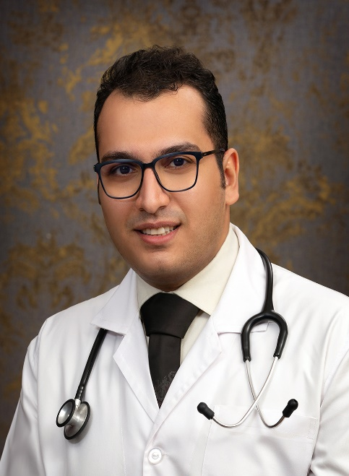
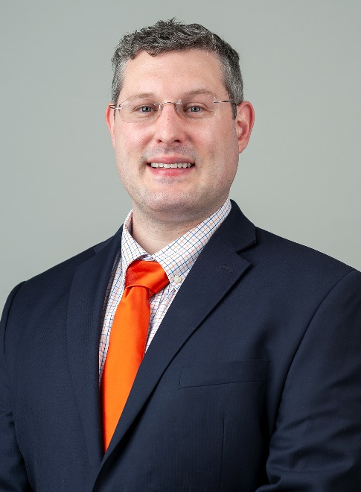
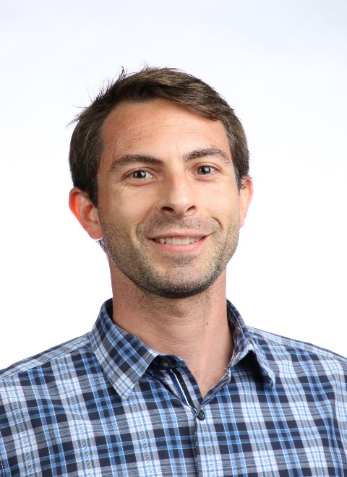
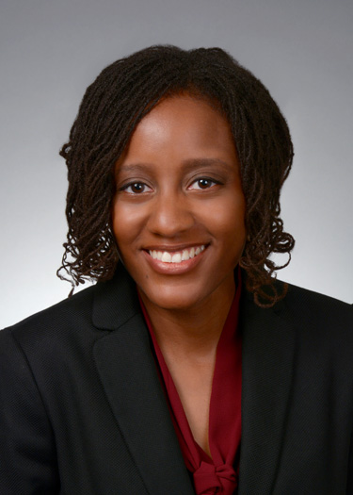
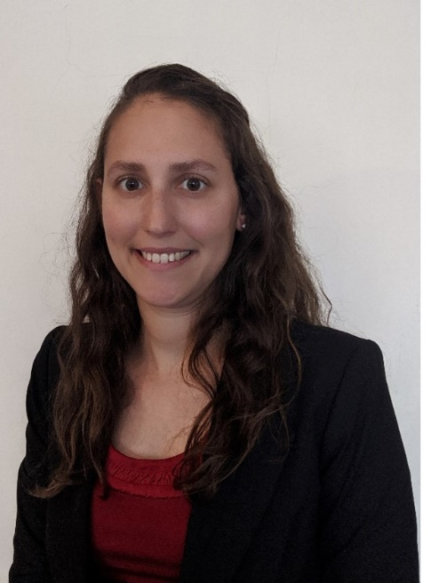
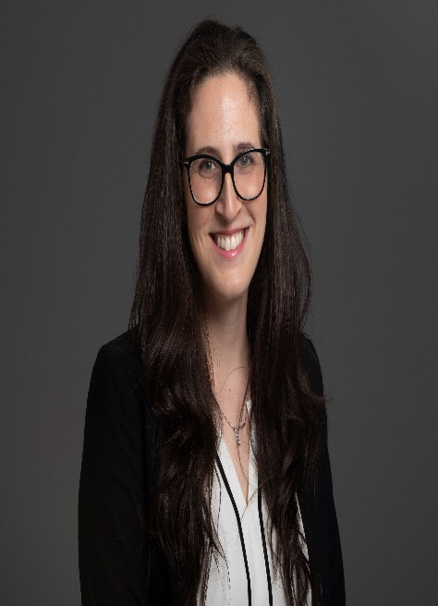
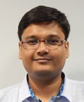
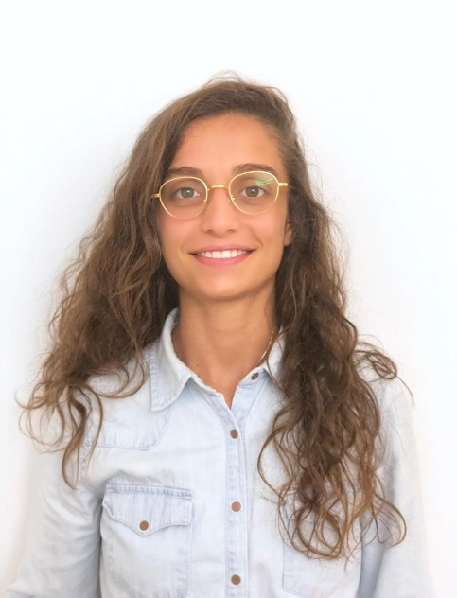
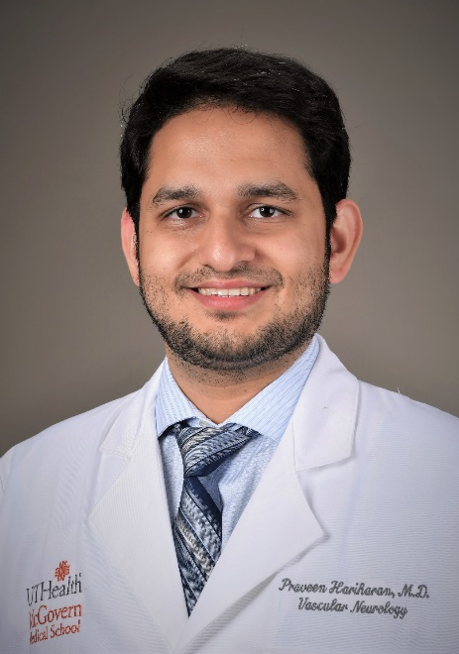
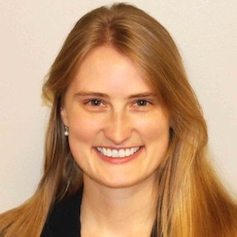
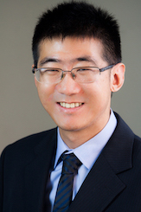
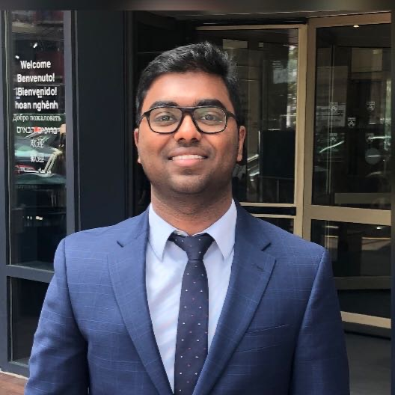
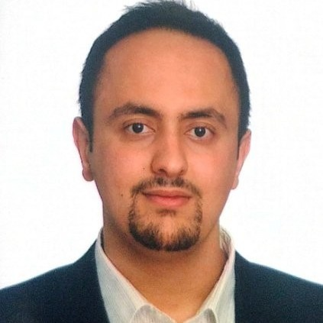
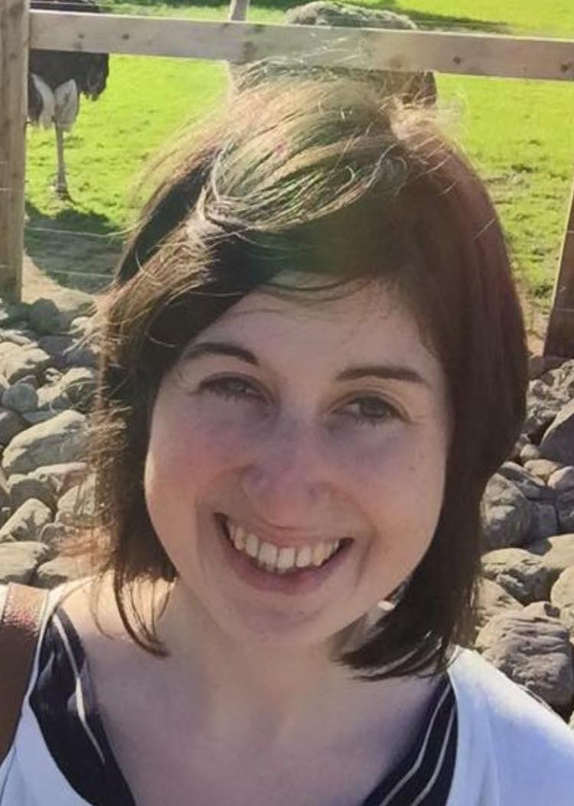
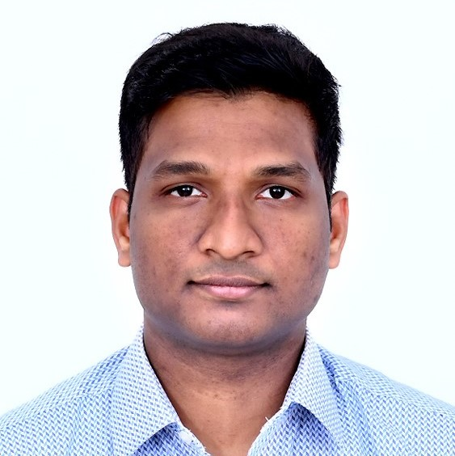
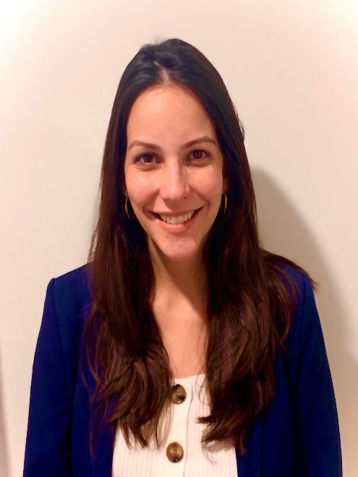
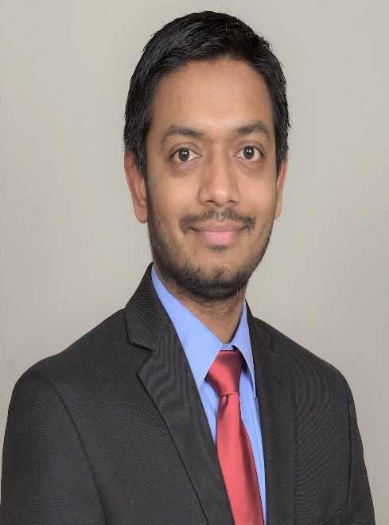
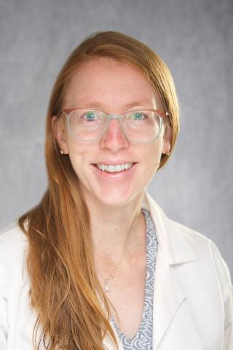
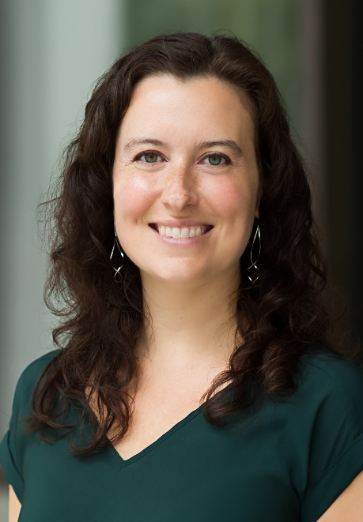
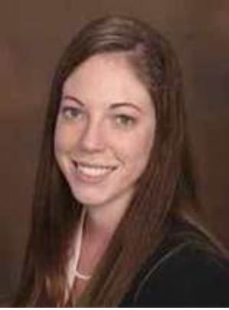
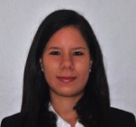
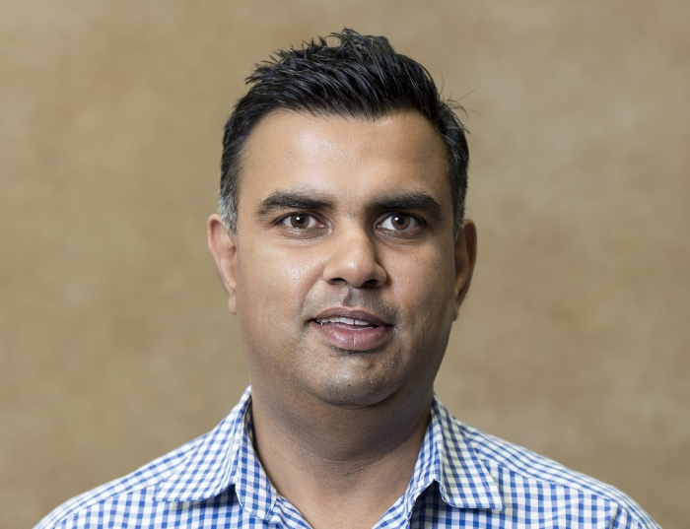
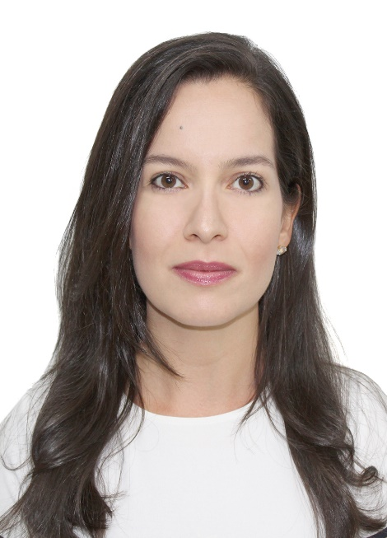
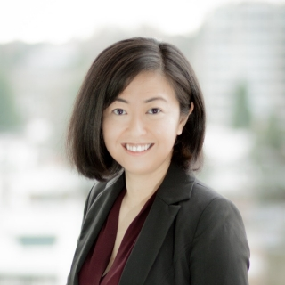
Mohammad Hossein Abbasi
Chad Aldridge
Ryan Bailey
Jakita Baldwin
Leanna Dehley
Rachel Forman
Sibaji Gaj
Stephanie Hage
Praveen Hariharan
Anna Huguenard
Michael Jang
Krishna Kandregula
Mohammad Kawas
Dearblha Kelly
Nishanth Kodumuri
Nastajja Krementz
Smit Patel
Hanna Roeder
Nicole Rosendale
Kristen Sandefer
Monica Maria Noya Santana
Amit Sethi
Lorena Viana
Lily Zhou

Slide 3
Learning Communities
Pam Duncan
05 MUSC Nishanth Kodumuri, MD
06 Medstar Chad Michael Aldridge, PT, DPT, MS-CR, NCS
15 Iowa Hannah Roeder, MD, MPH
19 UPENN Mohammad Hossein Abbasi, MD
20 U. Pittsburgh Amit Sethi, PhD, OTR/L
28 Washington U Anna Huguenard, MD
Anthony Kim
02 Columbia Jakita Baldwin, MD
11 USC Michael Jang, MD
13 UCSF Nicole Rosendale, MD
17 UMichigan Leanna Delhey, PhD
22 Utah Ryan Bailey, PhD, MSCI, MSOT
29 Yale Rachel Forman, MD
Cemal Sozener
03 Emory Lorena Souza Viana, MD
12 UCSD Monica Maria Noya Santana, MD
14 UC Krishna Kandregula, MD
16 Miami Nastajjia A Krementz, MD
21 Texas Praveen Hariharan, MBBS
26 Alabama Birmingham Kristen Sandefer, MD
Brad Worrall
01 Case Western Reserve Sibaji Gaj, PhD
04 Massachusetts General Dearbhla Kelly MB, BCh, BAO, MSc, DPhil, MRCPI, MRCP(UK)
08 Chicago Stephanie F. Hage, MD, MA, MSc
10 Stanford Lily Zhou, MD
11 UCLA Smit D. Patel, MBBS, MPH
27 Wake Forest Mohammad Iyas Kawas, MD, PhD
Thank you to mentors!!

Slide 4
Reminders
Request for new Trainees’ training plans – May 12, 2022
Survey to Trainees – May
Final Trainee Progress report – June
Fellows: Don’t forget to register your clinical trial enrollment on the StrokeNet website

