Slide 1
StrokeNet Clinical Research Professional Education Core
Heena Olalde, RN, MSN University of Iowa
Kinga Aitken, MPH, CCRP University of Utah

Slide 2
Why Was this Core Needed?
COVID19 and other factors led to instability in clinical trial workforce
Acute Need
For streamlined training for new coordinators
Integration in the StrokeNet Community
Retention & Career Development
Challenges and Potential solutions for RCC Management

Slide 3
Request for Funding Announcement NS-23-010
https://grants.nih.gov/grants/guide/rfa-files/RFA-NS-23-010.html

Slide 4
CRP Education Training Core
Dedicated to onboarding, continuing education and retention of research staff
Coordinators
RCC Managers
Grant administrators
Other research staff
Mirrors the existing Fellow Core
Leverage institutional CTSA resources

Slide 5
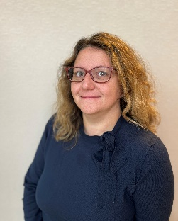
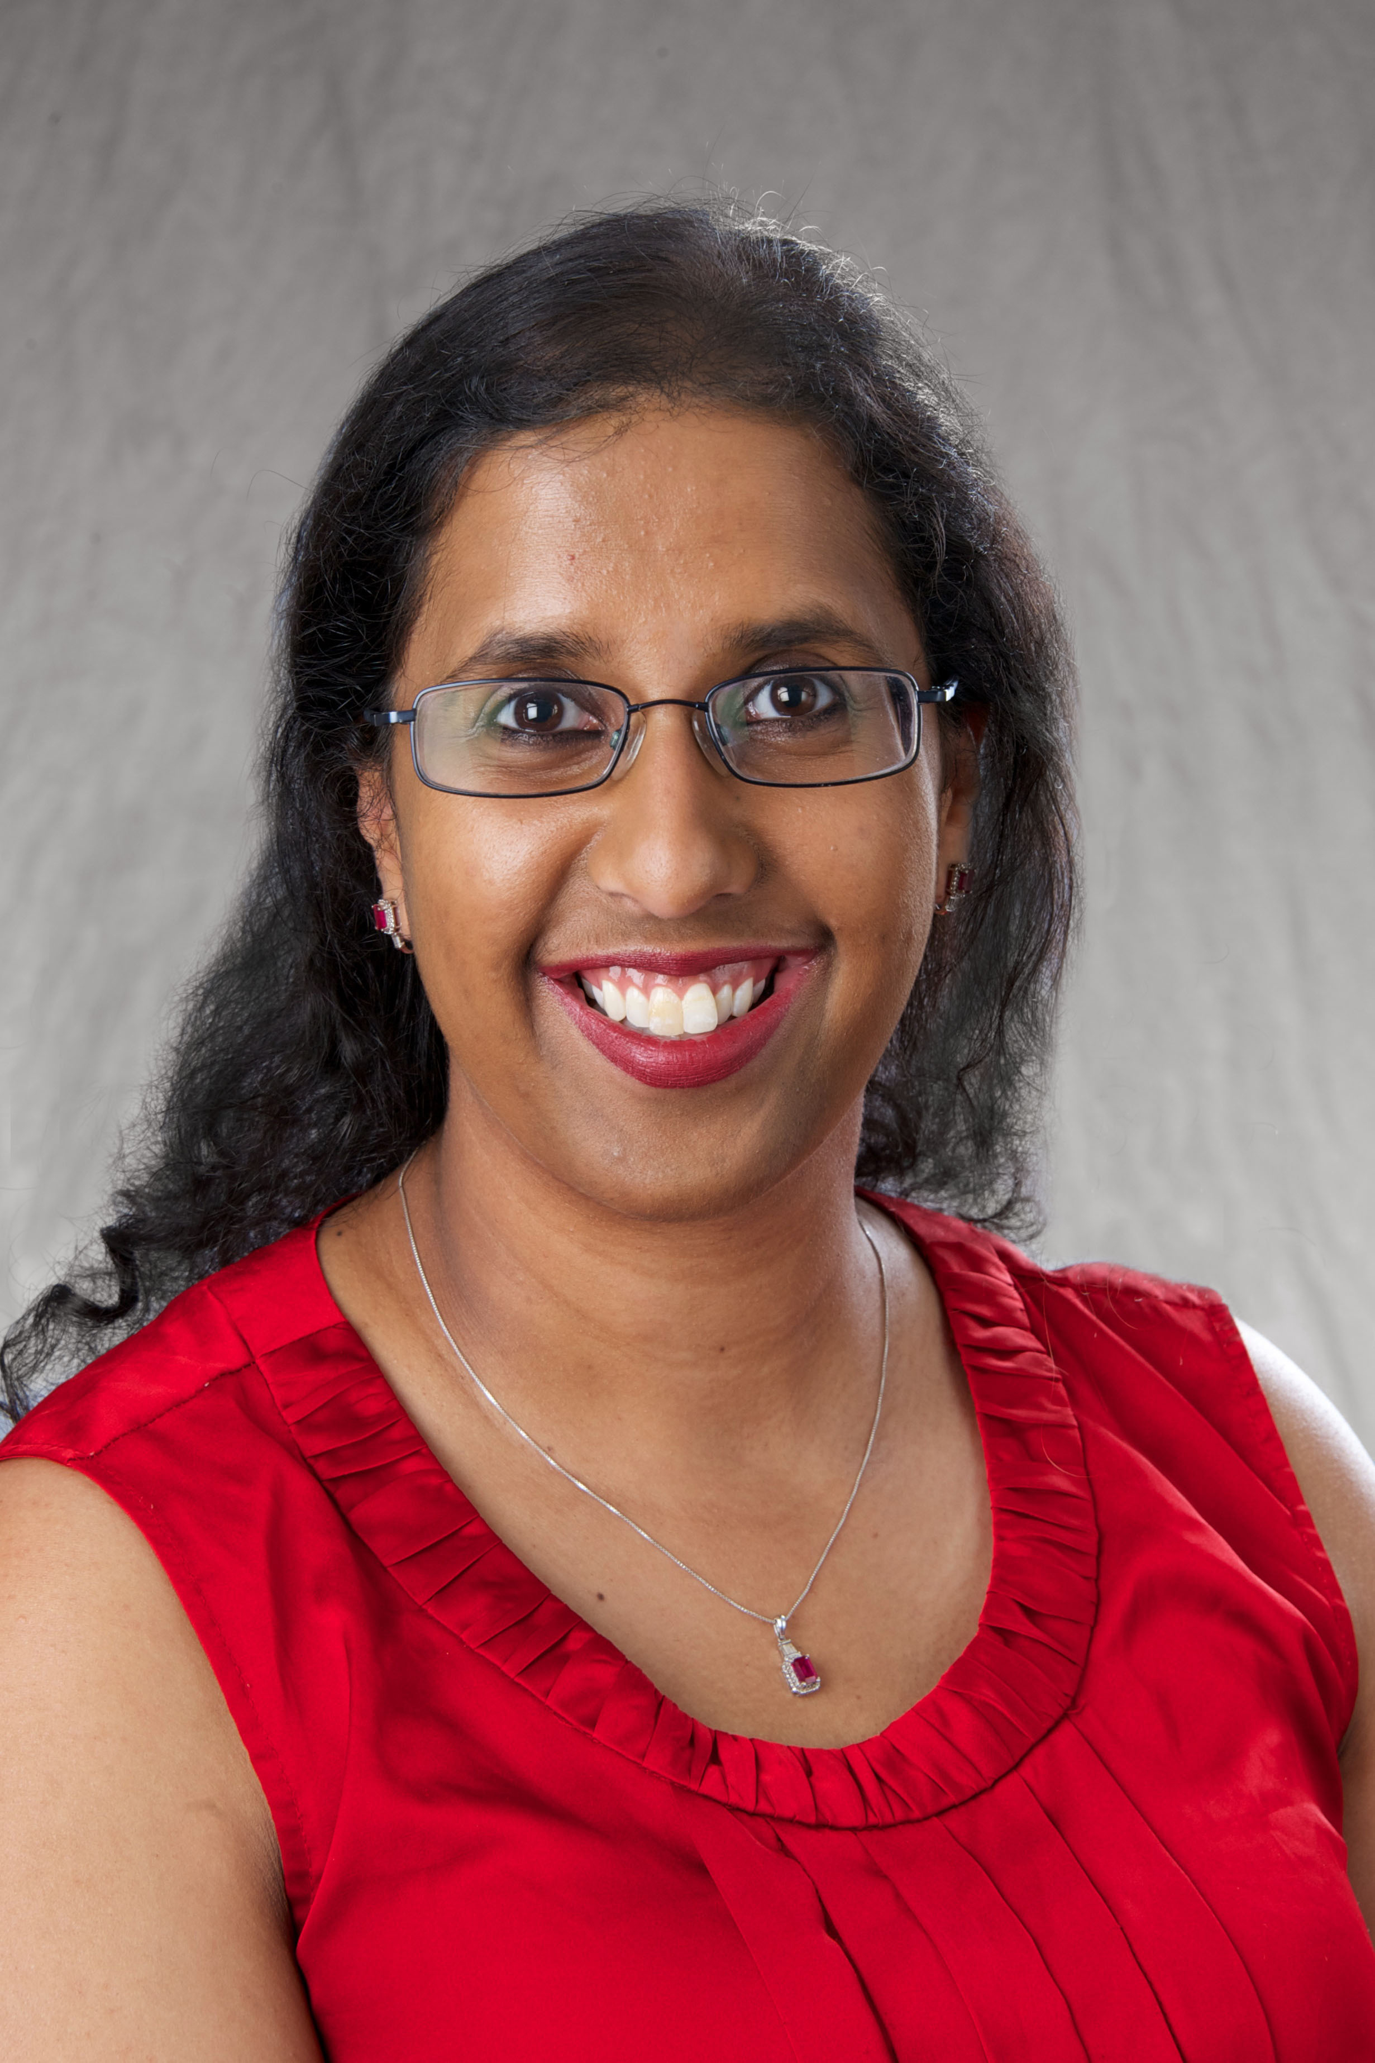
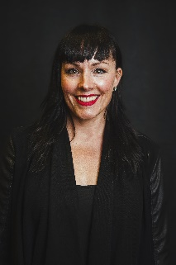
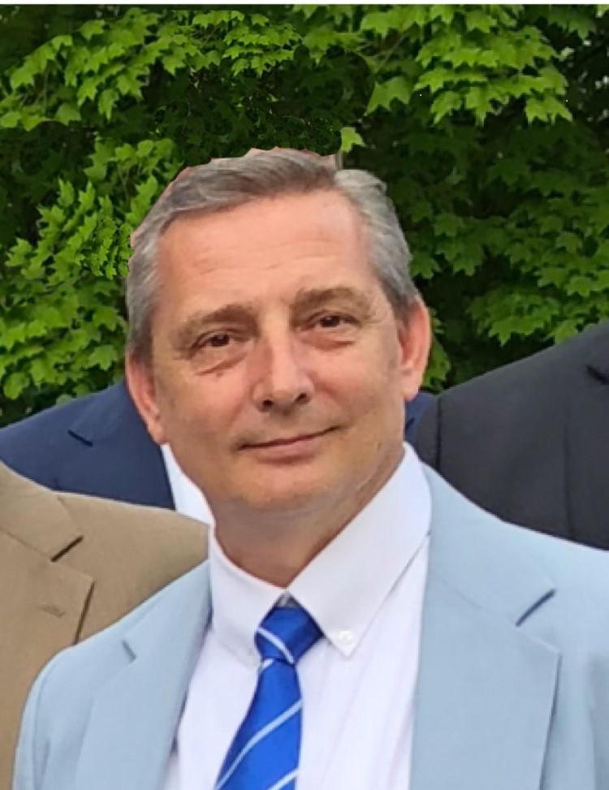
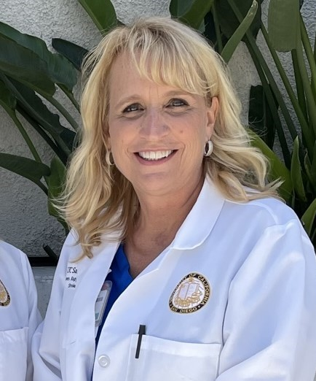
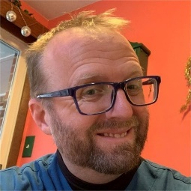
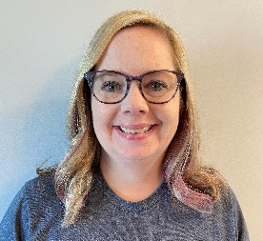
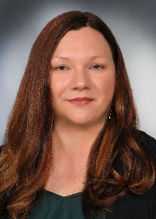
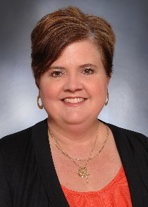
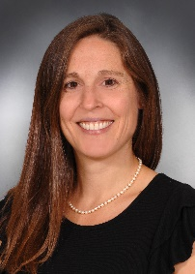
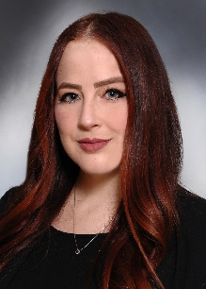
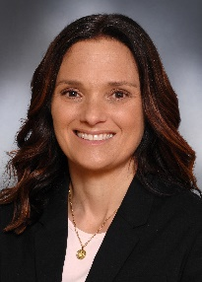
Co-Chairs
Heena Olalde, RN MSN
Kinga Aitken, MPH CCRP
Tammy Davis, RN
Jason Weimer, MA
Krystal Schmidtl
Abbey Staugaitis, RN MSN
David Haney
Karen Rapp,
RN, BSN
Laura Benken, MBA
Amy Sulken, CCRP
Jennifer Golan, MS
Kalli Beasley, MPH
Kristine Konsulis
Notes:
Heena and I have been selected as Co-Chairs for this core. We are humbled and excited about this opportunity.
We were able to assemble a core of wonderful colleagues who are very much invested in this mission.
We have included RCC managers (new and seasoned), site coordinators and NCC project managers, administrators and regulatory specialists. In the future, we would like to add a physician to this group to ensure that an MD perspective is preset as well
We would love to introduce the team, share their home institution and have them stand up and wave

Slide 6
Objectives for the CRP Core
NCC created training checklists (coordinators & RCC Managers)
Website reorganization for improved accessibility
Ongoing Needs Assessment
Bi-Monthly to Monthly CRP core meetings
Monthly RCC/Coordinator Meetings
Develop mentoring program

Slide 7
Coordinator Training Guidance
4 main domains
General Research Training
GCP, consenting, IATA, HIPPA, etc.
Stroke Related Training
Neuroanatomy, Stroke Localizations, Vascular Imaging, Scales, Stroke Types, etc.
NIH StrokeNet Training
SOPs, WebDCU, e-Consenting with RedCap, etc.
Trial Specific Training

Slide 8
RCC Manager Training Guidance
Includes Objectives for the Coordinators plus the following
Site Management Training
How to manage sites, financial management, etc.

Slide 9
Objectives for the CRP Core
NCC created training checklists (coordinators & RCC Managers)
Website reorganization for improved accessibility
Ongoing Needs Assessment
Bi-Monthly to Monthly CRP core meetings
Monthly RCC/Coordinator Meetings
Develop mentoring program

Slide 10
Open forum
What would you like to get out of this core?
What would benefit your RCC/ satellite?
What support can RCC PIs provide to their Managers and Coordinators?

Slide 11
Closing thoughts
Overall goal: to provide meaningful content to research staff at all levels
Ensure that everyone feels empowered and confident
Share ideas, fuel enthusiasm, and motivate
To continue supporting the StrokeNet mission

