Slide 1
Education and Training Core​
UPDATE ​
Randolph Marshall, MD, MS​
October 9, 2023​
Toronto, CA​

Slide 2

Education and Training Core
Mission: To develop stroke-related knowledge and skills for RCC trainees through interactive content and mentorship
Vision: To become the preeminent platform for education and training of future leaders in stroke research

Slide 3
Education and Training core
Randolph Marshall (Chair)
Devin Brown (Co-Chair)
Scott Janis (NINDS)
Harold Adams
Tatjana Rundek
Cemal Sozener
Shyam Prabhakaran
Farhaan Vahidy
Anthony Kim
Andrea Escobar (RCC coordinator)
Stephanie Wilbrand (RCC coordinator)
Lauren Menzies, MD U Cincinnati (Trainee)
Julia Bu, MD UC San Diego (Trainee)
Jeanne Sester (coordinator)
Notes:
Shout out to Dawn

Slide 4
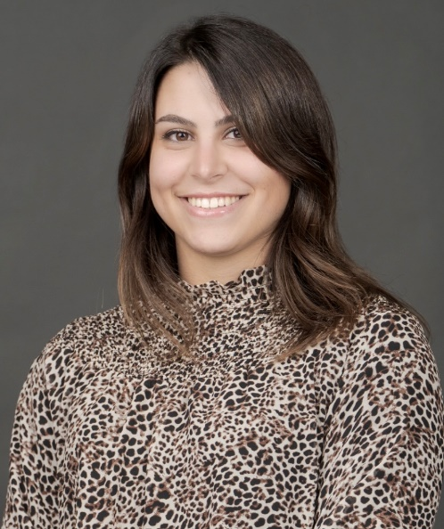
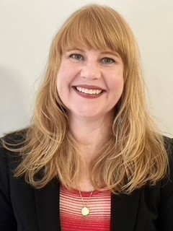
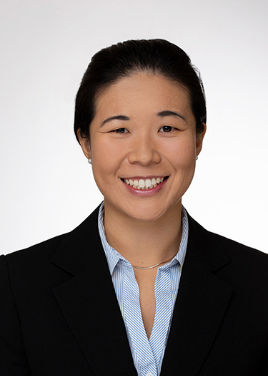
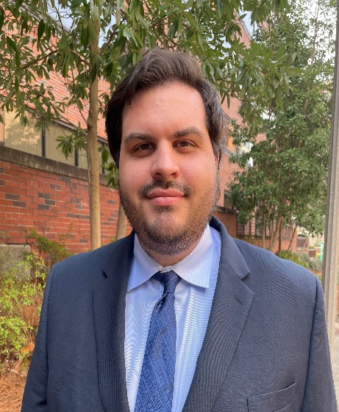
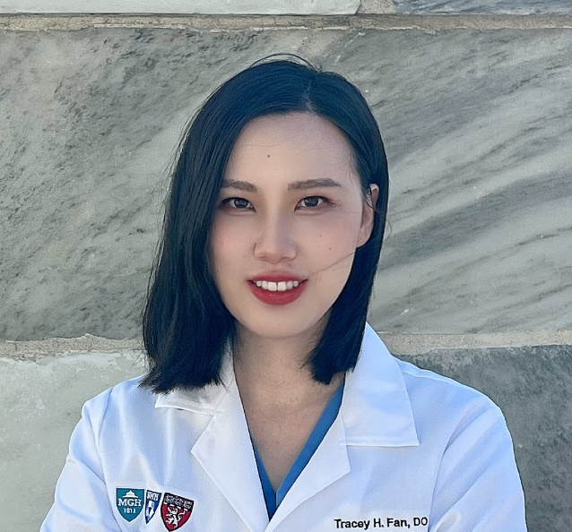
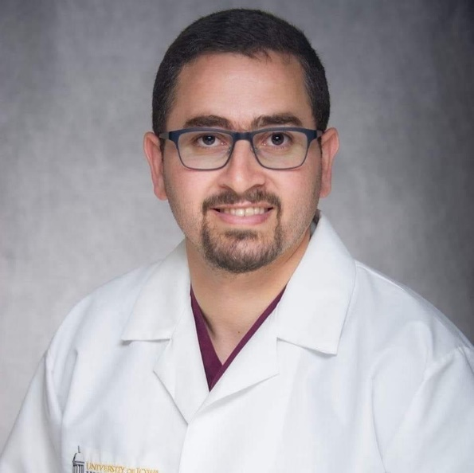
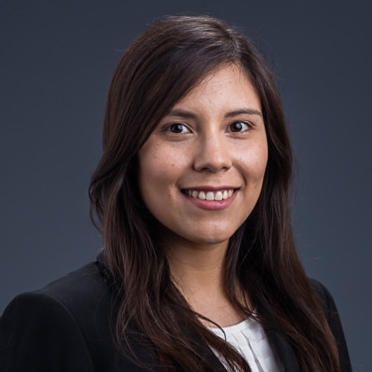
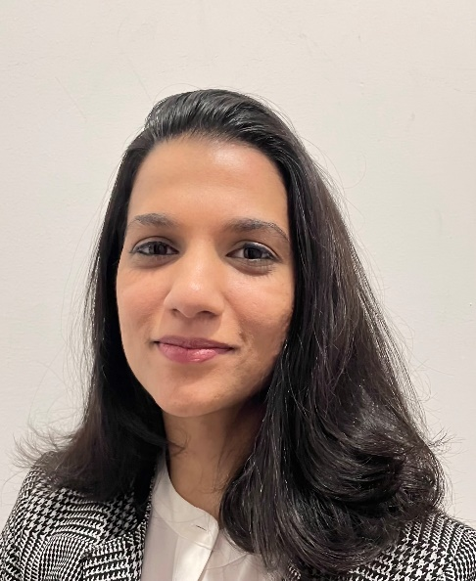
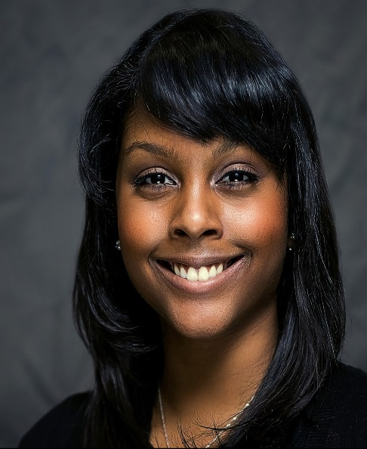
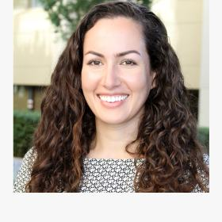
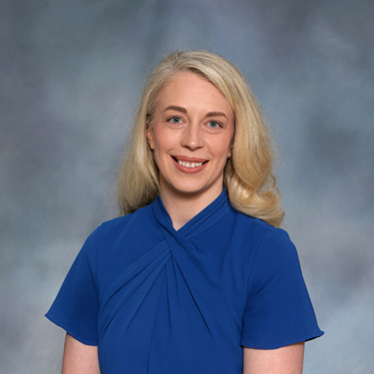
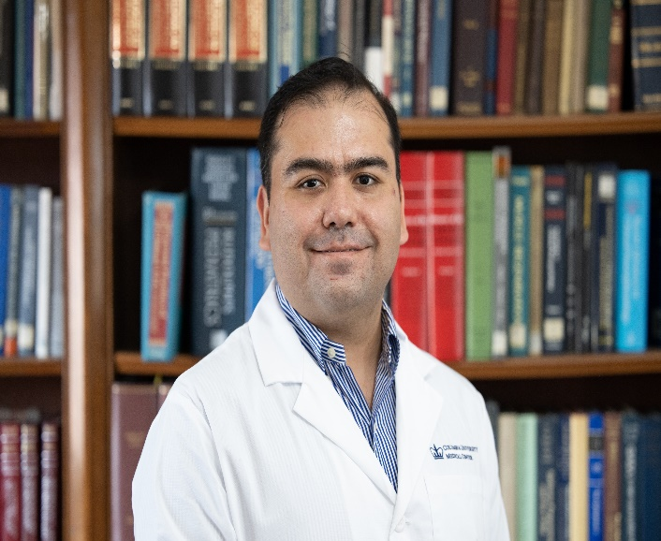
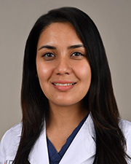
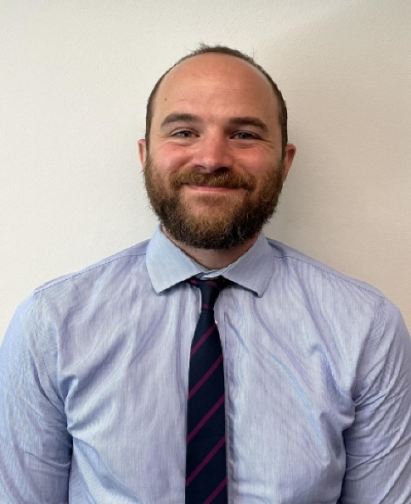
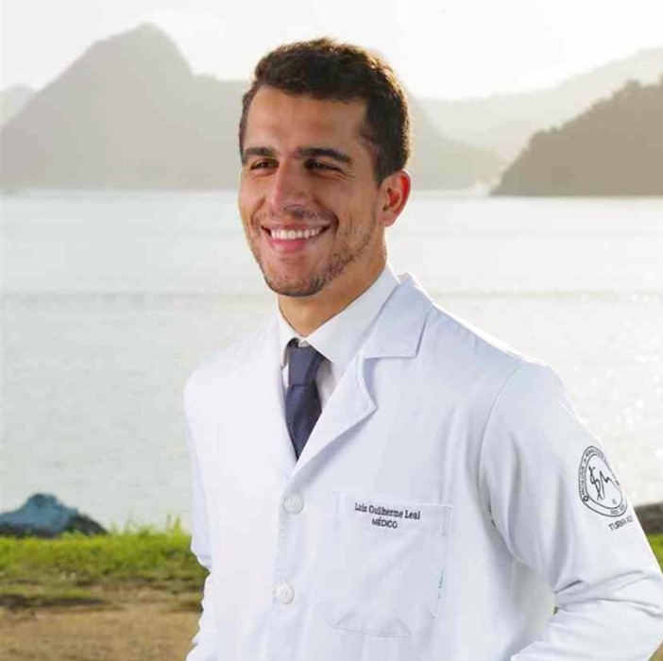
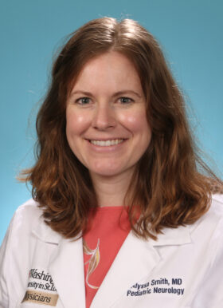
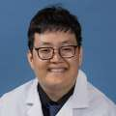
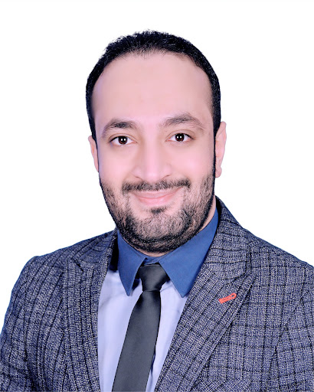
Jane Alkhazov, PT, DPT
MedStar
Lauri Bishop PhD, PT, DPT
Miami
Julia Ting Bu, MD
UCSD
Victor Del Bene, PhD
UAB
Tracey H Fan, DO
Chicago
Malik Ghannam, MBBCh
Iowa
Ana-Lucia Garcia Guarniz, MD
MGH
Lamya Ibrahim, MD
UPENN
Lorelei Johnson, PhD
Wake Forest
Lironn Kraler, MD
Stanford
Lauren E. Menzies, MD
UC
Edgar R. Lopez Navarro, MD Columbia
Azima Shaji, MD
Texas
Aaron Shoskes, DO
Utah
Luis Leal Silva, MD
Minnesota
Alyssa Smith, MD
Washington U.
Philip Sun, MD
UCLA
Mohamed Tarek, MD
Emory

Slide 5
2023-2024 Trainees (n=18)
Career stage
Clinical Fellow | 8
Junior Faculty | 8
Post-Doctoral Research Fellow | 1
Non-MD trainee | 1
TOTAL | 18
Degrees
MD | 11
DO | 2
MBBCh | 1
MD, MSc | 0
MD, PhD | 0
Non MD Trainee | 1
PharmD, BCPS | 0
PhD | 2
PhD, MD, MPT | 0
PhD, PT, DPT | 1
Disciplines
Biomedical Engineering | 0
Emergency Medicine | 0
Emergency Medicine Pharmacist | 0
Neurohospitalist | 0
Neurologist/ Vascular Neurologist | 12
Neuropsychologist | 1
Neuroscientist | 0
Pediatric Neurologist | 1
Physical Therapy | 2
Speech Pathology | 1
Data Science | 1
Demographics
Male | 7
Female | 11
Latino/Hispanic | 3
African American | 1

Slide 6
Education Training Core
Core Programming –
  Grand Rounds Webinar Series
  Professional Development Webinar Series
  Basic Science Webinars
  Learning Communities
  Mentored Trainee Research with presentations

Slide 7
NIH StrokeNet Grand Rounds Schedule
Date | Topic | Speaker | Institution | Moderator
July 27, 2023 | The organization of post-stroke care to mitigate health disparities | Anjail Sharrief, MD | UTH Houston | Randy Marshall, MD
Aug 31, 2023 | Expanded indications for Thrombectomy - Where are we Now? | Santiago Ortega Gutierrez, MD | University of Iowa | Randy Marshall, MD
Sept 28, 2023 | Stroke Neuroprotection: How to bring translational science to the bedside | Enrique Leira, MD | University of Iowa | Cemal Sozener, MD
Oct 26, 2023 | Vagus nerve stimulation for upper extremity stroke recovery: alternative pathways to recovery | Theresa Jacobson Kimberley, PT, PhD | MGH | Harold Adams, MD
Nov 30, 2023 | Primary prevention of stroke and cerebrovascular disease: the emerging potential for community-clinic collaboration | Walter Kernan, MD | Yale University | Devin Brown, MD
Jan 25, 2024 | Bioengineering prosthetics for stroke recovery | Jacob George, PhD | University of Utah | Farhaan, Vahidy, PhD, MBBS
Feb 29, 2024 | Imaging management in clinical trials and clinical research | Achala Vagal, MD | University of Cincinnati | Shyam Prabhakaran, MD
Mar 28, 2024 | Gloves Off for Acute Stroke Management: Fellow Case Presentations to 2 Stroke Experts | TBA | TBA
April 25, 2024 | The Rate of Blood Coagulation within the Hematoma of Patients with Acute Hemorrhagic Stroke: A Neuroimaging Study | Muhammad Haque, PhD | UTH Houston | TBD
May 30, 2024 | International Pediatric Stroke Study | Nomazulu Dlamini, MD, PhD | SickKids, Univ. of Toronto | Anthony Kim, MD

Slide 8
Basic Science Webinar series
2017 Atrial Cardiopathy. (ARCADIA) David Tirschwell
2018 Cerebral Hemodynamics (CREST-H) Randy Marshall
2019 The Science Underlying the MOST Trial (MOST) Joe Broderick
2020 Pediatric Stroke (FOCAS) Heather Fullerton
2021 Stroke Genetics (ARCADIA G) Dana Leifer
2022 Intracranial Athero and Vascular Remodeling (CAPTIVA) Jose Gutierrez
2022 Neuromodulation (TRANSPORT2) Wayne Feng

Slide 9
Basic/Translational Science Schedule
Date | Topic | Speaker | Institution | Moderator
Oct 23, 2023 2:00PM | Genetics of Recovery | Sean Savitz, MD | UTH | TBD
Mar 18, 2024 2:00 PM | RHAPSODY | Pat Lyden, MD | USC | TBD

Slide 10
Professional Development Webinar series 2023-4
Statistical Analysis – Big data (Adam De Havenon)
Grant writing (Dan Woo)
Preparing a job talk/Communication for job application
  (Tatiana Rundek, Shyam Prabhakaran, Lawrence Wechsler)
Work-life balance and team building (Dawn Kleindorfer)
Trainee presentations

Slide 11
Notes:
This was a really nice publication by Farhaan Vahidy and members of the Education and Training core that outlines the workings and accomplishments of the Training Core

Slide 12
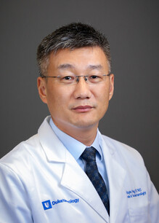
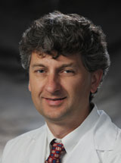
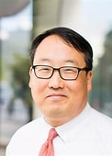
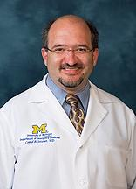
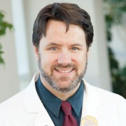
Wayne Feng, MD
Brett Cucchiara, MD
Anthony Kim, MD
Cemal Sozener, MD
Brad Worrall, MD
2023-2024 Learning Community Group Leaders

Slide 13
Learning Communities 2023-2024

Slide 14
Metrics
Mandatory attendance on Grand Rounds Webinars, Professional Development webinars, participation in Learning Communities
Mandatory trainee presentations
  In person/remote at national meeting (3)
  In person/remote on a special, mentored 2-hour session (6)
  Time slots on the Professional Development Webinar series (9)
Other service activity to the StrokeNet Community (e.g. trainee volunteer on the Education and Training Core.)
End of year survey: publications, grant submissions, professional appointments post-StrokeNet training
Database kept by Jeanne Sester

Slide 15
Post-training Survey Results on Research

Slide 16
New initiatives
Trainees observe in WGs
  Trainees sign up to join a WG session
  Feedback positive
Tracking clinical trial enrollments
  Self reporting of enrollments
  Award at the end of the year
Remote mentoring
  Trainees specify outside mentors on training plan
  Mentors have an initial Zoom meeting, discuss and meet as mutually decided.

Slide 17
New Directions for StrokeNet 3.0
Expanding education and training – coordinators, data management group
Interface with other platforms – NeuroNEXT? GAINS?

Slide 18

Questions?

Slide 19
Reminder: Deadlines
  Request for new Trainees’ training plans – May
  Solicit Grand Rounds Webinar topics and speakers – May
  Survey to Trainees – June
  Final Trainee Progress report – June
  Trainee Contact form – June
  Update from prior trainees – June

Slide 20
Self-directed learning opportunities (trainees, coordinators, mentors)
https://www.nihstrokenet.org/education
  Introduction to the Principles and Practice of Clinical Research (IPPCR) https://ocr.od.nih.gov/courses/ippcr.html
  Ethical and Regulatory Aspects of Clinical Research https://bioethics.nih.gov/courses/ethical-regulatory-aspects.shtml | https://videocast.nih.gov/PastEvents?c=22
  Principals of Clinical Pharmacology
  https://ocr.od.nih.gov/courses/principles-clinical-pharmacology.html

