Slide 1
Bernadette Boden-Albala, MPH, DrPH
Pronouns: she/her/hers
Director and Founding Dean, Program in Public Health
Professor, Department of Health, Society and Behavior and Department of Epidemiology & Biostatistics, Program in Public Health
Department of Neurology, School of Medicine
Susan & Henry Samueli College of Health Sciences
University of California, Irvine
Diversity, Equity, and Inclusion in Clinical Trials
Lesli Skolarus, MD, MS
Pronouns: she/her/hers
Lesli E. Skolarus, MD, MS
Vice-Chair of Faculty Development and Professor of Neurology Davee Department of Neurology, Feinberg School of Medicine
Director, Community Academic Consultations, Center for Community Health,
Northwestern University Clinical and Translational Sciences (NUCATS) Institute

Slide 2
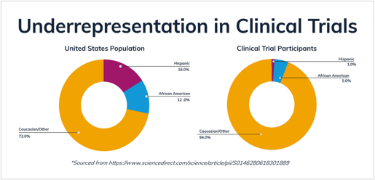
Inclusion in Clinical Trials
Inadequate involvement of women and racial-ethnic minorities can negatively impact the scientific, economic, and ethical value of a clinical trial. Matter of social justice​
NIH Policy and Guidelines on the Inclusion of Women and Minorities as Subjects in Clinical Trials 1993 – Amended 2001​
Racial-ethnic minorities account for one-third of the American population, but account for less than one tenth of U.S. clinical trial participants​
Low rates of women and racial-ethnic minorities in neurological clinical trials​
​

Slide 3
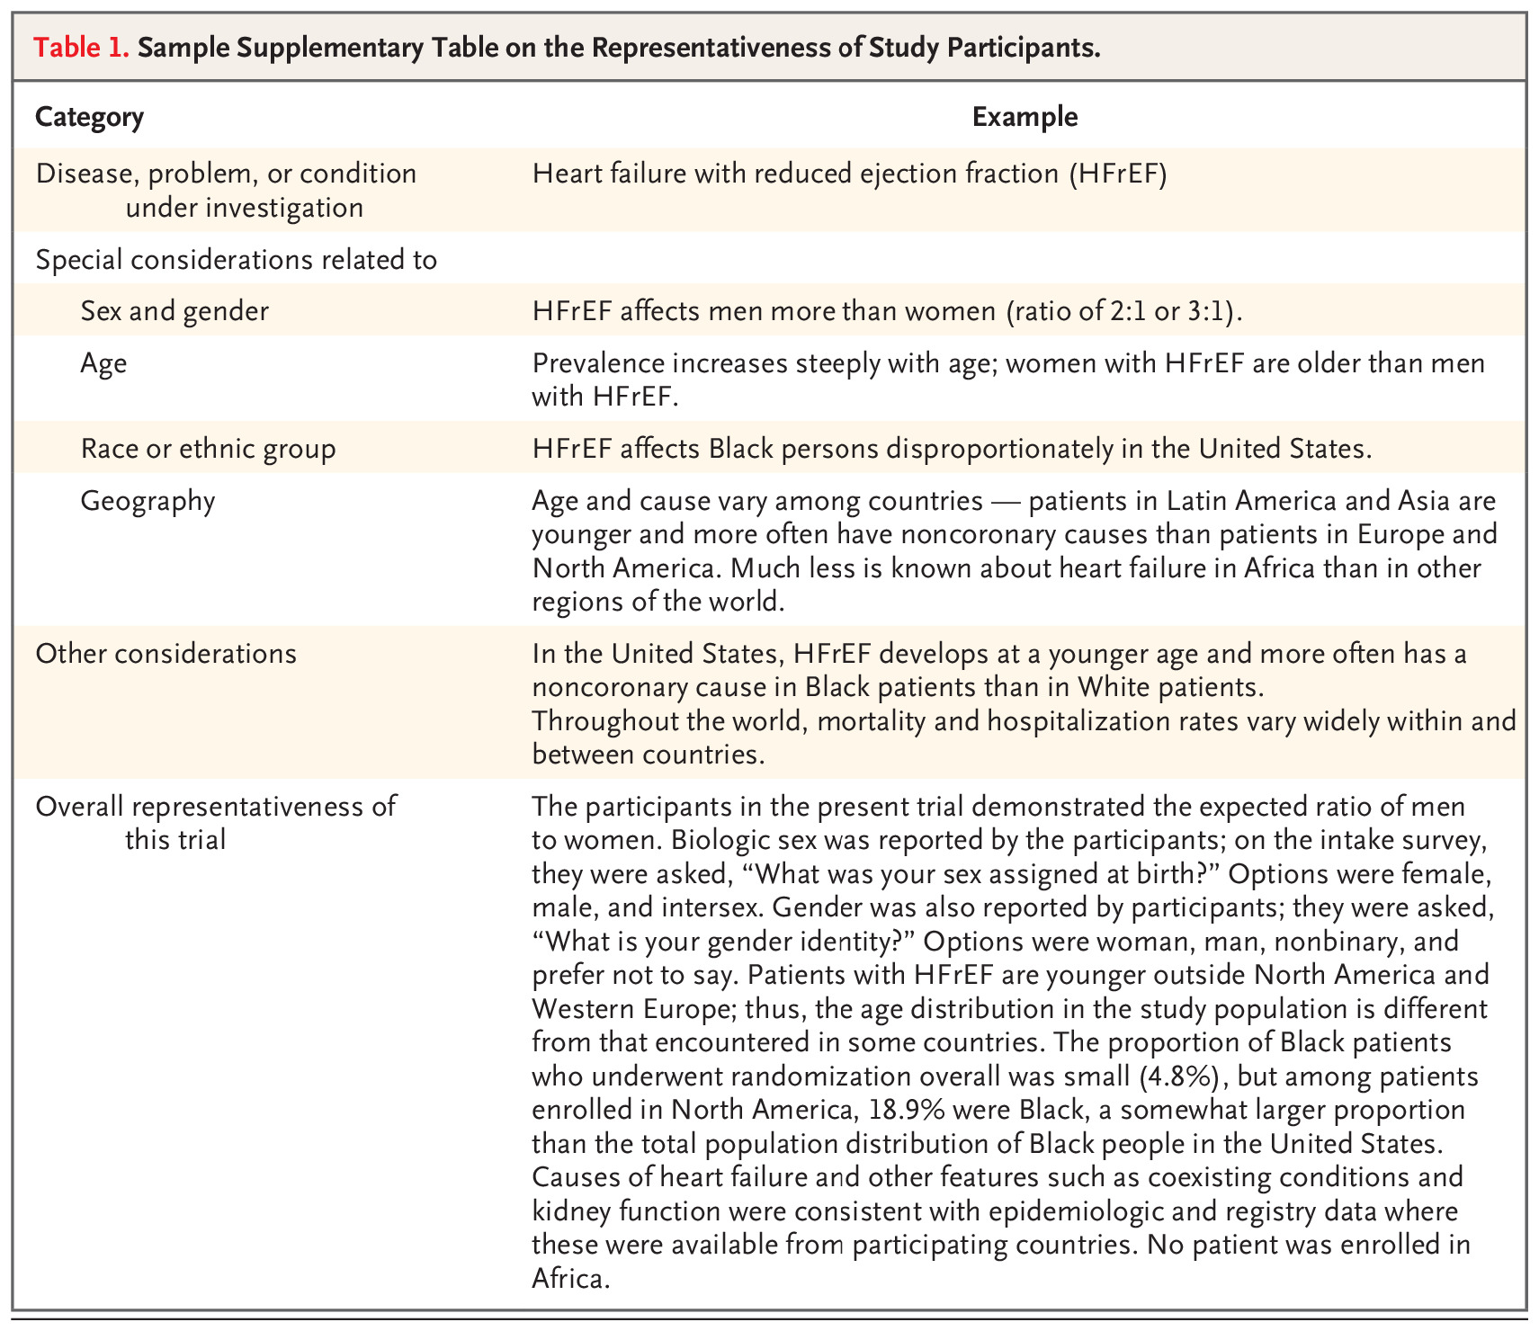
“Striving for Diversity in Research Studies” Key Points​
“Clinicians cannot know how to optimally prevent and treat disease in members of communities that have not been studied”​
Obstacles hinder diversity in clinical research​
Logistics: Inflexible work schedules, lack of convenient transportation to research center​
Mistrust: Potential participants fear exploitation/harm by medical establishment​
​
Dearth of investigators and study staff who are themselves members of minority groups​
Involvement may increase confidence of potential minority participants and community leaders​
Mentorship of minority investigators is key​
​
As of January 1, 2022, NEJM will require authors to prepare supplementary tables containing background information on the disease, problem, or condition and the representativeness of the study group​

Slide 4
Preliminary Trial Enrollment Data as of 9/22/2023
Project name | Sample size | Sites | enrolled | % Female | % Hispanic | % Black | % White | % American Indian / Alaska Native | % Native Hawaiian or Pacific Islander | % Asian | % More than one race
ARCADIA | 1100 | 141 | 1015 | 54.3 | 8.1 | 21.1 | 74.9 | 0.4 | 0.3 | 1.7 | 0.3
DEFUSE3 | 476 | 38 | 182 | 50.5 | 13.2 | 8.2 | 86.8 | 0.5 |  | 3.3
TeleRehab | 124 | 11 | 124 | 27.4 | 2.4 | 26.6 | 64.5 |  |  | 8.1
ASPIRE | 700 | 90 | 243 | 47.3 | 7.4 | 13.6 | 75.3 | 0.4 | 1.2 | 6.2 | 1.2
CAPTIVA | 1683 | 58 | 195 | 43.6 | 16.4 | 39 | 49.7 | 0.5 | 1 | 3.1 | 1
CREST2 | 2480 | 81 | 1320 | 38 | 3.4 | 7 | 89.5 | 0.7 | 0.1 | 1.4
FASTEST | 860 | 49 | 268 | 33.6 | 7.8 | 9.7 | 32.1 | 0.4 | 0.7 | 55.6
I-ACQUIRE | 240 | 13 | 163 | 49.7 | 17.8 | 7.4 | 78.5 |  | 0.6 | 3.7 | 2.5
MOST | 1200 | 57 | 514 | 49.8 | 7.8 | 25.1 | 71.4 |  | 0.2 | 2.7 | 0.2
SATURN | 1456 | 96 | 440 | 55 | 11.1 | 10.5 | 83.4 | 0.7 | 0.2 | 5
SleepSMART | 3062 | 111 | 1290 | 42.1 | 9.9 | 28.1 | 65 | 0.9 | 0.5 | 3.2 | 0.5
TRANSPORT2 | 129 | 14 | 112 | 42 | 8 | 42.9 | 50.9 |  |  | 3.6 | 0.9
VERIFY | 657 | 18 | 120 | 32.5 | 9.2 | 42.5 | 47.5 |  |  | 0.8 | 1.7

Slide 5
Improving the representativeness of trial participants
Elevate the Minority Recruitment/Retention Advisory Committee to a Diversity Equity Inclusion (DEI) core led by Drs. Boden-Albala and Skolarus along with 6-8 members (including clinical trials staff) that will be responsible for the following goals/activities:
Attend working groups in new proposal development, with dedicated time to:
discuss enrollment goals to match the sociodemographic profile of the population or disease of interest
recruitment and retention strategies to meet these goals.
Review newly funded protocols before implementation, in terms of:
eligibility, outreach, translations, and cultural sensitivity to ensure that strategies are in place to achieve a representative trial population.
Provide programming with trial coordinators at trial investigator meetings on:
strategies to ensure broad participant representation
Standing meetings at least quarterly to coordinate activities
Steering committee education to ensure inclusiveness in trial designs, screening, consenting, and retention.
Encouragement of broad trial implementation of short-form consents in as many languages as feasible.
Real-time monitoring of recruitment and retention in terms of gender/sex and racial/ethnic diversity.

Slide 6
Patient Input in all Aspects of Clinical Trials
By incorporating patient perspectives, we increase the likelihood of representative trial population and more meaningful trial results.
In mid-2022, we expanded our Working Groups to each include two patient representatives, in addition to their incorporation inn some individual trials.
Next step will be to form an advisory committee of these six individuals and assign a chair among them to lead a meeting bi-annually, with compensation for their efforts. This patient-driven activity will facilitate further meaningful and critical feedback to StrokeNet.

Slide 7
Patient and Community Input in All Aspects of Clinical Trials
 | Pre-Study | Trial Design | Trial Implementation | Analysis | Dissemination
ACADEMIC | Proposal writing | Protocol Informed Consent IRB/Regulatory | Conduct study | Ensure data sharing | Internal, national, international, conferences, media Publications
COMMUNITY/ PATIENT | Needs identification Resource identification | Eligibility criteria Recruitment and Retention strategies Incentives Outcome assessments Consent language | Support recruitment Advocate for the study | Contextualize the results | Local media, community social media, community events Publications

