Slide 1
NIH StrokeNet Network Meeting
October, 2023
DOMAIN SPECIFIC CONSIDERATIONS
Recovery& Rehabilitation Group
Steven C. Cramer, MD

Slide 2
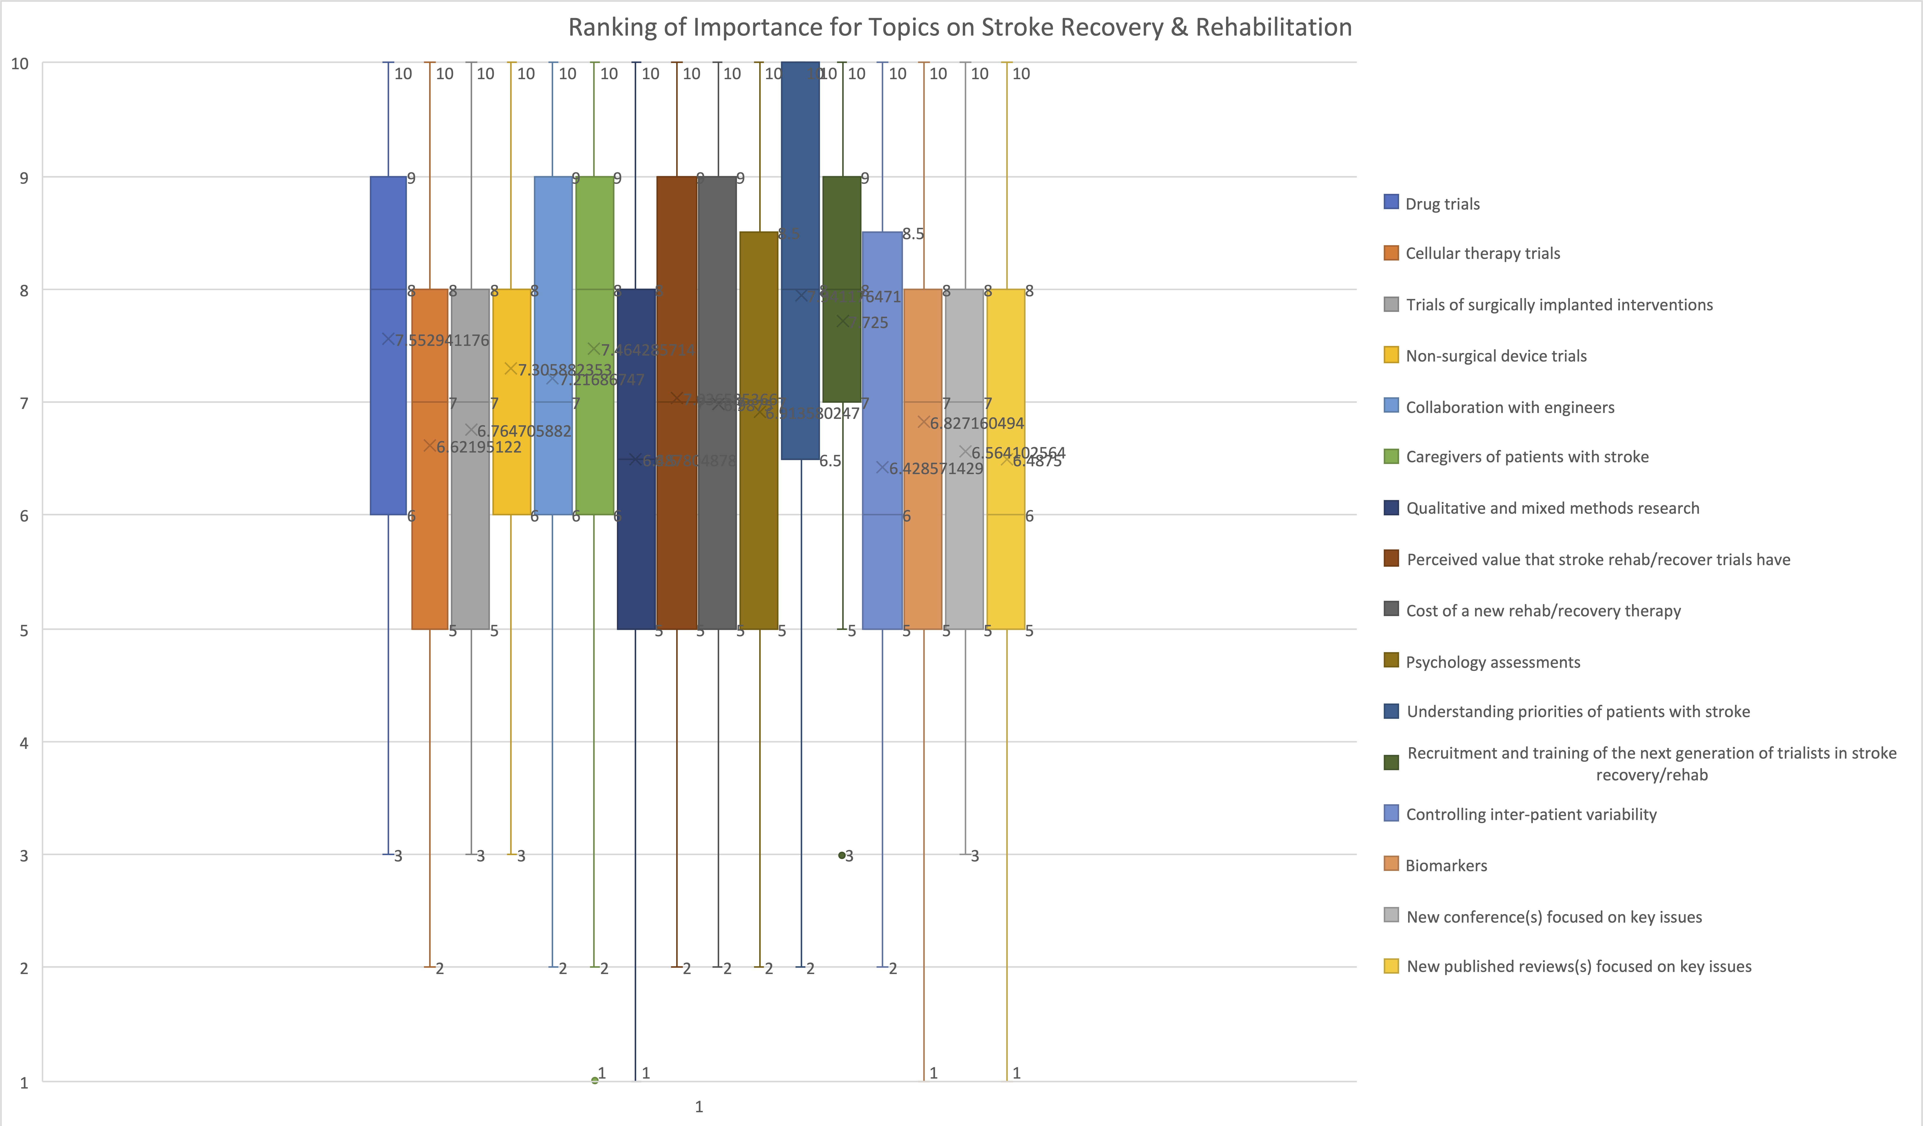
101 responses
65 PI
36 Coordinator

Slide 3
10 Understanding priorities of patients with stroke
9 Drug trials
9 Collaboration with engineers
9 Caregivers of patients with stroke
9 Perceived value that stroke rehab/recovery trials have
9 Cost of a new rehab/recovery therapy
9 Recruitment/training of next generation of trialists in stroke rehab/recovery

Slide 4
10 Understanding priorities of patients with stroke
9 Drug trials
9 Collaboration with engineers
9 Caregivers of patients with stroke
9 Perceived value that stroke rehab/recovery trials have
9 Cost of a new rehab/recovery therapy
9 Recruitment/training of next generation of trialists in stroke rehab/recovery

Slide 5
Unique challenges to stroke recovery/rehabilitation trials
Young field of investigation

Slide 6
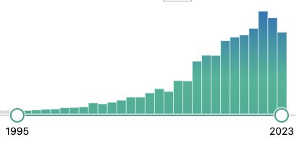
PubMed search “stroke recovery”

Slide 7
Unique challenges to stroke recovery/rehabilitation trials
Young field of investigation
Biomarkers still being defined

Slide 8
Unique challenges to stroke recovery/rehabilitation trials
Young field of investigation
Biomarkers still being defined
Biomarkers are sometimes unfamiliar

Slide 9
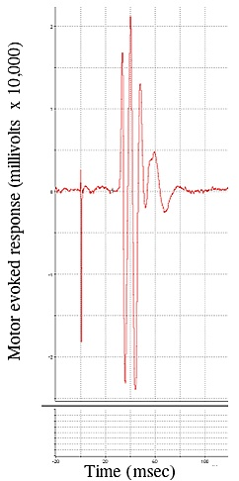
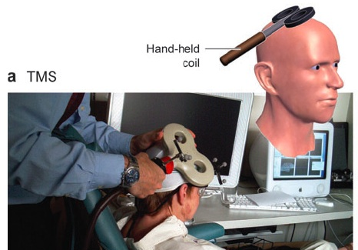

Slide 10
Unique challenges to stroke recovery/rehabilitation trials
Young field of investigation
Biomarkers still being defined
Biomarkers are sometimes unfamiliar
Often need many treatment sessions

Slide 11
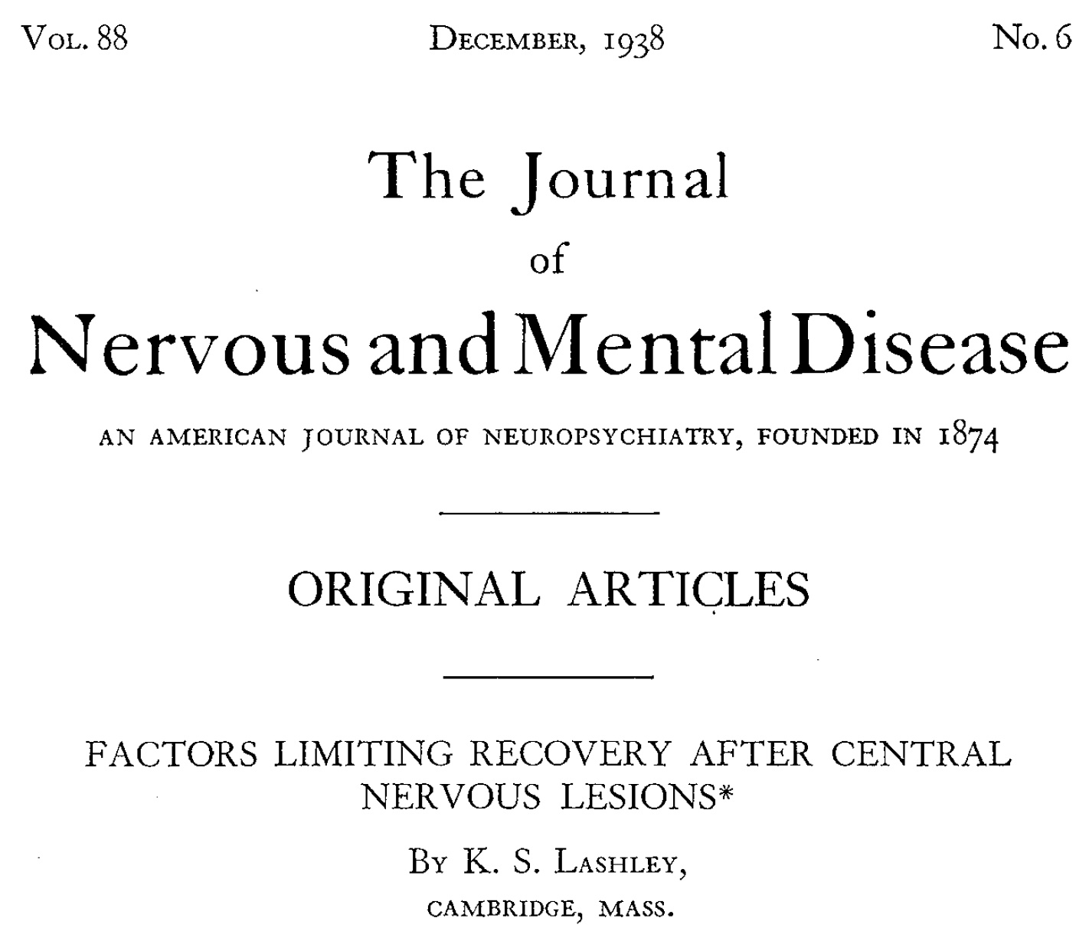
“After extensive lesions, the amount of training necessary to reestablish the habits is much increased.”
Lashley, KS. J Nervous Mental Disease. 1938; 88: 733-755.

Slide 12
20
treatment
sessions

Slide 13
20
treatment
sessions
36
treatment
sessions
Cramer et al. JAMA Neurology. 2019; 76:1079-1087

Slide 14
Unique challenges to stroke recovery/rehabilitation trials
Young field of investigation
Biomarkers still being defined
Biomarkers are sometimes unfamiliar
Often need many treatment sessions
Often patients change treatment setting during the trial

Slide 15
Unique challenges to stroke recovery/rehabilitation trials
Young field of investigation
Biomarkers still being defined
Biomarkers are sometimes unfamiliar
Often need many treatment sessions
Often patients change treatment setting during the trial
Often require multidisciplinary teams

Slide 16
Unique challenges to stroke recovery/rehabilitation trials
Young field of investigation
Biomarkers still being defined
Biomarkers are sometimes unfamiliar
Often need many treatment sessions
Often patients change treatment setting during the trial
Often require multidisciplinary teams
Can study unfamiliar forms of therapeutic intervention

Slide 17
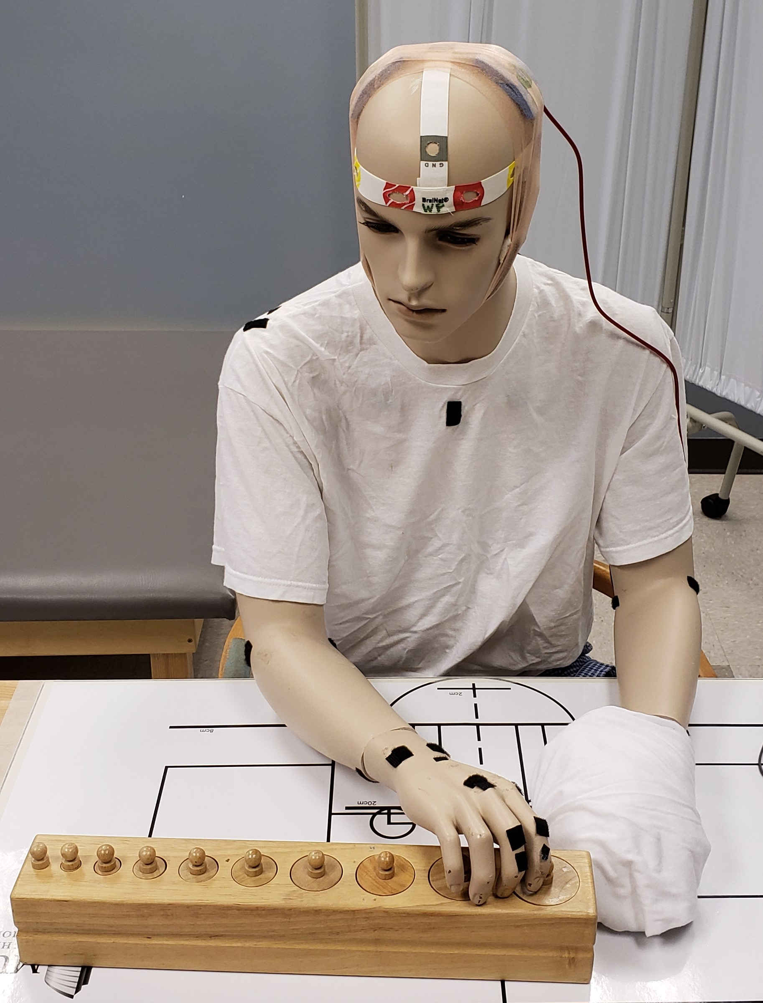
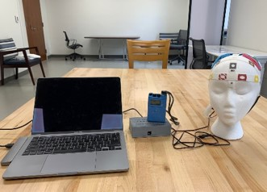

Slide 18
Unique challenges to stroke recovery/rehabilitation trials
Young field of investigation
Biomarkers still being defined
Biomarkers are sometimes unfamiliar
Often need many treatment sessions
Often patients change treatment setting during the trial
Often require multidisciplinary teams
Can study unfamiliar forms of therapeutic intervention
Often use detailed endpoints; some require special expertise

Slide 19
Stroke 2021; 52:1154-1161

Slide 20
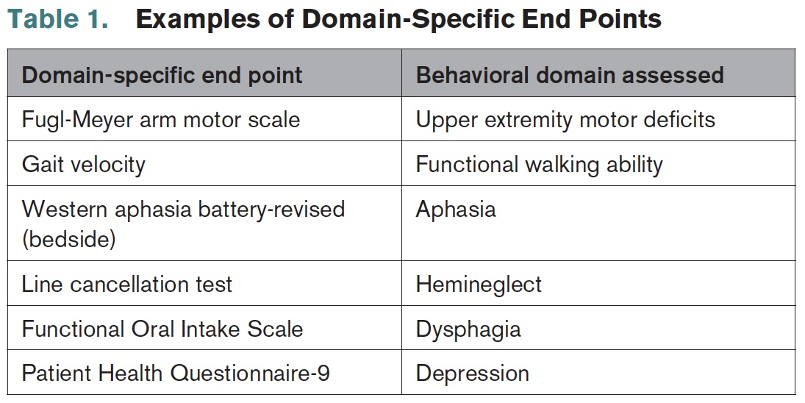
Stroke 2021; 52:1154-1161

Slide 21
Stroke 2021; 52:1154-1161
WHY?
Increased resolution
Better insight into recovery
Individual brain systems

Slide 22
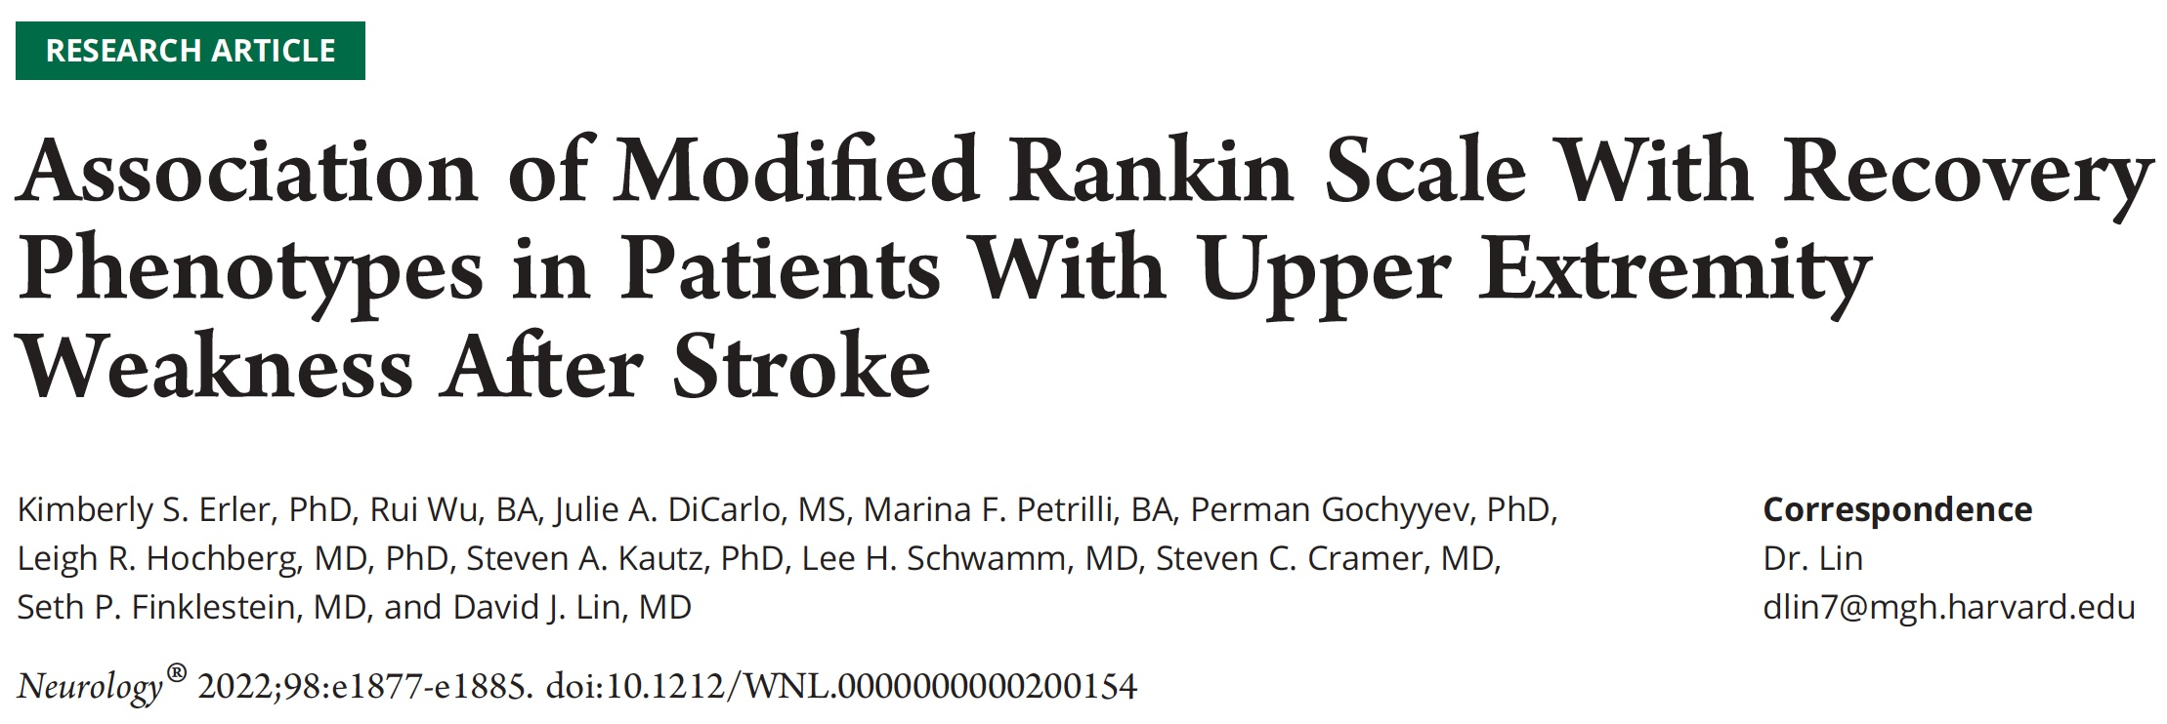
Examined different behaviors in relation to mRS score
Erler et al. Neurology. 2022; 98:e1877-e1885

Slide 23
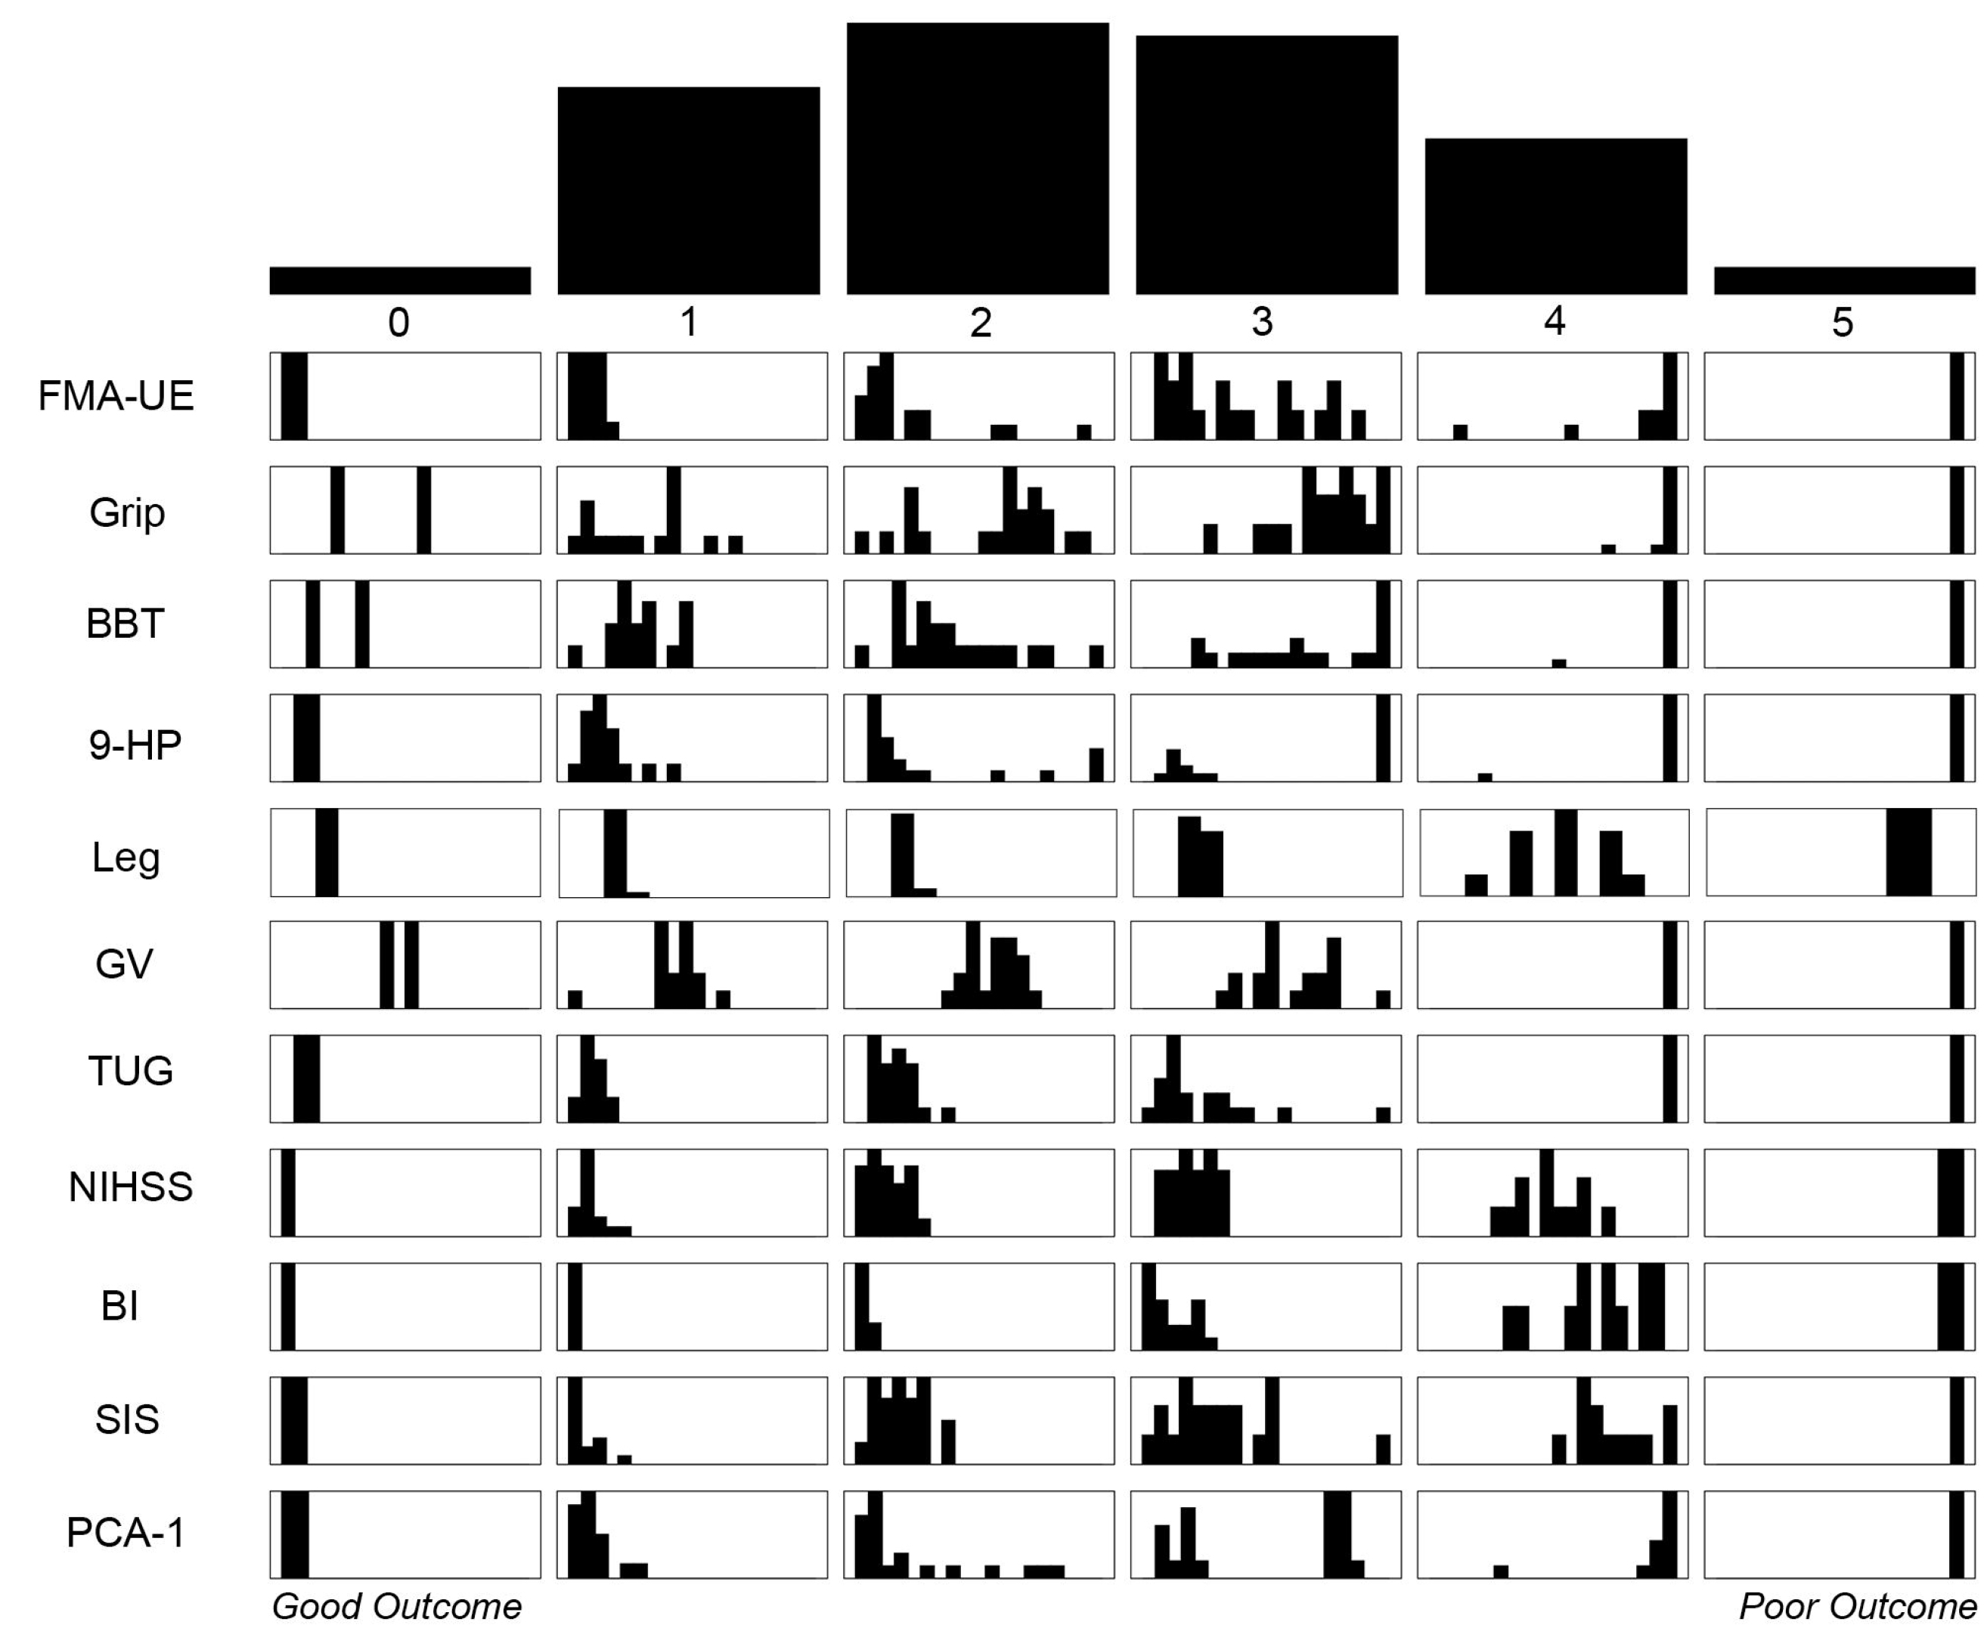
Examined different behaviors in relation to mRS score
Specific behaviors show a wide range at any given mRS score
Erler et al. Neurology. 2022; 98:e1877-e1885

Slide 24
Examined different behaviors in relation to mRS score
Specific behaviors show a wide range at any given mRS score
Values overlap substantially with neighboring mRS scores
Erler et al. Neurology. 2022; 98:e1877-e1885

Slide 25
Stroke 2021; 52:1154-1161
WHY?
Increased resolution
Better insight into recovery
Individual brain systems
BUT
Can be resource intensive
Less familiar
May require special hardware

Slide 26
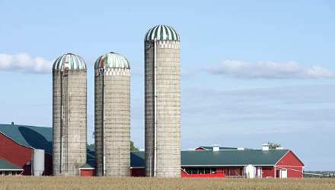
Opportunities in StrokeNet

Slide 27
Opportunities in StrokeNet
Common endpoints across all StrokeNet trials; big data
Can integrate recovery trials into acute and prevention studies
Potential to join forces for patient recruitment

Slide 28
NIH StrokeNet Network Meeting
October, 2023
DOMAIN SPECIFIC CONSIDERATIONS
Recovery& Rehabilitation Group
Steven C. Cramer, MD

