Slide 1
StrokeNet 3.0
Scott Janis, Ph.D., M.A.
Program Director, StrokeNet
Division of Clinical Research, NINDS

Slide 2
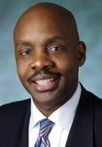
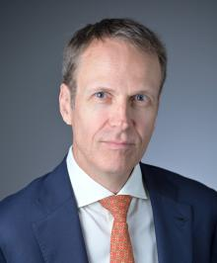
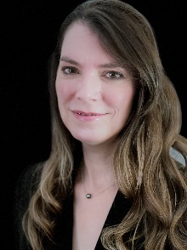
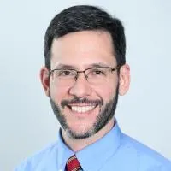
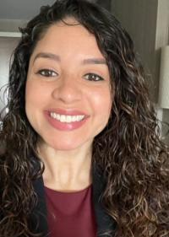
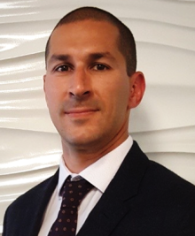
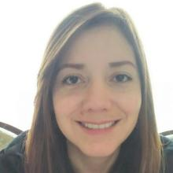
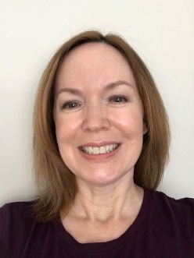
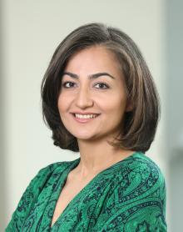
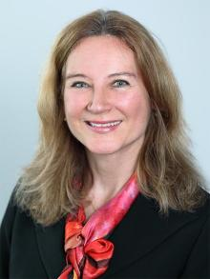
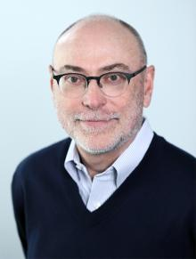
NINDS TEAM
Richard Benson, M.D., Ph.D.
Director, Office of Global Health
And Health Disparities
Division of Clinical Research
Clint Wright, M.D., M.S., FAAN, FAHA
Director
Division of Clinical Research
Scott Janis, Ph.D., M.A.
Program Director
Division of Clinical Research
StrokeNet Program Scientist
Laura Kimberly, B.S., C.I.P.
Clinical Research Project Manager
Division of Clinical Research
StrokeNet Program Official
Adam Hartman, M.D.
Program Director
Division of Clinical Research
Program Scientist FOCAS
StrokeNet DSMB
Alva Recinos, M.D.
Health Program Specialist
Division of Clinical Research
SPAN Program
Carlos Faraco, Ph.D.
Program Director
Division of Clinical Research
Lina Garcia, M.D.
Clinical Coordinator
Division of Clinical Research
TBD
STEP
Catherine Levy, M.H.A., B.S.N., R.N.
Clinical Research Project Manager
Division of Clinical Research
Marian Afzal, B.A.
Clinical Research Project Manager
Division of Clinical Research
Francesca Bosetti, PhD
Program Director
Division of Neuroscience
Jim Koenig, PhD
Program Director
Division of Neuroscience

Slide 3
U01 and OTA (Other Transaction Authority) Roles
Support mechanism for high-priority research areas that require a level of involvement from NIH staff that is higher than for a typical research project (R) grant
The PO-PS relationship is a collaborative relationship where both sides observe the necessary separation of duties
Program official
Program Scientist
NIH official on the grant
Reviews and approves annual RPPR and budget (including supplement requests)
Approves addition of new sites or clearance of foreign sites
Address FDA regulations or IRB requirements
Assess and review Milestones and continued funding
Approve any change in the PI/key personnel at awardee institution or clinical site
Cooperates with awardees in performing project activities (e.g., development of research protocols, oversight of data collection and analysis, and interpretation)
Serves as voting member on the primary leadership committee and its subcommittees
Participates in data analysis and manuscript preparation

Slide 4
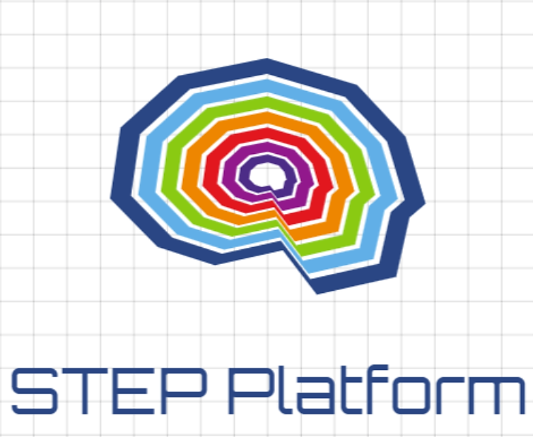
NIH StrokeNet by the Years
As of 9/30, the network has consented and enrolled 11,754 participants in a StrokeNet study
Total Submitted | 108 |  |  | Recovery Submitted | 22 | 20%
Total Reviewed | 104 |  |  | Prevention Submitted | 42 | 39%
Total Funded | 18 | 17% |  | Treatment Submitted | 44 | 41%
Total Approved* | 19 | 18%
Treatment Funded | 5 | 12%
Recovery Funded | 4 | 20%
Prevention Funded | 9 | 22%
Prevention w/Approved | 10 | 24%
*
*
*
LTF
LTF
*
*
MRI
*
MRI
*
2013
2014
2015
2016
2017
2018
2019
2020
2021
2022
2023
2024
*
CLARITY
*
17 Active Studies
* Completed Trials

Slide 5
Network Renewal Review
1
RFA-NS-23-008 NIH StrokeNet – National Data Management Center (U01)
1
RFA-NS-23-009 : NIH StrokeNet – National Coordinating Center (U01)
Stroke
Centers
Stroke
Centers
27
RFA-NS-23-010: NIH StrokeNet- Regional Coordinating Stroke Centers (U24)
RCC
(U24)
NINDS
Stroke
Centers
Steering
Com
DSMB
Central
IRB
NCC
(U01)
NDMC
(U01)
Operations Committee
Infrastructure established in 2013; renewed in 2018
Current renewal – Sept 2023

Slide 6
Reviewers evaluated:
Consider whether the application has a strong understanding of the Network's vision
Clinical trials expertise with a track record in successfully implementing stroke clinical trials
Plans to improve collaborations, training, recruitment, and promoting diversity among participants
An identified research coordinator or project manager with stroke trials experience
List of identified co-investigators from neurology, emergency medicine, interventional neurology, neurosurgery, neurointensive care, neuroimaging, neurorehab, and pediatric neurology
A leadership transition plan to assure continuity
Director and mentors for career enhancement program
Partial support for PD/PI salary for organizational/administrative tasks
Salary support for at least one full-time research coordinators or project managers
May include support for additional managers
Salary for the training fellow ($50k per year)
Evidence of institutional support willingness to accept NIH StrokeNet procedures coordinated by NCC specifically including: 1) standardized master trial agreements; 2) per-patient payments: 3) centralized trial budgeting; and 4) using a central IRB of record.

Slide 7
By the Numbers
 | 2018 | 2023
Number of applications submitted | 32 | 31
Mean Priority Score* | 33 | 31
Median Priority Score* | 30 | 31
Number of scored applications under 40 | 21 | 25
Number of scored applications under 20 | 6 | 7
Number of RCC’s approved for funding | 24 | 27
* 2 applications in 2018 review were not scored

Slide 8
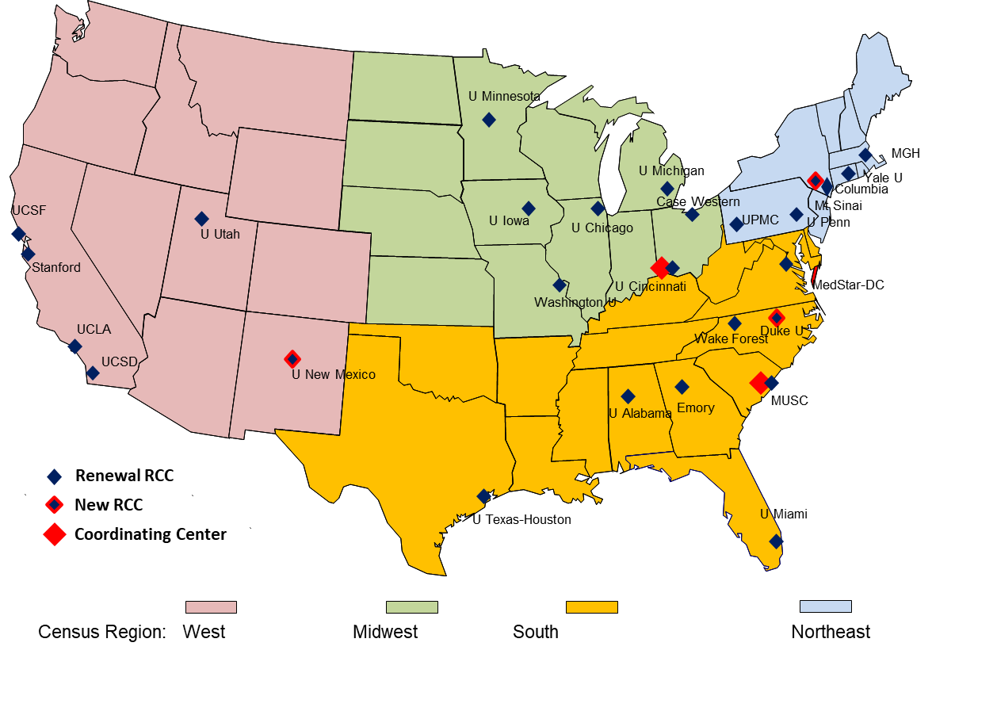
Network Renewal

Slide 9
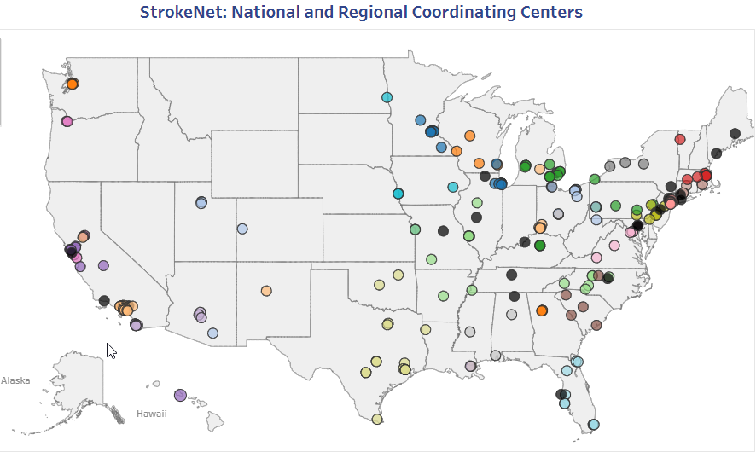
NIH StrokeNet Sites

Slide 10
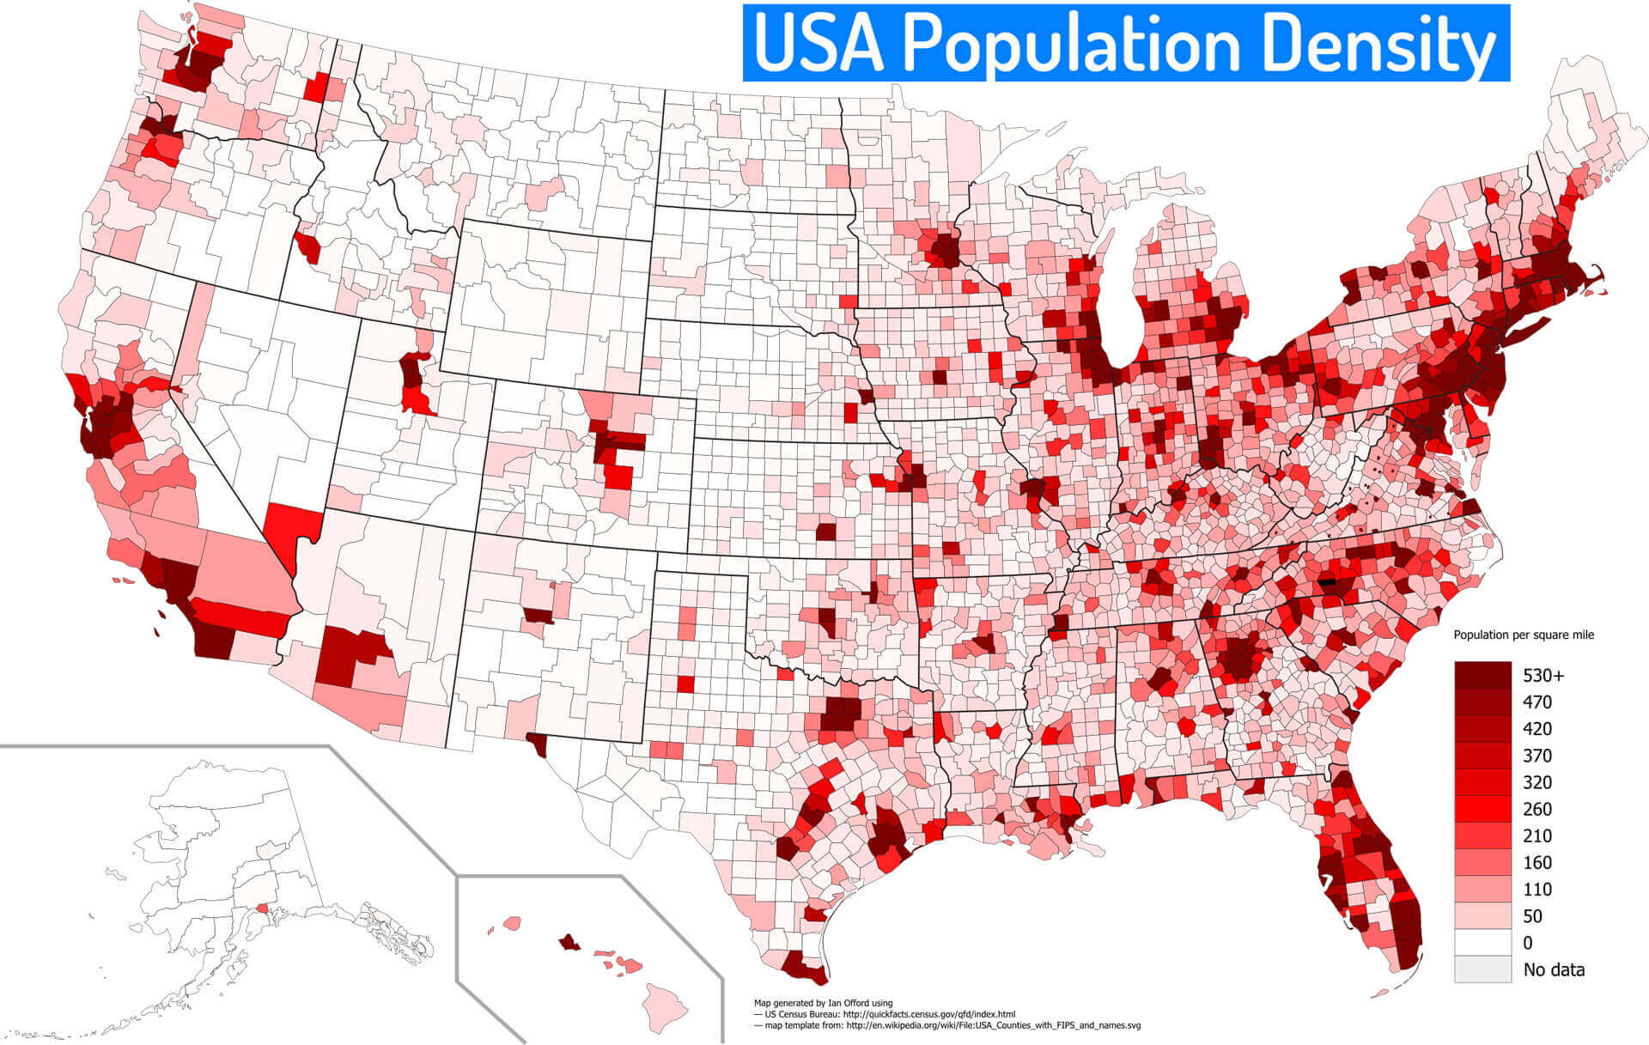
Coverage of U.S. Population

Slide 11
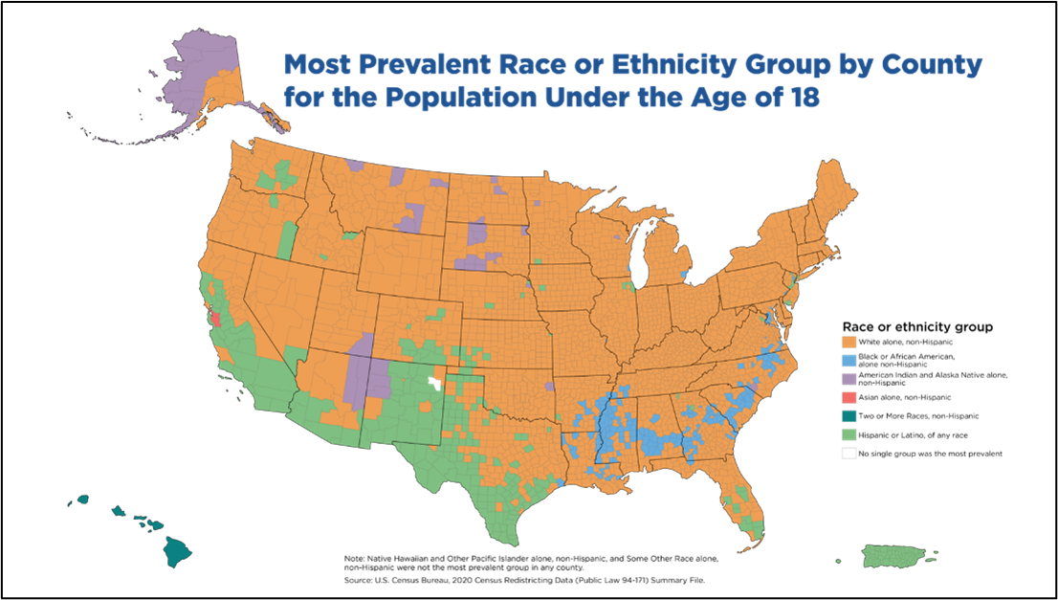
U.S. Race and Ethnic Population

Slide 12
Notes from the Review
Metrics
Generally positive overall (as a network we looked good)
Some overstating of data
Had several applications providing their rank in studies that was inconsistently reported by other applications
In some cases, it was hard to evaluate enrollment in non-SN trials
Start-up times were not always well explained (maybe need median time and explain outliers)
Didn’t focus enough on average monthly rates
Reviewers were sometimes confused with enrolled vs. randomized subjects
Review looked for contribution from network sites

Slide 13
Notes from the Review
Training
Overall, they were impressed
Focused on productivity of the fellows (grants, jobs, etc.)
High boost for sites that had very productive or successful fellows
Training didn’t cause us any problems in the review or final scores
Network communication between RCCs and sites
This was a big focus in the review. Reviewers looked for how well the RCC communicated with and managed issues in their network
i.e., how were enrollment problems managed, etc.
Big focus on corrective action plans

Slide 14
Notes from the Review
Succession/Transition plan
Everyone had one. That was noted as a requirement in the RFA.
Reviewers focused and credited sites who had a transitional development plan to train leadership (i.e., building on the opportunity to train younger PIs for a leadership role rather than just state a co-PI would take over).
This especially became important given all the well-established and accomplished PIs we have in the network and also in the spirit of the training programs we have established.
Commitment to cIRB
No issues with what was included in the applications. Need to adhere to this commitment. Expect milestones in the award notice to hold your institutions to enforce their reliance.
Lots of focus on EFIC

Slide 15
New for StrokeNet 3.0
NCC and NDMC will organize, with the collaboration of leadership from the RCCs, a series of network-linked, open conferences to facilitate community stakeholder discussions that identify areas of high unmet need and priorities in stroke research
At least one conference biennially
Leadership at the NCC, NDMC, and RCCs will be encouraged to work with the broader stroke community to prioritize areas of unmet need.
Additional support for the meetings will be encouraged through the submission of conference grants to NIH and solicitation of outside sponsorship as appropriate.
The addition of an Education and Development Program for program managers and research study coordinators that will be centrally run by the NCC and supported by the RCCs
its aim will be to build a robust resource of trained research managers for the future.
STEP EVT platform – First OTA (Other Transaction Authority) program

Slide 16
Brief NINDS updates
A new NOFO (notice of funding announcement) for the UG3/UH3 StrokeNet project submissions will be available by the end of the year and will replace PAR-20-185 starting with the Feb/March 2024 submission cycle.
NINDS is anticipating the STEP ROA (Research Opportunity Announcement) for the platform domain projects to be available this Fall or by the beginning of 2024.
The applications will use an open rolling submission using our OTA mechanism. This will be a two-stage application. The first be an objective premise review of the proposed idea followed by an invited second application for a technical review of the protocol.
Information for these programs will be available on an NINDS website. Stay tuned.

Slide 17
THANK YOU!

Slide 18
Ongoing Trials = 17 (updated 10/6/23)
As of 6/30, the network has consented and enrolled 11,185 participants in a StrokeNet study
PREVENTION OF STROKE (9)
CREST-2 Treatment of asymptomatic carotid stenosis (N=2375/2480) (CEA = 1241 / CAS = 1134)
CREST-H Hemodynamic impairment ancillary study in CREST-2 (N=359/385)
SATURN Statin use in ICH survivors (N=446/1456)
SATURN-MRI Statins for silent stroke (N=146/912)
ASPIRE Anticoagulation of atrial fibrillation in ICH survivors (N=245/700)
CAPTIVA Anticoagulation vs antiplatelets for intracranial stenosis (N=209/1683)
CAPTIVA-MRI MRI biomarkers of recurrent stroke in intracranial stenosis (N=500 in start-up)
Sleep-SMART Treatment of obstructive sleep apnea (N=1302/3062)
FOCAS Corticosteroids for pediatric stroke due to focal cerebral arteriopathy (n= 80 in start-up)
ACUTE STROKE TREATMENT (4)
FASTEST FVIIa for acute hemorrhagic stroke (N=280/860)
RHAPSODY-2 3K3A-APC with thrombectomy and thrombolysis (N=1400 in start-up)
SISTER, novel clot-dissolving antibody for ischemic stroke (N=300 in start-up)
STEP Platform Adaptive, registry-supported trial platform to optimize outcomes after LVO
STROKE RECOVERY & REHABILITATION (4)
TRANSPORT-2 Transcranial direct stimulation to aid recovery (N=113/129)
I-ACQUIRE Intensive infant rehabilitation for pediatric stroke (N=181/240)
I-ACQUIRE 12-month follow up study provide clinically meaningful and likely novel insights into longer-term outcomes (N=160)
VERIFY Acute prediction of motor recovery (N=124/657)
MRI
MRI

Slide 19
Completed Trials = 9
Trial | Findings | Impact
MISTIE-3 N=499 | Definitive trial that did not show benefit of minimally invasive surgery for ICH evacuation | Informed clinical care and generated follow up trials under development in StrokeNet
I-DEF N=294 | Pilot trial that determined the futility of deferoxamine mesylate treatment to improve 3-month outcomes after ICH | Raised awareness that ICH may benefit from 6-month outcome assessments, follow up trial in development
DEFUSE 3 N=182 | Definitive trial showing large treatment effect of endovascular therapy for imaging-selected patients at 4.5 to 16h from onset | Changed clinical guidelines and clinical practice worldwide
TeleRehab N=124 | Noninferiority trial demonstrating telehealth post-stroke rehabilitation is feasible and non-inferior to in-person, dose-matched therapy | Leading to a follow up trial (TeleRehab-2) under StrokeNet development
ARCADIA N=1015 | Definitive trial showing that Apixaban was not superior to aspirin for preventing recurrent stroke in patients with cryptogenic stroke and evidence of atrial cardiopathy | Primary paper pending and results that will challenge the hypothesis of atrial cardiopathy as a therapeutic target for anticoagulation in the absence of atrial fibrillation.
ARCADIA-CSI N=310 | Sub-study to the ARCADIA trial that will evaluate the hypothesis that subjects on apixaban experience less cognitive decline than subjects on aspirin. Results pending.
MOST N=514 | Definitive multi-arm trial to determine the benefit of combining tPA with blood thinners argtroban or eptifibide. Trial stopped for futility. Results pending.
ACTIV-4A N=2342 | Innovative platform trial that found that full dose anti-coagulation treatments given to moderately ill patients hospitalized for COVID-19 reduced the requirement of vital organ support—such as the need for ventilation
ACTIV-4C N=1219 | Innovative platform trial evaluating antithrombotic approaches for post-discharge COVID-19 patients. Results pending.

