Slide 1
July 22, 2024

Slide 2
Agenda
Interim analysis
FusionHealth
NDMC
Future Investigator Meeting

Slide 3
Enrollment update
Enrolled: 4,884
Randomized: 1,547

Slide 4
Continuing Review progress
Continuing review is almost complete, we are just waiting for a site to turn in their documents. We will have approval before the study expires on August 22nd.
We appreciate your patience.

Slide 5
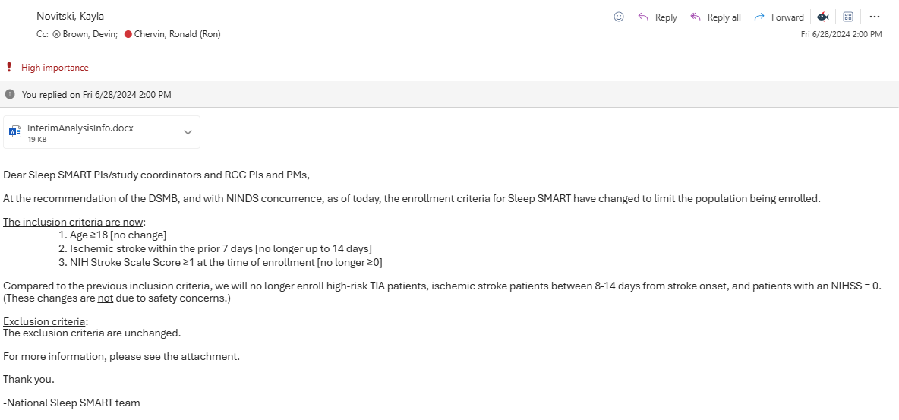

Slide 6
Objectives and Primary Endpoints
Objectives: Determine whether treatment of obstructive sleep apnea (OSA) with positive airway pressure started shortly after acute ischemic stroke or high risk TIA (1) reduces recurrent stroke, acute coronary syndrome, and all-cause mortality 6 months after the event (prevention aim), and (2) improves stroke outcomes at 3 months in patients who experienced an ischemic stroke (recovery aim).
Primary Endpoints: (1) Prevention endpoint: the composite outcome of recurrent stroke, acute coronary syndrome, or all-cause mortality at 6 months, (2) Recovery endpoint: functional outcome at 3 months.
Secondary Endpoints: neurological, cognitive, and quality of life outcomes at 3 months.
Notes:
The objectives of Sleep SMART are to determine whether treatment of obstructive sleep apnea (OSA) with positive airway pressure started shortly after acute ischemic stroke or high risk TIA (1) reduces recurrent stroke, acute coronary syndrome, and all-cause mortality 6 months after the event, and (2) improves stroke outcomes at 3 months in patients who experienced an ischemic stroke. The primary endpoint for prevention is the composite outcome of recurrent ischemic stroke, acute coronary syndrome, and all-cause mortality. These are assessed at 6 months. The primary endpoint for the recovery aim is functional outcome, measured by the mRS-9Q at 3 months. Other important outcomes assessed include neurological, cognitive, and quality of life.

Slide 7
…at the time of analysis
Prevention (n=3,062)
All subjects: ischemic stroke or high-risk TIA within prior 14 days
Recovery (n=1,362)
Ischemic stroke within prior 7 days
NIHSS ≥1 at time of enrollment
Notes:
Fast forward to the completion of data collection…
Although Sleep SMART operates as a single trial from the enrollment sites’ perspective, at the time of analysis, it essentially separates into two trials. All subjects (that is ischemic stroke or high risk TIAs enrolled within 14 days of stroke onset) will contribute to the prevention aim. However, only ischemic stroke subjects enrolled within 7 days of stroke onset and with an NIHSS at least 1 at the time of enrollment will contribute to the primary analysis of the recovery endpoint (the mRS scale at 3 months). We anticipate that we will need 3,062 subjects for the prevention aim and 1,362 for the recovery aim; however one interim analysis is planned.

Slide 8
Prespecified interim analysis plan
After outcomes available for the first 40% of randomized subjects
Prevention aim
Sample size re-estimation
Futility analysis
Assessment for overwhelming efficacy
Recovery aim
Assessment for overwhelming efficacy

Slide 9
Prespecified interim analysis results

Slide 10
DSMB recommendations (accepted by NINDS)
Prevention aim
Pause new enrollments
Continue with 3- and 6-month outcome assessments
Repeat interim analysis after participants enrolled before 6/28/24 have outcomes available
Continue enrollment in recovery aim
Continue with new enrollments
(Continue with 3- and 6-month outcome assessments)

Slide 11
Practical implications
Change in inclusion criteria:
Age ≥18
Ischemic stroke within prior 7 days [from last known well/stroke onset until consent]
NIHSS ≥1 at time of enrollment
Exclusion criteria
Unchanged
Training
ABCD2 no longer needed. There will be an option to waive the requirement in WebDCU.
Outcome assessments
Unchanged. Please continue to collect 3- and 6-month outcome assessments (entire visit blinded) on ALL Sleep SMART participants

Slide 12
Practical implications
Targeted enrollment
Most (about 2/3) of randomized Sleep SMART participants have been eligible for the recovery aim, which has required the slightly more restrictive criteria now in place for all recruited subjects.
Currently, 1,014/1,362 (74%) randomized for the recovery aim
we need 348 more!
Please try to maintain or grow your previous recruitment volume for Sleep SMART.

Slide 13
CIRB
Please continue to use your currently CIRB-approved consent forms
Consent includes TIA patient eligibility (no longer applicable), but that’s ok
We will submit a protocol and consent amendment when our continuing review is approved

Slide 14
How to determine eligibility
Ischemic stroke within 7 days of consent
Still using last known well to time stroke onset
Still using same definition of ischemic stroke:
Focal neurological symptoms ≥24 hours thought to be from cerebral ischemia, irrespective of presence of acute infarction
Focal neurological symptoms <24 hours thought to be from cerebral ischemia, if in the setting of thrombolytic or endovascular treatment, irrespective of presence of acute infarction
Focal neuro symptoms <24 hours thought to be from cerebral ischemia, with presence of plausibly associated brain infarction
NIHSS ≥1
Confirm prior to consent (e.g., based on medical record review, communication with the clinical team, etc)
Confirm on post-consent NIHSS performed by study team personnel and documented in the baseline CRF in WebDCU. Participants who have an NIHSS=0 on the baseline, post-consent NIHSS should be withdrawn and are ineligible for randomization.

Slide 15
Performance of NIHSS by study team
The post-consent NIHSS should be performed ASAP after consent
Withdraw participant if NIHSS=0 to avoid performance of T3 and/or run-in night on ineligible participants
WebDCU:
Enrollment form asks you to confirm ischemic stroke in prior 7 days and NIHSS at least 1. Form will not save if document ineligibility.
Reminds on enrollment form that the post-consent NIHSS must also be at least 1
Will block randomization if post-stroke NIHSS documented as 0

Slide 16
Have questions? The Sleep SMART GPT has answers!
AI-driven assistant for your Sleep SMART needs
It’s trained on Sleep SMART material (e.g, MOP, Data Collection Guidelines)

Slide 17
Enter your question here!

Slide 18
Benefits
Available 24/7/365
Can double check you if you aren’t sure about something
Can provide info more quickly than your sorting through the MOP etc
Anonymity
Can link you directly to a doc on our website if you really nail the name of it (e.g., “study brochure,” “mask selection procedure”)

Slide 19
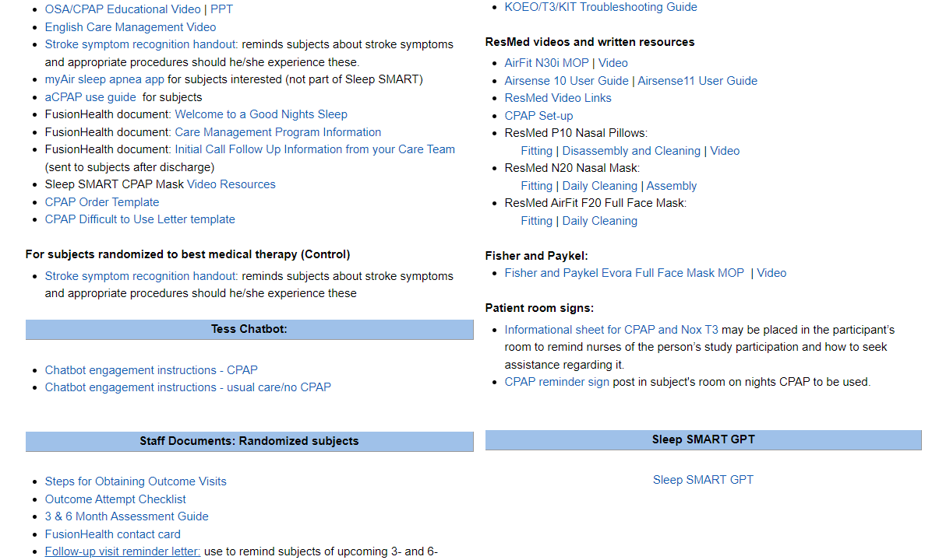
How to find it
Bookmark it: https://docsbot.ai/chat/n6lkSeOBfWo1Oc63RXmw/hxKF2vgUzUsoiHs91IyU
I forgot to bookmark it!
Got to Sleep SMART StrokeNet
website, research tab

Slide 20
Survey question: Have you asked a question of the GPT?
Yes
No
Do not recall

Slide 21
Check in calls
The prime team has been making check in calls for the last year. It has been a great way to touch base with teams.
These are not for-cause calls. Please reply when we email you for one ☺

Slide 22
Survey question: When you configure the Nox T3 device, what type of computer do you use:
Laptop
Desktop
It depends, sometimes a laptop and sometimes a desktop

Slide 23
Fusion Health Reminders
WE INNOVATE

Slide 24
Preparedness Tests
Device Compatibility Test
Dummy Test

Slide 25
Device Compatibility Test
Login with your KOEO ID and Password
Kick off the Sleep Smart Process in KOEO
You MUST enter the word “Delete” as the Last Name and ID of the subject to be tested.
Use SleepSMART for the first name, and use 01-01-1900 as the DOB.
Turn the T3 on and assure the oximeter is paired
Looking at the T3, press the Right Arrow Button once. The screen should now read “Connecting to XXXXXX”.
The device should begin to pair the two devices, signaled by a rotating spiral.
Once the connection is successful, a check mark appears on the display.

Slide 26
Device Compatibility Test
Without attaching belts and cannula, start the recording, and allow the timer to start and run until the screen goes dark, approximately 10 seconds.
Stop the recording. Upload the data using usual processes.
FH members will automatically intercept all “Delete” data so they are not sent to MUSC for analysis
If you are unable to upload the data, please contact your local IT group.

Slide 27
Dummy Test
Login to app.noxhealth.com with your KOEO ID and Password.
Kick off the Sleep Smart Process in KOEO.
You MUST enter the word “Delete” as the Last Name and ID of the subject to be tested
Use SleepSMART for the first name, and use 01-01-1900 as the DOB.
Complete the “T3 Setup Task”, making sure to configure the device. This step will require you to follow the prompts within KOEO and then log in to the KOEO Interactive Tool.

Slide 28
Dummy Test
Login and Initial Setup:
Login to app.noxhealth.com using your KOEO ID and Password.
Start the Sleep Smart Process in KOEO.
Enter “Delete” for the Last Name and ID of the subject.
Use "SleepSMART" for the First Name and "01-01-1900" as the DOB.
T3 Setup:
Complete the “T3 Setup Task” by following KOEO prompts.
Log in to the KOEO Interactive Tool.
Turn on the T3 and pair the oximeter.
Press the Right Arrow Button on the T3 to start pairing.
Ensure a successful connection (check mark on display).
Verify belts are transmitting data by checking signal reads.

Slide 29
Dummy Test
Data Collection:
Set up the volunteer with the T3 device, including belts, cannula, and oximeter.
Record at least 2 hours of data (recommended overnight study for site coordinators).
Upload T3 data using the “Upload T3 Data Task”.
Troubleshooting and Support:
If you receive a “Repeat T3 Setup” task, review the Invalid Study Questionnaire.
Ensure the only issue is short duration; otherwise, contact FH team:
Email: sleepsmarttechsupport@noxhealth.com
Phone: 404-480-5149
“Delete” data will be intercepted and not sent to MUSC for analysis.
For upload issues, contact your local IT group.

Slide 30
Security Issues

Slide 31
Can’t get to the KOEO platform
Double check that you are visiting app.noxhealth.com using Google Chrome and NOT any other variation.
If you still cannot gain access after verifying the address and browser:
1. Close all tabs and windows for your browser.
2. Clear Cookies.
3. Open a new browser tab.
4. Log in again.
If you still cannot gain access after following these steps, reach out to your internal IT dept as it is likely a firewall issue. Nox Health CANNOT fix firewall issues.

Slide 32
EROFS Error
If you are unable to upload or configure the T3, and see this error:
Reach out to your internal IT dept as it is a device specific permissions error. Nox Health CANNOT fix device specific permissions errors. You will need the permissions to read and write to USB devices.

Slide 33
“Server not responding” error
Reach out to your internal IT dept as this error typically means that the internal security settings have been adjusted and you need to have the program whitelisted

Slide 34
WebDCU form updates
As of 6/28/2024, per DSMB recommendations, enrollment into Sleep SMART will continue only for patients who had an ischemic stroke within 7 days prior to enrollment and have a NIHSS ≥ 1.
- In response we have updated the Subject Enrollment and Screen Failure forms.

Slide 35
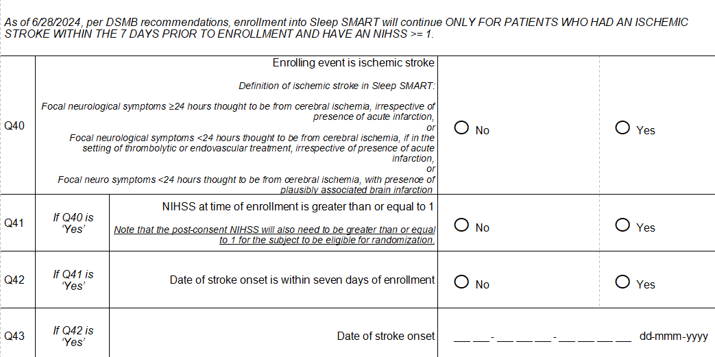
Subject enrollment Updates

Slide 36
Subject enrollment updates
The Subject Enrollment form has been updated to prevent a patient from being enrolled into the database and being assigned a subject ID if even any single question among Q40-Q42 is marked ‘No’
If such a subject has already signed a consent form:
You will be instructed to enter the subject as a screen failure in WebDCU
You will need to submit an Unanticipated Event Report

Slide 37
New screen failure definition
Currently, screen failures are defined as patients or their LARs who were approached for consent but declined
Screen failures will now also include patients consented by mistake (after 06/28//2024) for whom
The enrolling event is NOT an ischemic stroke
NIHSS is 0 at time of enrollment
The enrolling ischemic stroke is not within 7 days of consent
The screen failure form in WebDCU is being updated to allow for documentation of these cases. We will send out an email detailing the changes once implemented.

Slide 38
Consenting and Monitoring Updates
Informed Consent Form
Informed Consent Checklist is always required to be uploaded along with ICF to WebDCU for review (update next slide)
Please make sure to respond to any open DCRs
Monitoring visits
Monitor queries
Monitoring review closure / monitoring reports
Virtual site check-in meetings
Site Quality Metric Reports
If a NTF is requested, please remember to upload NTF along with ICF for review (in one upload)
Continuing
Q2-2024
Notes:
*Checklist will be queried if it is NOT uploaded for review along with the consent
*Monitoring visits are in process and if your site is chosen for a visit you will see an email from me about scheduling the visit
*Virtual site check-in’s are also in process
*The next round of reports will be sent in April 2023

Slide 39
F245 informed consent (Update)
NEW: Added Q30 ‘ICF checklist combined with signed informed consent form upload’

Slide 40
NDMC Contact Information
Faria Khattak - Data Manager
khattak@musc.edu
Emily Kaestner – Data Manager
kaestner@musc.edu
Mariana Gould – Data Manager
gouldma@musc.edu
When to contact: User accounts, data entry, CRFs, or any other WebDCU-related questions
Katherine Trosclair – Site Monitoring Manager
trosclak@musc.edu
When to contact: If you have WebDCU-related DOA/regulatory database questions, Informed Consent, Remote or Site Monitoring questions
Notes:
*Checklist will be queried if it is NOT uploaded for review along with the consent
*Monitoring visits are in process and if your site is chosen for a visit you will see an email from me about scheduling the visit
*Virtual site check-in’s are also in process
*The next round of reports will be sent in April 2023

Slide 41
We’re planning an in-person investigator and coordinator meeting!
Save the date: Oct 24/25
Suggestions for topics you’d like us to cover?

