Slide 1
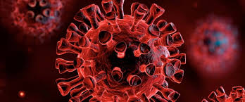
NIH StrokeNet in the Time of COVID-19
April 8th Webinar

Slide 2
Challenges for StrokeNet during pandemic
Remaining productive and documenting tasks while enrollment is suspended. And doing this remotely from home.
Financial stressors – no new monies at sites for recruitment/consent.
Suspension of enrollment means trials are extended by similar time period (at least). Infrastructure costs accrue.
Keeping research teams intact.
Improving and adapting processes to new reality.
Quick restart of trials when enrollment is reopened.

Slide 3
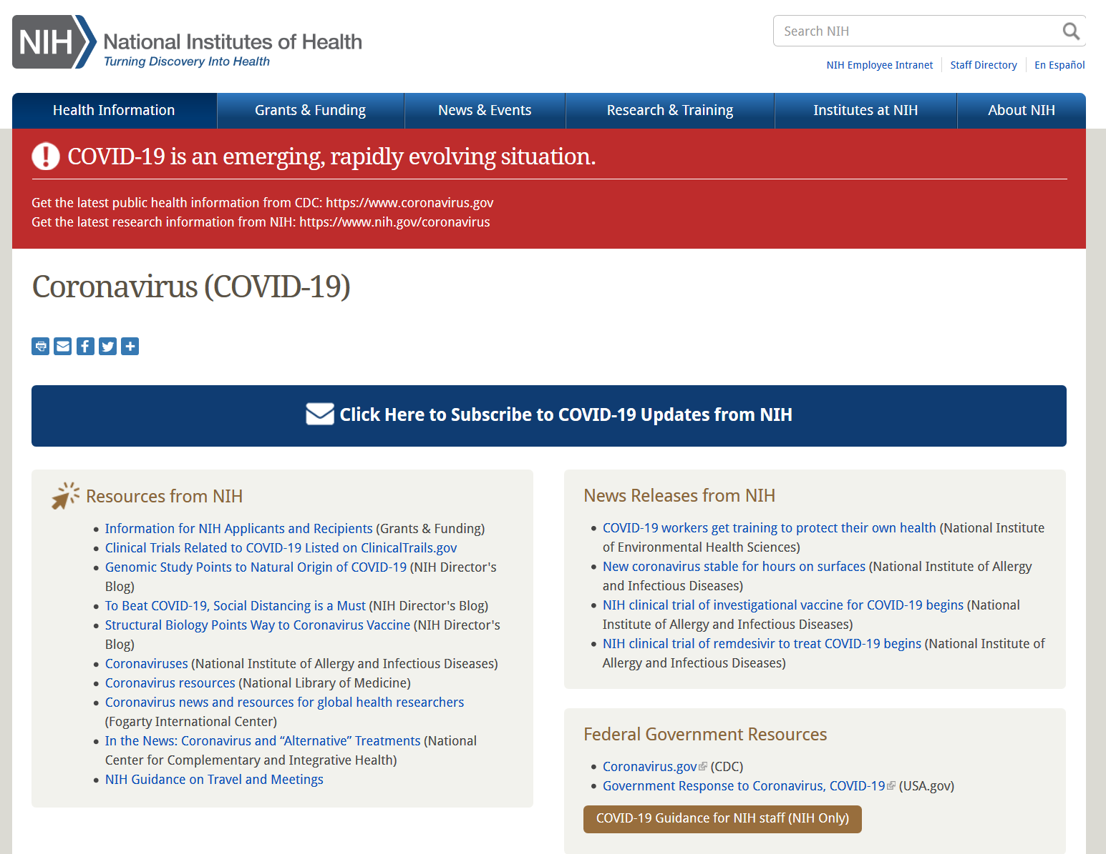

Slide 4
NIH Clinical Research Training Opportunities
The Introduction to the Principles and Practice of Clinical Research (IPPCR) course focuses on the spectrum of clinical research and the research process by highlighting biostatistical and epidemiologic methods, study design, protocol preparation, patient monitoring, quality assurance, ethical and legal issues, and much more. Individuals internal and external to NIH are able to register for the course.
https://ocr.od.nih.gov/courses/ippcr.html
Ethical & Regulatory Aspects of Clinical Research course is offered to anyone interested or involved in the ethics of clinical research with human subjects. Participants represent multiple disciplines including research teams, IRB members, physicians, psychologists, nurses, social workers, administrative staff, students, and others.
https://bioethics.nih.gov/courses/ethical-regulatory-aspects.shtml
https://videocast.nih.gov/PastEvents?c=22
Principals of Clinical Pharmacology is an online lecture series covering the fundamentals of clinical pharmacology as a translational scientific discipline focused on rational drug development and utilization in therapeutics. The course focuses on the following core principles of pharmacology: pharmacokinetics; drug metabolism and transport; drug therapy in special populations; assessment of drug effects; drug discovery and development; pharmacogenomics and pharmacotherapy. Individuals internal and external to NIH will be able to register for the course.
https://ocr.od.nih.gov/courses/principles-clinical-pharmacology.html

Slide 5
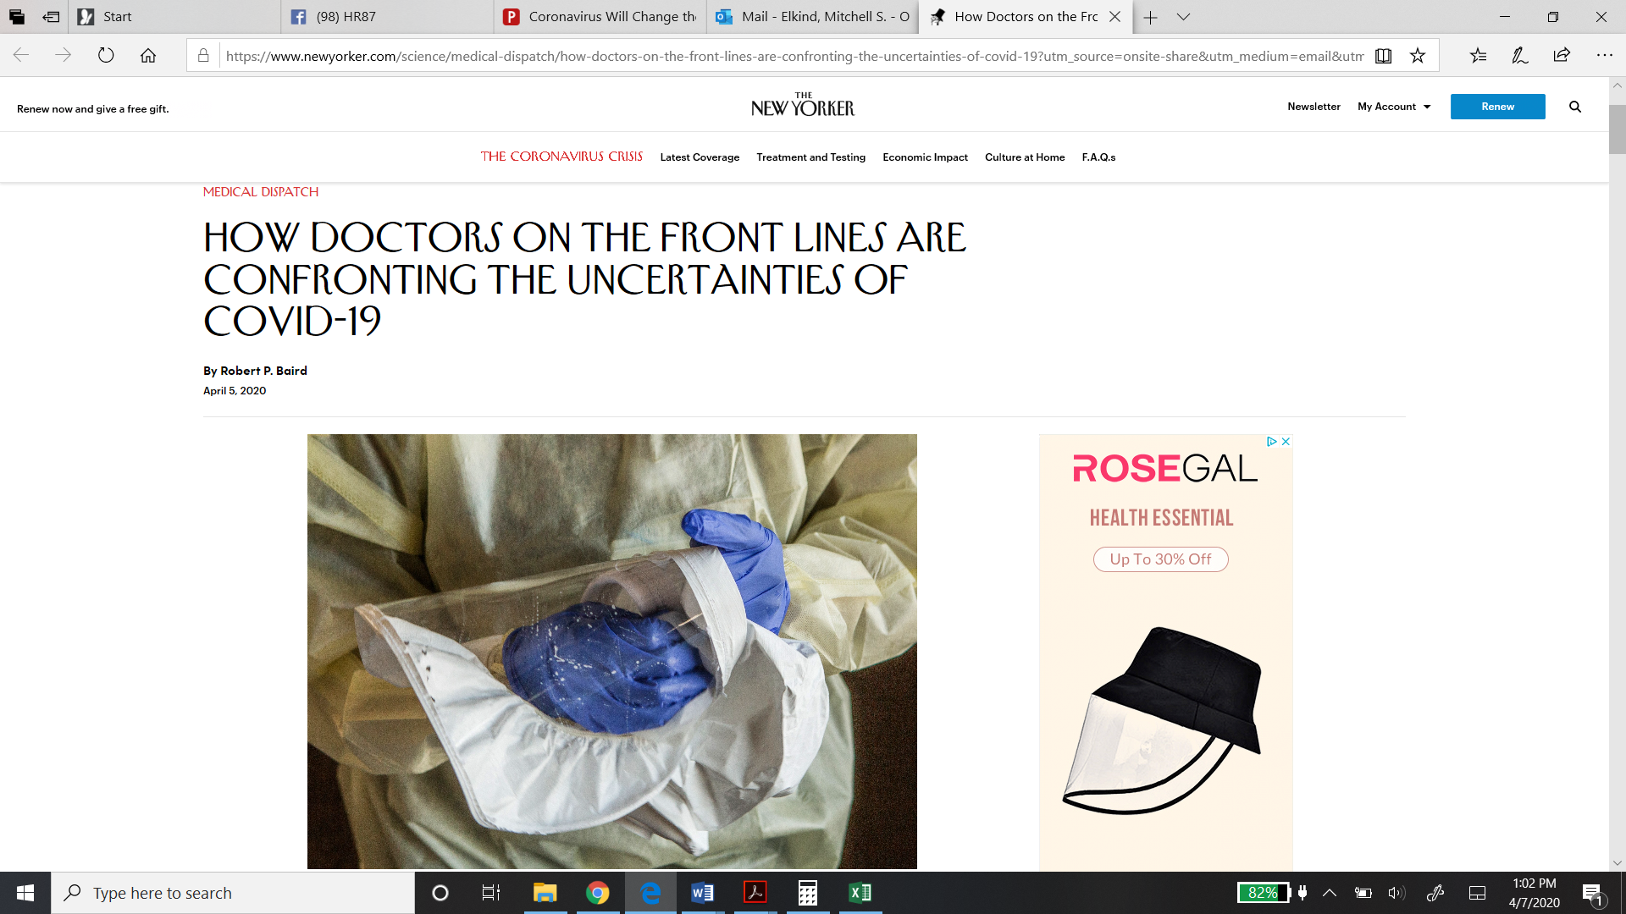
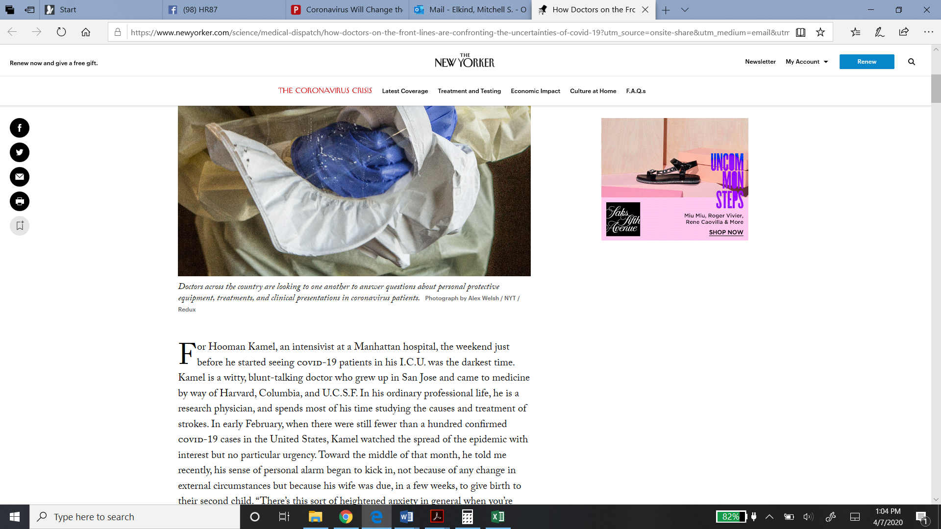
COVID-19 and cardiovascular disease/stroke
The New Yorker
April 5, 2020

Slide 6
COVID-19: The basics
COVID-19 is caused by the Severe Acute Respiratory Syndrome Coronavirus-2 (SARSCoV-2).
Novel single-stranded enveloped RNA virus.
Seventh known human coronavirus:
4 common cold viruses: 229E, OC43, NL63, and HKU1
3 severe acute respiratory syndrome (SARS): ARDS
SARS-CoV 2002: 10% case fatality
Middle East respiratory syndrome (MERS-CoV) 2012: 34% case fatality
Coronavirus disease 2019 (COVID-19): 1-3% case fatality
Clerkin KJ et al. Circulation 2020.

Slide 7
COVID-19: Portal of entry
Transmembrane protease serine 2

Slide 8
COVID-19 and cardiovascular disease/stroke
Although COVID19 is primarily an infectious respiratory illness, it has cardiovascular relevance and consequent clinical implications.
Clerkin KJ et al. Circulation 2020.
Elkind MSV et al. Circulation 2020.
Common infections, like influenza and sepsis, may trigger strokes and acute coronary events.
Elkind MSV et al. Stroke. 2011;42:1851-1856.
Boehme AK et al. Ann Clin Transl Neurol. 2018;5:456–463.
Some patients with COVID-19 present with primary cardiac complaints like chest pain and palpitations, without fever.
Zheng YY et al. Nat Rev Cardiol. March 5, 2020.
Early reports from some of our colleagues in US suggest that some patients are presenting with stroke symptoms and then turn out to be COVID positive: related or simply reflection of high infection rate among asymptomatic people.

Slide 9
Cardiovascular risk factors associated with worse outcomes
Meta-analysis of 8 studies
N=46,248
52% male; mean age 46 yrs
Hypertension 17%
DM 8%
Cardiovascular disease 5%
Respiratory disease 2%
Each was more common in those with severe disease than those with non-severe disease
Yang J et al. Int J Infect Dis. March 12, 2020.

Slide 10
COVID-19 and CVD/stroke
Potential mechanisms
Increased number of risk factors or comorbid conditions with age
Impaired immunity making patients more susceptible to virus
Other susceptibility to coronavirus with cardiovascular disease and risk factors
Decreased “physiological reserve”: Worse outcomes due to underlying cardiovascular disease
Increased ACE2 or TMPPRSS2
Others
.

Slide 11
COVID-19 may have direct adverse effects on cardiovascular system
The risk of cardiac injury and arrest appear to be higher than would be expected from pneumonia alone.
The mortality rate is higher among the elderly and those with cardiovascular disease, including stroke.
This also appears to be the case for patients with hypertension in several studies.
The ACE2 receptor is also found in heart, vascular endothelia, and even neurons.
This tropism could explain cardiac and cerebrovascular effects.
There is some evidence that ACEI and ARBs commonly used to treat hypertension can lead to an upregulation of ACE2 receptors, potentially facilitating infection.
However, there is also evidence that these drugs may be of benefit in reducing lung injury inflammation in viral pneumonias.
At present recommend against changing ACEI/ARBs (Do not stop them.)
  AHA/ACC/HFSA statement March 17, 2020.
Fang L et al. Lancet Resp Med 2020.

Slide 12

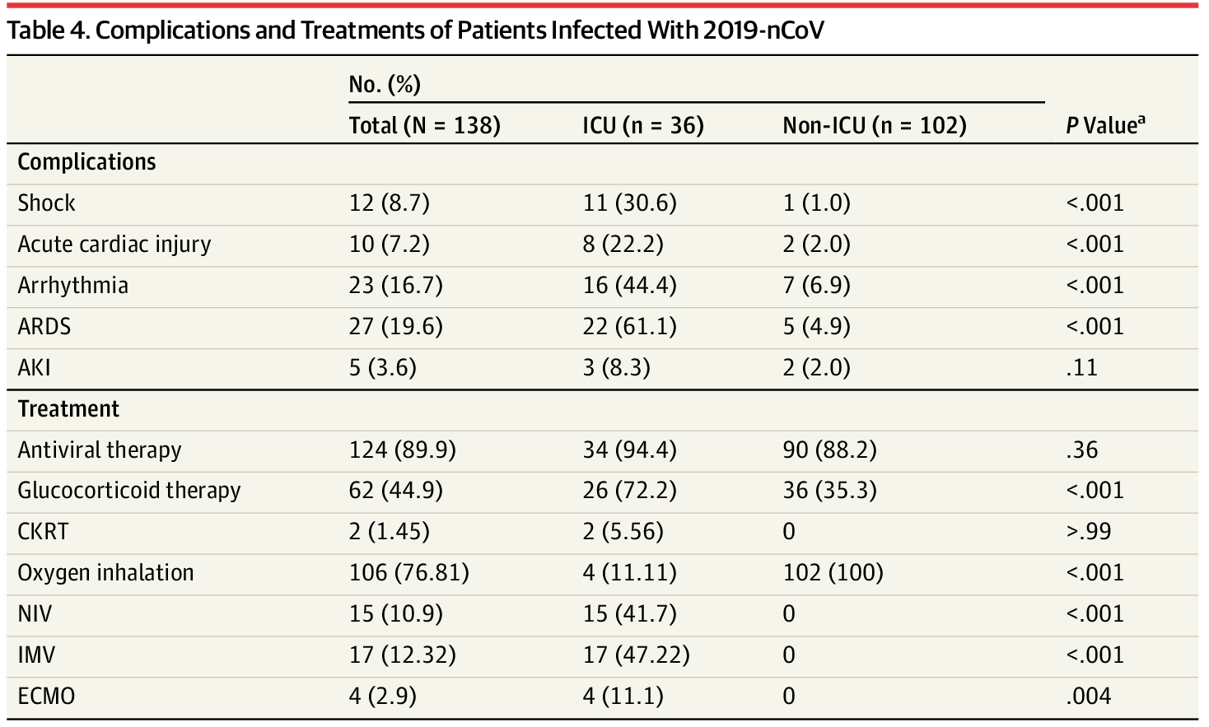
From: Clinical Characteristics of 138 Hospitalized Patients With 2019 Novel Coronavirus–Infected Pneumonia in Wuhan, China
JAMA. Published online February 07, 2020. doi:10.1001/jama.2020.1585

Slide 13
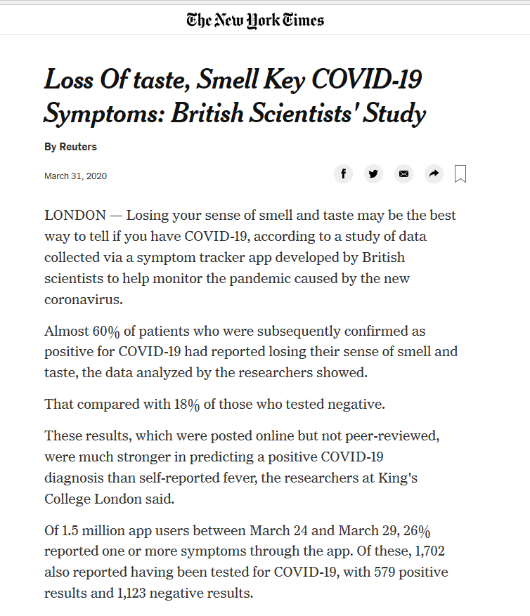
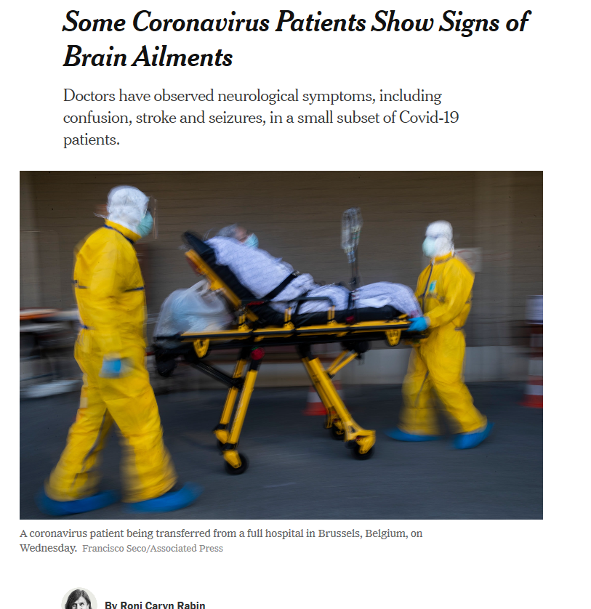

Slide 14
Clinical neurological findings in COVID-19
Early neurological symptoms of headache, confusion, dizziness, anosmia, and ageusia have been reported.
Report of the WHO-China Joint Mission on Coronavirus Disease 2019 (COVID-19). February 28, 2020.
More severe neurological complications may include ischemic stroke, ICH, myelitis.
In China, neurological manifestations occurred in 36% of patients, including stroke in 6% and encephalopathy in 15%.
Li Y, et.al. Lancet. Mar 13 2020: https://papers.ssrn.com/sol3/papers.cfm?abstract_id=3550025.
Mao L et al., MedRxiv, 2020.
The SARS coronavirus, to which the current pandemic virus SARS-CoV-2 is closely related, has been reported in brains from both patients and experimental animals, and the brainstem was heavily affected.
Ding Y et al., J Pathol, 2004, 203:622-630
Netland J et al., J Virol, 2008, 82:7264-7275

Slide 15
Clinical neurological findings in COVID-19
Chinese autopsy reports of endovasculitis, endothelial damage, cerebral edema, hyperemia, and neurodegeneration in SARS-CoV-2
Diagnosis and Treatment Protocol for Novel Coronavirus Pneumonia (Version 7). March 3, 2020.
Other neurological complications of critical illness, such as critical illness myopathy, increased thrombotic risk, and cerebral hypoperfusion, may result from the extended intensive care stays.

Slide 16
Stroke in COVID-19
Li Y, et.al. Lancet. Mar 13 2020.

Slide 17
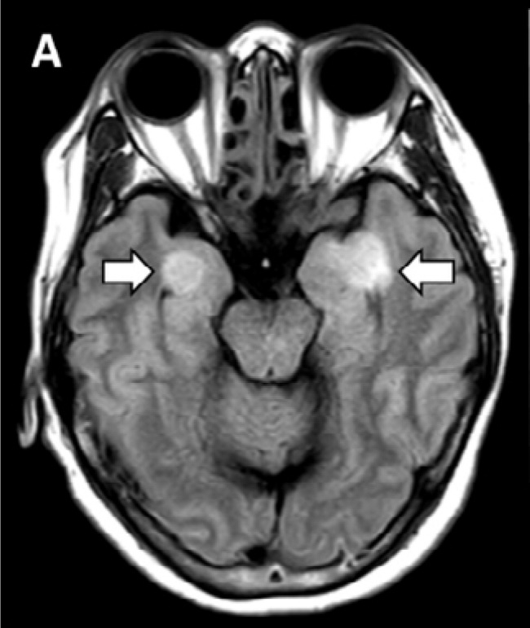
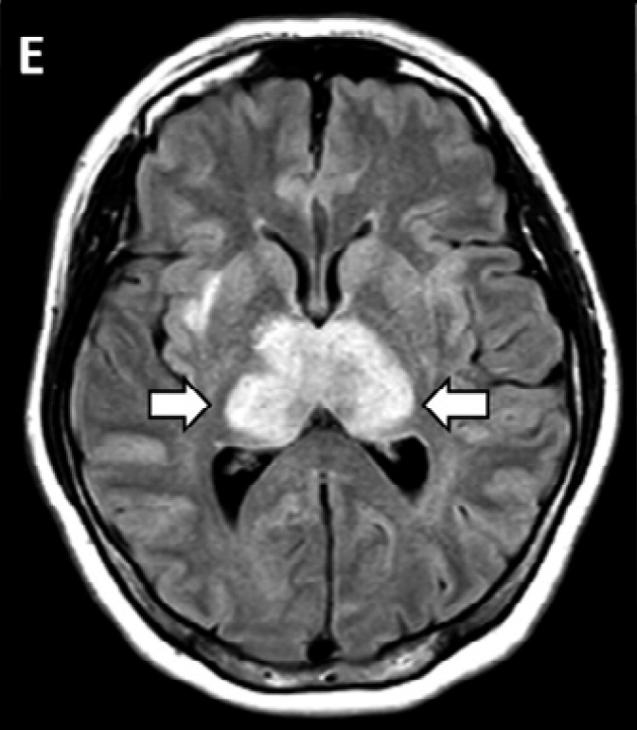
Encephalitis in COVID 19
58 year old woman (airline worker) with 3-day history of cough, fever, and altered mental status.
Nasal swab PCR positive for SARS-CoV-2
Diagnosed with acute hemorrhagic necrotizing encephalopathy
Poyiadji N et al. Radiology 2020.
26 year old with seizures; nasal swab negative; CSF positive for SARS-CoV-2
Diagnosed with meningitis/encephalitis
Moriguchi T et al. Int J Infect Dis. 2020.

Slide 18
COVID-19 recommendations to patients
Stay at home unless getting essentials.
Avoid ANY gatherings of more than 1-2 people.
  “Physical distancing, social solidarity”
Wash hands and items purchased before preparing.
Do not touch face. Touching the face allows virus to enter through mouth, nose and eyes.
Do not wear a mask unless sick, as this may increase face-touching.
Wash hands frequently with soap and water, and do so for at least 20 seconds; use hand sanitizer as alternative.
Keep extra refills of medications on hand in case of a prolonged period of unavailability of their pharmacy.
If sick, stay at home, unless worsening symptoms (dyspnea) require hospital management.
Call ahead to the hospital if going and wear a mask when going to the hospital.
Follow the news, read WHO and CDC materials on line, and check with your local health authorities.
Opportunity for coordinators to stay in touch with trial patients.

Slide 19
COVID-19 and stroke
Health system stresses and stroke patients, including StrokeNet trial patients
Stroke patients, including those in ARCADIA, may face exacerbation of their illness as the focus of health care systems shifts to caring for patients with COVID-19.
Reports from China and Italy indicate that patients with chronic conditions have had difficulty accessing care.
Physicians may be overwhelmed caring for patients with COVID-19, or they may themselves be quarantined due to exposure, making care harder to obtain.
Supply chains for production of medications may be disrupted, leading to shortages of cardiovascular drugs, like statins and blood pressure medications. The FDA has been working to ensure the availability of drugs, but these systems may become challenged.
Consider discussing with patients having extra supply of drugs available.

Slide 20
COVID-19 and stroke
AHA/ASA Statement: Lyden P et al. Temporary Emergency Guidance to US Stroke Centers During the COVID19 Pandemic; Stroke, April 1, 2020.
Guidance:
  Guideline Adherence: Continue treating stroke patients as appropriate. Full adherence to guidelines may be challenging, but needed treatment should be offered to the extent possible .
  PPE: Seek ways to minimize the use of scarce PPE in your medical center.
  Telemedicine.
  Health and Safety. Take care of yourselves, your families, and your teammates.
  Teamwork.

Slide 21
Silver linings of COVID-19
Outpouring of altruism
Outpouring of scientific productivity
  Basic
  Clinical
  Population
AHA grants for COVID related research
Get with the Guidelines COVID-19 registry
Changes to healthcare system/reduce disparities
Epidemiologists are finally rock stars!
Keep safe!

Slide 22

What Coordinators/PIs Can Do Now
Check in regularly with your teams.
Screen for studies with longer enrollment windows.
Maintain activities in enrolled patients
  Study follow ups via phone and HIPAA-compliant video visits
  Maintain drug delivery and accountability
Catch up
  Complete all outstanding data queries.
  Complete and upload all outstanding regulatory documents.
  Complete contracts/regulatory documents (CTA and IRB packets)
  If signatures required, use set up electronic signatures
Set up educational activities locally (education core).
Document your activities
NCC personnel are available to help.

Slide 23
What NIH StrokeNet Is Doing to Adapt
NCC is actively working on a centralized eConsent process*
NDMC has set up site updates re: COVID on WebDCU*
Trial PIs are reconsidering trial consent, enrollment, intervention, and follow-up in new post-pandemic environment*
  Meeting of Trial PIs with StrokeNet leadership every two weeks to consider when to reopen and talk through ideas
* More discussion later in agenda

Slide 24
Proposed steps to restart trial recruitment
Written plan agreed to by PI(s), including any changes in protocol/informed consent to minimize person-to-person contact during time of increased risk of infection.
Discussion and agreement with NINDS and NIH StrokeNet leadership
Submission to CIRB by project manager on behalf of PIs regarding approval for restarting subject recruitment.
  Request submitted into RAP system.
After CIRB approval, notify DSMB and change clinicaltrials.gov to open to enrollment.
Communication to participating sites that the study is open to enrollment.

Slide 25
Proposed steps to restart trial recruitment
Each site will need to follow local institutional guidelines regarding restarting enrollment in clinical trial.
When local site is approved to begin enrollment, they should notify PIs and project manager.
WebDCU will officially list site as open for enrollment.

Slide 26
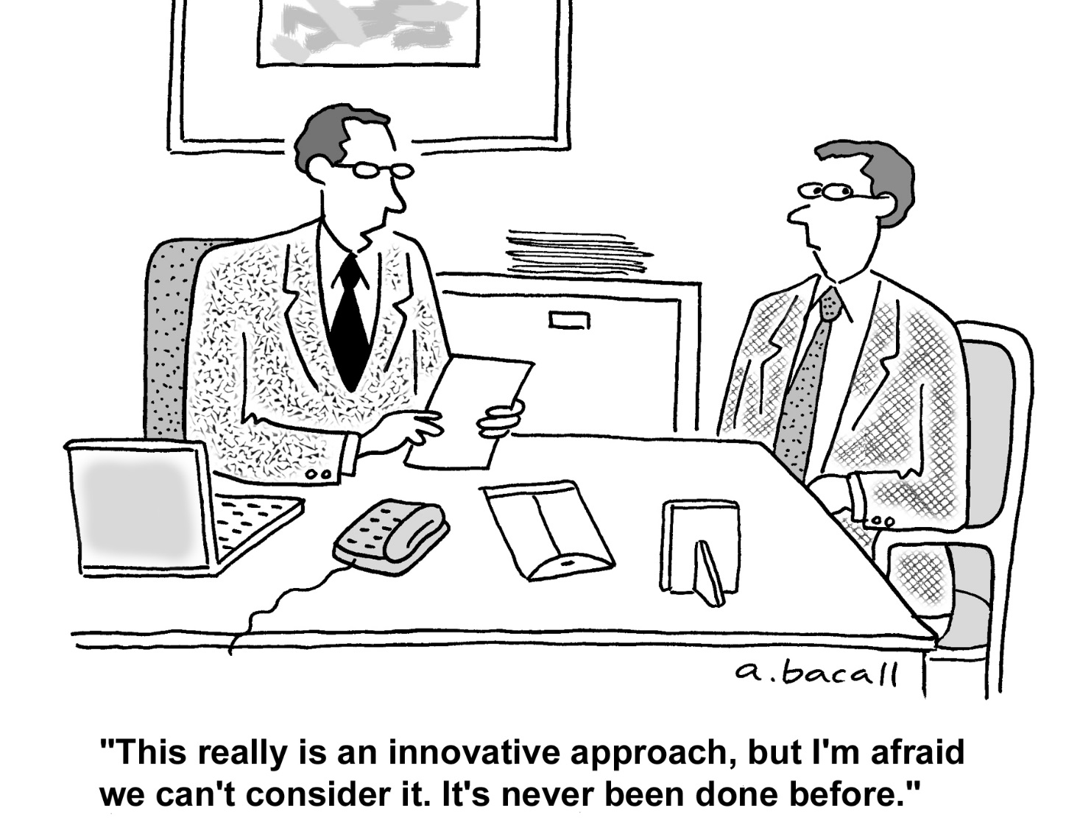
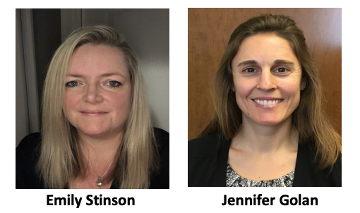
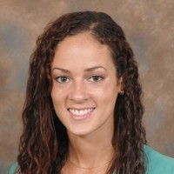
E-Consent Considerations
Iris Deeds
Humor stolen from Rob Silbergleit
Notes:
Abby / Dr stribe

Slide 27
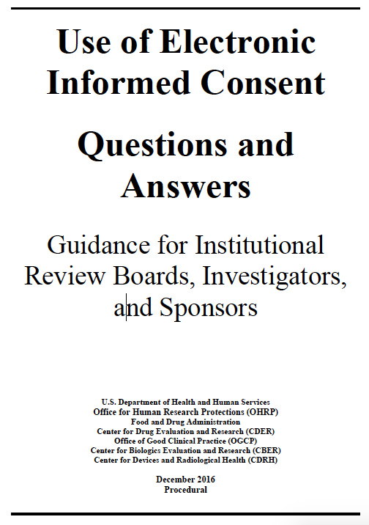
What is e-Consent?
“…use of electronic systems and processes…including text, graphics, audio, video, passive and interactive Web sites…to convey information related to the study and to obtain and document informed consent.”
Key components for our purposes
  Sending a secured link to by text or email
  In-person as well
  REDCap-based website
  Fillable and signature-capable
  User-friendly
  Compliant
  Immediate dissemination

Slide 28

Advantages of eConsent
Off site LAR
  Increase rate of recruitment and speed of individual enrollment
User friendly even in-person
  Adjustable text
  Error reduction (ex: time/date)
Compliance and remote monitoring
  Correct version, no paper, real-time updates
Immediate dissemination
  To LAR/participant, local coordinator, and centrally
Others…

Slide 29
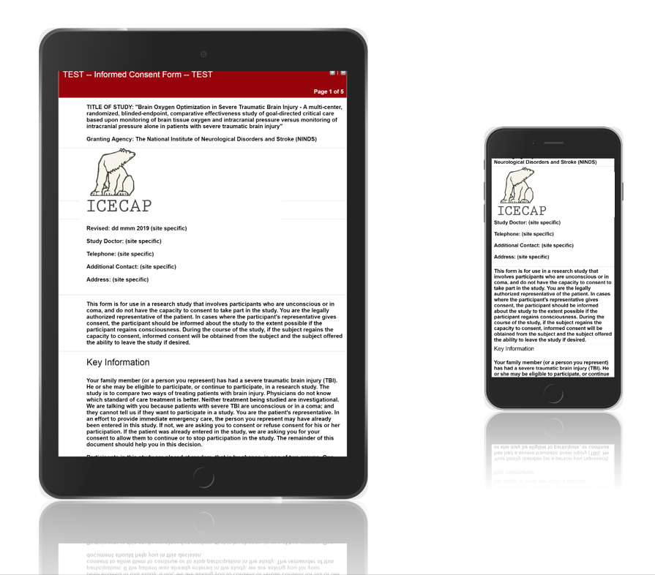
Example:
ICECAP Trial
Slides courtesy of
SIREN Team
Robert Silbergleit, MD
Deneil Harney, MPH MSW

Slide 30
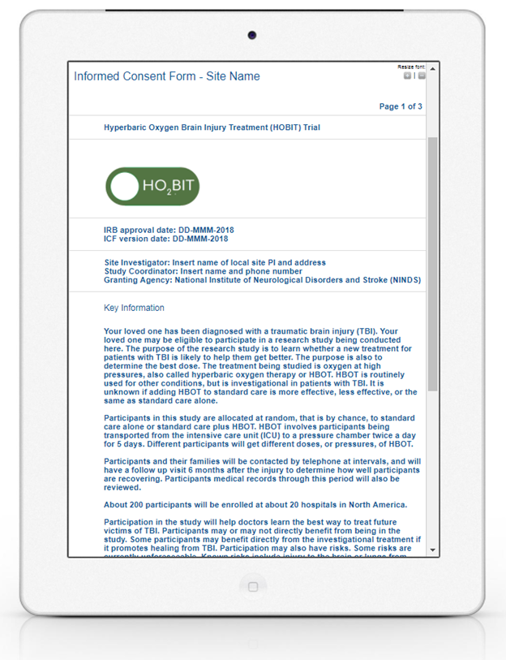
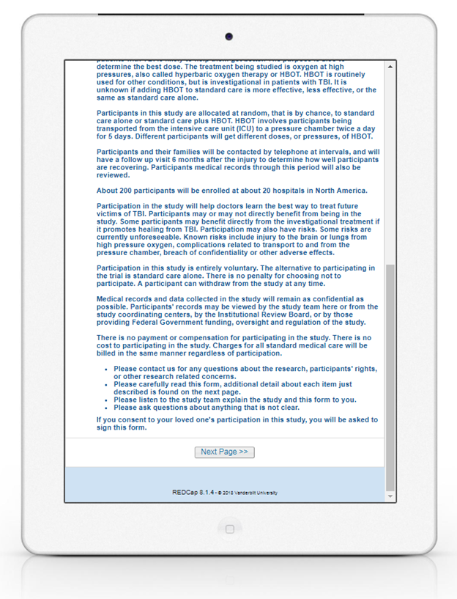



Slide 31
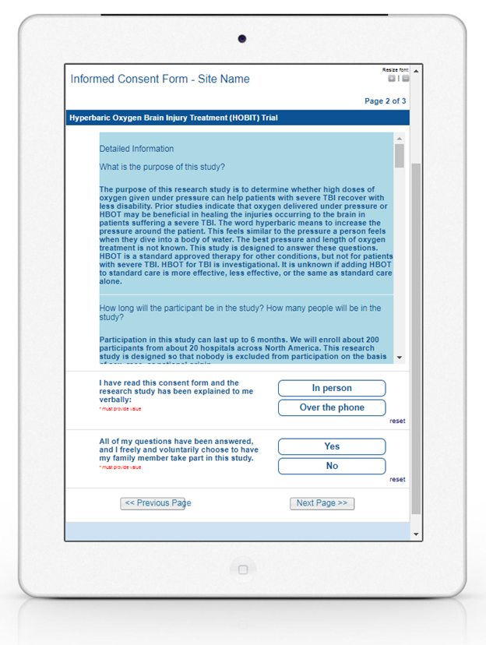
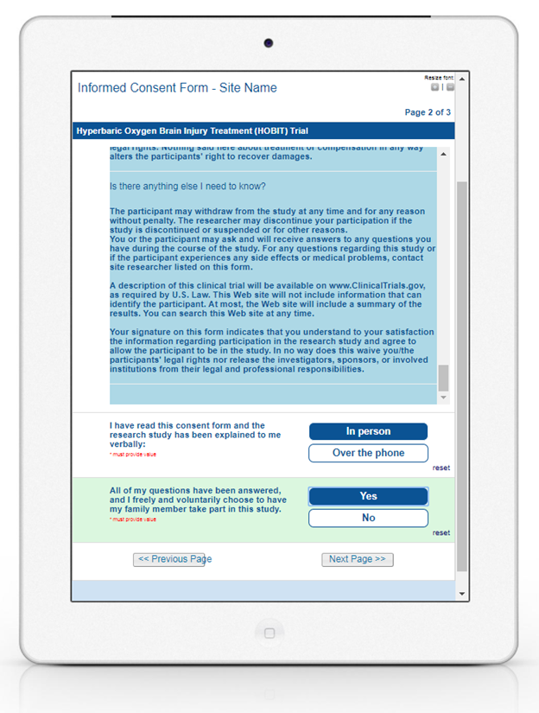

Slide 32
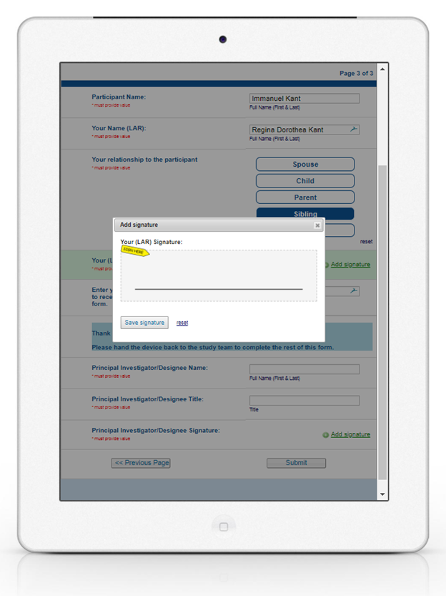


Slide 33
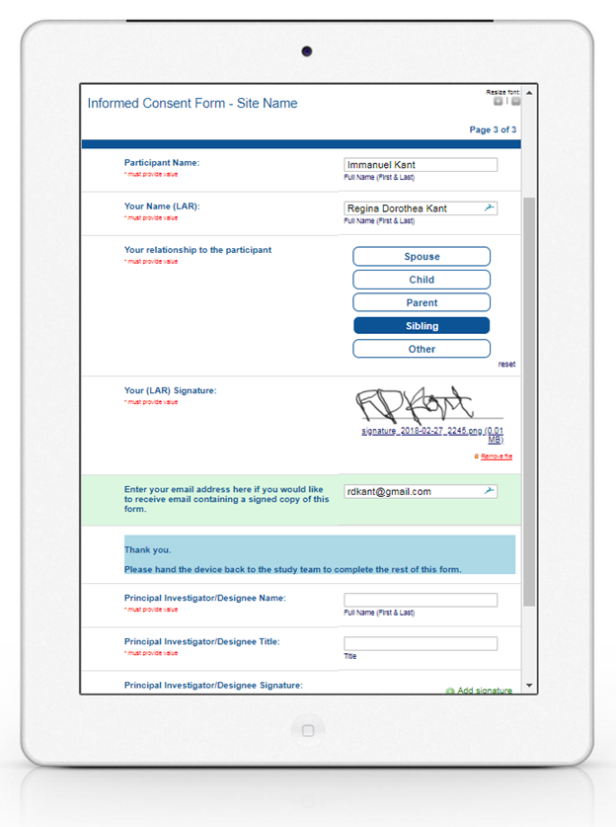
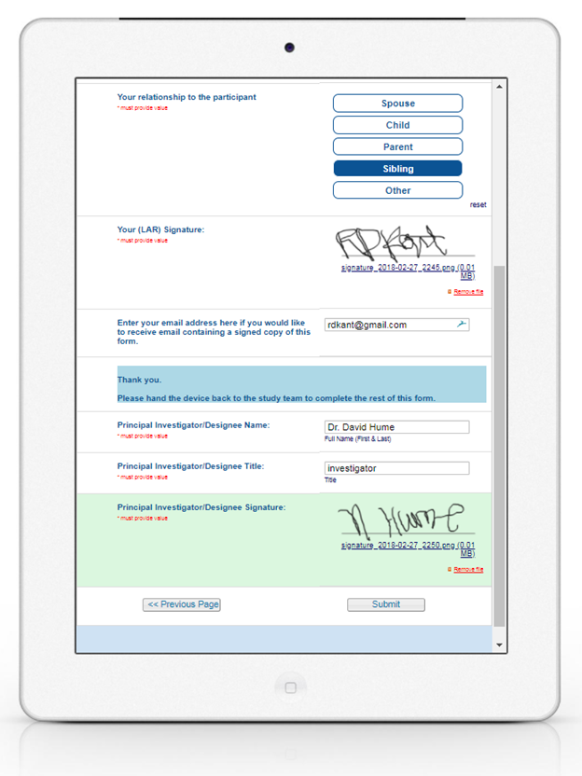

Slide 34
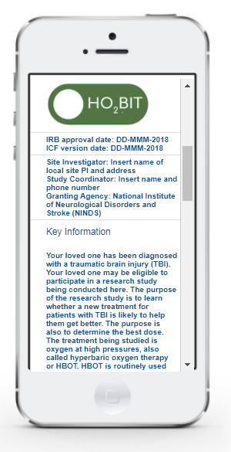
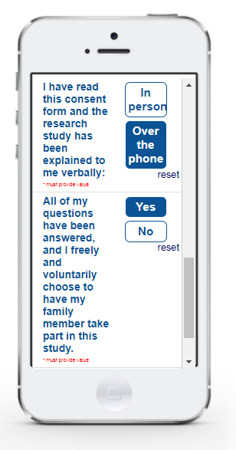
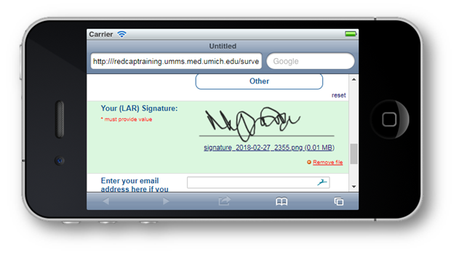

Slide 35
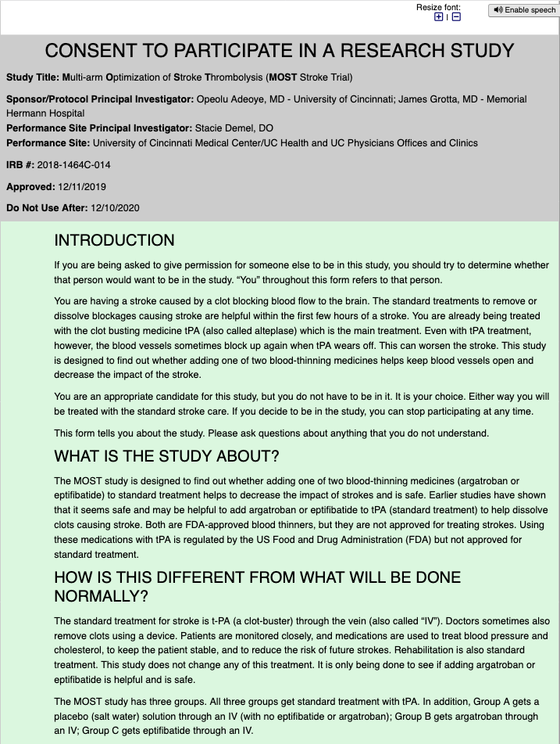
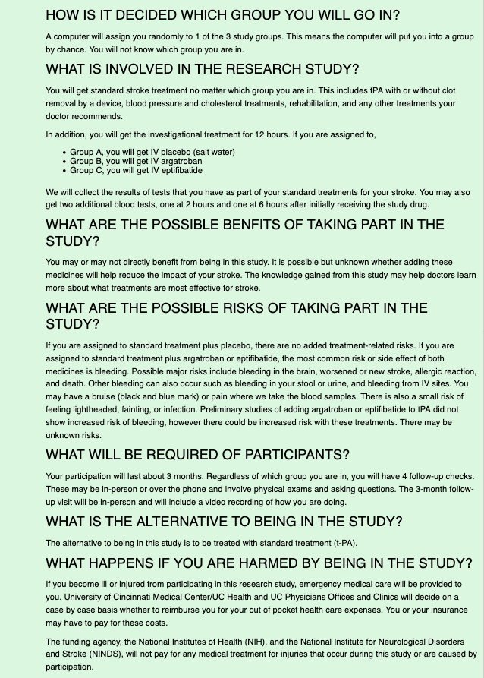
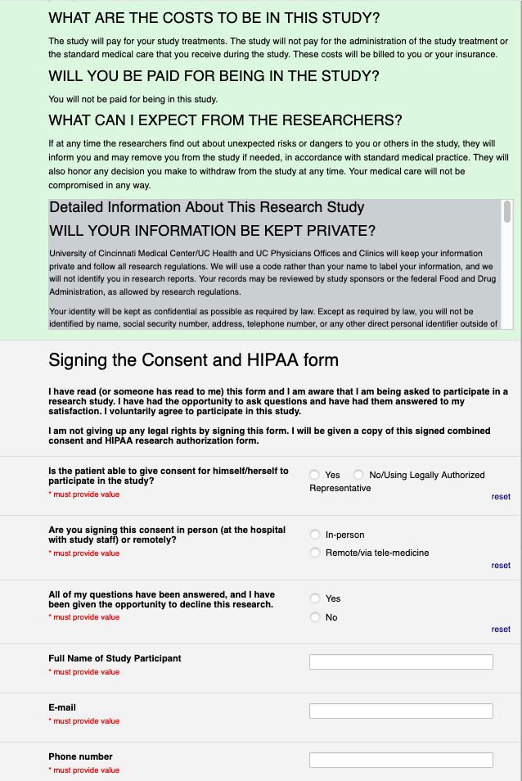
Example:
MOST Trial at UC (Iris Deeds, CCRP)
https://redcap.research.cchmc.org/surveys/?s=4YKLJC7AYY

Slide 36

Two Potential Approaches to our Roll-Out
LOCAL
CENTRAL
Local ICF build in each site
Not all SN sites have REDCap
cIRB approved process
StrokeNet SOP to develop for local process
Train lead site coordinator in REDCap
Challenge of streamlining central language and site specific language components
Some sites may be able to move faster locally
Some already have local eConsent process in place
Added work for local IRBs who are new at this
Central ICF build once
Leverage REDCap centrally for all
cIRB approved process
StrokeNet SOP developed for central process
Train NCC PMs in REDCap
Challenge of streamlining central language and site specific language components
NCC has to revise/update processes centrally
Even those with local process would need to transition to central process
Added work for local IRBs who are new at this

Slide 37

Next Steps
Discuss further with cIRB
Engage leadership of local REDCap
Continue discussions with SIREN
Develop StrokeNet Working Group
Reorganize effort within NCC team
Review with NINDS
cIRB webinar to local IRBs priming them for e-Consent approval
Engage local coordinators to lead the change

Slide 39

Training Core Update
April 8, 2020

Slide 40
Training Core
Mission: To develop stroke-related knowledge and skills for RCC trainees through formal and informal interactive content and mentorship
Programming
  Grand Rounds Webinar Series
  Professional Development Webinar Series
  Learning Communities
  Mentored Trainee Research with presentations

Slide 41
Education and Training core
Randolph Marshall (Chair)
Devin Brown (Co-Chair)
Scott Janis (NINDS)
Harold Adams
David Liebeskind
Cemal Sozener
Shyam Prabhakaran
Farhaan Vahidy
Lori Jordan
Iszet Campo-Bustillo (RCC coordinator)
Stephanie Wilbrand (Coordinator Representative)
Christine Tschoe (Trainee)
James Giles (Trainee)
Jeanne Sester (coordinator)

Slide 42
Metrics
Track progress of trainees during the year with phone interviews, surveys, and progress reports
Trainee presentations
  In person at national meeting
  On the Professional Development webinar
Publications, grant submissions, and professional appointments during and post-StrokeNet training
Database kept by Jeanne Sester

Slide 43
Reminder
Attendance at Webinars is mandatory!
  All current trainees must watch all Grand rounds and Professional Development webinars
    Can be done in real time, or at a later date from StrokeNet website (let Jeanne know)
RCC PIs: please remind the trainees to view webinars, as this is a metric for both trainees and RCCs!

Slide 45
New ideas under development
Coordinator education
  Some programming has been started at U Cincinnati which may be adopted for StrokeNet nationally, NIH educational offerings.
  Incorporate content into monthly coordinator meetings vs separate webinars
  Will be surveying coordinators for interest, logistics, and content
Basic Science programming
  Recommendation from Walter Koroshetz
  Likely to continue to springboard from StrokeNet RCTs, but revamping how to deliver
Reorganizing and enhancing Learning Communities
  Will be surveying trainees and Mentors/Leaders to decide whether and how to continue

Slide 46
Deadlines
  Request for new Trainees’ training plans – 5/15/20
  Request for Grand Rounds Webinar topics and speakers – 5/15/20
  Survey to Trainees – 6/12/20
  Final Trainee Progress report – 6/12/20
  Trainee Contact form – 6/19/20
  Update from prior trainees – 6/19/20

Slide 47
Self-directed learning opportunities (trainees, coordinators, PMs)
https://www.nihstrokenet.org/education
  Introduction to the Principles and Practice of Clinical Research (IPPCR) https://ocr.od.nih.gov/courses/ippcr.html
  Ethical and Regulatory Aspects of Clinical Research https://bioethics.nih.gov/courses/ethical-regulatory-aspects.shtml | https://videocast.nih.gov/PastEvents?c=22
  Principals of Clinical Pharmacology
  https://ocr.od.nih.gov/courses/principles-clinical-pharmacology.html

Slide 48

Questions?

Slide 49
ARCADIA COVID-19 enrolment pause update
Site activities:
Screening
Continue screening remotely/Keep a list of eligible patients
When we resume full activities can reach out to patients for participation
Follow up:
Remote/telehealth follow-up visits for currently enrolled participants
Shipping of study drugs to participants
Other
Document maintenance
New site start-up (cIRB document preparedness, CTA review and execution)
Central study team activities:
Supporting sites
Answering questions/phone calls as needed
Site payments
New US and Canadian site start-up
  Review & approval of cIRB and other regulatory documents

Slide 50
ARCADIA COVID-19 enrolment pause update
Central study team activities:
Administrative tasks
Updating clinicaltrials.gov
CIRB/protocol amendments
NIH reporting
Pharmacy and database management
Site education
Webinars
Newsletters
Site-specific as needed
Other academic activities
Plan for use of video for on-line recruitment
Ancillary study support/grant proposals
Manuscript preparation
Conversion of abstracts presented at ISC

Slide 51
ARCADIA-CSI COVID-19 update
MARCH 16 TO PRESENT
Central Study Team Activities:
  The UAB Survey Research Unit (SRU) for telephone cognitive testing suspended its activities
  Supporting Site Activities:
    Enrolling new sites, involving document upload and review, site initiation calls
    Coordinating activities in StrokeNet webinars and teleconferences
    Exploring feasibility of Canadian sites
    Answering questions
    Phone calls as needed
Site Activities
  Continue screening already-enrolled ARCADIA patients for CSI candidacy

Slide 52
ARCADIA-CSI COVID-19 update
Major Development: The UAB SRU is reopening for cognitive assessments
  SRU testers will be administering exams remotely from private rooms at home, using an encrypted system to access firewalled-protected UAB servers where all reservation information, PHI and test data are stored. No data of any kind will be stored remotely.
  For already-enrolled CSI patients, the SRU will resume follow-up telephone exams to patient homes using the existing protocol for reservations and calls.
Proposal to StrokeNet/CIRB for enrolling new CSI patients:
  Approval of protocol amendment to permit site personnel to remotely contact ongoing ARCADIA patients who meet CSI eligibility criteria and obtain remote consent.
  Site coordinators will schedule baseline cognitive examinations through the SRU reservation system for calls to patients’ homes.
  As already done, Site Coordinators will obtain and upload clinical MRI from the ARCADIA index event.
  For patient without clinical MRI, we would obtain baseline study MRI when feasible.
  No risks to patients or coordinators.
  Maintains scientific integrity of study since remote cognitive exams were already performed.

Slide 53

MOST Trial Update
We hope everyone is staying safe during this time and adjusting well to working remotely. Please continue to communicate with the MOST team about regulatory, data entry and follow-up activities.
Remote follow up (phone, telemedicine, video call) may be substituted for in-person follow up as necessary.
  A recording of remote Day-90 mRS interview conversations should be obtained and uploaded for University of Glasgow review.
  Try to use the provided video camera even for audio recording of a phone call.
  If an audio only file is obtained, please contact Alastair Wilson, Alastair.Wilson@glasgow.ac.uk, to ensure the file uploads properly.

Slide 54
MOST Trial Update
For sites not yet activated, we will continue the site activation process including completion of regulatory documents, delivery of study drug and releasing sites to enroll. Our goal is to have as many sites ready as possible once we are able to return to usual procedures.
A protocol amendment has been submitted to the CIRB. Once approved, the regulatory team will be in contact regarding site-specific ICD changes.
  If your local team and/or local IRB is NOT able to remotely process an amendment, please email MOST@uc.edu.

Slide 55


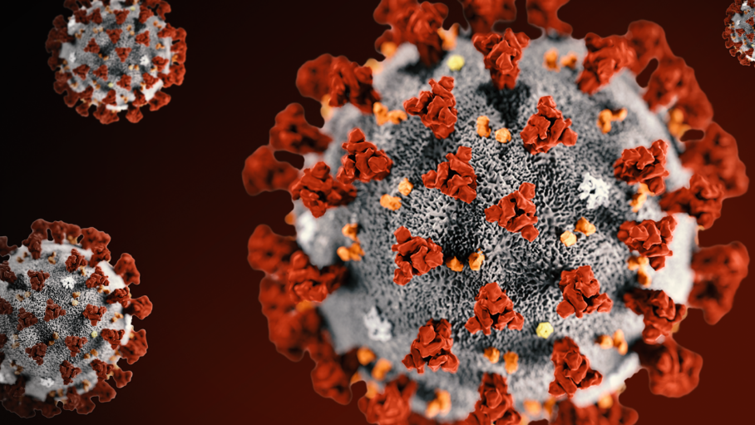
Update
April 8, 2020

Slide 56
If site had been released to enroll
3- and 6-month blinded outcome assessments by phone on randomized subjects. (Video visits are not allowed.)
Respond to WebDCU queries (check ‘Alerts’ tab)
Make sure all trainings are up-to-date in WebDCU for all team members
Review revised MOP
Join us: monthly webinars (next: April 29 at 1 pm)
Please read: monthly newsletters
Please review: www.nihstrokenet.org/sleep-smart-trial/research-team
Our plans…

Slide 57
If site not yet released to enroll
Please continue to work on your contracts and/or CIRB submissions. You will need CIRB approval, CTA, and both FusionHealth agreements (DUA and Consignment) executed.
Work on Sleep SMART trainings and completing your DOA in WebDCU.
If you have all contracts complete, a site readiness call can still be conducted.
Sleep SMART checklist to prepare for Sleep SMART
Reliance agreement, if not already done
CTA
FusionHealth DUA
FusionHealth consignment agreements
*CIRB submission
Local IRB submission for acknowledgement (site dependent)
*Collect names and DOB of study team members who will require KOEO accounts
*PI, investigators, study staff, RT trainings - pass quizzes
*Work on your DOA in WebDCU
KIT installment on local computer - may need IT help
*Identify secure location for equipment
Any desired Nox T3 pre-testing
Inspection of devices by biomedical engineering, if required by local site
*Develop plan for blinded outcome assessment
*Develop plan for administration of Nox T3 sleep apnea test
*Develop plan for conduct of aCPAP run-in night
*Understand process for providing incentives to subjects
*Make arrangements with RT (or sleep techs)
*Educate nursing, other physicians, residents (slide set available for nurses)
Site readiness call
*things that can be done before the Fusion contracts and CTA are executed

Slide 58
I-ACQUIRE Trial Update
All trial activities are suspended due to COVID-19.
a. This affected a small number of infants who were in treatment, scheduled for treatment, or scheduled for assessments.
b. We developed a plan for communicating with families and permitting children who currently are age-eligible (8 – 24 mos) to be enrolled later (when trial suspension is over) up to the age of 36 mos.
c. We distributed written guidelines to all sites and have held a Webinar about COVID-19 trial suspension.
d. We are communicating frequently and openly with our Parent Council about all COVID-19 considerations and decisions, and seeking input from parents.

Slide 59
Activities under during I-ACQUIRE Trial suspension
Finalizing additions and minor changes that require CIRB and DSMB approval - collecting saliva for DNA analysis; adding a Parent Council questionnaire for parents at end of study; submitting revised SAP with a modified ITT analysis (excluding those who withdraw prior to Baseline assessment); and clarifying that Adverse Events reporting is focused on events possibly related to trial participation.
Continuing to conduct, assess, and document protocols for centralized scoring of therapy (Treatment Fidelity) at VT and assessments at OSU.
Seeking approval to implement the Parent Council guidelines and opening the parent Facebook page (awaiting CIRB review)
Developing plans for likely need for training of additional I-ACQUIRE therapists and assessors, along with staying in touch to minimize loss of highly qualified, study-certified research personnel
Engaging leaders of Publication Committee and colleagues in working on ideas and manuscripts for publication and presentation
Documenting the impact of COVID-19 on the study

Slide 60

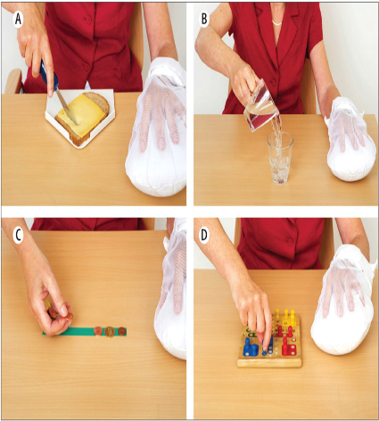
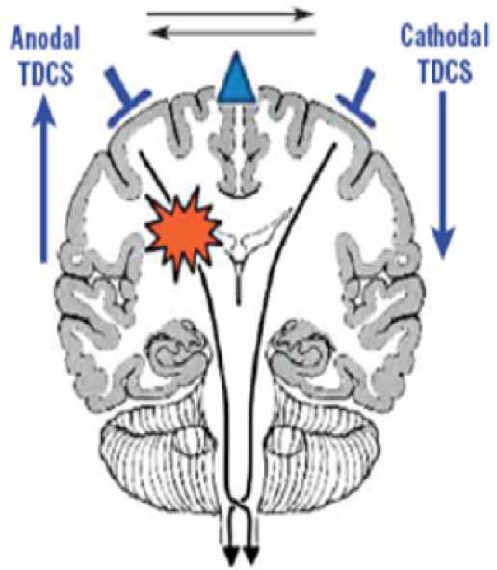
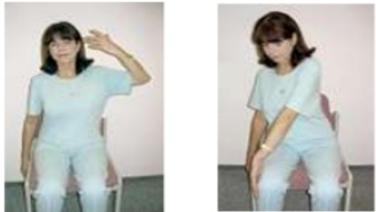
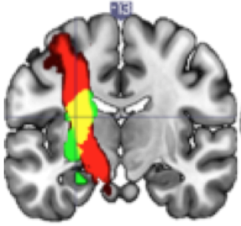
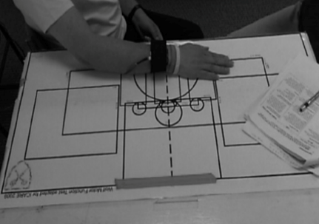
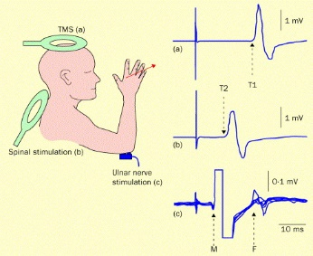

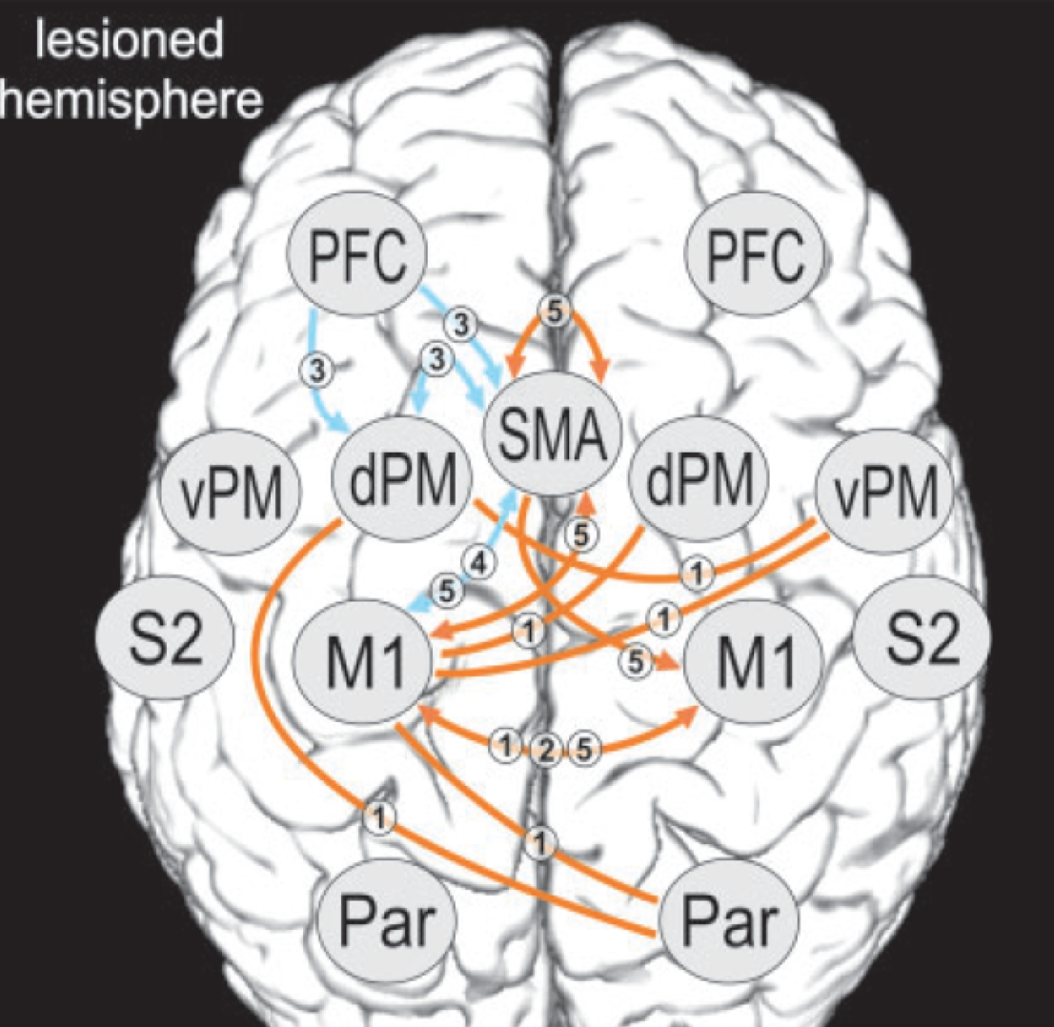
Transcranial Direct Current Stimulation for
Post-stroke Motor Recovery – a Phase2 Study
Wayne Feng MD/MS and Gottfried Schlaug MD/PhD
Pre- and Post-Assessments
Design
Intervention
Phase2 (n=43/arm);
pts between 1-6 months after first ischemic stroke; UE-FM of ≤56;
30min-tDCS with 2hrs-CIMT + home contract for 10 sessions over 14 days.
FM-UE
mCIMT
tDCS
Sham vs 2mA vs 4mA
MRI
WMFT
TMS
WMFT
Stroke Impact
Scale
Data Analysis
Concern: Intense contact between subject and staff during many visits
Concerns: Intense contact between subject and several staff members on many visits

Slide 61

Current Status and Plans during Suspension
11 (out of 129) subjects have been randomized.
All 11 subjects completed the 10 sessions of intervention and day 15 f/u visit (our primary end point).
Day 45 f/u visits for 4 subjects and day 105 f/u visits from 2 subjects will likely be affected during the suspension period (assuming a suspension for 2 months).
Randomization is suspended but pre-screening at most sites is still ongoing. Suspension has some effect on pre-screening.
2/3 of our sites are currently in low risk regions with low number of positive cases.
During the suspension period, we are focusing on data QA/QC (behavior, MRI, TMS), protocol refinements, creating pipelines for rapid TMS and MRI analysis, and getting 3 additional sites up and ready for enrollment.

Slide 62
Covid-19 - Problems and Possible Solutions for TRANSPORT2
We are assuming that the Covid-19 infection risk will become less, but won’t go away, and Covid-19 will become a seasonal virus infection
Design
Major: change to a Tele-Rehab intervention and remote brain-stimulation
Minor: limit visits to medical/rehab area; limit interactions with others
Screening and consenting by video/remotely
Intervention in low risk medical area; subject/staff have to wear PPE
Some/all assessments done by interactive video or in subjects’ homes
- Bring Subject to low risk areas in medical/rehab center
- Therapists/Assessor have to wear PPE (gloves, mask, eye shield);
- Subject has to wear PPE (mask, eye shield, gown);
- POC or medical center testing for Covid-19 of subjects and staff x 2;
- Therapy tools have to be thoroughly disinfected
Intervention
Pre- and Post-Assessments
- Disinfection of gear/equipment (MRI, TMS, tools)
- Assessments by video and/or in subject’s home
- Modifications to assessments to make them suitable for video

Slide 63
ASPIRE COVID-19 Update: Activated Sites
At 30 Activated Sites:
  Enrollment and randomization activities were suspended on March 20, 2020.
  Screening activities are continuing as permitted by local institutional policies.
    Per COVID-19 Impact Assessments in WebDCU:
      16 sites do not have restrictions on screening
      3 sites report an impact on screening
      11 sites have not completed the survey
  Our protocol already allows consent via telephone/telehealth contact. Methods to implement remote consent and randomization are being developed for consideration by the cIRB.

Slide 64
ASPIRE COVID-19 Update: Sites Pending Activation
At 90 Sites Pending Activation:
As institutional guidelines allow, we are continuing with startup activities
  Finalizing clinical trial agreement (32 sites)
  Submitting cIRB (38 sites)
  Conducting readiness call (72 sites)
  Completing regulatory documents (87 sites)

Slide 65




COVID-19 Priorities
U01NS102289

Slide 66
1. Working with sites pending completion of startup materials (CTA & cIRB) ççç
STATUS | CTA | cIRB | CTA + cIRB
Fully executed/Approved | 77 | 56 | 44
Pending/In process | 12 | 20 | 12
10 responded
18 Canadian sites pending Fogarty approval
2. Complete site readiness calls to get sites released to enroll
Completed 21 calls
13 scheduled
10 to be scheduled
3. Exploring the possibility of re-opening enrollment at sites which were released to enroll if
local conditions/regulations permit the conduct of non-COVET research – Shipping of
blood tubes is a rate-limiting step!
4. Beginning to explore the feasibility of remote consent – Several logistic challenges
during COVID

Slide 67
Site Readiness Calls
Completed 21 site readiness calls
10 sites released to enroll
13 calls scheduled
10 to be scheduled

Slide 68






CREST-2 Recruitment
132 sites with at least one patient enrolled
155 green-lighted sites
  Good Samaritan Hospital in Cincinnati, OH 4/03
  St. Joseph Heritage Healthcare in Mission Viejo, CA 3/25
1653 Overall
  870 CEA & 783 CAS

Slide 69
COVID-19 Updates
Surveyed all PIs & Coordinators on COVID-19 policies at their institution March 17th
  158 responses from 110 sites
Suspended new enrollments into CREST-2 & the Low Enrollment Policy March 24th
  Communicated that sites should log their screening efforts to enroll patients at a later date
Coordinators’ Calls will now be weekly rather monthly starting March 17th
  Announced that all CREST-2 sites will be on phone follow-up on March 31st
  Discussed the pilot of the COVID-19 Risk Factor Mitigation Plan on March 31st

Slide 70

Sites = 54 (6 more pending) Subjects = 139/350
New subject recruitment is on hold
Follow ups (for CREST-2) by telephone
Most critical is the 1-year cognitive exam
  Primary endpoint for CREST-H
  done by telephone through CREST-2
1-year follow up perfusion scans may be done at a delayed time point after 1-3 months
Once enrollment resumes, we need about 1 of 3 CREST-2 patients to meet our target, so let’s hit the ground running!
Recruitment on hold

Slide 71

The FASTEST Trial

Slide 72
Design
Global randomized, double-blind controlled efficacy trial of rFVIIa plus best standard therapy vs. placebo plus best standard therapy (including INTERACT 2 goal of target BP of 140 mm Hg).
Includes a projected 860 subjects in 6 countries:
  Baseline volume of ICH < 60 cc, ≥ 2 cc
  No or small volume of IVH (IVH score ≤ 7)
  Age ≤ 80, ≥ 18
  Treated within 120 minutes from stroke onset (goal ½ within 90 minutes).
    EFIC, mobile stroke units, streamlined processes in ED
Notes:
1. Score of 3 to 7 on the Glasgow Coma Scale (indicating deep coma).
2. Secondary ICH related known causes (e.g. trauma, aneurysm, AVM, current oral anticoagulant use, coagulopathy, etc.)
3. Known or suspected pregnancy.
4. ICH volume < 2 cc and ≥ 60 cc
5. IVH score > 7
6. Pre-existing disability (mRS > 2)
7. Symptomatic thrombotic or vaso-occlusive disease in past 90 days (e.g. cerebral infarction, myocardial infarction, pulmonary embolus, deep vein thrombosis, or unstable angina).
8. Clinical or EKG evidence of ST elevation consistent with acute myocardial ischemia
9. Brainstem location of hemorrhage (patients with cerebellar hemorrhage may be enrolled)
10. Refusal to participate in study by patient, legal representative, or family member.
11. Known or suspected thrombocytopenia (unless current platelet count documented above 50,000 / μl)
12. Unfractionated heparin use with abnormal PTT
13. Low-molecular weight heparin use within the previous 24 hours.
14. Recent (within 90 days) carotid endarterectomy or coronary or cerebrovascular angioplasty or stenting
15. Advanced or terminal illness or any other condition the investigator feels would pose a significant hazard to the patient if rFVIIa were administered.
16. Recent (within 30 days) participation in any investigational drug or device trial or earlier participation in any investigational drug or device trial for which the duration of effect is expected to persist until to the time of FASTEST enrollment.
17. Planned withdrawal of care or comfort care measures
18. Patient known or suspected of not being able to comply with trial protocol (e.g., due to alcoholism, drug dependency or psychological disorder).
19. Known or suspected allergy to trial medication(s), excipients, or related products
20. Contraindications to study medication.
21. Previous participation in this trial. (Clarify screened or randomised)

Slide 73
FASTEST Trial
Advarra is CIRB – approved trial
DSMB reviewed
Subawards sent out.
Sites selection completed and will be distributed within next week.
Challenge
  EFIC in the time of COVID
  Working on online focus groups and survey
Next steps:
  Protocol minor amendment
  Begin contract process with sites
  Planned first enrollment at present – postponed to October 1.

