Slide 1
WebDCU Site and People document review
Jennifer Golan, regulatory specialist

Slide 2
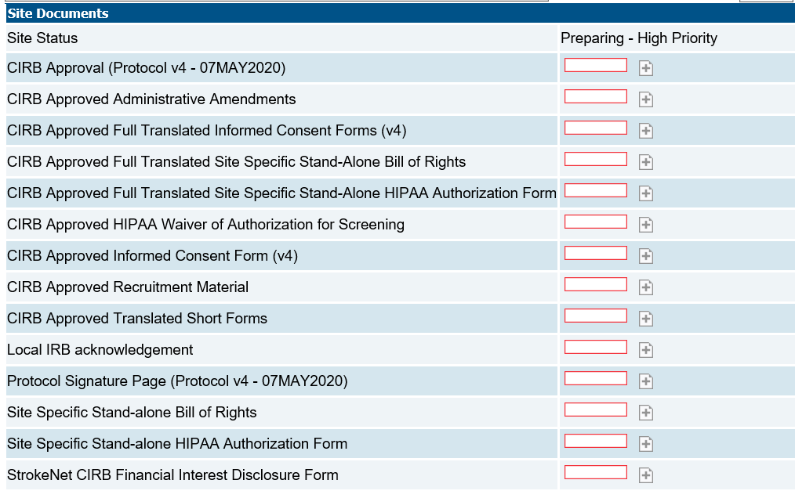
Site Documents

Slide 3
CIRB Approval
Specific to protocol version
New placeholder for protocol amendment
Four types of approvals:
Initial approval letter
Site-specific letter
Continuing review approval letter
PRIME study-level letter
Protocol amendment letter with consent changes
Site-specific approval letter
Protocol amendment without consent changes
PRIME study-level letter

Slide 4
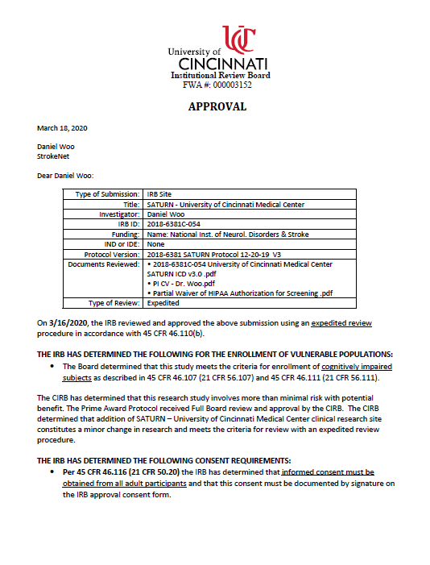
CIRB Approval - examples
Initial Approval
Site-specific approval
letter

Slide 5
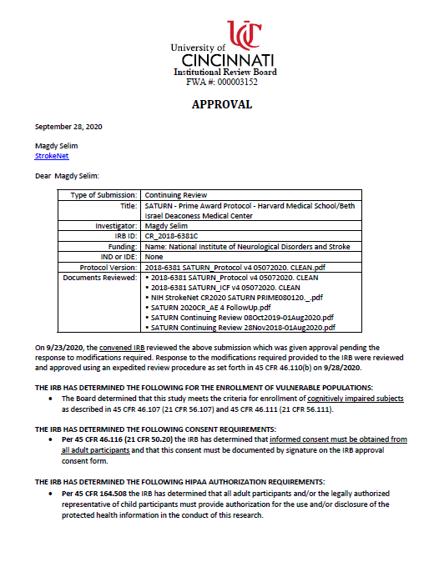
CIRB Approval - examples
Continuing review
PRIME study-level approval
letter

Slide 7
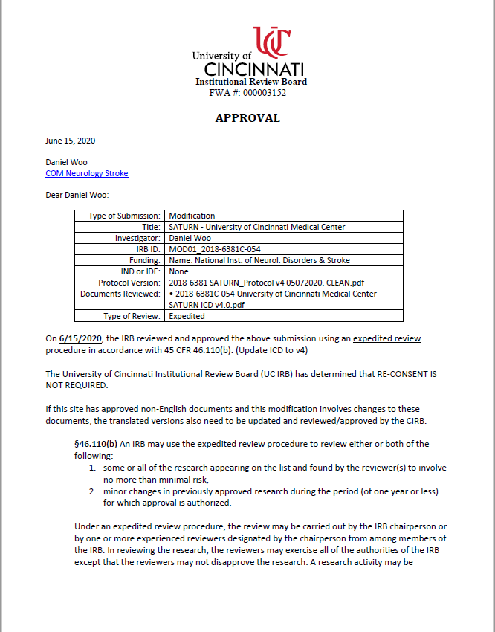
CIRB Approval - examples
Protocol amendment
letter with consent changes
Site-specific approval letter

Slide 8
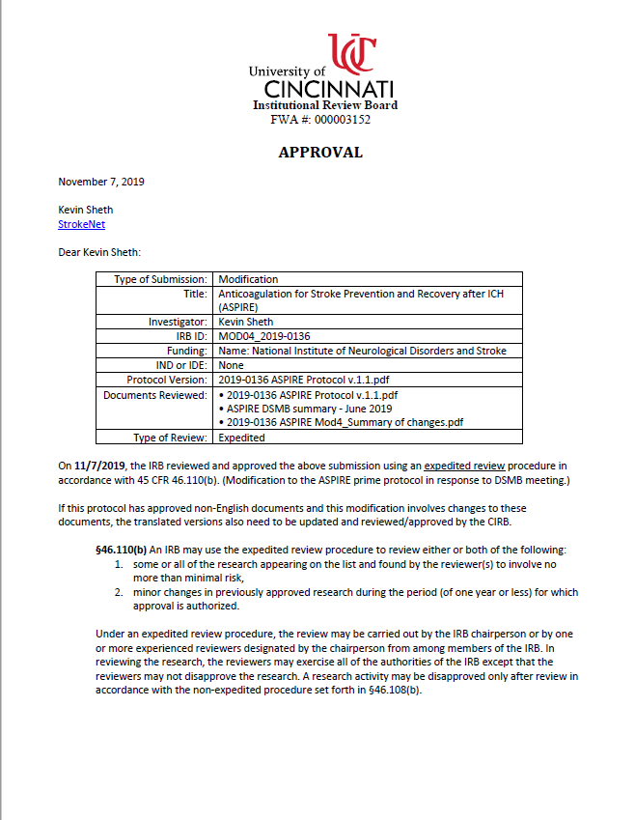
CIRB Approval - examples
Protocol amendment without
consent changes
PRIME study-level approval
letter

Slide 9
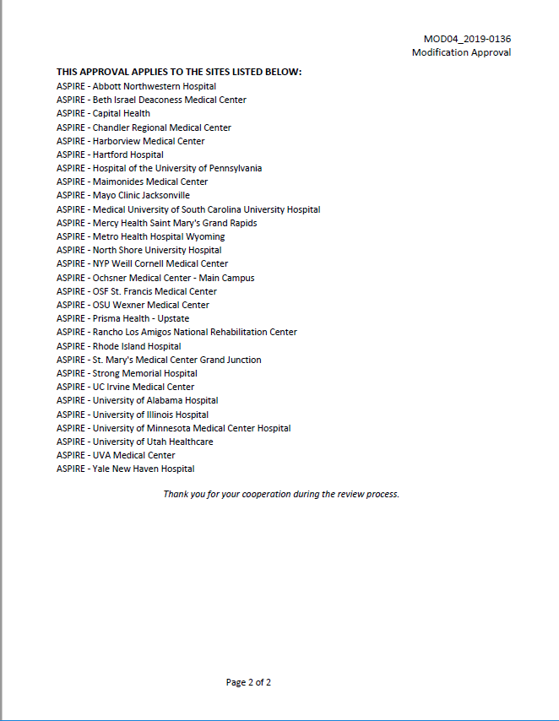

Slide 10
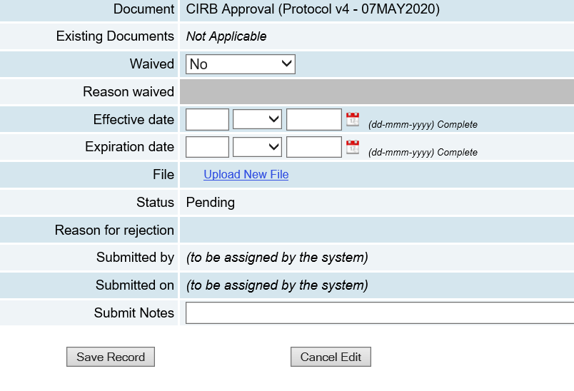
CIRB Approval - WEBDCU
Effective date – approval date on letter
Expiration date – expiration date of study

Slide 11
CIRB Approved Administrative Amendments
Types of approvals:
Site specific changes
PI Change
Site-specific ICD changes
Adding additional study locations
Translations
Remote and eICD implementation forms

Slide 12
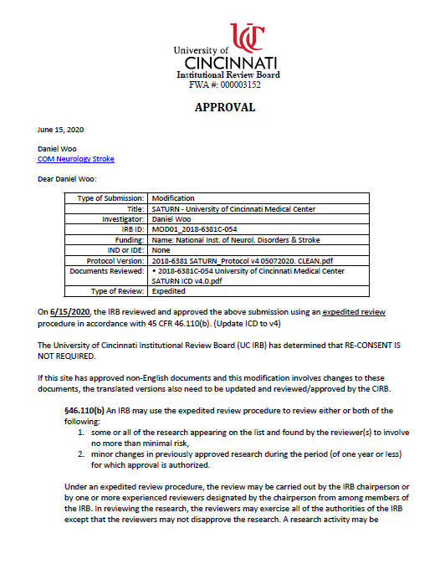
CIRB Approved Administrative Amendments
Modification number
corresponds to number of
approvals received after
initial approval
Ensure all modifications
are uploaded in WebDCU
Reach out to the NCC
for any missing documents

Slide 13
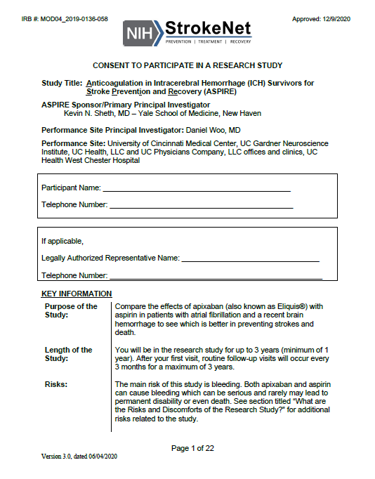
CIRB Approved Informed Consent Forms
Update: CIRB has removed
the expiration dates
Notes:
Update: No expiration dates

Slide 14
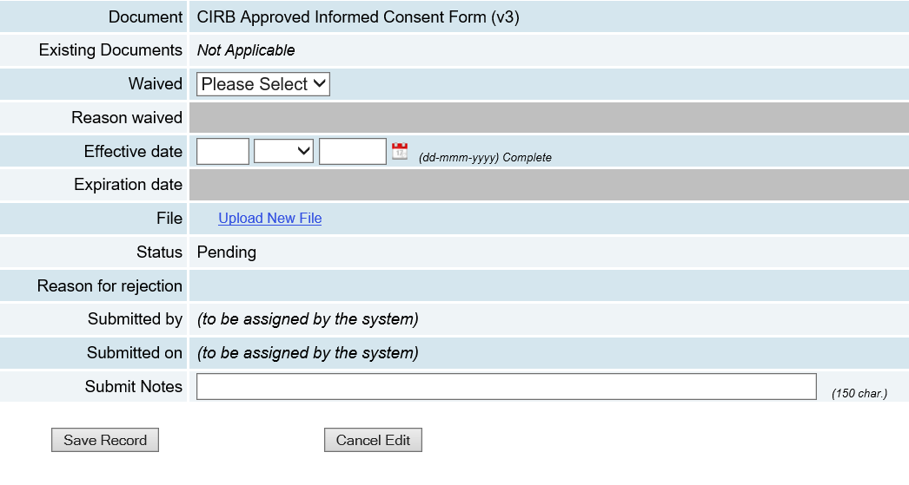
CIRB Approved Informed Consent Forms

Slide 15
Other Consent Documents
Site Specific Stand-alone HIPAA Authorization Form
Site Specific Stand-alone Bill of Rights(BOR)

Slide 16
Translations
CIRB Approved Full Translated Informed Consent Forms
CIRB Approved Full Translated Site Specific Stand-Alone HIPAA Authorization Form
CIRB Approved Full Translated Site Specific Stand-Alone Bill of Rights
CIRB Translated Short Forms
More than one pdf as one file

Slide 17
Translations
Sites not using translations can waive these placeholders
Translations provided by the NCC
Exception: site specific stand-alone HIPAA and BOR
Send translation and translation certificate to NCC for IRB submission and approval
Reminder: upload approval letter in CIRB approved administrative amendments placeholder that is sent with your translated documents

Slide 18
StrokeNet CIRB Financial Interest Disclosure Form (fCOI)
fCOI forms must be completed for each study team member yearly.
Document must be hand signed and dated or signed electronically with DocuSign or Adobe signature.
Upload the completed PI fCOI and any other COI forms with a positive financial disclosure to WebDCU.
The remaining forms must be available for review as part of your onsite documents and/or files.
PI COI form must be signed within 3 months of CIRB submission.

Slide 19
Other Site Documents
CIRB Approved HIPAA Waiver of Authorization for Screening
Needed for initial CIRB submission
Local IRB acknowledgement
Documentation of initial protocol acknowledgement by your local IRB is required
Only initial approval should be uploaded, all other local IRB acknowledgements should be filed on-site.
Protocol Signature Page

Slide 20
People Documents

Slide 21
Common People Documents
Curriculum Vitae (CV)
Document must be signed and dated.
CV must list person's current affiliation with site.
Good Clinical Practice (GCP) Training
Human Subjects Protection (HSP) Training
Most commonly completed through CITI
Other certifications might be rejected asking for more information
Medical/Professional License
mRS Certification – 2 year expiration
NIHSS Certification – 2 year expiration
Notes:
CITI
AHA, BlueCloud

Slide 22
Common People Documents

Slide 23
Reminders
Please upload site documents upon receipt from NCC
Please keep site contact/Delegation Of Authority (DOA) list updated for WebDCU for document distribution
Address expired documents asap
Reach out to the NCC for any missing site documents

Slide 24
Helpful links and tools
WebDCU campus – training center
https://webdcu.musc.edu/campus/
Parameters document
Located in study toolbox

Slide 25
NCC Regulatory Contacts
Emily Stinson stinsoey@ucmail.uc.edu
Jen Golan golanjl@ucmail.uc.edu
Lauren Stricker strickla@ucmail.uc.edu

Slide 26
Questions?

