Slide 1
PI and Coordinator Webinar
February 26, 2019

Slide 2
Site startup/recruitment profile
In past month:
114→ 116 sites released to enroll
59 → 63 sites with at least one randomization
  Randomizations 0-10
  Randomizations per month: 0 – 1.01 (mean 0.18)
97 → 101 sites with at least one consent
  Range 0 to 30 consents per site

Slide 3
Enrollment
In past month:
612 → 677 patients consented
~40% eligible for randomization
149 → 166 randomized
25 eligible but not yet randomized

Slide 4
Top enrolling sites – by # randomized
 | Randomized | Consented
United | 10 | 30
OHSU | 9 | 30
Iowa | 9 | 25
Cincinnati | 9 | 24
UF Shands | 6 | 17
Memorial Hermann | 6 | 16
MUSC | 5 | 19
Penn | 5 | 15
Intercoastal | 4 | 18
St. Mary's Grand Junction | 4 | 10
Univ. Illinois | 4 | 7

Slide 5
Top enrolling sites – by randomization rate
 | Randomized/Month | Consented/Month
United | 1.01 | 3.0
OHSU | 0.92 | 3.1
Iowa | 0.83 | 2.3
Cincinnati | 0.69 | 1.9
MUSC | 0.53 | 2.0
UF Shands | 0.53 | 1.5
Memorial Hermann | 0.51 | 1.4
Univ. Illinois | 0.50 | 0.9
Emory | 0.49 | 2.7
Long Beach | 0.48 | 0.5

Slide 6
ARCADIA heroes
Above and beyond:
  Medstar team identified a potentially eligible patient
  Being discharged before complete work-up
  Patient lives in New Jersey
  Service attending (Amie Hsia) coordinated with site PI (Chandni Kalaria) and national PIs to arrange evaluation at Columbia
Thank you Dr. Hsia and Dr. Kalaria!
Notes:
We have had numerous sites enroll subject that end up moving. We appreciate all the efforts these site have made to retain these subjects and to find a new home for their subjects.

Slide 7
Exciting news!
ARCADIA-CSI (Cognition and Silent Infarcts)
First ancillary study funded!
PIs: George Howard, DrPH; Maarten Lansberg, MD, PhD; Ronald Lazar, PhD; Kevin N. Sheth, MD; David Tirschwell, MD
Aims:
To determine the effect of anticoagulation (vs antiplatelet therapy) on cognitive function after stroke (primary clinical outcome)
To determine the effect of anticoagulation (vs antiplatelet therapy) on the incidence of silent infarcts after stroke (primary imaging outcome)
To determine the imaging and clinical predictors of cognitive impairment after stroke

Slide 8
Inclusion of Women and Minorities in ARCADIA
Bernadette Boden-Albala, MPH, DrPH
Co-Chair, StrokeNet National Advisory Committee for Minority Recruitment and Retention
Senior Associate Dean, Research and Program Development
Interim Chair, Epidemiology
Professor of Public Health, Epidemiology and Neurology and Global Public Health
New York University
February 26th, 2019

Slide 9
Importance of Inclusion
Stroke is characterized by stark racial/ethnic disparities
Trials must include adequate representation of racial/ethnic subgroups in order for results to generalize to U.S. population
  Scientific: Critical to determine if there are differences in safety or efficacy by race/ethnicity
  Ethical: Everyone should have equal access to trials that determine clinical guidelines

Slide 10



Overall Challenges to Inclusion
Enhancing the screening pool
Converting eligible to enrolled
Retaining enrolled participants

Slide 11
Enhancing the Screening Pool

Slide 12
Promoting ARCADIA In Your Hospital
Present at Departmental or Division Conferences
Host Grand Rounds or CME meetings
Post information about ARCADIA on your hospital or practice website
Send reminders in hospital staff newsletters or email blasts
Present at physician meetings and calls
Enter ARCADIA information in your hospital or clinic ‘StudyFinder’ system
Pass out inclusion/exclusion cards to other departments or teams within your hospital system.

Slide 13
Promoting ARCADIA In Your Community
Why let communities know about ARCADIA and other ongoing trials?
Strategies:
Present at Community Research Advisory Board meetings
Talk to your hospital CTSI or public/ community relations department about additional ways to publicize ARCADIA within your hospital and community

Slide 14
Converting Eligible to Enrolled

Slide 15
Recruitment Best Practices
Clearly explain that the purpose of informed consent is to protect, not relinquish, participants’ rights.
Provide time between screening and randomization for patients to reflect and discuss participation with family.
Emphasize the proven track record of the study drugs.
Emphasize the trial’s potential to help find better treatments to prevent stroke.
Minimize concern about randomization by clearly explaining its rationale and highlighting the possibility of cross over if clinically indicated.
Emphasize that participants will be kept up to date on scientific developments in this field throughout their participation in the trial.

Slide 16

Motivational Interviewing (MI)
MI skills can be used to build trust and rapport with patients during recruitment interactions:
Approach participants with welcoming attitude that is open, sincere and present
Use a guiding rather than directive communication style
Honor patients’ autonomy
Express empathy and compassion
Ask open-ended questions
Practice reflective listening
Remain calm and engaged when a patient expresses ambivalence about participation

Slide 17
Retaining enrolled participants

Slide 18




Optimizing Retention
Extend site hours beyond 9am-5pm to accommodate working individuals or those with child care needs
Provide vouchers, transit cards, and/or gift cards to cover non-medical costs, such as gas mileage, parking, and a meal
Establish regular contact with participants (birthday cards, holiday cards, appointment reminders)
Provide a study number or email address for participants to reach research staff
Appreciate participant time and effort (certificates, thank you notes, pens, calendars, bags, etc.)

Slide 19


NIMICT.com
Toolkit for Recruitment and Retention
Supported by
NINDS/NIMHD
U24#MD006961

Slide 20
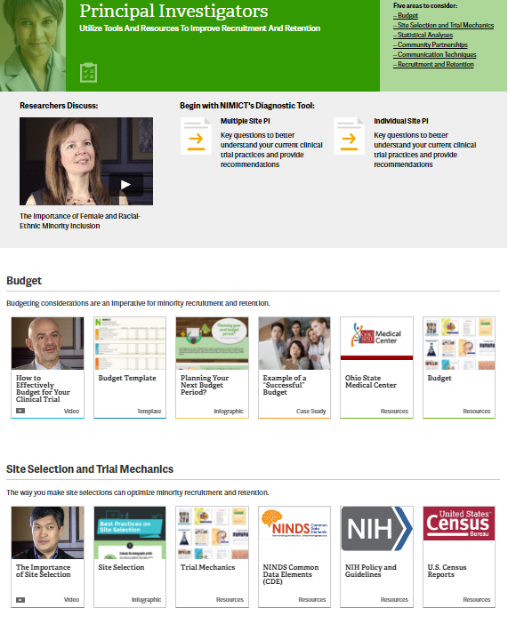
NIMICT.com Tools and Resources
Video series
Diagnostic quizzes
Best practices
Checklists
Resource collections
Templates
Case studies

Slide 21
Questions or Comments?
Bernadette Boden-Albala: Bb109@nyu.edu
Noa Appleton: Na67@nyu.edu

Slide 22
Plans to increase recruitment by adding sites
Adding additional sites: StrokeNet, non-StrokeNet US sites, Canadian
If you have sites that are interested in participating, let us know and we will have them complete a site selection survey
If you have clinics or rehab facilities near you where you could possibly screen subjects for ARCADIA, let us know and we can work with you on what you would need to do to add them

Slide 23
Potential patient concerned about travel?
Many sites get referrals from far away
We have heard that some potential patients do not want to travel for follow-up visits

Slide 24
Potential patient concerned about travel?
Many sites get referrals from far away
We have heard that some potential patients do not want to travel for follow-up visits
PROTOCOL AMENDMENT:
  “If in-person visit cannot be done, an interview via telephone or other HIPAA-compliant telehealth technology should be performed.”
  Study drug will need to be resupplied by mail

Slide 25
Recruitment challenge
Case
Patient admitted with retinal artery branch occlusion.
She noted a "grey curtain that moved downward" in her right eye; it only affected the upper portion of her vision.
She saw her eye doctor and was referred to a neuro ophthalmologist, who diagnosed the patient with a retinal artery branch occlusion. He noted retinal pallor present 48 hours after onset.
NIHSS Score: 0.
Head CT and brain MRI did not show any infarct.
CTA neck showed < 30% right carotid stenosis. CTA head showed no flow-limiting stenosis.
TT echo showed severely increased LA volume; no atrial fibrillation on telemetry.
QUESTION: Is she eligible? YES or NO

Slide 26
Recruitment challenge
YES. The patient can be considered eligible.
If symptoms last less than 24 hrs, but an infarct is diagnosed in the eye based on ophthalmology exam, then can be considered eligible, even if MRI is negative.
The diagnosis of infarct should be based on evidence of infarct, which could be seen on MRI (brain) or on direct exam (eye).
We would not expect MRI to show an infarct of the eye (we see strokes but not retinal strokes on MRI).
Remember definition of stroke and infarction:
  Definition of ischemic stroke: An episode of neurological dysfunction caused by focal cerebral, spinal, or retinal infarction.
  Definition of CNS infarction: CNS infarction is brain, spinal cord, or retinal cell death attributable to ischemia, based on:
  1. pathological, imaging, or other objective evidence of cerebral, spinal cord, or retinal focal ischemic injury in a defined vascular distribution; or
  2. clinical evidence of cerebral, spinal cord, or retinal focal ischemic injury based on symptoms persisting ≥24 hours or until death, and other etiologies excluded.

Slide 27
Other protocol changes
Mild mitral stenosis not an exclusion
Tests to establish ESUS (echo, vessel imaging, etc) can be from 3 months prior to stroke or more recent. Older tests must be repeated.
Clarifying procedures for contacting potential subjects by phone.
Study drug must be stopped if you report a potential primary or secondary event. If the event is adjudicated as not an event, then patient can resume study drug after, as long as there has not been any unblinding.
Change in consent form to include apixaban reversal agent (andexanet alfa)

Slide 28
New payment terms planned
Current:
  We pay $100 each for up to 3 patients consented but not randomized
  Payment at time of randomization
On average, we are right at the 3:1 ratio or even better
But some individual sites have worse luck

Slide 29
New payment terms planned
We will pay $100 for all consented patients
Requires completion of all screening tests (echo, ECG, NT-proBNP) and end-of-study CRF

Slide 30
Consenting process
Numerous cases of incorrect procedure
Extremely important for this to be done correctly
Respect for patients, compliance with laws, good practice

Slide 31
Informed Consent
Use the most current cIRB approved version of the ICF when obtaining consent (all StrokeNet sites should be using ICFs with an approval date in December 2018 or later).
Consent should be obtained ONLY by staff who have been delegated this responsibility on the DOA.
Double check consent document to make sure all sections have been correctly signed/dated by subject and person obtaining consent.

Slide 32
Determining capacity to consent and use of LAR
Subjects who lack cognitive ability to make decisions about study participation cannot give consent.
If there is any question about a subject’s cognitive ability, a trained site investigator must assess the subject for capacity to consent. This assessment must be documented in the subject’s medical record.
If a subject lacks capacity to consent, a legally authorized representative may consent on behalf of the subject. Refer to section 10.1 of the MOP for guidance on how to determine who is an appropriate LAR.
If a subject regains the ability to consent during study participation, the consent process should be completed with the subject at that time.

Slide 33
Inappropriate use of LAR/surrogate consent
LAR signature on an ICF = LAR made decision b/c subject was not capable.
LAR signature is NEVER an appropriate way to document the consent of the subject.
Examples of when LAR signature is used to incorrectly document a subject’s consent:
Subject has trouble physically signing the ICF
Subject is illiterate
Subject is blind
Subject does not speak English
Subject prefers to have friend/family member sign documents

Slide 34
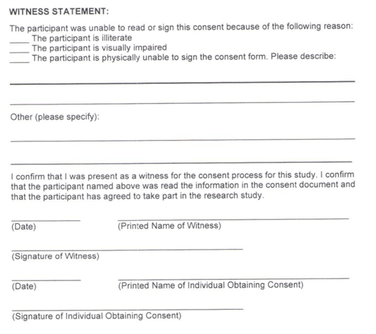
Documenting consent for subjects with non-cognitive impairments
When subject is capable of giving consent, but is unable to physically sign the consent:
  Impartial witness must be present during the consent process and sign consent document.
  If possible, subject should make their mark on signature lines.
When a subject is illiterate or visually impaired:
  The entire consent must be read aloud to the subject.
  Impartial witness must be present during the consent process and sign consent document.
  If possible, subject should make their mark on signature lines.

Slide 35
Obtaining consent from non-English speaking subjects
To obtain consent from non-English speaking subjects, you must have either a cIRB approved Full Translated ICF or a translated Short Form consent in the subject’s language.
The presentation of the consent must be done in the subject’s language. Either the person obtaining consent must be fluent in the subject’s language or an interpreter must be used. The subject’s friends of family members MAY NOT be used as interpreters.

Slide 36
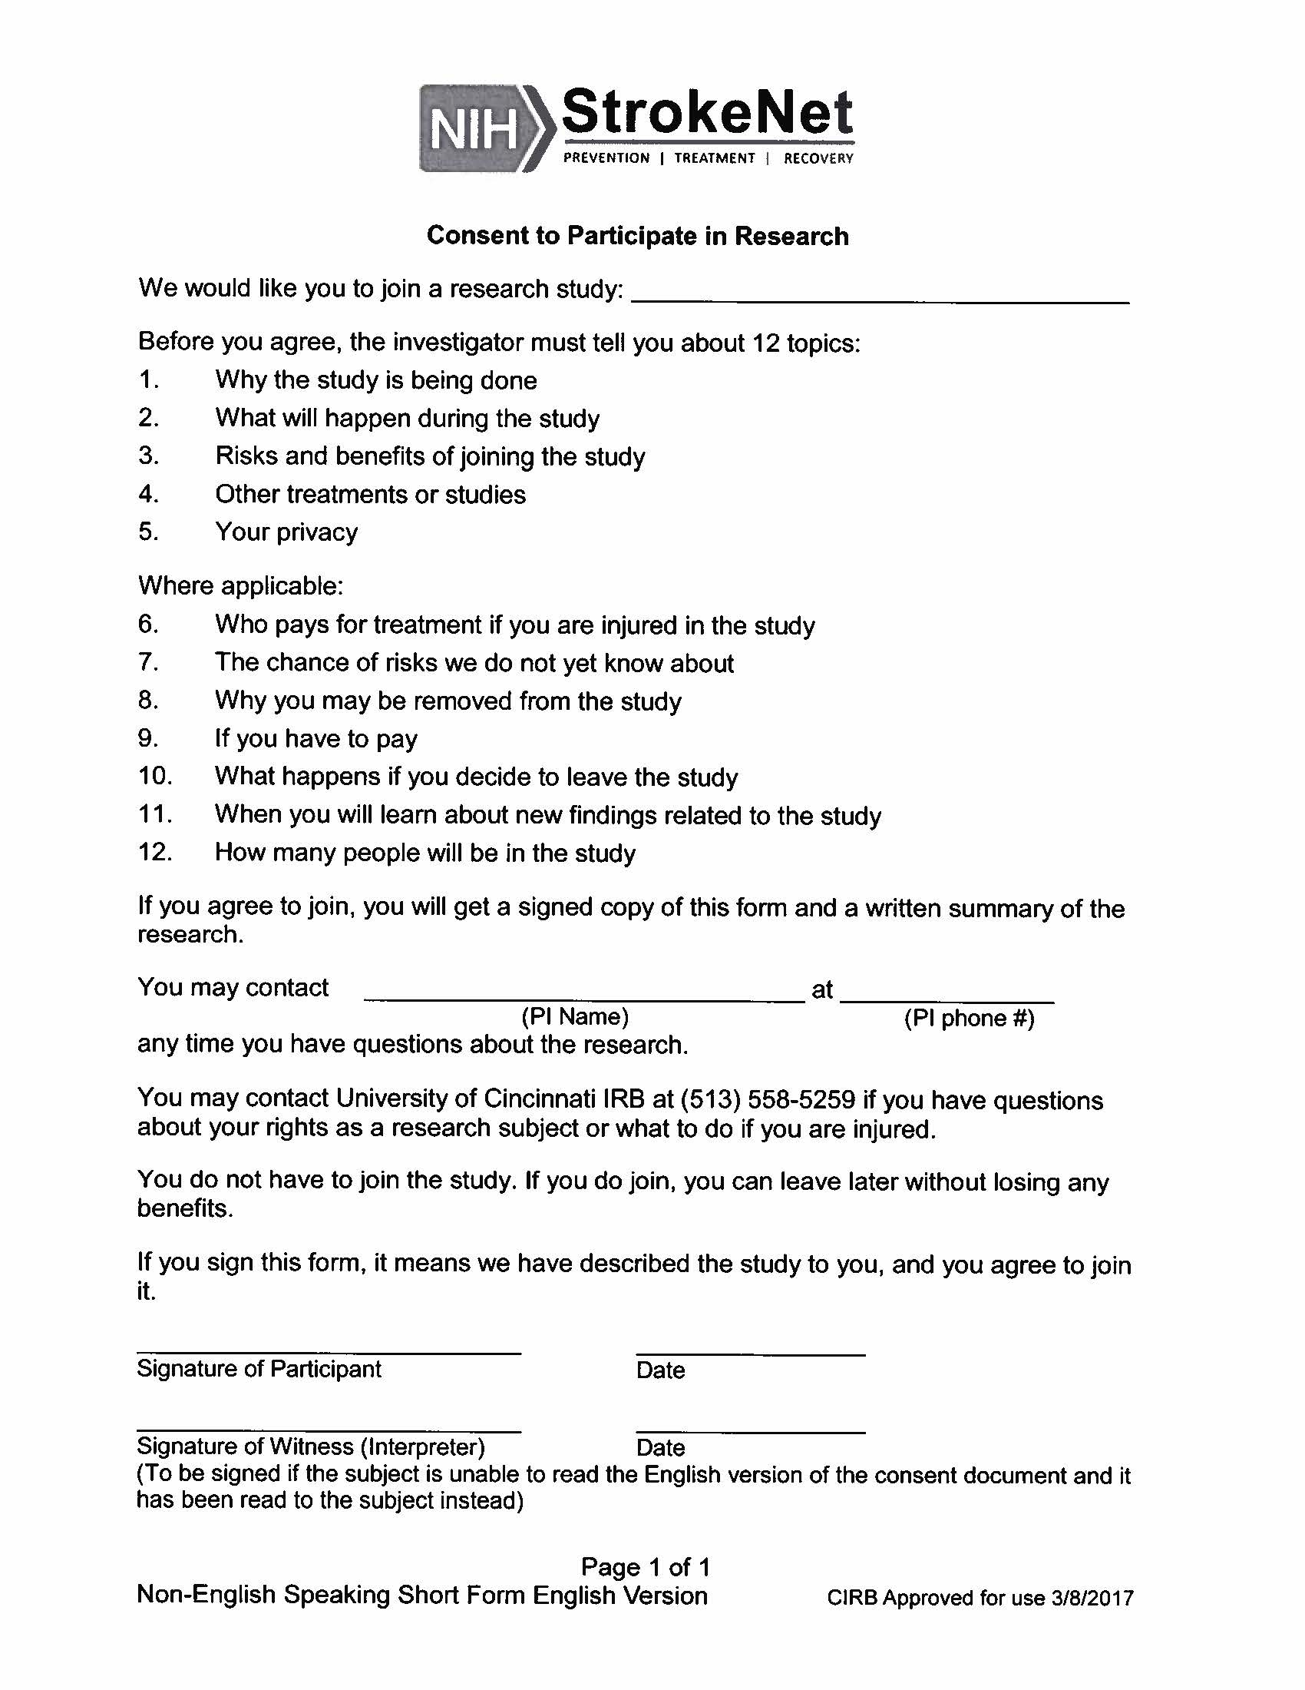
Short form consent
The short form is used when the consent is presented orally (because there is no translated full consent document).

Slide 37
Short Form consent
The subject should read and sign the short form
A study team member who has been delegated responsibility to obtain consent should perform the consent process orally. If the person obtaining consent is not fluent in the subject’s native language, an interpreter should be used.
A witness, who is fluent in both English and the subject’s native language must witness the entire consent process. If an interpreter is used, the interpreter may serve as witness. The witness/translator will sign the English consent as well as the short form as the “witness”
The study team member who obtains consent must sign the English ICF. A copy of the short form and English ICF must be provided to the participant.
Notify the project manager who will request a fully translated consent in that language to be signed by the subject within 30 days.

Slide 38

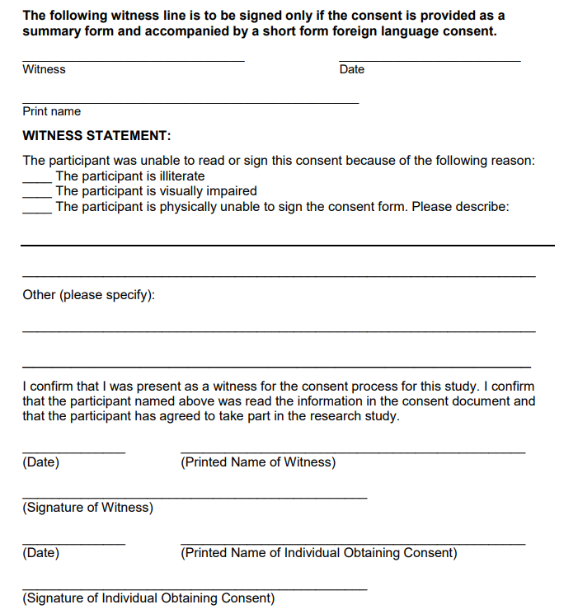
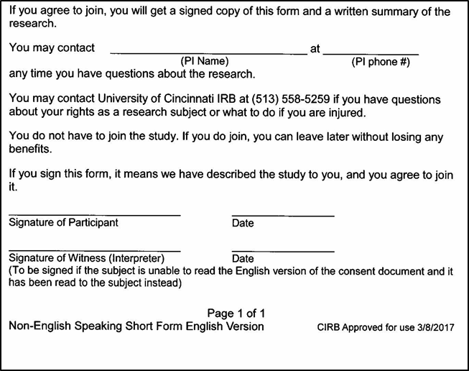
Documentation of short form consent
On Short Form:
Subject
Interpreter OR witness fluent in both languages
Person obtaining consent

Slide 39
Consenting process
Question 1
TRUE OR FALSE: The investigator/coordinator can write the date on the patient’s signature block on behalf of the patient

Slide 40
Consenting process
Question 1
TRUE OR FALSE: The investigator/coordinator can write the date on the patient’s signature block on behalf of the patient
Answer: FALSE
The patient must write the date, and if the patient makes an error, he/she should be the person to correct it

Slide 41
Consenting process
Question 2
TRUE OR FALSE: LAR should provide consent if a patient cannot physically sign the document, but has capacity to make decisions

Slide 42
Consenting process
Question 2
TRUE OR FALSE: LAR should provide consent if a patient cannot physically sign the document, but has capacity to make decisions
Answer: FALSE
The patient should make a mark on the signature block and a witness (not the person obtaining consent) should sign on the witness block

Slide 43
Consenting process
Question 3
TRUE OR FALSE: If the Investigator and the coordinator are present during the consent process it is ok for the coordinator to sign as the witness and the investigator to sign as the person obtaining consent.

Slide 44
Consenting process
Question 3
TRUE OR FALSE: If the Investigator and the coordinator are present during the consent process it is ok for the coordinator to sign as the witness and the investigator to sign as the person obtaining consent.
Answer: FALSE
A study team member cannot be a witness

Slide 45
Consenting process
Question 4
What is the most common error when obtaining consent?
Choices
Signature in wrong section
Missing information
Wrong version of consent

Slide 46
Consenting process
Question 4
What is the most common error when obtaining consent?
Correct answer
Wrong version of consent

Slide 47
Other consenting FAQs
When is a witness necessary?
  Patient has full capacity to consent, but cannot read or write, or is blind
  LAR cannot read or write, or is blind
  When using a short form consent
Who can be a witness?
  Impartial third party (never a study team member)
What is the witness attesting to?
  The patient was read the information and marked an X or signature as best they could at that time expressing voluntary consent to participate

Slide 48
Other consenting FAQs
When is it appropriate to consent an LAR instead of the patient?
  Patient does not have capacity to consent
  Subject should be re-consented as soon as they have regained capacity

Slide 49
FAQs
Question: What should we do if patient placed on amiodarone for VT after randomization?
Answer:
  Clarify that it was not AF
  If not, no action needed

Slide 50
FAQs
Question: What to do if patient provided consent but then found to have a bladder mass while still hospitalized?
Answer:
  Judgment call
  May make sense to delay randomization until diagnosis, prognosis, and treatment plan more clear
  The presence of cancer does not in itself exclude participation. Remember, though some cancers are associated with a hypercoagulable state and increase stroke risk, cancer is not generally considered a proximate cause of stroke.
  Other issues may need to be taken into account in such patients:
    are they able to participate in a stroke trial, or will they be receiving aggressive or experimental chemotherapy that may complicate the use of study medications?
    What is their cancer-related prognosis and will they be able to follow up?
    In some cases, especially in patients with adenocarcinoma or those at risk of deep venous thrombosis, an oncologist may want to prescribe anticoagulation for these patients

Slide 51
FAQs
Question: OK to consent if investigator has only MRI report, not actual images? Report says there is a small cortical infarct
Answer:
  OK to use report

Slide 52
Tips
Uploading ECGs
  Only first technically adequate post-stroke ECG should be uploaded to WebDCU
Sending echo images
  Only first technically adequate post-stroke transthoracic echo should be sent
  Please check with echo lab to determine if it is transthoracic or transesophageal
  DO NOT SEND TRANSESOPHAGEAL ECHOS FOR CENTRAL REVIEW

Slide 53
Tips
If study personnel DOA name is different than document being uploaded (e.g., marriage), please add reason on “submit notes”
When adding/changing/removing roles and responsibilities
  Remove Dr. X as of Y date from prior role
  Add Dr. X as of the same Y date to new role
  Submit revised DOA for review and approval

Slide 54
Lab Core reminders
Ideally, lab specimens should …
  … be shipped the same day
  … not be shipped late on Thursday or anytime Friday
  … centrifuged/refrigerated if drawn late Thu/anytime Friday, and shipped Monday

Slide 55
Lab Core reminders
Question 1
TRUE OR FALSE: If shipping to the lab the same day, you need to centrifuge or refrigerate the sample

Slide 56
Lab Core reminders
Question 1
TRUE OR FALSE: If shipping to the lab the same day, you need to centrifuge or refrigerate the sample
Answer: FALSE

Slide 57
Lab Core reminders
Question 2
TRUE OR FALSE: If you need to store the specimen overnight or over the weekend, then you must centrifuge the specimen and refrigerate it

Slide 58
Lab Core reminders
Question 2
TRUE OR FALSE: If you need to store the specimen overnight or over the weekend, then you must centrifuge the specimen and refrigerate it
Answer: TRUE
Please refer to Lab Manual section 12 for instructions on centrifuging

Slide 59
PROMIS Assessments
If a subject was consented with a non-English informed consent form, then the PROMIS assessments must also be conducted in the same language used to consent the subject.
Translations for both the Physical Function 6B and Global Health assessments can be requested online. Please make sure to request the translations well in advance of the subject’s 12 Month visit.
Spanish translations of both assessments are saved under Project Documents on WebDCU.
Please see the Data Collection Guidelines for details of other available languages and the link to request translations.

Slide 60
Feel free to reach out!
24-hour telephone hotline
  Please use it for any urgent questions
  Eligibility, randomization, unblinding, etc
1-877-427-2234 (1-877-4AR-CADI): useful to save in your cell phone
The hotline automatically calls the four PIs in succession
  Please let it ring
  And call back if no luck—one of us will pick up!
Please email arcadia@ucmail.uc.edu with non-urgent questions, including eligibility of challenging cases

